Slide 1
Higher Education and Post Secondary Readiness
January 5|2022|9:00 a.m. CT

Slide 2
Statement
The Tennessee Department of Education is excited to work with you on this opportunity to discuss the State’s formula for funding public education. Before we begin, the Department would like to remind you of the following:
Conversations on this topic are not intended to reflect on the current BEP funding formula. The current BEP funding formula will remain in place until a new funding formula is recommended to and approved by the Tennessee General Assembly.
The public is encouraged to submit comments in writing to ensure that all communications are thoroughly documented and can be reviewed and considered in the future.
Public comment is encouraged to focus on developing a new funding formula, rather than revising the current funding formula. Consider what should be funded in a new funding formula and at what level.
Subcommittees will be responsible for reviewing public comment and making recommendations for what should be included in a new funding formula.
While all committees, subcommittees, and members of the public should feel free to communicate openly, documents and records may be subject to public inspection pursuant to the Tennessee Public Records Act and may be publicly posted or otherwise made available .
All recommendations that are submitted by committees and subcommittees will be reviewed and considered, but not all recommendations will ultimately be included in the proposed new funding formula.

Slide 3
Agenda
Welcome and Call to Order
Statement
Roll Call and Attendance
Discussion: Follow-ups from Meeting #3
Feedback on Proposals
Next Meeting Details

Slide 4
Review: Meeting #3 Follow-ups

Slide 5
January Preview
Meeting #4
Review initial feedback buckets and provide prioritization of resources within each category
Materials: requested resources, requests for expert input, public comment
Meeting #5
Review public comment on draft structure and then make final recommendations on formula components
Materials: public comment, expert access
Meeting #6
Final policy considerations (ex. how to define each student groups, recommendations on policies)
Recommendations on reporting structures
Materials: requested resources

Slide 6
Prioritization
Finalizing Resource Prioritization Lists

Slide 7
Finalize Supports and Services
Please finalize your supports and services recommendation list into the buckets outlined (and note which part of the formula they should be considered).
Must Have: Those supports and services required as a result of federal and/or state law, for safety, or similar.
Should Have: Those supports and services that may not be mandatory but are essential to ensure the student or student group receives access to a quality education.
Nice to Have: Those supports and services that are not mandatory and not essential, but (1) may provide a clear and added benefit to students and (2) have a clear return on the investment related to student achievement and future success.
Long Shot: All other supports and services ideas.

Slide 8
Feedback Summary
Feedback Consolidated for Subcommittee Comment and Review

Slide 9
General Overview
Now please review the consolidated ideas on the following slides. Provide feedback on each.
Overall
Base
Weights
Direct Funding
Outcomes
Other

Slide 10
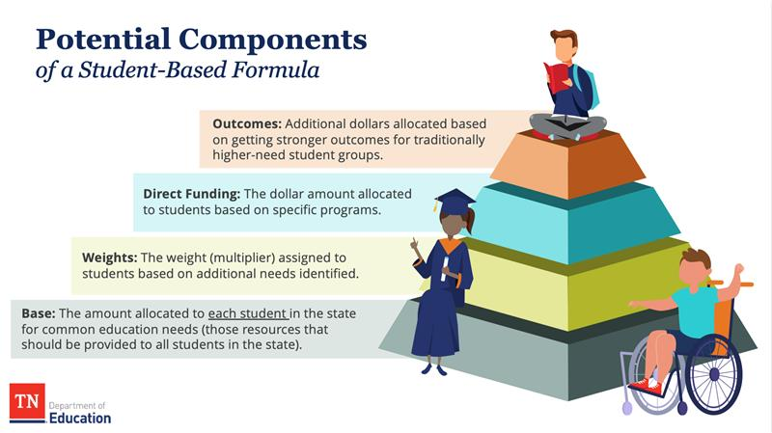
Overall Feedback Received (General)
Requested: Districts should not receive less state funding than they currently receive in the BEP.
Requested: Maintain flexibility for local district budgeting.
Requested: Ensure whatever is currently funded outside of the BEP is included in a new formula.
Requested: Local match should be reconsidered (county commissioners) AND maintenance of effort should not change (school districts).
Guiding Question: Are there any other broad recommendations you would include here?

Slide 11
Base
The feedback for the base includes the content currently being discussed in subcommittees (ie. the supports and services you believe are critical to include in a state formula).
Nurses (*at the recommended ratio)
School Based Supports: Counselors and School Psychologists (*at the recommended ratio)
Teacher Salaries and Benefits
Technology Sustainability
Flexibility for Varied Local Needs (SROs, RTI2, Principals and APs, Middle School CTE, financial literacy)
Guiding Question: Consider these current priority areas. Are there others you would add here and how would you prioritize them?

Slide 12
Weights
The following are the areas that received the most positive feedback in terms of what should be weighted:
Unique Learning Needs:
Economically Disadvantaged and Concentration of Poverty
Students with Disabilities and Gifted Students (to include tiers based on the cost to provide services)
English Learners (to include tiers based on English proficiency)
Dyslexia
Rural
Sparsity
Charter Enrollment
Guiding Questions: Consider these current priority areas. Are there other areas you would add for weights here and how would you prioritize them? How might you think about tiers for students with disabilities and English learners?

Slide 13
Additional Dollars
The following are the areas that received the most positive feedback in terms of what may be considered for additional funding:
Additional Support for Fast Growing
Middle School CTE
Innovative High School Models (IHS, STEAM, P-TECH)
High Dosage Tutoring in 4th grade (Learning Loss Bill)
Guiding Question: Consider these current priority areas. Are there others you would add here and how would you prioritize them?

Slide 14
Outcomes
The following are the areas that received the most positive feedback in terms of what may be considered for outcomes:
Early Postsecondary Opportunity (EPSO) Completion
AP Course Completion and/or Passing
Earning Industry Certificates or Certification
Work-based Learning Completion Metric
Reading proficiency (multiple ideas on measurement)
Differentiated compensation support
Guiding Questions: Consider these current priority areas. Are there others you would add here and how would you prioritize them? Do you have ideas on how some of these could be measured? Do you recommend including all students, or only students with historic achievement gaps (low income, students with disabilities and/or English learners)?

Slide 15
Next Meeting Details
January 19
9:00 a.m. CT
TEAMS
Review and Provide Final Recommendations

