Slide 1
Webinar: Part 1-Implementing a Comprehensive School Counseling Program
Leigh Bagwell | Coordinator of School Counseling
Notes:
Introduction
Prompt attendees to answer:
Why should be have standards and a model?
Gives structure to counseling programs
Helps to clarify roles and responsibilities of school counselors
Builds awareness for other stakeholders
**Helps us to meet the diverse and changing needs of our students

Slide 2
Tennessee School Counseling Model of Practice

Slide 3
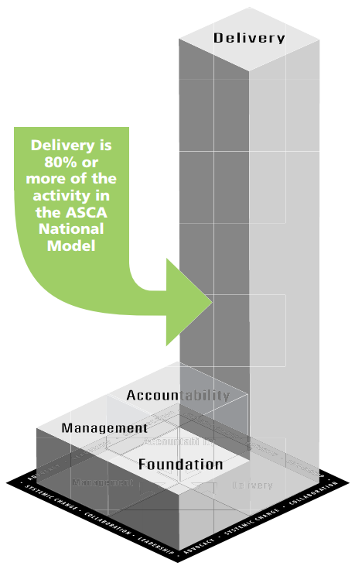
The National Model of School Counseling: Elements of Best Practices
School Counselors work within 3 domains of student development:
Academic, Social and Emotional, College and Career Readiness
Foundation – WHY we do what we do
e.g., setting annual goals, aligning work to standards, compliance to statutes/policies
Management – HOW we do what we do
e.g., needs assessments, setting expectations, analyzing data
Delivery – what we DO
e.g., individual student planning, delivering core counseling curriculum, responsive services, collaboration, consultation, referrals
Accountability – the IMPACT of what we do
e.g., program and professional evaluations, impact analyses
Source for graphic and more information: http://schoolcounselor.org/asca/media/asca/ASCA%20National%20Model%20Templates/ANMExecSumm.pdf

Slide 4
Foundation-WHY?

Slide 5
Foundations
Beliefs
Vision Statement
Mission Statement
T.C.A.
State Board of Education policy
Expectations
Program Goals
Student Standards
Professional School Counselor Competencies & Ethical Standards
Notes:
How have/are you developing these pieces of your program? How many have a mission statement? Do other stakeholders know your mission statement? How many have clear expectations of the counseling program – who else helped develop those? Did you set a goal for your program this year? What kind of goal – SMART or general? Did you meet it? Did you communicate that progress with any stakeholder?
Foundations gets at the WHY we do what we do. What do we believe about students, what do we believe about school counseling, what do we believe about our ability to impact our students’ lives.
We have started conversations about revising both TCA and State Board policies to reflect school counseling as it is now and where it is going…transformed school counseling.
ASCA is revising the school counselor competencies so we will include those when they are released.

Slide 6
Foundations: Philosophical
Beliefs
What do we believe about the school counseling program’s impact on student achievement?
What are the unique contributions of the school counseling program?
Vision
How are our students different as a result of participating in the school counseling program?
States best possible student outcomes
Is believable and achievable
Mission
Provides focus and direction to reach vision
Aligns with school, district, and state goals
Identifies unique contributions of CSCP to meet students’ needs
Notes:
Group Activity:
Give each table a question to consider:
What do we believe about the ability of all students to achieve?
How do we address developmental needs of all students?
What is the school counselor’s role as an advocate for every student?
Who do we believe is involved in planning, managing, delivery and evaluation of the CSCP?
How is data used to inform program decisions?
How do ethical standards guide the work of the school counselors?
This belief is important for students because….
What this belief means for the program is….
What this belief means the school counselor will do

Slide 7
Foundations: Program Expectations
Program expectations ensure the School Counselor has the support necessary for effective CSCP implementation.
Budget
Facilities
Materials
Supplies/Equipment/Technology
Staffing & Ratios
Use of Time – 80/20
Appropriate School Counseling Activities
To be implemented by 2018-19 school year*
Notes:
Budget: i. An adequate school counseling budget should be established to reflect program needs. TENNESSEE STATE BOARD OF EDUCATION SCHOOL COUNSELING MODEL & STANDARDS POLICY 5.103 Adopted: 10/26/2005 Page 3 of 9 Revised: 10-14-16 IV G School Counseling Model & Standards Policy 5 103 Attachment Clean Copy.docx ii. The counseling staff shall be included in the budget planning. Counselors should provide information regarding funds needed and knowledge of other funding sources that may be available. iii. Such information should be included in the program management agreement between administration and counseling department. b. Facilities: i. A counseling office should be established in each school to implement a comprehensive school counseling program. The office should be accessible to all students, including those with disabilities. ii. The counselor shall have access to a private office designed to protect students’ right to privacy and confidentiality. c. Materials: i. School counselors should have access to research-based materials and resources to implement developmentally appropriate activities for each grade level. This includes both curricula and relevant assessments and inventories. d. Supplies/Equipment/Technology: i. School counseling supplies and equipment should be relevant to the program and appropriate for the community it serves. These should be easily accessible and of sufficient quantity to support the program. e. Staffing: i. The school counselor shall be licensed by the Tennessee Department of Education and shall have the training needed for fulfilling the responsibilities and specialized job assignments. ii. It is strongly recommended that the length of a counselor’s contract be extended to ensure adequate time to plan and implement a quality program. iii. Clerical support staff and other system support should be provided to ensure the effective management and delivery of quality comprehensive school counseling programs. iv. Appropriate counselor/student ratios are critical for program success and increased student achievement and development. The current student to counselor ratios, as calculated in the Basic Education Program (BEP) Formula, are: • Elementary School Counselors - Grades K-6: 1:500 • Secondary School Counselors - Grades 7-12: 1:350
School counselors should keep track of their time and document activities performed throughout the day. This documentation serves as a guide for future planning and program evaluation. ii. In order to deliver an effective comprehensive school counseling program, school counselors shall spend the majority of their time in direct and student support services to students. iii. To ensure that the school operates effectively, school counselors are expected to participate in “fair share” responsibilities at the same level as all members of the school staff. iv. While the amount of time counselors should spend delivering services in each component area remains relative to the individualized needs of each school, the guidelines below represent best practice in school counselors’ use of time: Counselor Activity Time Direct Student Services • School Counseling Curriculum o Instruction o Group Activities • Individual Student Planning o Appraisal o Advisement • Responsive Services o Counseling o Crisis Response At least 80% that includes all services Student Support Services • Referrals • Consultation • Collaboration Program Management and School Support • Program Foundation, Management, and Accountability • Fair-share responsibility No more than 20% g. Appropriate School Counseling Activities: i. Responsibilities shall align to the school counselor’s training and expertise so that all students will benefit from the counseling program as well as master the school counseling standards. ii. A school counselor shall not be used as the teacher of record for content courses, for the delivery of academic interventions, or for organization and management of testing program. These duties shall be reassigned to other school staff. iii. A list of activities that are appropriate for school counselors, as well as examples of activities that should be reassigned to other school staff, is included in the Tennessee Comprehensive School Counseling Model of Practice.

Slide 8
Foundations: Expectations
Reassignment of Responsibilities
Identify tasks that do not align with program implementation
Use data to determine how much time these tasks take away from CSCP
Consider ways to improve efficiency of completing tasks
Determine what program activities will replace these tasks and estimated impact on students
Be a part of the solution to the reassignment of these tasks
Understand that reassigning tasks take time
Notes:
Program Management Agreement – based on time – let them role play those discussions

Slide 9
Foundations: Legal & Ethical
Tennessee Code Annotated
T.C.A. § 49-5-302. School counselors & school teachers
T.C.A. § 49-6-303. School counselors
State Board of Education Policy 5.103
Counseling Standards describe the attitudes, knowledge, skills, and experiences students need to achieve academic success, postsecondary and career readiness, and social/emotional development
School Counseling Model provides a framework for delivering high quality school counseling services
Notes:
Group Activity:
Give each table a question to consider:
What do we believe about the ability of all students to achieve?
How do we address developmental needs of all students?
What is the school counselor’s role as an advocate for every student?
Who do we believe is involved in planning, managing, delivery and evaluation of the CSCP?
How is data used to inform program decisions?
How do ethical standards guide the work of the school counselors?
This belief is important for students because….
What this belief means for the program is….
What this belief means the school counselor will do

Slide 10
Foundations: Legal & Ethical
School Counselor Competencies
Identify the knowledge, abilities, skills, and attitudes necessary to plan, organize, implement, and evaluate a comprehensive school counseling program
Drive professional development and growth plans
Ethical Standards
Are the accepted practice, norms, and standards of the profession
Guide decision-making, standardize professional practice
Protect students and school counselors
Ensure fair and consistent practice
Notes:
Competencies Assessment – identify strengths and areas of growth, align to school/student needs assessments results to develop professional growth plan annually

Slide 11
Foundations: Goals
Program Goals
Address specific student outcomes
Based on school and student data
Promote achievement, attendance, behavior, and/or school safety
Support school improvement goals
Drive planning of comprehensive school counseling programs
Example: M.E.A.S.U.R.E. or SMART goals
Increase the % of students enrolling in postsecondary education/training from 57% - 82%
Reduce the % of chronic absenteeism by 38%
Increase the # of African American males in EPSOs
Notes:
Group Activity:
Give each table a question to consider:
What do we believe about the ability of all students to achieve?
How do we address developmental needs of all students?
What is the school counselor’s role as an advocate for every student?
Who do we believe is involved in planning, managing, delivery and evaluation of the CSCP?
How is data used to inform program decisions?
How do ethical standards guide the work of the school counselors?
This belief is important for students because….
What this belief means for the program is….
What this belief means the school counselor will do

Slide 12
Management-HOW?
Notes:
This is really the HOW of our work – how are we going to get it all done. How are we going to ensure all students benefit from our counseling program, etc.
Use of time assessment: How are counselors spending their time in terms of the expectations of the model: Foundations, Management, & Accountability should be no more than 20% of counselor time. Delivery of services should be at least 80% of time. We are a long way from there but we will get much closer – one step at a time.
We will collect examples and templates of these tools to have available for all counselors on the counselor resource page of CollegeforTN.org
Please send good tools to School.Counseling@tn.gov

Slide 13
Management
Data
Use of data
School data profile
Program results data
Assessments
School and student needs assessments
School counselor competencies assessment
School counseling program audit
Use of time assessment
Tools
Program Management agreements
Advisory councils
Closing the gap action plans
Lesson plans
Calendars
Notes:
This is really the HOW of our work – how are we going to get it all done. How are we going to ensure all students benefit from our counseling program, etc.
Use of time assessment: How are counselors spending their time in terms of the expectations of the model: Foundations, Management, & Accountability should be no more than 20% of counselor time. Delivery of services should be at least 80% of time. We are a long way from there but we will get much closer – one step at a time.
We will collect examples and templates of these tools to have available for all counselors on the counselor resource page of CollegeforTN.org
Please send good tools to School.Counseling@tn.gov

Slide 14
Management: Data
Use of Data
Monitor student progress
Identify specific needs of students
Identify barriers to learning
Understand factors impacting student behavior
Identify access and equity issues
Close achievement and opportunity gaps
Assess and evaluate effectiveness of CSCP activities
Improve, modify, or change CSCP services
Advocate for additional resources to support CSCP
Notes:
Last 30 minutes today you will begin the program assessment

Slide 15
Management: Tools
School Data Profile
Helps organize and disaggregate date to determine specific programs, activities, and interventions of CSCP
Achievement Data
Promotion/retention rates
Graduation/Drop-out rates
Achievement data
Grades
Behavioral Data
Discipline referrals
Suspension rates
ATOD violations
Attendance rates
Course enrollment patterns
Postsecondary attendance rates
Participation in extra-curricular activities
Notes:
Last 30 minutes today you will begin the program assessment

Slide 16
Management: Tools
Program Results Data
Process Data
“What did you do for whom?”
Provides evidence that an event occurred and who was involved
Perception Data
“What do people think they know, believe, or can do?”
Mastery of standards
Outcome Data
“What is the impact of this program?”
How are students able to use knowledge, skills, or experiences to improve achievement or behavior?
Changes in attitudes or beliefs
Perceived gains in knowledge or skills
Behavior includes college and career readiness skills and postsecondary planning
Meeting Program Goals
Notes:
Last 30 minutes today you will begin the program assessment

Slide 17
Management: Assessments
School and Student Needs Assessments
Perception Data to show stakeholder mastery of standards, changes in attitudes and beliefs, and perceived gains in knowledge and skills
Examples are Pre/Post-tests or surveys
Should be conducted at least annually
Can be comprehensive and/or specific to program/strategy
Involve various stakeholders
Notes:
Last 30 minutes today you will begin the program assessment

Slide 18
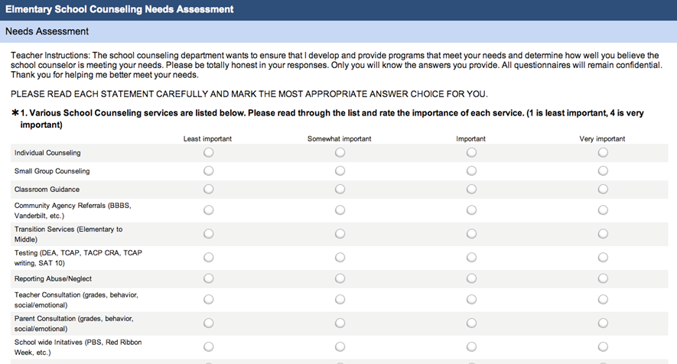
Management: Assessments

Slide 19
Management: Assessments
Program Assessments & Audits
Identify strengths and opportunities for growth
Provide direction for continued program improvement
Conducted when CSCP is being developed then annually to appraise program implementation
Help to set short and long-term goals for improvement
Involve various stakeholders in this process
Use of time Assessments
Ensures a complete and balanced CSCP is delivered to all students
Should align to school and student needs assessment
Notes:
Last 30 minutes today you will begin the program assessment

Slide 20
Management: Program Audit
Management | Completed/ Implemented | In process | Not Started | Notes
School counselor competencies assessment |  |  | ✓
School counseling program assessment |  | ✓ |  | Assessment prepared; will be distributed to stakeholders Sept. 2017
Use of time assessment |  | ✓ |  | Reviewing time use for 2016-17 school year
Program Management agreements | ✓ |  |  | Completed-July 2017
Advisory councils |  |  | ✓
School data profile |  | ✓ |  | Counseling Team is reviewing data; anticipated completion Sep. 2017
Program results data |  |  | ✓
Closing the gap action plans |  |  | ✓
Lesson plans | ✓ |  |  | Lesson plans aligned to new counseling standards
Calendars | ✓ |  |  | 2017-18 SC calendar developed; published on website and newsletter

Slide 21
Management: Tools
Program Management Agreement
Outline organization of counseling program
Developed with school counselors and administration
Ensures the counseling program aligns to School Improvement Plan goals
Increase administrator understanding of counseling program
Completed prior to or early in school year
Can be reviewed throughout the year to evaluate progress toward meeting program goals
All School Counselors and Administrators should complete the Program Management Agreement for the 2018-19 school year.
Notes:
Last 30 minutes today you will begin the program assessment

Slide 22
Management: Tools
Advisory Council
Advising on program goals
Review program results
Make recommendations for the counseling program
Educate and engage other stakeholders
Advocate for resources and funding
Developing an Advisory Council
Goals and objectives
Representation and appropriate candidates
Size
Meeting schedule
Terms of membership
Agenda and minutes
Notes:
Last 30 minutes today you will begin the program assessment

Slide 23
Management: Tools
Action Plans
Curriculum delivery, small groups, closing the gap activities
Include:
Goals to be addressed
Domain and standard alignment
Description of activity
Resources/materials needed
Timeline for completion
Person responsible for delivery
Method of evaluation
Expected results
Notes:
Last 30 minutes today you will begin the program assessment

Slide 24
Management: Tools
Notes:
Last 30 minutes today you will begin the program assessment

Slide 25
Management: Tools
Lesson Plans
Student standards
Learning objectives
Materials
Procedures
Plan for evaluation (process, perception and outcome data)
Follow-up
Calendars
Inform all stakeholders of various activities of CSCP
Increase awareness of totality of CSCP
Lesson Plans will be included in the Counselor Resource Center on collegefortn.org

Slide 26
Questions

Slide 27
Next Steps
Webinar: Part 2 Implementing the School Counseling Model-May 31, 1-2 p.m. (CDT)
Release of Implementation Guide and Timeline Checklist
Complete Program Audit
Watch for “Save the Dates”

Slide 28
Contact
Leigh Bagwell
Coordinator of School Counseling
College, Career and Technical Education
Leigh.Bagwell@tn.gov
(615) 418-4527

