Slide 1

Response to Instruction and Intervention (RTI²) Overview &
Data-Based Decision Making
Dr. April Ebbinger, NCSP
Director of School Psychology Services | Special Education and Intervention Programming
Melanie Schultz
Director of Interventions | Special Education and Intervention Programming
© 2022 Tennessee Department of Education
Notes:
Welcome Slide

Slide 2
Notes:
1-2 minutes
This is the Department’s strategic plan. RTI fits into this plan in many ways:
Ensuring students have access to a high-quality education
Support students' academic needs
Developing educator understanding to make effective data-based decisions regarding student academic needs

Slide 3

Agenda
Develop an understanding of RTI²
Gain strategies to support effective data-based decision making
Learn how to set goals, calculate the rate of improvement (ROI), and gaps
Develop an understanding of Child Find obligations
Notes:
2-3 minutes
*Read the slide to discuss the agenda for the session.

Slide 4
RTI² Overview
Notes:
Transition Slide

Slide 5
The Impact of RTI2

Slide 6
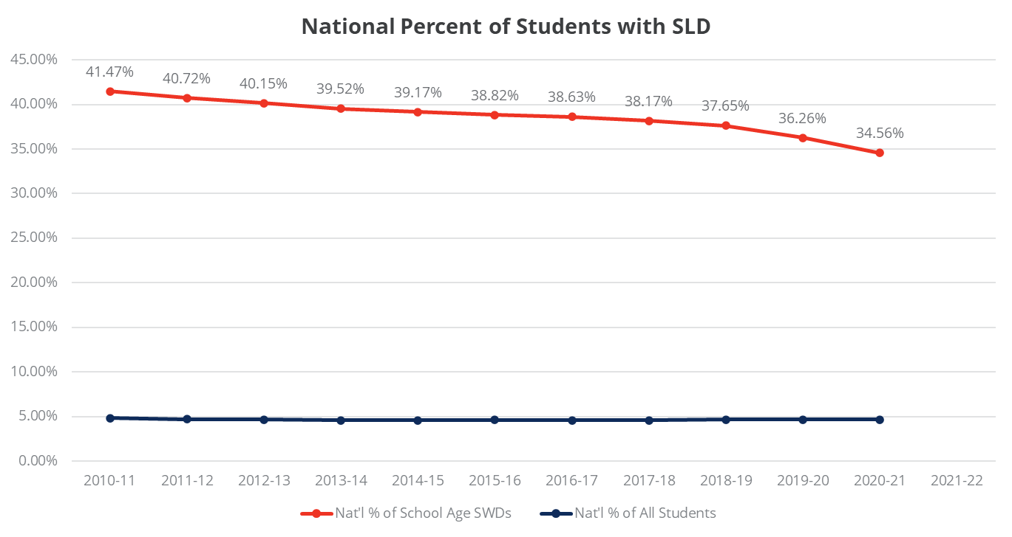
National Percent of Students with Specific Learning Disability

Slide 7




RTI² Misconceptions
A pathway to special education
The same in every school
An instructional program
Only for academics

Slide 8
Four Essential Components
Leadership
Assessment
Data-Based Decision Making
Instruction and Intervention
Notes:
5 minutes
RTI has 4 Essential Components for ALL tiers: academics AND behavior
Leadership
Assessment
Data-Based Decision Making
Instruction and Intervention
The Reason for RTI²
The role of the public education system is to prepare ALL students for success after high school. Response to Instruction and Intervention is designed to empower educators to give every student the opportunity to meet high expectations. This three-tiered system helps educators meet the needs of ALL learners, identifying when students need additional supports in order to be successful.
The RTI² framework is a multi-tiered delivery system that allows for an integrated, seamless problem-solving model that addresses individual student needs.
The RTI² framework relies on high-quality instruction and interventions tailored to student need where core instructional and intervention decisions are guided by student outcome data.
The RTI² framework has district and school teams making local decisions to create an RTI² framework. This framework allows school teams to identify the supports every child needs to achieve academically.

Slide 9

RTI²
What does “response” mean?
How do you respond to instruction?
How do you respond to intervention?
Notes:
8 -10 minutes
Framing: Ensuring participants understand the RTI Framework.
Animation: Display each prompt and allow participants to Turn and Talk. Have 1-2 volunteers share out.

Slide 10

Importance of Tier I Core Instruction
Teachers lay a foundation in reading and math like that of a master mason laying structural bricks.
Ninth Grade Standards
Eighth Grade Standards
Seventh Grade Standards
Sixth Grade Standards
Fifth Grade Standards
Fourth Grade Standards
Third Grade Standards
Second Grade Standards
First Grade Standards
Kindergarten Standards
Notes:
1-2 minutes
The importance of Tier I Core Instruction is that at each grade-level students master the standards.
Each layer of bricks represents a standard that must be mastered.
Each brick represents a skill that students need in order to master that standard.
Mastery of each standard is needed so that the next grade-level standard can connect and build on the previous standard. And so on....

Slide 11

Importance of Tier I Core Instruction
What are the missing bricks?
Notes:
1-2 minutes
This is what a student's mastery may look like if Tier I Core Instruction is not strong.
Notice a standard wasn’t mastered in Kindergarten, therefore, 1st grade, then second, and so on.
As students move into 3rd grade and beyond, the text and problem solving get more complex and the wall begins to crumble.
Why? Because there are skill deficits.

Slide 12
Tier I – Core Instruction for ALL students
High-quality instruction with scaffolding for access to instruction aligned to Tennessee Academic Standards
Instructional decisions driven by ongoing formative assessment
High-quality professional development and support
Fidelity of instruction and progress monitoring
Notes:
2-3 minutes
ALL students receive Tier I Core Instruction: EL, SpEd, Gifted, etc.
Tier I Core instruction should be meeting the needs of 80-85% of students
High-Quality instruction aligned to state standards
Instructional decisions driven by ongoing formative assessments
High-Quality professional development and support

Slide 13
RTI² Assessment Process
Universal Screener
Given to all students - K-3 Matrix
Diagnostic Assessment
Given to students who are “at risk”
Progress Monitoring
Students in Tiers II, III and special education monitor progress in their skill deficit area
Notes:
2-3 minutes
Remember that one of the essential components for RTI is Assessment.
This visual walks us through the RTI Assessment Process.
Universal Screener – Given to ALL students. “Serves as temperature check” – Allows us to know what student we need to closely look at to determine if additional supports are needed.
Diagnostic Assessment – These assessments are given to students who are “at risk.” These assessments give more information regarding what a student’s skill deficit is so that supports can be tailored to individual student needs.
Progress Monitoring – Progress monitoring assessments monitors progress based on instruction provided for students in Tiers II, III, and special education.

Slide 14
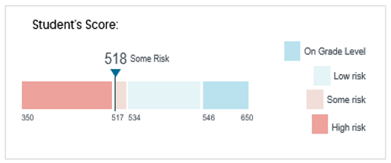

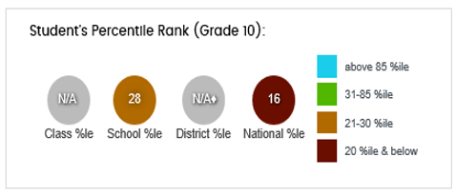
Case Study: Meet Johnny
Notes:
Johnny is a tenth-grade student. Above is his Fastbridge winter benchmark score in the area of reading.
At the quarterly data team meeting, Johnny’s lack of progress is discussed.
What other pieces of data should the team consider collecting? What additional evidence would support a tier II or III intervention?

Slide 15
Tier II – Targeted Intervention
Addresses the needs of struggling and advanced students
Additional time beyond time allotted for the core instruction
High-quality intervention matched to student-targeted area of need
Provided by highly trained personnel
Progress monitoring is required for data-based decision-making
Notes:
2-3 minutes
Tier II is targeted intervention supports meeting the needs of 10-15% of students
Addresses the needs of struggling AND advanced students
Provides additional time beyond the time allotted for core instruction
High-Quality interventions MATCHED to student-targeted area of need (Remember that this is determined from those diagnostic assessments)
Provided by highly-trained personnel (Discuss what this means)
Progress monitored is required for data-based decision making

Slide 16
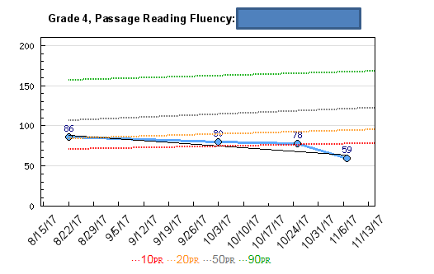
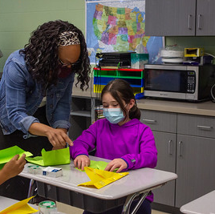
Case Study: Meet Sally
Notes:
Sally is a fourth-grade student who has been participating in tier II intervention since enrolling in ABC Elementary in August. The fluency scores above indicate her progress monitoring from August to November.
What other information/data do you need to support a change in intervention or a move to tier III?

Slide 17
Tier III – Targeted Intervention
Address small percentage of struggling students
More explicit and more intensive interventions targeting specific area of need
Intervention provided by highly trained personnel
Progress Monitoring is required for data-based decision-making
Notes:
2-3 minutes
Tier III is targeted intervention supports meeting the needs of 3-5% of students. Students who are determined to be significantly at risk may need to “bypass” Tier II intervention supports and receive Tier III intervention supports – Others may receive Tier II and then transition to Tier III based on the data-based decision-making conversations of leadership team.
Addresses small percentage of struggling students.
More explicit and more intensive intervention targeting specific area of need
Intervention provided by highly trained personnel
Progress monitoring required for data-based decision making

Slide 18
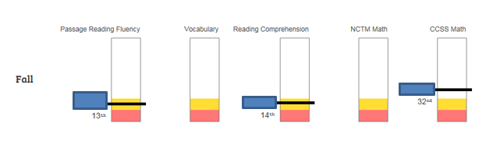
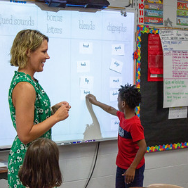
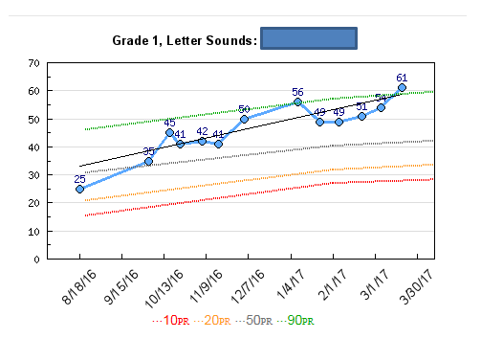
Case Study: Meet Bryan
Notes:
Bryan is a second-grade student who has been in tier III since he enrolled at the beginning of his second-grade school year.
The team is recommending a possible referral for a special education evaluation. As you determine next steps, what other data would you want to analyze/collect?

Slide 19
Standards vs. Skills
Intervention
Tier II/III:
The goal is to provide research-based interventions aligned to specific skill deficit(s) as identified by a universal screener and other diagnostic assessments.
Skills Based Assessment:
Skills based universal screener
Skills based Progress Monitoring specific to area(s) of deficit
Formative assessment
Notes:
1-2 minutes
Now take a moment to read about the goal of Interventions .... “What is different from Intervention from what we just previously discussed with reteaching/remediation?”
- Take-Away: Intervention is aligned to skill deficits w/ focus on skills ...... Reteaching/remediation is focused on teaching proficiency on the standards.
For intervention to be effective, it is important to understand students’ skill deficits to be able to provide targeted intervention supports.

Slide 20
What is systematic?
Sequenced
Instruction is strategic.
Lessons move from simple to complex.
Hierarchical
Lessons build on previously taught information.
Clear, concise objectives with ongoing assessment.
Practice
Meaningful opportunities to engage in practice.
Modeling is embedded throughout instruction with time for feedback.

Slide 21

What are the options?
Notes:
2 minutes
Let’s say you have a hole in your boat. What are your options?
Expect answers like bail the water, abandon ship, call for help, plug the hole.
It seems that sometimes we do everything except the most obvious answer, which is to fix the boat.

Slide 22
Areas of Deficit for Intervention
Basic reading skills (letters, letter sounds, phonological awareness, phonics)
Reading comprehension (recalling, summarizing, inferencing, extending)
Reading fluency (oral reading fluency, silent reading fluency, word reading fluency)
Written expression (transcription and composition)
Math calculation (column addition, basic facts, complex computation, decimals, fractions, conversions, percentages, etc.)
Math reasoning/problem solving (number and operations, base ten, place value, measurement and length, fractions, geometry, algebra, expressions, linear equations etc.)
Notes:
5 minutes to work
3-minute Gallery Walk
Create 6 groups and assign each group an Area of Deficit for Intervention.
Participants in each group will “Brain Dump” what research-based resources their district has in “their toolbox” to address the deficit area to provide explicit and systematic intervention supports.
Gallery Walk to charts on the wall. Each group will have a different color marker – rotate and add to.
Do you see any areas where you are unsure of what you have to address this skill deficit? What could be brought in to support this?
What structures are in place for each resource to be systematic and explicit? Are these skills-based or standards-based?
*This slide will be made into handout if allowed.

Slide 23
Alignment
Comprehension
Reading Fluency
Skill Deficit
Intervention
Read 180
Progress Monitoring
Notes:
Make sure the deficit aligns to intervention which aligns to progress monitoring probe. We wouldn’t use a fluency measure if the deficit was in comprehension.

Slide 24
Data-Based Decision Making
Notes:
Transition Slide **BREAK**
1 minute
We have discussed the Overview of RTI, the differences between addressing standards vs. skills, and explored the meaning of Systematic and Explicit instruction.
Now with this knowledge we are going to dive into how we engage in the Data-based decision-making process to ensure we are meeting the needs of ALL students.

Slide 25
Typical Distribution
80-85 percent of students will receive Tier I instruction.
10-15 percent of student will receive Tier II interventions.
Traditionally, we would identify students at or below the 25th percentile.
3-5 percent of students will receive Tier III interventions.
Traditionally, we would identify students at or below the 10th percentile.

Slide 26
What would you do in this scenario?
40-50 percent of student will need Tier II interventions.
20-40 percent of students
will need Tier III
interventions.
20-30 percent of students will need only Tier I instruction.

Slide 27
What would you do in this scenario?
90-95 percent of students
will need only Tier I
instruction.
3-8 percent will need Tier II intervention.
1-2 percent will need Tier III intervention.

Slide 28
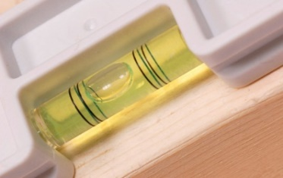
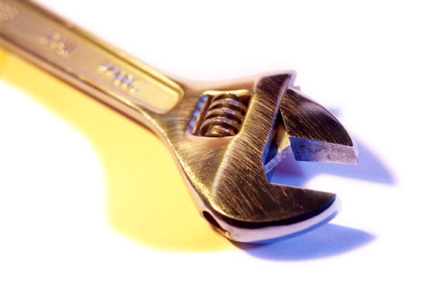








What’s the problem?
Strategies
Notes:
2 minutes
Let’s pretend I have a problem. This problem is hidden behind the toolbox. What I’d like you to do is choose a tool to fix my problem.
What is your immediate response?
Expect everyone to say, “What’s the problem”?
Seems like a logical question, right? The issue is that sometimes we don’t ask that about reading. Someone has a problem with reading, and we’re ready to purchase the tool to fix it.
So, let’s play along. Someone choose a tool.
Let’s say they choose the hammer. (Transition to next slide)

Slide 29
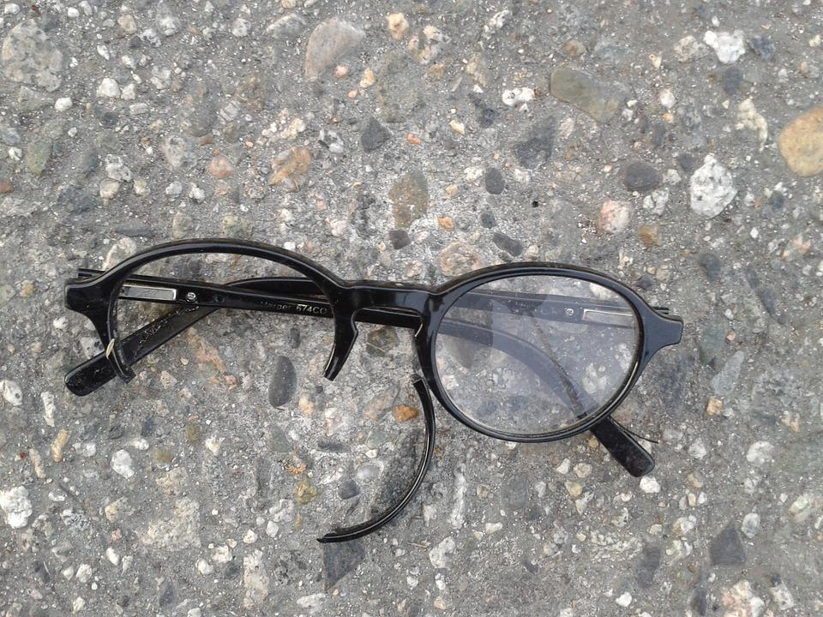

Notes:
1 minute
Will this tool fix my problem? Could it possibly do harm? Absolutely.
This works the same with our intervention choices, except for us the damage that we do is often wasted time.

Slide 30
Digging Deeper
Potential Root Causes
Risk Event
Sick?
Headache
See a doctor
Not enough sleep?
Go to bed early
Neighbor’s loud music?
Talk to your neighbor
Lack of understanding/attention to how language sounds is interfering with gaining the author’s message
Screening data is Yellow or Red
Fluency Intervention
Student cannot identify/recall what is critical information in the text
Comprehension Intervention
Multiple Data Measures
Student would be able to comprehend if he could decode (or efficiently decode) the words
Phonics Intervention
Notes:
2-3 minutes
What if we look backward to potential root causes? (Click)
For example, let’s say you have a (Click) headache.
Would you (Click) see a doctor, go to bed early, or talk to your neighbor? Seems a bit off, right? These don’t seem to make a lot of sense and how would you possibly choose? Take a few responses.
What if we look backward to potential root causes? (Click) Does this make more sense now?
The first way is very much what is happening in educational interventions today. (Click) We see numbers, maybe they are percentiles, or colors like yellow or red, or maybe rankings compared to peers, and we immediately jump (Click) to deciding what intervention they must need. Without digging deeply (Click) to find the root cause of the problem to inform our decision-making. As a result, our interventions are unmatched to our students’ needs and we never get around to fixing the hole in the boat.

Slide 31

How tall is your temperature?
Notes:
1 minute
There are many tools that measure, we want to make sure we are measuring with the correct tool…the right match makes all the difference.

Slide 32
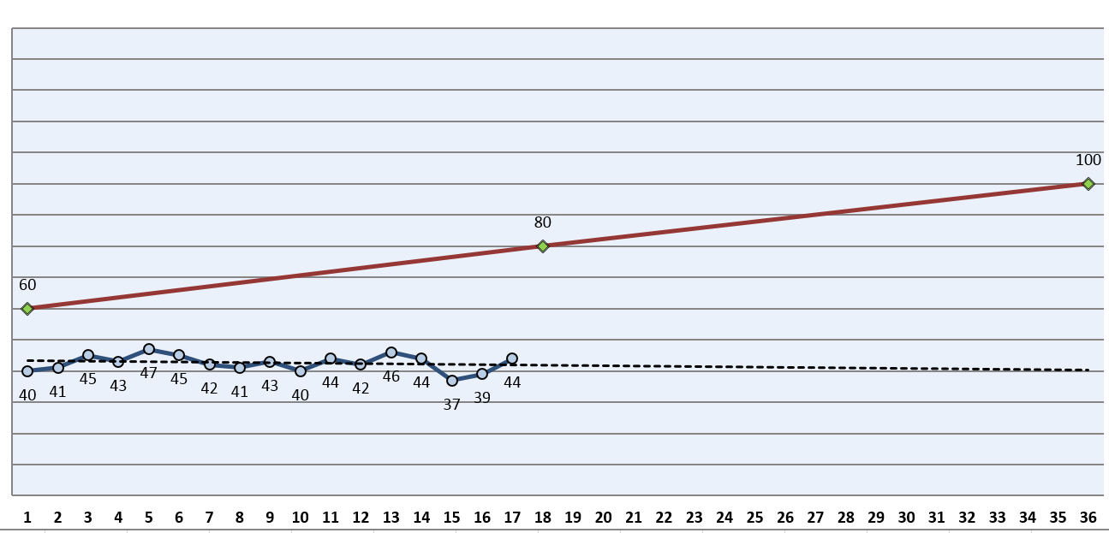
Activity: Data Tells a Story
Notes:
5 minutes
Let’s look at a student’s progress monitoring chart.
Turn and Talk: Is this student making adequate progress? Why or Why not? What would be some next steps for this student? Should we refer the student for a special education eval now?
These are the conversations that our Data teams/Leadership teams should be having each month with students receiving intervention supports. When changes are made with a students’ intervention supports, it is important that the changes are documented and can be referred back to if needed later on.
*This slide will be made into handout if allowed.

Slide 33

Free Diagnostics for Reading
Diagnostic assessments that identify specific skill deficits help answer the question, “Where do I start?”
Free diagnostics examples:
Phonological Awareness Skills Screener (PASS) – primarily grades K-2
Phonics and Word Reading Survey (PWRS) – primarily grades 2-12
Notes:
1 minute
TDOE does not require a specific diagnostic to be used across the state, these are district decisions. For the purpose of our time together we wanted to look at these two free reading diagnostics to give some clarity on how data from these assessments can be utilized.

Slide 34
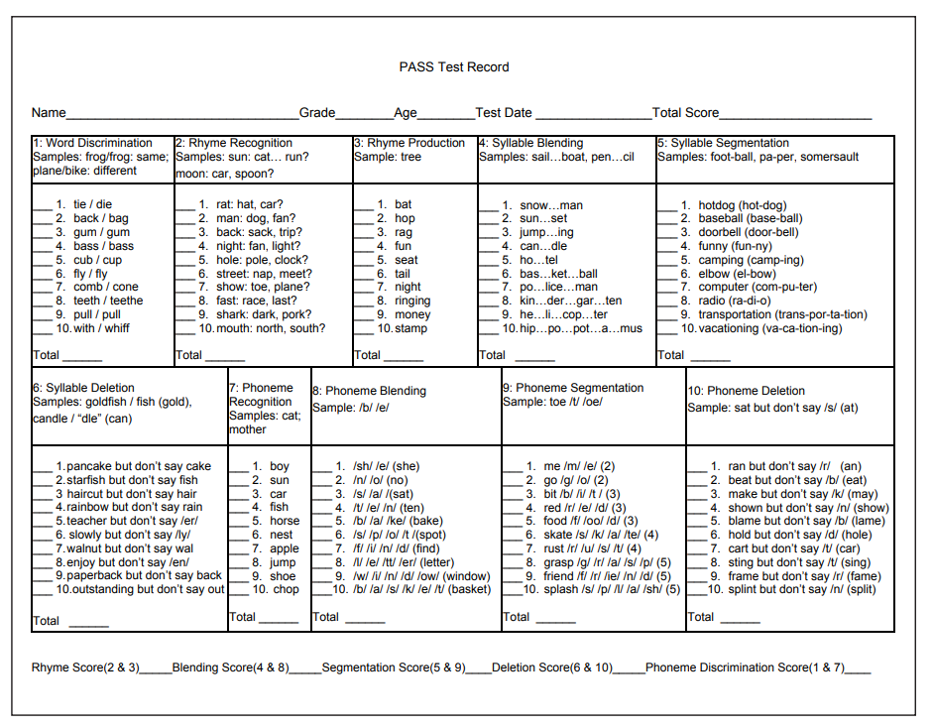
Phonological Awareness Skills Screener (PASS)
Notes:
3 minutes to work/talk – 2 minutes to share out
Take a minute to look at this diagnostic and Turn and Talk about the following question prompts:
How could this surveys help us find our students’ “missing bricks” in their learning?
How will this enable us to identify the most accurate skills specific intervention?
*This slide will be made into handout if allowed.

Slide 35
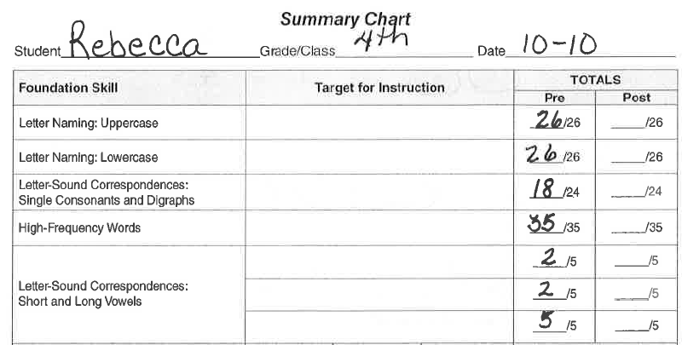
Rebecca’s Phonics and Word Reading Survey (PWRS)
Notes:
3 minutes
Let’s look at some example student samples. What do you notice? What do you wonder?
*This slide will be made into handout if allowed.

Slide 36
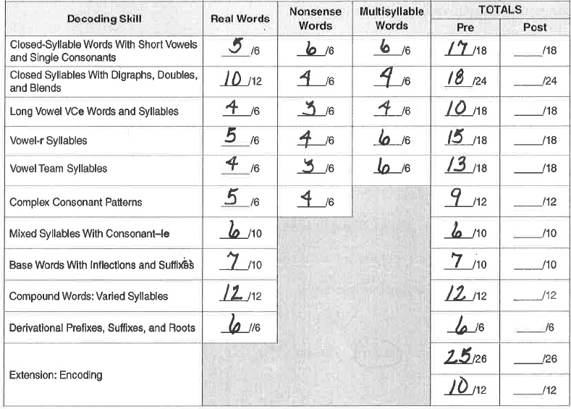
Rebecca’s Phonics and Word Reading Survey (PWRS)
Notes:
3 minutes
Let’s look at some example student samples. What do you notice? What do you wonder?
*This slide will be made into handout if allowed.

Slide 37
Mathematics Diagnostic Assessments
Diagnostic assessments are designed to pinpoint where a student is in the learning trajectory.
What are some examples of mathematics diagnostic assessments?
  Institute for Learning (IFL)
    Five Domains: Base Ten, Addition/Subtraction, Multiplication/Division, Fractions, Ratio/Proportions
  Textbook Diagnostic Assessments
  Item Analysis of Student Work
  Universal Screening/ Progress Monitoring Probes
  Intervention Formative Assessments
Notes:
1-2 minutes
In our examples we looked at reading diagnostics, but we wanted to take just a minute to emphasize that diagnostics are needed in Math in order to target student skill deficits for math as well.

Slide 38

Progress Monitoring
Progress monitoring is used to assess student’s academic performance, to quantify a student rate of improvement or responsiveness to instruction, and to evaluate the effectiveness of instruction. Progress monitoring can be implemented with individual students or an entire class.
Notes:
2 minutes
Ok we have discussed the student identified at risk by the Universal Screener, looked at multiple data pieces including a diagnostic to determine student skill deficit, aligned a systematic and explicit intervention resource for intervention supports .....
Now we are ready to discuss Progress Monitoring.
Take a minute to read the definition of “progress monitoring” and jot down key words that stand out to you.
SHARE OUT
*This slide will be made into handout if allowed.

Slide 39

Case Study: Meet Sara
Sara is a 2nd grade student at Hill Elementary. On her Fall Universal Reading Screener, she scored at the 10th percentile on her composite.
Vocabulary was 43%,
Reading Comprehension was 14%, and
Oral Reading Fluency was 3%.
What progress monitoring measure should be used to most accurately measure this student’s progress?
Notes:
5 minutes
Presenter will share the following case study about a 2nd grade student.
“Sara is a 2nd grade student at Hill Elementary. On her Fall universal reading screener, she scored at the 10th percentile on her composite. Vocabulary was 43%, Reading Comprehension was 14%, and Oral Reading Fluency was 3%. What interventions are needed for this student?
- Hopefully participants will identify we need more information to be able to align interventions (connecting the Diagnostic assessment learning)
“Knowing that we need more information regarding Sara’s skill deficit we administered a Diagnostic Assessment. It was determined that Sara needs intervention instruction targeting her decoding skills. She particularly struggled decoding words with more than two syllables, and regularly struggled with words containing long vowel patterns.” What interventions are needed for this student?
What measure should we use for progress monitoring to reflect the responsiveness of the intervention?
*This Case Study will be made into handout if allowed.

Slide 40
Fidelity
Fidelity
The extent to which the prescribed instruction or intervention plan is executed. Fidelity includes addressing the deficit area, using the type of intervention prescribed, maintaining an appropriate group size, length of session, etc.
Fidelity of Instruction
Providing instruction with integrity, aligned with instructional goals for student learning and attending to the critical features of instructional best practices designed to meet those goals. Fidelity Monitoring: The systematic monitoring by a responsible instructional leader (i.e., principal, instructional coach) to determine the extent to which the delivery of instruction or an intervention adheres to the protocols or program models originally developed.
Fidelity Monitoring
Has increasing significance for evaluation and treatment effectiveness. The fidelity of implementation per intervention and instruction should be assessed throughout the process as per the guidelines in the manual.
Notes:
3 minutes to read,
Take a few moments to read these definitions, jot down key words or you're understanding as you read.
(Transition to reflection on next slide)
*This slide will be adjusted if allowed to have handouts.

Slide 41

Reflection
What are the ways we monitor the fidelity of our Core instruction?
Why would monitoring the fidelity of intervention instruction be important?
Reflect on what this looks like in your district.
Notes:
5 minutes
Turn and Talk at your table and discuss these reflection questions.
Have 1-2 volunteers share out for each question prompt.

Slide 42
Calculating Rate of Improvement (ROI) and Gap Analyses
Notes:
1 minute (Transition Slide) ** BREAK**

Slide 43
Setting Goals and Calculating ROIs
Rate of Improvement (ROI)
The expected rate of improvement on progress monitoring assessments is the number of units of measure (e.g., words read correctly [WRC], correct responses, correct digits) a child has made per week since the beginning of the intervention.
To discover this rate, teachers should divide the total number of units gained by the number of weeks that have elapsed.
The ROI is compared to the improvement of a typical peer to determine adequate progress.
Notes:
(April?)

Slide 44
Monitor Student Progress
Progress monitoring data
Monitoring the fidelity of the interventions
Family communication
Be responsive to the data!
Notes:
2 minutes
Let’s explore the RTI component of monitoring student progress. We are going to discuss:
The purpose of progress monitoring data and how this data reflects and guides the intervention instruction.
The importance of monitoring the fidelity of interventions.
The importance of communicating student progress with families and the frequency requirements of this communication.

Slide 45

Data Tells a Story
Weighing the cow doesn’t make it fatter!!
Notes:
1 minute
When we assess students and collect data, we use the data to tell us a story. We want to make sure we are using the data to guide our instruction NOT collecting data for the sake of collecting data under compliance reasons.

Slide 46
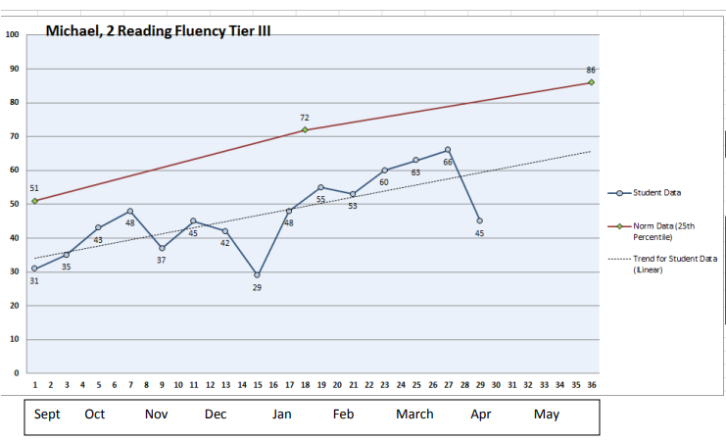
Calculating Rate of Improvement
Notes:
Calculate Michael’s rate of improvement (ROI) using the last minus first method (i.e. ROI worksheet). Calculate Michael’s rate of improvement (ROI) using the Tukey Method. How do these calculations compare to the ROI provided by the graphing tool, which uses a linear regression? Which method would you recommend for determining the most valid measure of Michael’s ROI? Why? What does Michael’s response pattern suggest? Conduct a gap analysis to determine whether Michael’s current progress is enough to close the achievement gap within a reasonable amount of time. What recommendations would you give for Michael’s continued intervention?

Slide 47
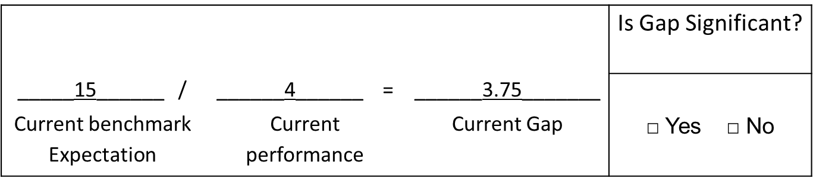
Gap Analysis: Step One
Interpretation: Malik’s performance is currently 3.75 times deficient compared to his peers.
Notes:
Show where to find the needed data within TN-URS to get “Current benchmark expectation,” “Current Performance,” and how to divide to get the current gap.

Slide 48
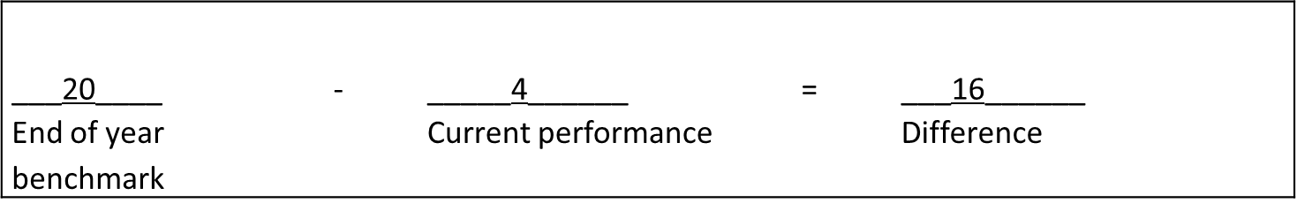
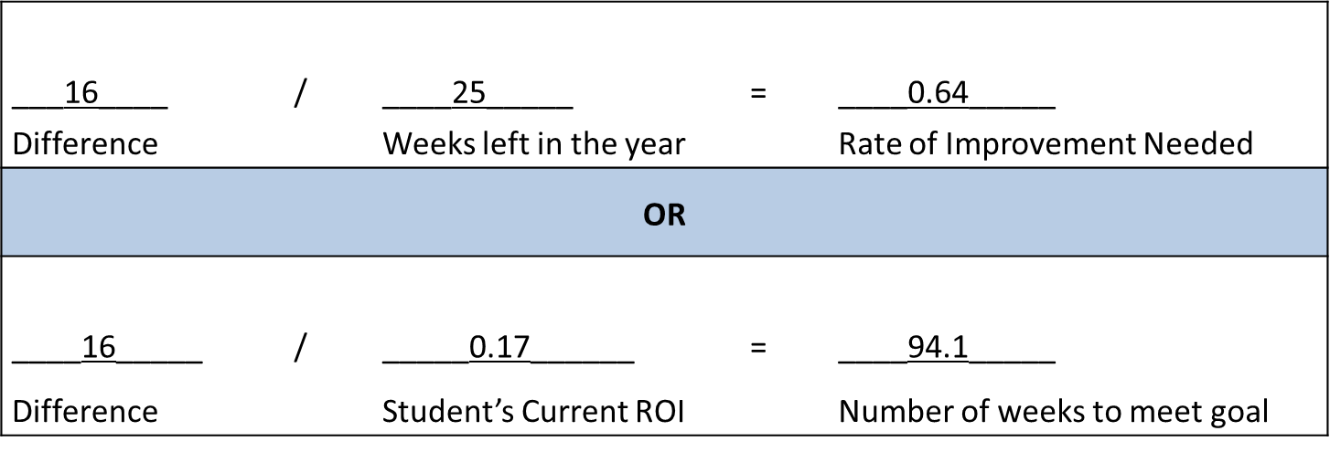
Gap Analysis: Step Two
Interpretation: Malik needs to improve by .64 digits per week in order to reach his goal. He is currently improving by .17 digits per week. If he continues at this rate, it will take him 94 weeks to reach his goal.
Notes:
Show where to find the needed data within TN-URS to get “End of year benchmark” and “Current Performance” and how to subtract to find the difference, divide the difference by the weeks left in the year to get the Rate of Improvement needed to meet their goal.
OR
Divide the difference by the student’s ROI to see how many weeks of instruction at the student’s current rate it would take for the student to meet their goal.

Slide 49
Child Find Requirements

Slide 50
Individuals with Disabilities Education Act (IDEA) Requirements
IDEA requires local education agencies (LEAs) to:
Identify students at risk for disabilities
  Child find
  Parent referral
Evaluate students suspected of a disability
  Timely evaluations (60 days)
Determine students’ eligibility for special education services
  Federal and state definitions
Develop an individual education program (IEP) for eligible students based on student need
  All decisions are made by the IEP team
Provide a free and appropriate public education (FAPE) for students with disabilities

Slide 51
Evaluation
Progress monitoring data
Observations
Parent and Teacher Input
Work samples
Achievement assessments
Exclusionary Factors
Rate of Improvement
Number of Data Points

Slide 52
Tips to Avoid Procedural Violations
Focus on the data, not the process
Respond to the data
Respond appropriately to requests for evaluation
  Avoid language: “We don’t have enough data points.” or “The student must go through RTI² first.”
Avoid pre-determination
  Avoid language: “The student hasn’t been in RTI² long enough. If I test the student now, we won’t be able to make the student eligible.”
  All decisions are made by IEP team
Refer if a disability is suspected

Slide 53

OSEP Memo 07-11
The use of RTI² strategies cannot be used to deny or delay a parent’s request for evaluation to a student suspected of a disability.
  If the LEA agrees that the student is suspected of a disability, they must evaluate.
  If the LEA does not agree that the student is suspected of a disability, they must provide prior written to the parent of the refusal to evaluate.
Notes:
1-2 minutes
As a reminder, we have an OSEP memo that emphasizes that RTI cannot be used to deny or delay a request for an evaluation. The district must consider the request and either choose to evaluate or not. The district must also document their decision and why they made that decision in a prior written notice provided to the parent.
Students are not required to exhaust all tiers of intervention.
Schools are not required to obtain a specific number of RTI data points prior to conducting an evaluation for special education and related services.
Students are not required to receive any certain number of weeks in any tier of intervention.
Referrals for initial evaluations should not be based on assessment score cutoffs.
RTI progress monitoring and initial evaluations for a specific learning disability can occur simultaneously.
*This slide will be made into handout if allowed.

Slide 54
RTI² Intervention Process
Universally Screen All Students
(Measures Depend on Grade Level)
Data Review
Intervention Plan
Tier II or Tier III Supports
Intervention/ Progress Monitoring
Progress Monitoring Data Review
Intervention Plan
Core Instruction
Intervention
Notes:
In grades K-5 and in grade 6, the universal screening process should be conducted three times per year: at the beginning, middle, and end of the school year.
By seventh grade, student performance is relatively stable from one benchmark period to the next; therefore, in grades 7-8, the universal screening process should be conducted once at the end of each school year to inform intervention decisions for the following year.
However, if districts have a large number of at-risk students who are struggling to meet grade level expectations, they should continue the universal screening process three times per year and use data from multiple, appropriate sources to adequately support tiered service of interventions and the high level of need for skills-based instruction.

Slide 55






Questions?
Notes:
Pause to address any questions participants may have.

Slide 56

RTI² Contact Information
rti.questions@tn.gov

