Slide 1
UNDERGROUND STORAGE TANKS AND SOLID WASTE DISPOSAL CONTROL BOARD
Voluntary Program Update December 4, 2019
Evan Spann, DoR Environmental Protection Specialist

Slide 2
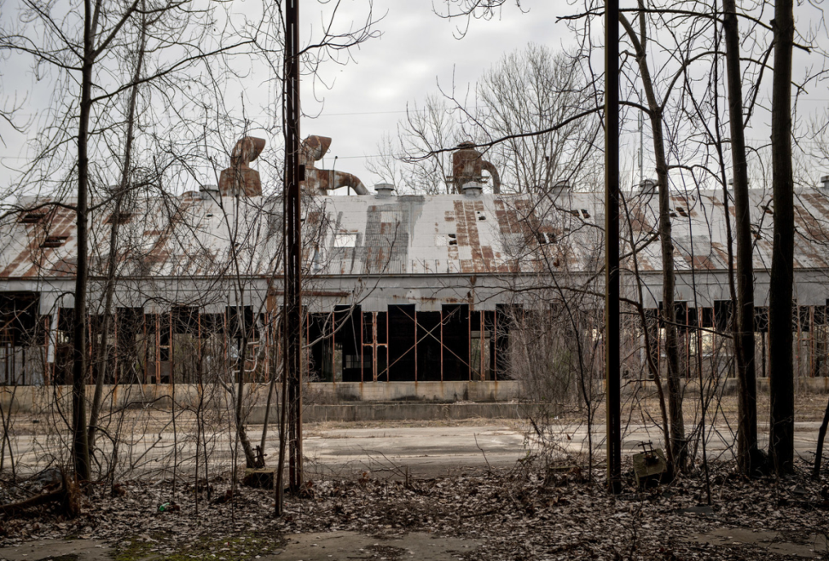
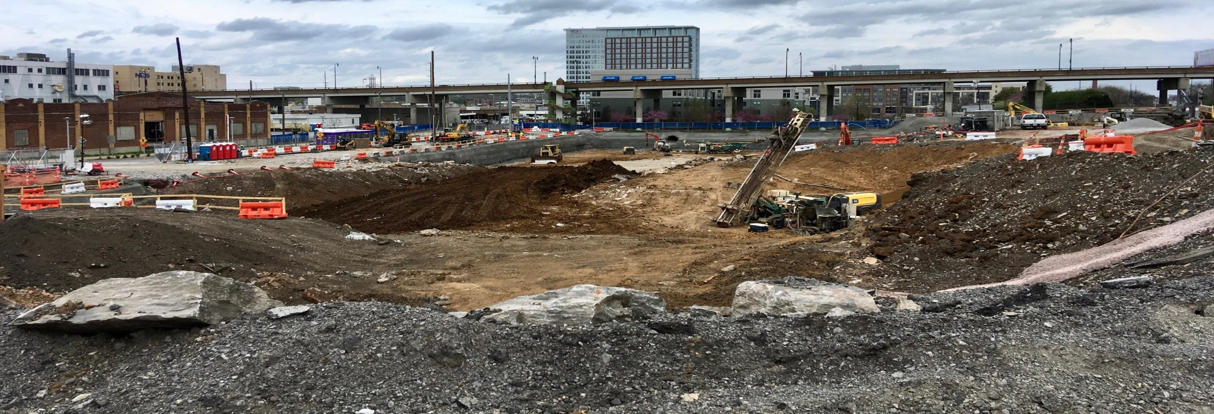
Brownfields
Underused commercial or industrial site,
Redevelopment potential,
Redevelopment may be complicated by real or perceived environmental contamination.

Slide 3
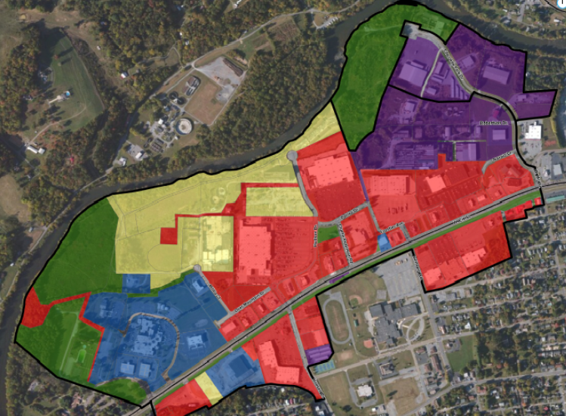
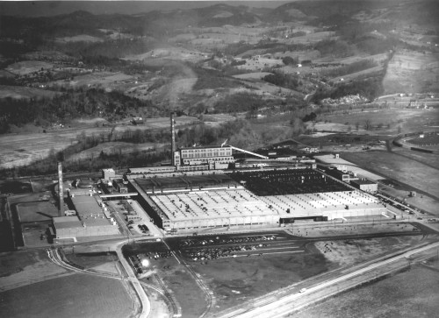
Brownfield Redevelopment
Brownfields strike a careful balance between development needs and mitigating environmental impacts, decreasing blight and public safety hazards, facilitating job growth and community investment, and saving green space.

Slide 4
Brownfields are a Tool for Redevelopment
Community – blight removal, infill development, reuse of idled/abandoned property
Environmental – removal of contamination, reduction of health risks, ecological mitigation
Economic Development – new jobs, attract new business, support business expansion

Slide 5
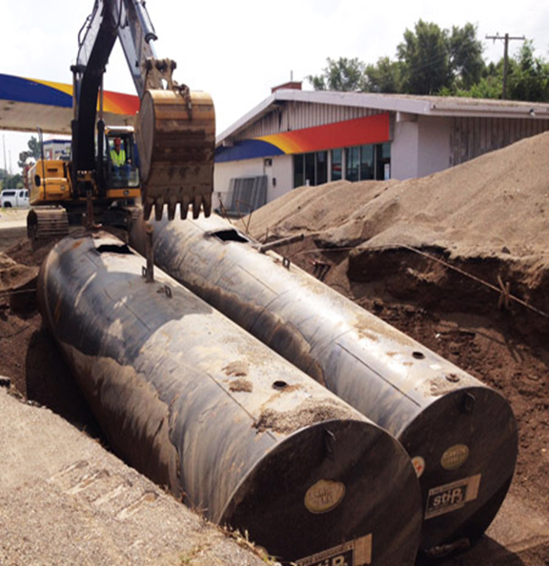
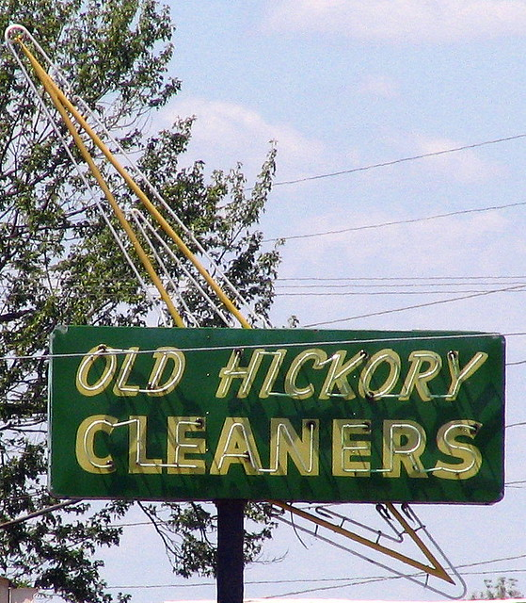
Voluntary Oversight and Assistance Program
Brownfield Projects Voluntary Cleanup Oversight and Assistance Program (VOAP) (TCA 68-212-224)
Provide oversight and technical assistance to voluntary parties,
Resolve potential liability for an innocent landowner or prospective owner at a contaminated site,
Establish a legal basis for enforcement of institutional controls to limit future liability at a site resulting from it progressing to uses with increased risk,
As an alternative to receiving a unilateral order from the Commissioner to investigate and clean up an inactive hazardous substance site.

Slide 6
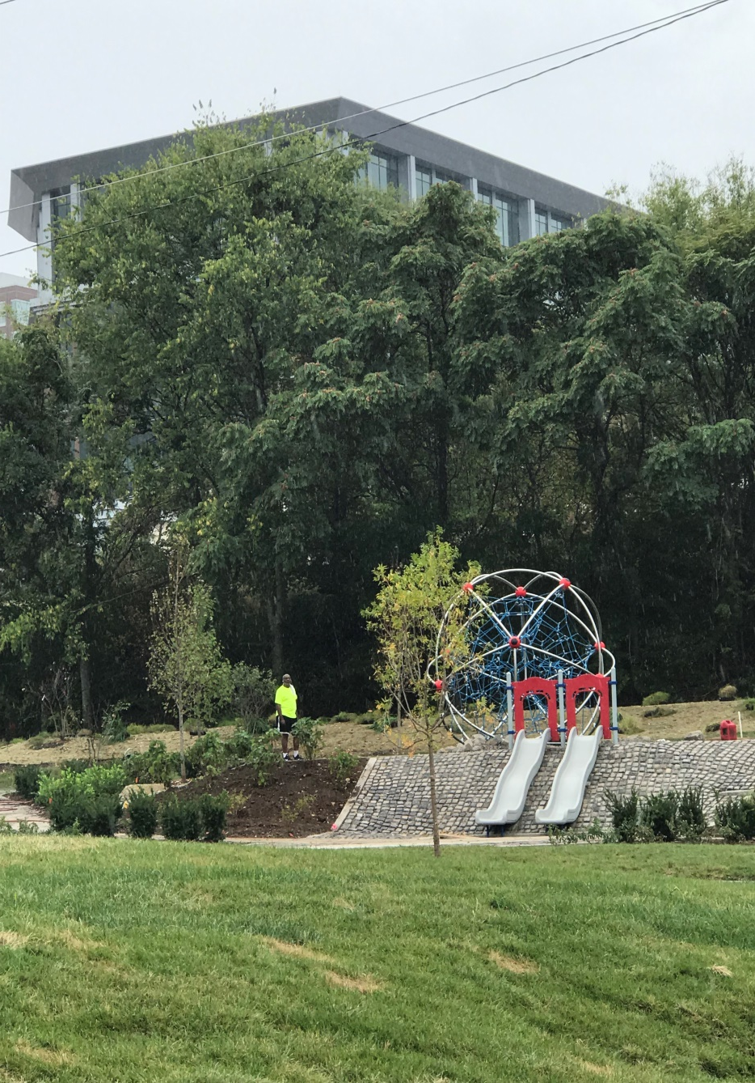
Voluntary Program by the numbers
Current inventory of Brownfield Voluntary projects - 313 sites
In CY 2019:
68 sites entered the Program
54 sites completed under the Program
1,318 acres determined to be ready for reuse or redevelopment through Program

Slide 7
Tax Increment Financing
New Brownfield TIF statute
On April 30, 2019, Governor Lee signed into law SB0355, amending T.C.A. § 7-53-316, Redevelopment of Brownfield Sites in Economically Disadvantaged Areas (the “Brownfield TIF Law”)
The statute now allows costs which are directly related to the investigation, remediation, or mitigation of the brownfield projects to be recovered as “Qualified Costs”, removes size requirements for the “Brownfield Site”, and allows statewide application of the TIF regardless of county population.

Slide 8
VOAP Cost Recovery
TCA 68-212-224(a)(3);
“All such voluntary agreements or consent orders may provide for the reimbursement of the department's oversight costs.”
Current Cost Recovery Assessments (implemented in 2007)
Program Entry $ 750
Site Characterization $ 2,000
Remediation/ Corrective Action $ 2,500
Risk Assessment Review $ 2,000
Vapor Intrusion Evaluation $ 2,000
Land Use Restrictions $ 500
Consent Order/Brownfield Voluntary Agreement $ 3,000
Annual Assessment $3,000
“Typical” project costs - $8,250

Slide 9
VOAP Cost Recovery
Updated Cost Recovery Assessments (effective January 1, 2020 for new projects entering the VOAP)
Program Entry $ 3,000
Site Characterization $ 2,500
Remediation/ Corrective Action $ 3,000
Risk Assessment Review $ 2,500
Beneficial Use Determination $ 2,500
Vapor Intrusion Evaluation $ 2,500
Land Use Restrictions $ 1,000
Institutional and Engineering Controls Compliance Review $ 750
Consent Order/Brownfield Voluntary Agreement $ 4,000
Annual Assessment $4,000
Cost Recovery Assessments increased via inflation adjustment from Jan 07-June 2019
“Typical” project costs expected to increase by $6,000 to $14,250

Slide 10
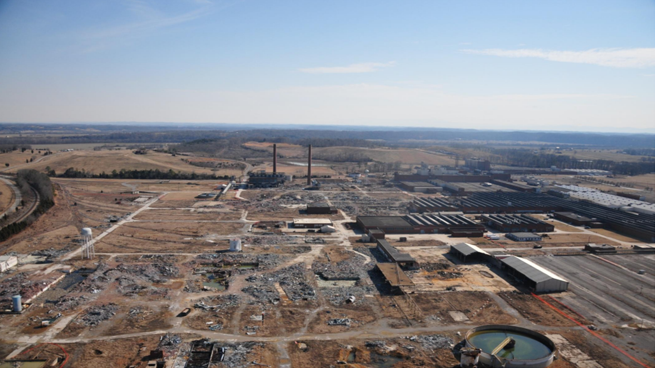
Tennessee’s Brownfield Voluntary Program Evan Spann (615) 532-0919 Evan.W.Spann@tn.gov

