Slide 1
Supplier Maintenance Agency Training Workshop #1
Topic: Supplier Update Form
Division of Accounts, Supplier Maintenance

Slide 2
Upcoming Training Workshops
Month | Topic
December 2021 | W-9
March 2022 | TBD
June 2022 | TBD
Please submit any topic ideas or questions with specific examples to Supplier.Maintenance@tn.gov and include in the Subject: ATW.

Slide 3
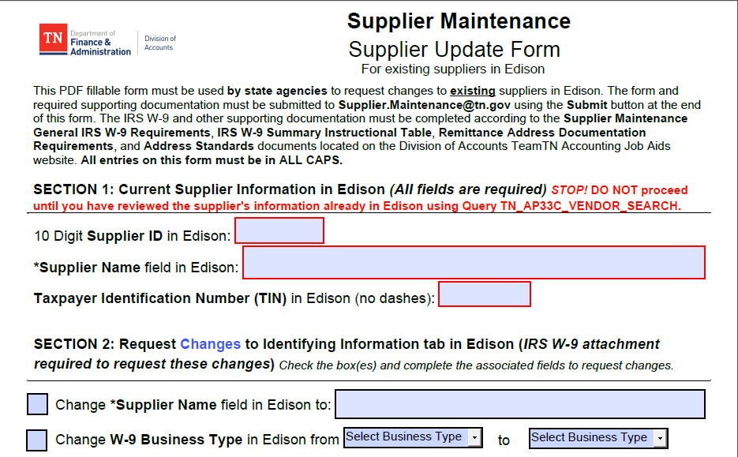
Supplier Update Form
Found on the DOA Accounting Job Aids website
Notes:
Today we will break down the Supplier Update Form or SUF one section at a time.
We will talk about Only, MUST EXACTLY, and Always

Slide 4
Supplier Update Form (SUF) Helpful Hints
Read the instructions
Follow the instructions
Notes:
The most important information I can give you is to:

Slide 5
FOR AGENCY USE ONLY
SUPPLIER UPDATE FORM
This is the ONLY way for an AGENCY to update an existing supplier
Emergency Requests are the only exceptions
Must use
This ensures that all information can be copied and pasted and decreases errors
Notes:
The SUF is the only way for an Agency to update a Supplier File
It is for existing Suppliers
It MUST be submitted to Supplier.Maintenance@tn.gov not staff, not Katelyn, not Christy
Emergency Requests are the ONLY exception. These will follow the instructions for Emergency Requests found on the DOA job Aides Website
You MUST use the submit button at the bottom of the page to ensure all needed documents are attached properly.
The form MUST be completed in all caps. Staff will copy and paste to ensure information is accurate and in accordance with supplier Maintenance address standards which are USPS address standards and both are found on the DOA Job Aides Website.

Slide 6
Section 1: Current Supplier Information
STOP
Notes:
Before you Submit this form. Run Query TN_AP33C_Vendor_Search. To make sure the information you are requesting is not already in Edison.

Slide 7
TN_AP33C_Vendor_Search
Location Name, Description of Location, and Location Status (A = Active, I = Inactive)
If bank information is on file, Payment Method = EFT
Bank ID = Routing #
Account # = Last four digits of bank account
Email ID = for electronic remittance advices
Supplier Name (Line 1 of IRS W-9)
Address information: Payment Alternate name (DBA name) and address
Supplier ID
Supplier Business Type
Supplier ID status
A = Approved
I = Inactive
R = Ready for Review
Address ID # and Address Status
(A = Active;
I = Inactive)
Last four digits of tax ID
Notes:
Query AP33C shows
Supplier ID #
Supplier Status – Will show if it is Active or Inactive
Supplier Business Type, This is what is already on file
Last four digits of Tax ID this is all you will be able to see
Supplier Name as it appears in Edison
Lists all Address #’s for this supplier, Address status whether the address is active or inactive, Address as entered in Edison , and Payment Alternate name which is the DBA
Lists all locations by name and shows if they are Active or Inactive
Banking, if on file is listed by payment method, Bank ID/Routing #, Last four digits of Account #, and email to which electronic remittance advices are being sent.
This a very handy tool when you are looking for information about a specific supplier.

Slide 8
Section 1: Current Supplier Information
Must include leading zeros
MUST EXACTLY match what is in Edison. Do not abbreviate the name entered here unless it is already abbreviated in Edison
Must be nine-digits and match what is in Edison, no dashes
Notes:
Once you have determined the information you need is not already available, then you MUST complete Section 1 COMPLETELY!!!! This must completed by anyone and everyone making a change.
All 10 Digits of the Supplier ID in Edison. YES! That includes the leading zeros, and it MUST exactly match the Supplier ID number in Edison.
The Supplier name MUST be filled out and MUST EXACTLY match what is in Edison. Only abbreviate if it is abbreviated in Edison.
The third line is theTax Identification Number – this MUST have 9 digits and must the TIN already in Edison. We CANNOT change a supplier TIN. If the TIN is no longer valid, you will inactivate the supplier and create a new supplier through the Edison portal. We will talk about inactivating shortly

Slide 9
Section 2: Request Changes to Identifying Information tab
W-9 name must exactly match the name entered here. Do not abbreviate the name entered here. Only special characters allowed are the dash (-) and ampersand (&).
W-9 Line 3 must match the W-9 Business Type requested
Note: Ask yourself, does the information provided on the W-9 already match what is in Edison, except for what I am asking to be changed? If not, do additional changes need to be requested?
Notes:
Section 2: Request Changes to Identifying Information tab. This section will only be filled out if you need to change the Supplier Name or Change the Business Type. You must check the box next to what you need us to do. To change the Supplier Name you must submit a W9 with all the appropriate boxes checked and associated fields completed.
To change the Supplier name, the name on the W9 must match the name you are entering here is Section 2 for the Supplier Name.
To change the business W9 Business Type, select the drop down beside FROM and click on what is already in Edison. Select the drop down beside TO and click the new BT.
If any of these are not done, then we will send this back to you to re-work.
Before you go any further, you need to make sure that the information on the W9 you are currently providing is either already in Edison or you are requesting additional changes in another section.

Slide 10
Section 3: Request to add an Address or change Address(es)
Click here to go to Address Standards PDF.
To add a remittance address:
Check the box and complete all fields. Address must be entered according to Supplier Maintenance Address Standards.
Attach to your request an invoice to or from the supplier or signed memo on company letterhead. Payment name and address on invoice or memo must exactly match the information entered in these fields.
Note: Memo must contain a handwritten or digital signature. Electronic signatures are not accepted.
Notes:
Section 3 has 4 parts. This is where you will request to add or change an address. If you click on the box above Address Standards, it will take you to the DOA job aide Website to our address standards for review.
If you need to add a New Remittance Address you will check the first box in section 3. This is only for an address that is not already on the Supplier File and you did not find when you ran the AP33C query. To add this address you must attach an invoice to or from the supplier or a signed memo on company letterhead. Print the Payment Alternate Name that you want associated with this new address on the first line. This must exactly match what is on the invoice or memo. Add the Street Number and Name, using Supplier Maintenance Address Standards, the fill in the City, State and zip. This must also match what is on the invoice or memo. If they do not match, we will send it back to you to re-work.

Slide 11
Section 3: Request to add an Address or change Address(es)
To change a remittance address:
Check the box and complete all fields.
Attach to your request an invoice to or from the supplier or signed memo on company letterhead.
You MUST enter the Address ID in Edison you want changed. One Address ID per form. New form required for each change.
To: address MUST match the invoice or memo submitted and be entered in these fields according to Supplier Maintenance Address Standards
From: Address MUST exactly match what is currently in Edison
Note: If the Payment Alternate name in Edison does not match the name on the invoice or memo, you will need to complete the Change Payment Alternate name fields in Section 3 of the Supplier Update Form.
Notes:
You will use this section to change a remittance address. A remittance address will be address 2 or greater. Not address 1 for this purpose. You must check the box, then enter the address # that you need to change. Type in the FROM address exactly as it appears in Edison. Type in the TO address exactly as it appears on the invoice. If the Payment Alternate name already in Edison does not match what is on the invoice, then you will need to also complete the Change Payment Alternate Name fields in Section 3.

Slide 12
Section 3: Request to add an Address or change Address(es)
To change Address ID 1:
Check the box and complete all fields.
Attach to your request the supplier’s W-9.
MUST match W-9 and be entered in these fields according to Supplier Maintenance Address Standards
MUST EXACTLY match what is in Edison
Notes:
Section 3 is also where you will ask to change Address 1. Address 1 is the 1099 Address and yes we know that not all Suppliers will receive a 1099, however IRS standards require that we have this information on file from a W9. Therefore, you must submit a new W9 dated within one year to change this address 1. You will check the box, type in the FROM address directly from Edison and it must match exactly. Type in the To address which must exactly match the W9 and meet Supplier Maintenance Address Standards

Slide 13
Section 3: Request to add an Address or change Address(es)
To change the Payment Alternate name field:
Check the box and complete all fields.
Attach to your request an invoice to or from the supplier or signed memo on company letterhead.
May include multiple Address IDs. To and From DBAs must be the same for all.
MUST EXACTLY match what is in Edison
MUST EXACTLY match invoice or memo
Notes:
The fourth part of Section 3 is the request to change the Payment Alternate Name field, otherwise known as the DBA or Doing Business As. You must have an Invoice to or From the supplier or a signed memo on company letterhead to update the Payment Alternate name. You may however, include multiple addresses to have this name change applied to. List all the address #s you would like to change on the first line. The beside FROM type the current Payment Alternate Name EXACTLY as it appears in Edison. On the TO line type the new Payment Alternate name EXACTLY as it appears on the invoice or memo. If these do not match, we will send it back to you for re-work

Slide 14
Section 4: Request to Add a Location
Click here to view chart on DOA Accounting Job Aids website.
If a location is already in Edison DO NOT mark it here. EXAMPLE: Edison shows a CAT7 and you need a CAT7 and a MAIN, only mark MAIN. CAT7 is already there.
Notes:
Section 4!! This is where you can add another Location to the Supplier. You may mark all that apply on one form. BUT! If the location is already on the supplier file, then DO NOT mark it here. Only mark new ones you need to add. However, if you request a location that is inappropriate for the Business Type, we will not add it. We will email you that it is not being added. For instance if you are asking to add a CAT7 to a Corporation and it is not a lawyer, we will not add that.

Slide 15
Section 5: Request to Inactivate Supplier ID or Address ID(s) and /or Location(s)
To inactivate an ENTIRE supplier file:
Check the box
Give a brief reason for inactivation.
Notes:
We have actually covered the areas where most of the mistakes are made when filling out this form. The next few sections are a little more straight forward.
Section 5 Is where you are going to ask to inactivate a Supplier, an Address, or a location. To inactivate the entire supplier file, you will check the first box then type a brief description of why you need the file to be inactive. This means that no payments can be made to the supplier as long as it is in inactive status. Reasons to inactivate a supplier would be the owner was deceased, the business was no longer active, there was a merger or buy out and the TIN no longer needs to be used, or there could be an error or possible error in the file.

Slide 16
Section 5: Request to Inactivate Supplier ID or Address ID(s) and /or Location(s)
To inactivate Address ID 2 or greater (not used for Address ID 1):
Check the box
Enter the Address IDs you want to inactivate. Can list multiple IDs.
Give a brief reason for inactivation.
To inactivate one or more locations:
Check the box
Enter the locations you want to inactivate. Can list multiple locations.
Give a brief reason for inactivation.
Notes:
You would check the second box if you needed to inactivate an address. In this instance, you would check the box, enter all the address #s that you need inactivated, and put in a brief description. You would inactivate an address in situations where the business moved, or the mail was returned as non-deliverable.
The next box is used to inactivate Locations. If there is a location that is no longer needed, you check the box, type in all the locations that you need to inactivate, then type in a brief description of why. An example of this would be inactivating CAT7s if a business that was not an attorney’s office became a coporation.

Slide 17
Section 6: Request to Activate Supplier ID, Address ID(s), and/or Location(s)
To activate a Supplier ID:
You MUST check this box to make it active again.
You MUST submit a new W-9 which contains a date after the date of inactivation.
Note: Ask yourself, does the information provided on the W-9 (name, business type, address) already match what is in Edison? If not, do additional changes need to be requested?
Notes:
Section 6 is just the opposite of section 5. This is where you make requests to activate suppliers, addresses, or locations. This requires a little more than just an explanation. To activate an entire supplier file that is currently inactive, you must submit at W9. This W9 must be dated after the date the file was inactivated. If the file was inactivated January 1, 2021, the W9 would have to be dated January 2, 2021 or later. You need to make sure that the information on the W9 matches what is already in Edison. If it does not, you need to request additional changes to make it match or we will send it back for re-work.

Slide 18
Section 6: Request to Activate Supplier ID, Address ID(s), and/or Location(s)
To activate Address ID(s):
You MUST check this box.
Enter the Address ID(s) you want to activate. Multiple Address IDs can be listed.
Attach correct supporting documentation
To activate Location(s):
You MUST check this box.
Enter the Location(s) you want to activate. Multiple Locations can be listed.
Note: Ask yourself, does the information provided on the supporting documentation already match what is in Edison? If not, do additional changes need to be requested?
Notes:
To activate an address, you will check the box and enter all the address #s that you want to activate. If you are activating address 1, you must attach a W9. I you are activating Address 2 or greater, you must submit an invoice or memo to or from supplier or signed memo on company letterhead. Remember that for Address 1 the W9 must be dated after the date the address was inactivated.
To activate a location, check the third box, and type in the location numbers. Stop here! Make sure that the information in the supporting documents matches what is already in Edison, if not you must fill out additional sections to update the information.

Slide 19
Section 7: Request to Add or Remove Synchronizations (1. And 2. are required)
Click the dropdown and select
Click the dropdown and select
Multiple Address IDs can be listed
Notes:
Section 7 is new to those of you who have been using this form for a while. The general rule of thumb is if you don’t know what Section 7 means, then it does not apply to you. A very few agencies will use this feature to synchronize Edison with another system so that the information flows properly. They will click the drop down and choose add or remove, then they will click the drop down and click the system they need. They will then enter the address ID or IDs that this needs to be applied to.

Slide 20
Section 8: Agency Certification
In other words, this section MUST be filled out completely.
Notes:
Section 8: Agency Certification. This section is very important and it MUST be filled out completely. Everything with an asterisk is REQUIRED.

Slide 21
Section 8: Agency Certification
This section MUST, MUST, MUST be filled out completely! The Supplier Contact should be the person you verified the information with. Supplier Maintenance may contact this person with any questions.
This should be the agency person who is completing this form. DO NOT use someone else’s name.
Notes:
The first part asks for the Supplier Contact Information. I know that this is not always easy to obtain but if there is a problem with a payment it is essential that we have someone we can contact with questions. This must be filled out, no exceptions.
The next part is the Agency Contact Information. This must be filled out by the person completing the form. Please do not let someone else use your name and information on this form. If we have a question then we end up reaching out to the wrong person and this will only delay you request.

Slide 22
Section 8: Agency Certification
1. This should be a digital signature.
2. Electronic Signatures are not accepted.
3. If you have issues with this signature box, contact Supplier Maintenance.
Notes:
The next to last step of this form is the signature panel. If you are using this form in adobe, you should have no trouble. If you are not using adobe, it probably is not going to work. This should be a digital signature. We DO NOT accept Electronic Signature. If you have issues with the signature box, contact Supplier Maintenance we will be glad to help.

Slide 23
Section 8: Agency Certification
MUST use this email
The Subject line MUST include the Supplier ID and the Supplier Name as entered in Section 1 of this form.
Notes:
Now you are ready to submit the form. It must be sent to Supplier.Maintenance @tn.gov. If you use the submit button, it will auto fill that email address. BUT WAIT!!!! You must enter the Supplier ID and Supplier Name in the subject line. This is for your benefit as well as ours. Many agencies send in multiple requests on the same day. If one of those should be returned, then it is easy to determine which one is being returned because the name and ID are in the subject line. It only takes a minute and may save you a lot of time later.

Slide 24
Contact Supplier Maintenance
Email – Supplier.Maintenance@tn.gov
Voicemail line - 615-741-9745
Strongly encourage agencies to visit the Supplier Maintenance Section of the DOA Accounting Job Aids website
Emergency Request Procedures
Announcements
Current Forms
Helpful Instructions

Slide 25
Questions?
Notes:
We have covered this form from top to bottom. I have pointed out things that if not completed correctly will be sent back. Don’t fill out this form thinking that if it is not correct we will fix it for you. We only enter what we are sent and I have explained what we need. Right now we are working on a 3 day turn around. That means if you email Supplier Maintenance today, your request, if correct, will be processed withing 3 business days. If we have to send it back to you, then you are at a minimum of 6 days to get your request updated, so please take your time, make sure that everything is filled out completely.

