Slide 1
Governor’s Office of Diversity Business Enterprise (Go-DBE)
Local Government Purchasing Forum
October 26, 2022
Rafael, Borjas, Diversity Business Liaison
State of Tennessee Central Procurement Office

Slide 2
Agenda
Program Overview
Diversity Business Partners in Local Gov. and Higher Ed.
Benefits for Certified Businesses
Business Eligibility Guidelines
Current Statistics/Diversity Reporting
Directory

Slide 3
Recent Milestone

Slide 4
Program Overview
§ T.C.A. 12-3-1102 – 1107 was amended April 2, 2012 and established the Governor’s Office of Diversity Business Enterprise (Go-DBE) within the Department of General Services under the direction of the Central Procurement Office.
The central point of contact to attract and assist minority owned, women owned, service-disabled veteran owned, persons with disabilities owned and small business enterprises to compete successfully in state procurement and contracting activity.

Slide 5
Program Overview (continued, 2)
§T.C.A. 12-3-1101 – 1108 state law known as the “Tennessee Minority-Owned, Woman-Owned, Service-Disabled Veteran-Owned, Business Owned by Persons with Disabilities, and Small Business Procurement and Contracting Act.”
The purpose of the law is to develop a program to expand economic procurement opportunities to Tennessee businesses.
The law was originally signed by state legislature in April 2004.

Slide 6
Program Overview (continued, 3)
T.C.A. § 12-3-1106 requires Go-DBE to:
Compile and maintain a comprehensive directory of certified diversity businesses (M/W/SDVBE/SDBE/SBE(s))
Assist any diversity businesses in complying with state procurement and contracting requirements
Examine request from state agencies for purchase of goods or services in the way of Bids and Proposals
Make recommendations to appropriate state agencies for simplification of procurement and contract specifications
Report annual diversity spend to the Governor and Tennessee General Assembly

Slide 7
Benefits for Local Entities as Business Partners
Go-DBE will share the Diversity Business Partners’ (such as local governments’ and higher ed’s) solicitations and procurement opportunities with its database.
Community Development Block Grants (CDBG) – construction opportunities
Go-DBE will share and collaborate with the Diversity Business Partners on various outreach activities.
Certification workshops, networking events
Diversity Business Partners refer businesses to Go-DBE for certification.

Slide 8
Testimonials from Diversity Business Partners
City of Knoxville
“The City of Knoxville often relies on the TN Go-DBE, by utilizing their services. Such a robust and secure online diversity business certified directory where to obtain contact information, commodity codes and a business.”
University of Tennessee
“Their certification workshops have helped multiple university suppliers achieve certification. The Go-DBE team is committed to improving and adding value to their program, both for agency partners and DBEs.”

Slide 9
Testimonial From A Certified Business
Commercial Coatings & Associates LLC:
"Go-DBE certification helps us tremendously by being a sounding board and constant avenue for references. They aided in the success of our company being awarded a large contract that without them, may have not been possible.”

Slide 10
Benefits for Certified Businesses
Certification is FREE!!!
100% online process
Certified businesses published in Go-DBE’s public directory
State agencies looking to meet diversity goals
Corporate and local government partners
Notifications for procurement opportunities
Subcontracting opportunities
Award advantage on Invitation to Bids (ITB) in the case of a tie
One-on-one assistance from Go-DBE liaisons
Business Development Program

Slide 11
Benefits for Certified Businesses (continued)
Reciprocity with other state and local government partners
Current Procurement Opportunities link:
Current Procurement Opportunities (tn.gov)
Upcoming Procurement Opportunities of Acquisition Forecast:
Acquisition Forecast (tn.gov)
Annual publications as required by T.C.A. § 12-3-1107(a)
Go-DBE Publications (tn.gov)

Slide 12
Business Eligibility Guidelines
All businesses certified with Go-DBE must be a continuing, independent, for-profit business which performs a commercially useful function and meets one (1) of the State’s definition of diversity. The five (5) diversity categories are:

Slide 13
Business Eligibility Guidelines: MBE
Minority Business Enterprise- at least fifty-one percent (51%) owned and controlled by one (1) or more minority individuals who are impeded from normal entry into the economic mainstream because of past practices of discrimination based on race or ethnic background.

Slide 14
Business Eligibility Guidelines: WBE
Woman Business Enterprise- at least fifty-one percent (51%) owned and controlled by one (1) or more women; or in the case of any publicly owned business, at least fifty-one percent (51%) of the stock of which is owned and controlled by one (1) or more women and whose management and daily business operations are under the control of one (1) or more women

Slide 15
Business Eligibility Guidelines: SDVBE
Service-Disabled Veteran Business Enterprise- a business owned by any person who served honorably on active duty in the armed forces of the United States with at least a twenty percent (20%) disability that is service-connected, meaning that such disability was incurred or aggravated in the line of duty in the active military, naval or air service.

Slide 16
Business Eligibility Guidelines: DSBE
Persons with Disability- a business owned by a person with a disability that is a continuing, independent, for-profit business that performs a commercially useful function, and is at least fifty-one percent (51%) owned and controlled by one (1) or more persons with a disability.

Slide 17
Business Eligibility Guidelines: SBE
Small Business Enterprise- a business that has total gross receipts of no more than ten million dollars ($10,000,000) averaged over a three-year period or employs no more than ninety-nine (99) persons on a full-time basis.

Slide 18
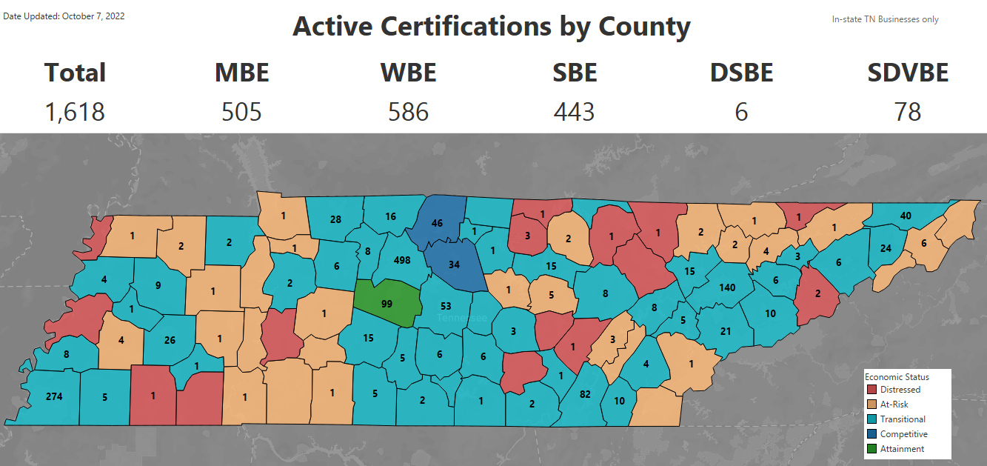
Go-DBE Certifications map (as of Oct 2022)

Slide 19
Current Statewide Contracts
Some current Statewide Contracts with Certified Diversity Businesses include:
SWC 375 Institutional Clothing
SWC 306 Headsets
SWC 021 Comprehensive Cloud Solution
SWC 700 Electrical, HVAC, Plumbing
SWC 747 Travel Services

Slide 20
Top Diversity Spend Counties in Tennessee
Go-DBE currently has over 2,000 certified diversity businesses located in Tennessee with $347,161,844 in diversity spend for FY2022.
The top 10 diversity spend counties are: Knox ($126M), Shelby ($64M), Davidson ($33M), Williamson ($23M), Hamilton ($19M), Gibson ($18M), Carter ($10M), Putnam ($10M), Carroll ($10M), and White ($8M)
Additionally, Diversity Spend in 40 rural counties was $88.9 million in FY22 (43% increase).

Slide 21
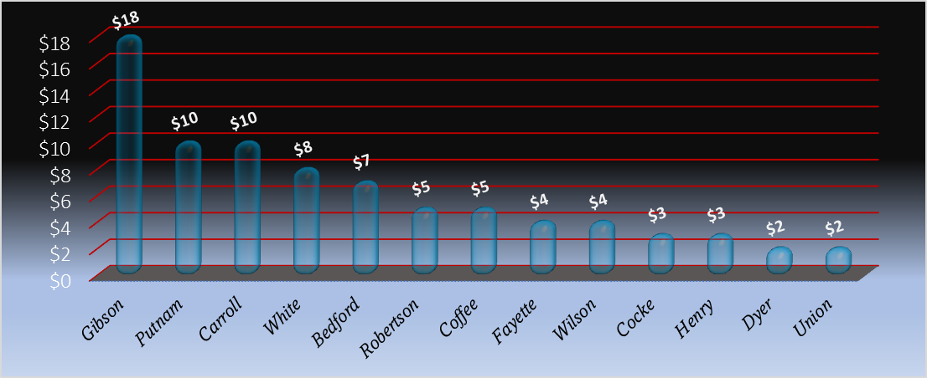
Top Diversity Spend Rural Counties

Slide 22
Certifications by Industry

Slide 23
Annual Subcontracting Diversity Dollars

Slide 24
Annual Diversity Spend from FY05 – FY22

Slide 25
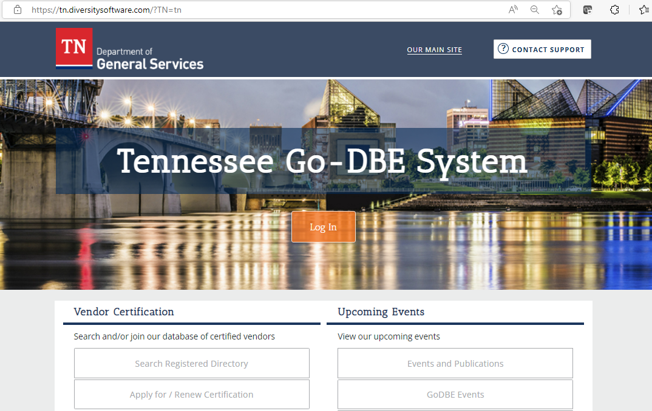
Directory: https://tn.diversitysoftware.com/
Step 1
Step 2

Slide 26
Contacts at Go-DBE
Title | Contact Name & Email | Contact Phone
Procurement Program Director | Jessica Starling Jessica.Starling@tn.gov | 615-532-9125
Diversity Team Lead – Professional Services | Richard Van Norman Richard.VanNorman@tn.gov | 615-253-4654
Diversity Liaison – Capital Projects, STREAM | Gwen Sanders Gwen.Sanders@tn.gov | 615-741-6145
Diversity Liaison – CPO, Higher Education (MTSU, UofM, TSU) | Edric Hammond Edric.Hammond@tn.gov | 615-741-4657
Diversity Liaison – CPO, Higher Education (APSU,ETSU, TTU) | Rafael Borjas Rafael.Borjas@tn.gov | 615-532-9013
Diversity Liaison – CPO, Higher Education (TBR) | Kimberly Fox Kimberly.Fox@tn.gov | 615-253-3835

