Slide 1
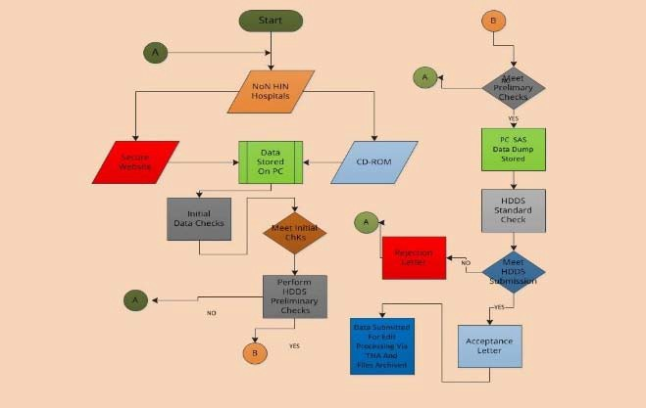
Tennessee Department of Health Division of Population Health Assessment
Hospital Discharge Data System (HDDS)
Informational Webinar
Date: Tuesday, October 20th, 2020 Time: 10:00am —11:30am CT

Slide 2
Agenda
Introductions
Processing hospital data into the HDDS
Data availability
Submitting HDDS data requests
Using HDDS data
Discussing HDDS data needs

Slide 3
Who are we?
Division of Population Health Assessment Office of Healthcare Statistics
Generosa Kakoti, PhD Director
Office of Healthcare Statistics
Division of Population Health Assessment Generosa.Kakoti@tn.gov
Daniel Merchant, MS Manager
Hospital Discharge Data System
Office of Healthcare Statistics Daniel.Merchant@tn.gov
William Grib, MS Manager
Ambulatory Surgical Treatment Center/Outpatient Diagnostic Center Data System (ASTC/ODC)
Office of Healthcare Statistics william.grib@tn.gov
Nerissa Harvey, BA Assistant Manager
Hospital Discharge Data System
Office of Healthcare Statistics
Nerissa.Harvey@tn.gov

Slide 4
THA Health Inf
ormation Network
Bryan Metzger, Senior Vice President
10.20.2020

Slide 5
Hospital Discharge Data System (HDDS)
T. C. A. 68-1-108 (a TN law) requires all Tennessee hospitals to submit their UB-04 claims data on all inpatient and outpatient discharges to the Department of Health
The Rules of the Tennessee Department of Health
HDDS User Manual
https://www.tn.gov/health/health-program-
areas/statistics/special-reports/hdds.html

Slide 7
Program Goals
Collect and summarize UB-04 hospital claims data from all the licensed hospitals in the state of Tennessee
Analyze and compare similar types of services to promote a more price competitive environment in the medical marketplace
Examine data to gauge the delivery of health care services to patients
Produce various reports.

Slide 8
UB-04 Claim Form
HDDS receives information from the UB-92 form (HCFA- 1450) or a successor form (UB-04) on all inpatient discharges and other selected patient visits from Tennessee hospitals.
Each form contains:
Patient diagnoses
Procedures performed
Charges for services provided
Select patient demographics.

Slide 9
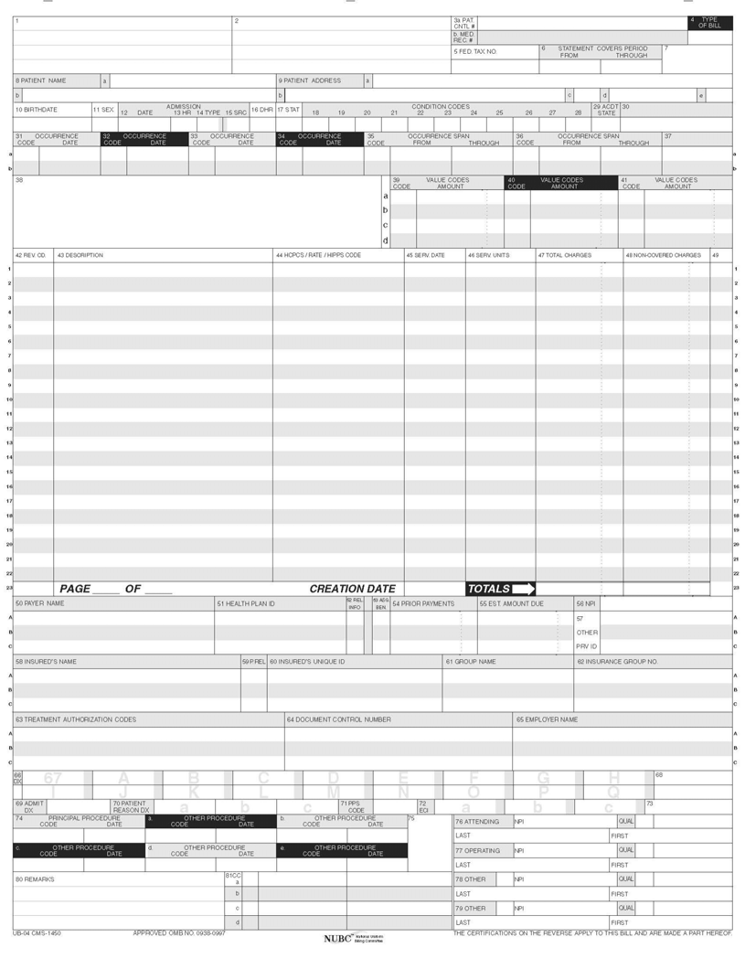
UB-04 Claim Form

Slide 10
Who Reports Data to TDH?
Acute Care hospitals
Psychiatric hospitals - licensed by TDH
Rehabilitation
Specialty hospitals
Mental Health hospitals – licensed by Tennessee Department of Mental Health Services
We do not receive data from the Veterans Administration (VA), but they have reported voluntarily in the past.

Slide 11
Tennessee Acute Care Hospitals by County – 2018

Slide 12
Questions?

