Slide 1
Submitting HDDS Data Requests
10.20.2020

Slide 2
About Data Request
The Division of Population Health Assessment is responsible for collecting, analyzing, and sharing data to inform health policy and planning.
Thus, health reports, fact sheets, and visualizations (charts, graphs, maps, etc.) of data related to Tennesseans' health using HDDS data will generally be provided by this division.
Data may be provided in the form of aggregate data or record level data.

Slide 3
Finding the Data Request Webpage
Go to the Department of Health website at https://www.tn.gov/health.html
On the top ribbon, click “Statistical Data”
Scroll down to “To request data, documents, or analysis, please click below:” and click on “Submit a Data Request”.
Direct Website: https://www.tn.gov/health/health- program-areas/statistics.html

Slide 4
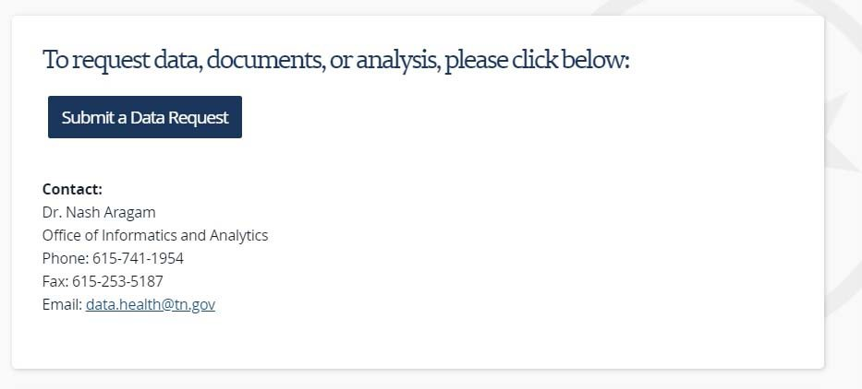
TDH Data Request Portal

Slide 5
How To Make A Data Request
Before making a request, please read the “Welcome Page” for information on what type of data is available in the datasets.
Enter contact information.
Enter purpose of request and specification of data (e.g. aggregate or record level data).
Select the available dataset (e.g. HDDS, PRAMS, etc.).
Acknowledge Data Release Agreement and sign request.

Slide 6
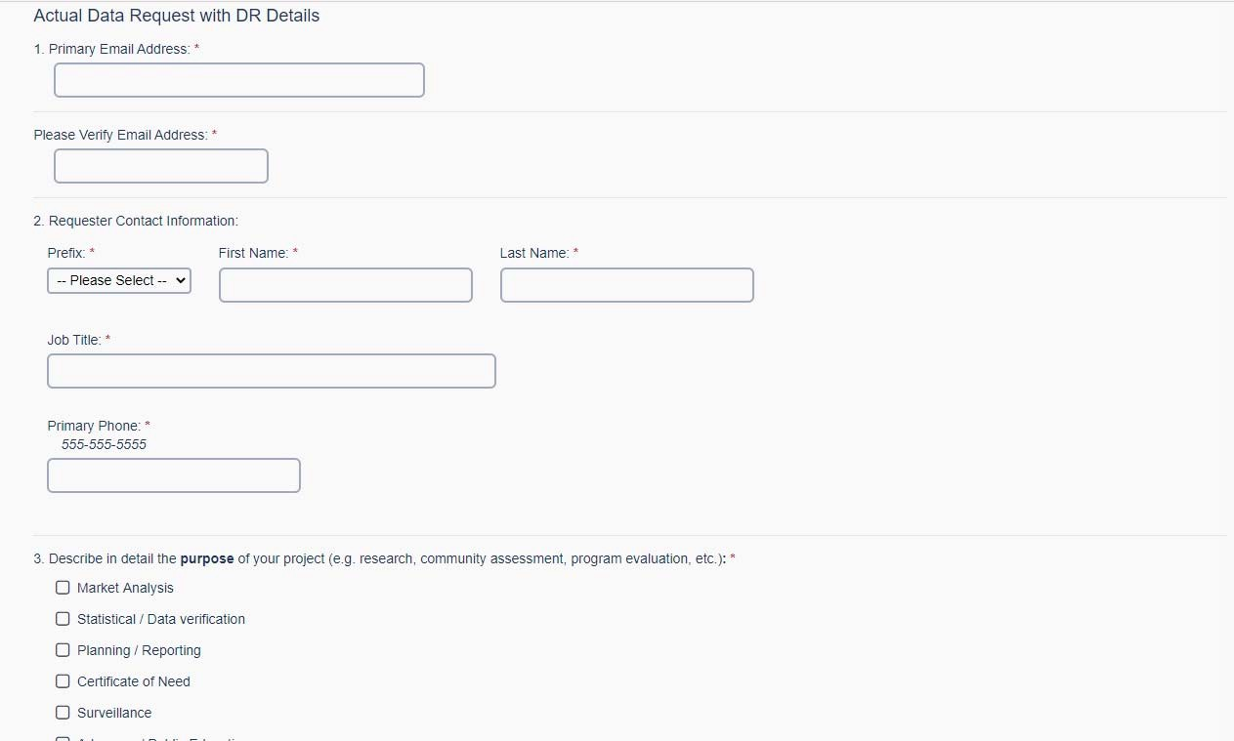
View of the Data Request Page

Slide 7
Response from TDH
After the request submission, TDH staff will contact the applicant for verification and with any questions about the request.
The data request is then assigned to program staff for completion.
Program staff may take up to 30 days to complete the request.
Once completed, staff will send the following:
PDF file of the original request
Request results
Fulfillment letter

Slide 8
Questions?

