Slide 1
Drug Overdose Deaths in Tennessee
2014-2018

Slide 2
Introduction
The following slides are a summary of Drug Overdose Deaths in Tennessee from Tennessee’s Annual Overdose Report for 2020. This report was produced by the Office of Informatics & Analytics (OIA) at the Tennessee Department of Health (TDH) and can be found on TDH’s Prescription Drug Overdose website. While these slides will specifically focus on the most recent findings for Drug Overdose Deaths in Tennessee, additional slides and the 2020 annual report itself will provide information on each the following:
Non-fatal drug overdose hospital discharges in Tennessee
Opioid, benzodiazepine and gabapentin prescription trends
Ongoing epidemiologic analyses
Our data-driven support of licensure and over-prescribing investigations
Dissemination of data at the county level
The statewide drug overdose reporting system for healthcare facilities
A summary of the Hal Rogers grant, which provides key support for collaboration with mental health and law enforcement through data sharing
Indicators that are currently being traced in an ongoing way through the integrated data system
The development, specifications, and purpose of the integrated data system
Partnership with the Opioid Response Coordinating Office (ORCO) to further enhance surveillance for both nonfatal and fatal overdoses

Slide 3
A Note from the Executive Summary
Tennessee continues to face a severe opioid crisis.
From 2014 to 2018:
The rates of all drug overdose deaths increased, regardless of race and sex
The rate of opioid overdose deaths also increased to an age-adjusted rate of 27.4 per 100,000 residents
The number of heroin overdose deaths increased nearly 250%
The number of overdose deaths involving fentanyl (largely due to illicitly manufactured fentanyl), increased over 1075%
Opioid and benzodiazepine deaths, while remaining high, decreased for the second consecutive year
This report provides key epidemiologic data on risk measures and trends to understand and respond to the opioid epidemic in TN. Specifically, these slides will focus on Drug Overdose Deaths in Tennessee from 2014-2018 and highlight these epidemiologic data trends:
Opioid overdose deaths continue to increase in TN through 2018, and most involve more than one contributing drug
Drug overdose deaths due to illicit opioids are continuing to increase

Slide 4
Mortality Data Collection
Tennessee Department of Health Death Statistics Files
The primary source of finalized statewide mortality data in Tennessee
Contains death certificate information for all individuals who have died in the state of Tennessee and TN residents who died out of state
The causes of death are approved by county medical examiners and standardized by the CDC’s National Center for Health Statistics (NCHS) using ICD-10 codes
These ICD-10 codes classify drug overdose deaths as poisonings and provide information on intent and contributing substances
Limitations of the NCHS coding is lack of ICD-10 T codes specific for drug types that are important to monitor for public health surveillance
The OIA in collaboration with the Office of the State Chief Medical Examiner (OSCME) has developed methods for scanning and summarizing the text fields on the death certificate that compromise the cause of death in order to address limitations of the current NCHS coding. In addition, OIA is working with the OSCME to go beyond death certificate data to incorporate information from the medical examiners’ death reports to enhance drug overdose death surveillance¹.
¹For additional information please reference the Drug Overdose Deaths in Tennessee section of Tennessee’s Annual Overdose Report for 2020.

Slide 5
All Drug Overdose Deaths in Tennessee

Slide 6
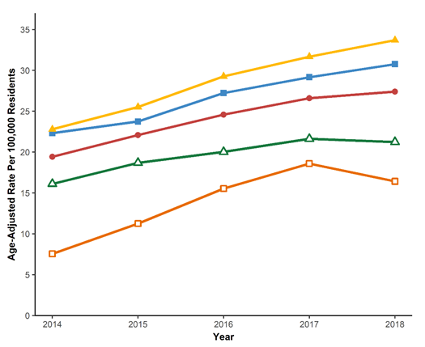
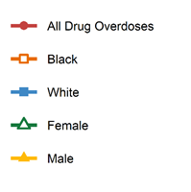
All Drug Overdose Deaths
Age-Adjusted Rates for All Drug Overdose Deaths by Sex and Race in TN by Year for 2014-2018*
*Analysis by the Office of Informatics and Analytics, TDH (last updated November 26, 2019). Limited to TN residents. Data Source: TN Death Statistical File

Slide 7
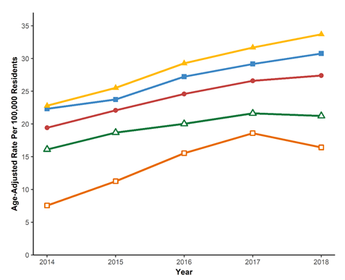
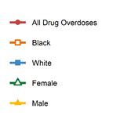
All Drug Overdose Deaths
Age-Adjusted Rates for All Drug Overdose Deaths by Sex and Race in TN by Year for 2014-2018*
Age-adjusted rates for all drug overdose deaths continued to increase from 1,263 (2014) to 1,818 (2018)
Age-adjusted rates increased for both males as well as Whites
*Analysis by the Office of Informatics and Analytics, TDH (last updated November 26, 2019). Limited to TN residents. Data Source: TN Death Statistical File

Slide 8
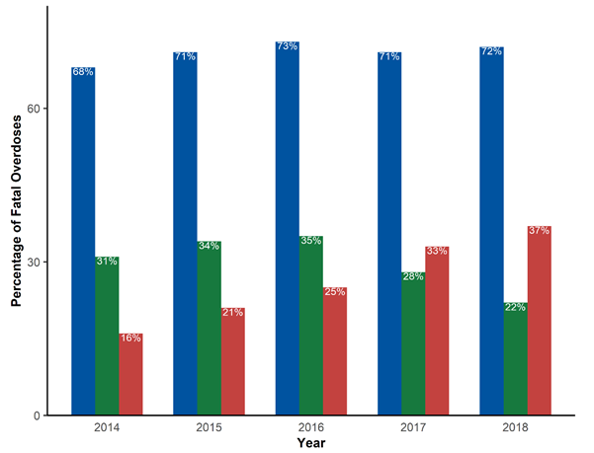
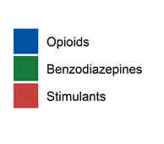
All Drug Overdose Deaths
Opioids, Benzodiazepines, and Stimulants Present in All Drug Overdoses in TN by Year for 2014-2018*
**
**Major stimulants include cocaine and methamphetamines
*Analysis by the Office of Informatics and Analytics, TDH (last updated November 26, 2019). Limited to TN residents. Data Source: TN Death Statistical File. Categories in this graph are not mutually exclusive.

Slide 9
All Drug Overdose Deaths
Opioids, Benzodiazepines, and Stimulants Present in All Drug Overdoses in TN by Year for 2014-2018*
The percentage of all drug overdose deaths involving stimulants (e.g., cocaine and methamphetamines) increased steadily from 2014 to 2018
The percentage of all drug overdoses involving benzodiazepines increased until 2016, then has decreased in 2017 and 2018
*Analysis by the Office of Informatics and Analytics, TDH (last updated November 26, 2019). Limited to TN residents. Data Source: TN Death Statistical File. Categories in this graph are not mutually exclusive.

Slide 10
All Drug Overdose Deaths-Polydrug
Polydrug Overdose Deaths in TN by Year for 2014-2018*
Polydrug overdoses in Tennessee, 2014-2018
 | 2014 |  | 2015 |  | 2016 |  | 2017 |  | 2018
 | Yes | % | Yes | % | Yes | % | Yes | % | Yes | %
All Drugs | 432 | 34.2 | 569 | 39.2 | 699 | 42.9 | 725 | 40.8 | 721 | 39.7
Opioids | 428 | 49.7 | 560 | 54.2 | 681 | 57.4 | 706 | 55.7 | 699 | 53.6
Heroin | 71 | 48.3 | 118 | 57.6 | 156 | 60.0 | 179 | 57.6 | 191 | 52.0
Fentanyl | 29 | 42.0 | 90 | 53.3 | 170 | 57.8 | 285 | 57.0 | 376 | 50.7
Buprenorphine | 23 | 48.9 | 33 | 66.0 | 48 | 69.6 | 51 | 69.9 | 50 | 60.2
Benzodiazepines | 356 | 91.8 | 455 | 92.5 | 536 | 93.5 | 459 | 91.1 | 369 | 90.2
Other Stimulants | 50 | 68.5 | 69 | 61.6 | 121 | 64.7 | 190 | 59.6 | 301 | 65.2
Cocaine | 88 | 65.7 | 130 | 64.0 | 163 | 65.2 | 208 | 68.0 | 182 | 72.5
*Analysis by the Office of Informatics and Analytics, TDH (last updated February 4, 2020). Limited to TN residents. Data Source: TN Death Statistical File. Categories in this graph are not mutually exclusive.

Slide 11
All Drug Overdose Deaths-Polydrug
Polydrug Overdose Deaths in TN by Year for 2014-2018*
Polydrug overdoses in Tennessee, 2014-2018
 | 2014 |  | 2015 |  | 2016 |  | 2017 |  | 2018
 | Yes | % | Yes | % | Yes | % | Yes | % | Yes | %
All Drugs | 432 | 34.2 | 569 | 39.2 | 699 | 42.9 | 725 | 40.8 | 721 | 39.7
Opioids | 428 | 49.7 | 560 | 54.2 | 681 | 57.4 | 706 | 55.7 | 699 | 53.6
Heroin | 71 | 48.3 | 118 | 57.6 | 156 | 60.0 | 179 | 57.6 | 191 | 52.0
Fentanyl | 29 | 42.0 | 90 | 53.3 | 170 | 57.8 | 285 | 57.0 | 376 | 50.7
Buprenorphine | 23 | 48.9 | 33 | 66.0 | 48 | 69.6 | 51 | 69.9 | 50 | 60.2
Benzodiazepines | 356 | 91.8 | 455 | 92.5 | 536 | 93.5 | 459 | 91.1 | 369 | 90.2
Other Stimulants | 50 | 68.5 | 69 | 61.6 | 121 | 64.7 | 190 | 59.6 | 301 | 65.2
Cocaine | 88 | 65.7 | 130 | 64.0 | 163 | 65.2 | 208 | 68.0 | 182 | 72.5
The percentage of all drug overdoses that included more than one drug increased from 34.2% in 2014 to 39.7% in 2018
*Analysis by the Office of Informatics and Analytics, TDH (last updated February 4, 2020). Limited to TN residents. Data Source: TN Death Statistical File. Categories in this graph are not mutually exclusive.

Slide 12
Opioid-Related Drug Overdoses in Tennessee

Slide 13
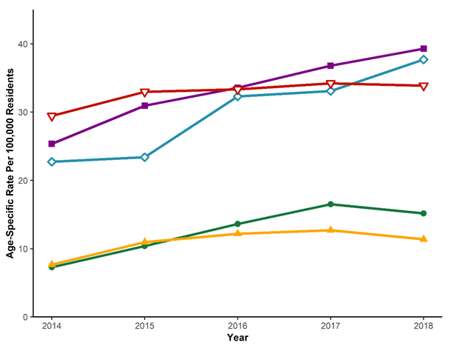
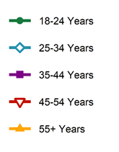
Opioid-Related Drug Overdose Deaths
Age-Specific Rates for Opioid Overdose Deaths in TN by Year for 2014-2018*
*Analysis conducted by the Office of Informatics and Analytics, TDH (last updated November 27, 2019). Limited to TN residents ≥ 18 years. Table excludes deaths for individuals younger than 18 year of age as rates were considered unreliable and not calculated. Data Source: TN Death Statistical File.

Slide 14
Opioid-Related Drug Overdose Deaths
Age-Specific Rates for Opioid Overdose Deaths in TN
by Year for 2014-2018*
Persons aged 25-34 years and 35-44 years consistently had the highest rates of death from 2014 to 2018.
The age-specific rates for age group 25-34 years increased substantially from 2014 to 2018, overtaking the 45-54 year age group in 2018
*Analysis conducted by the Office of Informatics and Analytics, TDH (last updated November 27, 2019). Limited to TN residents ≥ 18 years. Table excludes deaths for individuals younger than 18 year of age as rates were considered unreliable and not calculated. Data Source: TN Death Statistical File.

Slide 15
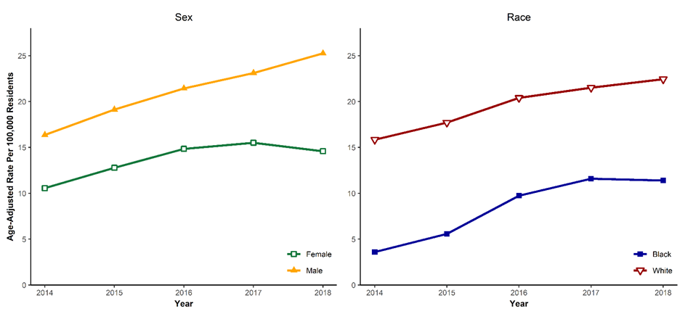
Opioid-Related Drug Overdose Deaths
Age-Adjusted Rates of All Opioid Overdose Deaths by Race and Sex in TN
by Year for 2014-2018*
*Analysis conducted by the Office of Informatics and Analytics, TDH (last updated November 26, 2019). Limited to TN residents. Limited to Black and White TN residents for analyses by race. Data Source: TN Death Statistical File.

Slide 16
Opioid-Related Drug Overdose Deaths
Age-Adjusted Rates of All Opioid Overdose Deaths by Race and Sex in TN
by Year for 2014-2018*
While both male and female age-adjusted rates increased until 2017, in 2018 males had higher rates of opioid-related overdose deaths compared to females
Rates for opioid-related overdose deaths for Whites have been consistently higher since 2014
*Analysis conducted by the Office of Informatics and Analytics, TDH (last updated November 26, 2019). Limited to TN residents. Limited to Black and White TN residents for analyses by race. Data Source: TN Death Statistical File.

Slide 17
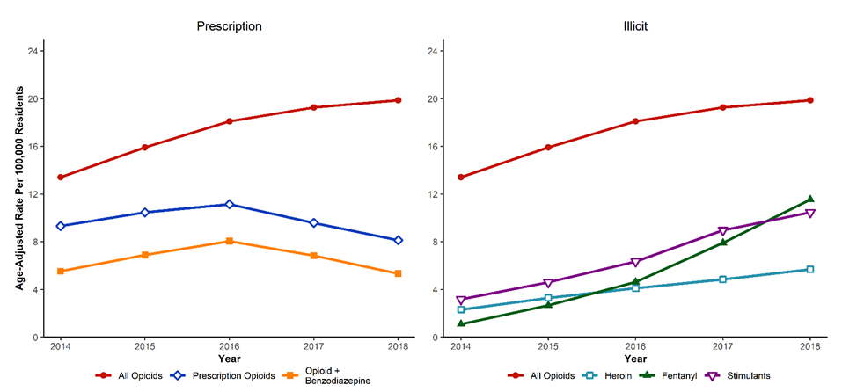
Opioid-Related Drug Overdose Deaths
Age-Adjusted Rates for Opioid Overdose Deaths in TN by Year for 2014-2018*
*Analysis conducted by the Office of Informatics and Analytics, TDH (last updated November 26, 2019). Limited to TN residents. Data Source: TN Death Statistical File

Slide 18
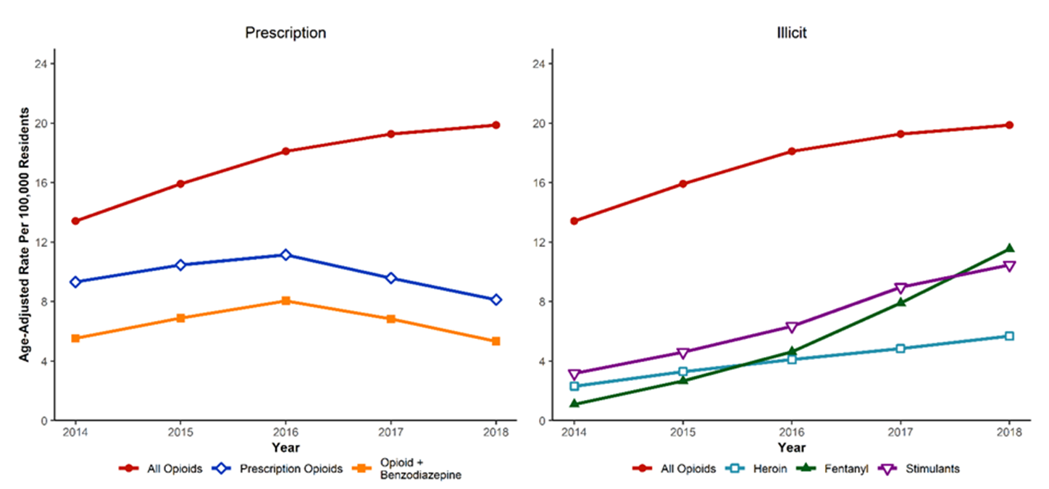
Opioid-Related Drug Overdose Deaths
Age-Adjusted Rates for Opioid Overdose Deaths in TN by Year for 2014-2018*
Age-adjusted rates for deaths due to prescription opioids continued the downward trend in 2018, as did age-adjusted rates for deaths due to combined opioid and benzodiazepine use
Increases in age-adjusted rates for illicit opioid-related overdose deaths including heroin, fentanyl, and stimulants were observed from 2014-2018
*Analysis conducted by the Office of Informatics and Analytics, TDH (last updated November 26, 2019). Limited to TN residents. Data Source: TN Death Statistical File

Slide 19
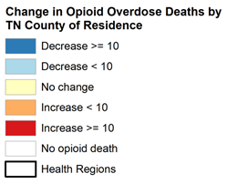
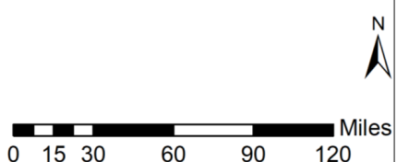
Opioid-Related Drug Overdose Deaths
Change in Number of Opioid Overdose Deaths by TN County of Residence for 2017-2018*
*Data Source: Tennessee Department of Health, Death Statistical File. Analysis conducted by the Office of Informatics and Analytics. Updated on November 26, 2019.

Slide 20
Opioid-Related Drug Overdose Deaths
Change in Number of Opioid Overdose Deaths by TN County of Residence for 2017-2018*
Thirty-nine counties reported an increase in the number of opioid overdose deaths
Eighteen counties reported no change in the number of opioid deaths
Thirty-seven counties reported a decrease in the number of opioid overdose deaths
*Data Source: Tennessee Department of Health, Death Statistical File. Analysis conducted by the Office of Informatics and Analytics. Updated on November 26, 2019.

Slide 21
Prescription Opioid Overdose Deaths in Tennessee

Slide 22
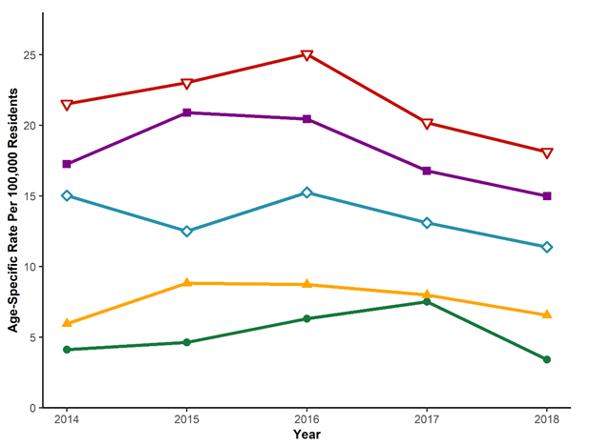
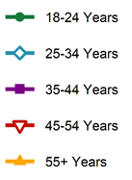
Opioid-Related Drug Overdose Deaths
Age-Specific Rates of Prescription Opioid Overdose Deaths in TN
by Year for 2014-2018*
*Analysis conducted by the Office of Informatics and Analytics, TDH (last updated November 27, 2019). Limited to TN residents ≥ 18 years. Data Source: TN Death Statistical File.

Slide 23
Opioid-Related Drug Overdose Deaths
Age-Specific Rates of Prescription Opioid Overdose Deaths in TN
by Year for 2014-2018*
The age-specific rates for prescription opioid overdose deaths for all age-groups decreased from 2017 to 2018
The age-group 18-24 years experienced the sharpest decrease in prescription opioid overdose deaths from 2017 to 2018
*Analysis conducted by the Office of Informatics and Analytics, TDH (last updated November 27, 2019). Limited to TN residents ≥ 18 years. Data Source: TN Death Statistical File.

Slide 24
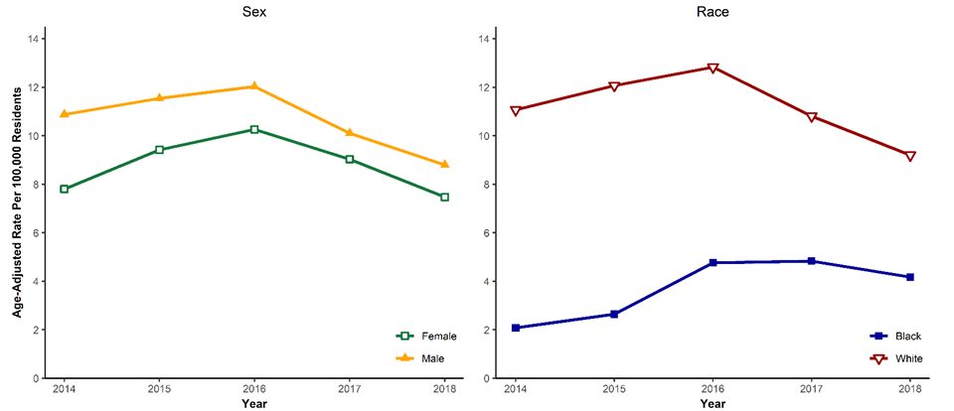
Opioid-Related Drug Overdose Deaths
Age-Adjusted Rates of Prescription Opioid Overdose Deaths by Race and Sex in TN by Year for 2014-2018*
*Analysis conducted by the Office of Informatics and Analytics, TDH (last updated November 26, 2019). Limited to TN residents. Limited to Black and White TN residents for analyses by race. Data Source: TN Death Statistical File.

Slide 25
Opioid-Related Drug Overdose Deaths
Age-Adjusted Rates of Prescription Opioid Overdose Deaths by Race and Sex in TN by Year for 2014-2018*
Both males and females experienced similar trends with increasing prescription opioid overdose deaths from 2014 to 2016, and a decrease from 2016 to 2018
Whites had higher prescription opioid overdose death rates than Blacks , however, while rates decreased for Whites from 2016 to 2018, rates did not decrease for Blacks during that same time period
*Analysis conducted by the Office of Informatics and Analytics, TDH (last updated November 26, 2019). Limited to TN residents. Limited to Black and White TN residents for analyses by race. Data Source: TN Death Statistical File.

Slide 26
Illicit Opioid Overdose Deaths in Tennessee

Slide 27
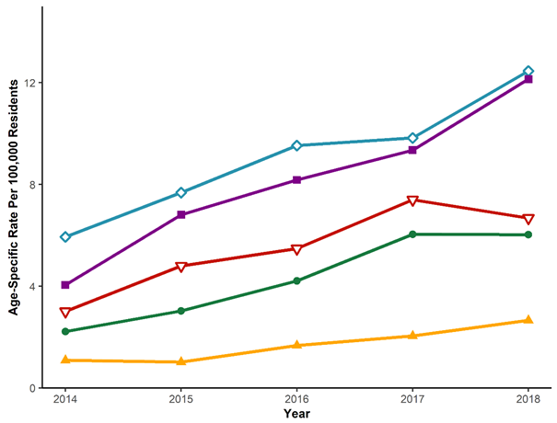
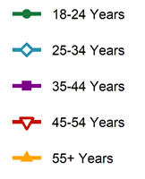
Opioid-Related Drug Overdose Deaths
Age-Specific Rates of Heroin Overdose Deaths in TN by Year for 2014-2018*
*Analysis conducted by the Office of Informatics and Analytics, TDH (last updated November 27, 2019). Limited to TN residents ≥ 18 years. Data Source: TN Death Statistical File.

Slide 28
Opioid-Related Drug Overdose Deaths
Age-Specific Rates of Heroin Overdose Deaths in TN
by Year for 2014-2018
An increasing trend in rates of heroin overdose deaths was observed for all age groups, except 45-54 years where a decrease was seen in 2018
The age group 25-34 years had the highest rates of heroin overdose deaths
*Analysis conducted by the Office of Informatics and Analytics, TDH (last updated November 27, 2019). Limited to TN residents ≥ 18 years. Data Source: TN Death Statistical File.

Slide 29
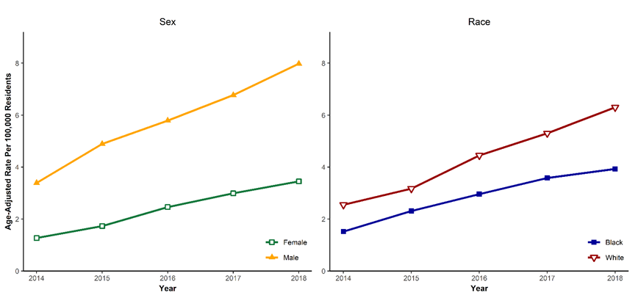
Opioid-Related Drug Overdose Deaths
Age-Adjusted Rates of Heroin Overdose Deaths by Race and Sex in TN by Year for 2014-2018*
*Analysis conducted by the Office of Informatics and Analytics, TDH (last updated November 26, 2019). Limited to TN residents. Limited to Black and White TN residents for analyses by race. Data Source: TN Death Statistical File.

Slide 30
Opioid-Related Drug Overdose Deaths
Age-Adjusted Rates of Heroin Overdose Deaths by Race and Sex in TN by Year for 2014-2018*
Males had higher age-adjusted rates for heroin overdose deaths compared to females, with an increasing trend more apparent among males than females
Whites had higher age-adjusted rates for heroin deaths compared to Blacks
*Analysis conducted by the Office of Informatics and Analytics, TDH (last updated November 26, 2019). Limited to TN residents. Limited to Black and White TN residents for analyses by race. Data Source: TN Death Statistical File.

Slide 31
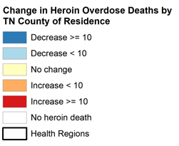
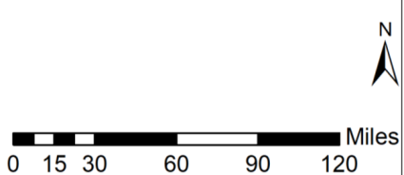
Opioid-Related Drug Overdose Deaths
Change in Number of Heroin Overdose Deaths by TN County of Residence for 2017-2018*
*Data Source: Tennessee Department of Health, Death Statistical File. Analysis conducted by the Office of Informatics and Analytics. Updated on November 26, 2019.

Slide 32
Opioid-Related Drug Overdose Deaths
Change in Number of Heroin Overdose Deaths by TN County of Residence for 2017-2018*
Thirty-one counties in TN reported an increase of heroin overdose deaths from 2016 to 2017
Twenty-five counties reported a decrease in the number of heroin deaths
Three counties reported no change in heroin overdose deaths
*Data Source: Tennessee Department of Health, Death Statistical File. Analysis conducted by the Office of Informatics and Analytics. Updated on November 26, 2019.

Slide 33
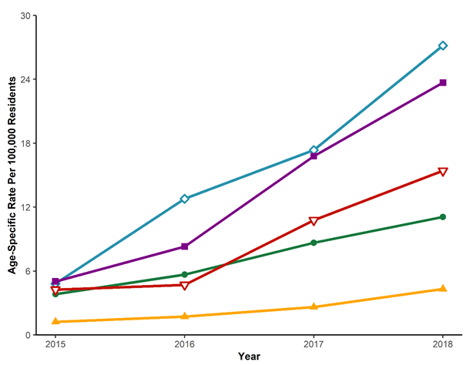
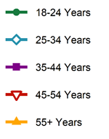
Opioid-Related Drug Overdose Deaths
Age-Specific Rates of Fentanyl Overdose Deaths in TN by Year for 2015-2018*
*Analysis conducted by the Office of Informatics and Analytics, TDH (last updated November 27, 2019). Limited to TN residents ≥ 18 years. Rates for counts <= 10 were considered unreliable and not calculated for 2014. Data Source: TN Death Statistical File.

Slide 34
Opioid-Related Drug Overdose Deaths
Age-Specific Rates of Fentanyl Overdose Deaths in TN
by Year for 2015-2018*
All age groups showed an increase in fentanyl overdose death rates between 2015 and 2018
Rates for fentanyl overdose deaths were highest for individuals aged 25-34 years
*Analysis conducted by the Office of Informatics and Analytics, TDH (last updated November 27, 2019). Limited to TN residents ≥ 18 years. Rates for counts <= 10 were considered unreliable and not calculated for 2014. Data Source: TN Death Statistical File.

Slide 35
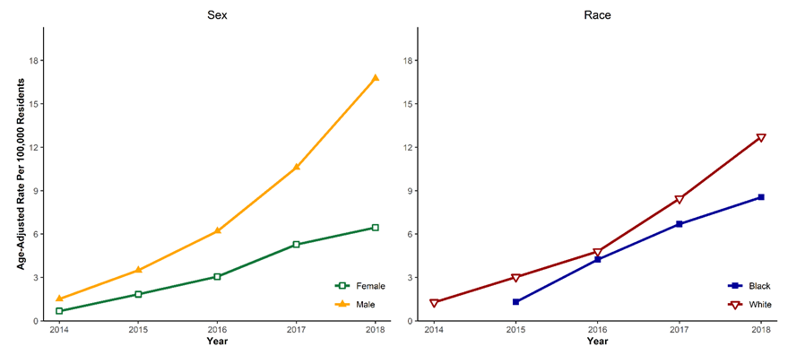
Opioid-Related Drug Overdose Deaths
Age-Adjusted Rates of Fentanyl Deaths by Race and Sex in TN by Year for 2014-2018*
*Analysis conducted by the Office of Informatics and Analytics, TDH (last updated November 26, 2019). Limited to TN residents. Limited to Black and White TN residents for analyses by race. Data Source: TN Death Statistical File. Rates for counts <=10 were considered unreliable and not calculated for 2014.

Slide 36
Opioid-Related Drug Overdose Deaths
Age-Adjusted Rates of Fentanyl Deaths by Race and Sex in TN by Year for 2014-2018*
Increasing age-adjusted rates for fentanyl overdose deaths were seen among both males and females from 2014 to 2018, with males having higher rates for fentanyl overdose deaths compared to females
Age-adjusted rates for fentanyl overdose deaths for Whites were higher than Blacks, with overdose rates increasing in both race groups through 2018
*Analysis conducted by the Office of Informatics and Analytics, TDH (last updated November 26, 2019). Limited to TN residents. Limited to Black and White TN residents for analyses by race. Data Source: TN Death Statistical File. Rates for counts <=10 were considered unreliable and not calculated for 2014.

Slide 37
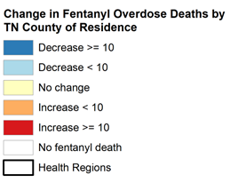
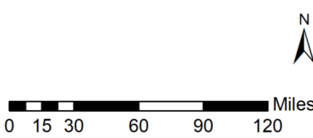
Opioid-Related Drug Overdose Deaths
Change in Number of Fentanyl Overdose Deaths by TN County of Residence for 2017-2018*
*Data Source: Tennessee Department of Health, Death Statistical File. Analysis conducted by the Office of Informatics and Analytics. Updated on November 26, 2019.

Slide 38
Opioid-Related Drug Overdose Deaths
Change in Number of Fentanyl Overdose Deaths by TN County of Residence for 2017-2018*
Forty-seven counties had an increase in fentanyl overdose deaths from 2017 to 2018
Twenty-three counties reported a decrease in fentanyl overdose deaths
Seven counties reported no change in fentanyl overdose deaths from 2017 to 2018
*Data Source: Tennessee Department of Health, Death Statistical File. Analysis conducted by the Office of Informatics and Analytics. Updated on November 26, 2019.

Slide 39
Stimulant-Related Overdose Deaths in Tennessee

Slide 40
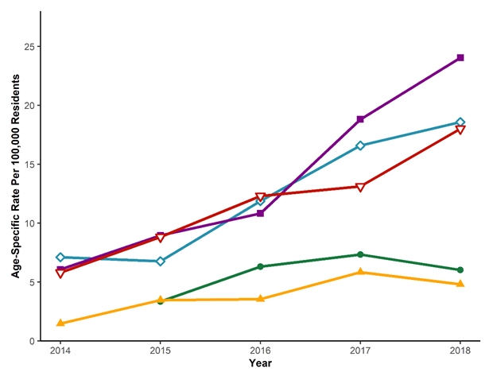
Stimulant-Related Overdose Deaths
Age-Specific Rates for Stimulant Overdose Deaths in TN by Year for 2014-2018*
*Analysis conducted by the Office of Informatics and Analytics, TDH (last updated November 27, 2019). Limited to TN residents ≥ 18 years. Table excludes deaths for individuals younger than 18 year of age as rates were considered unreliable and not calculated. Data Source: TN Death Statistical File.

Slide 41
Stimulant-Related Overdose Deaths
Age-Specific Rates for Stimulant Overdose Deaths in TN
by Year for 2014-2018*
Persons aged 35-44 years had the highest rates of death from 2014 to 2018, with a rapid increase from 2016-2018.
Both the youngest (18-24 years) and oldest (55 + years) age groups showed a decline in 2018
*Analysis conducted by the Office of Informatics and Analytics, TDH (last updated November 27, 2019). Limited to TN residents ≥ 18 years. Table excludes deaths for individuals younger than 18 year of age as rates were considered unreliable and not calculated. Data Source: TN Death Statistical File.

Slide 42
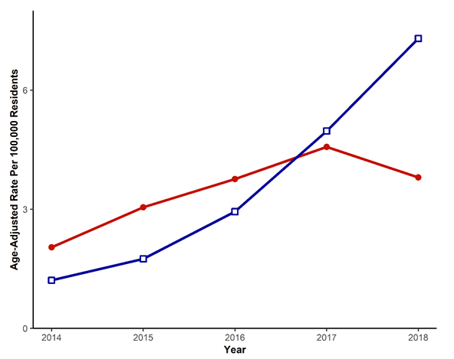
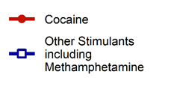
Stimulant-Related Overdose Deaths
Age-Adjusted Rates for Stimulant Overdose Deaths in TN
by Year for 2014-2018*
*Analysis conducted by the Office of Informatics and Analytics, TDH (last updated November 26, 2019). Limited to TN residents. Data Source: TN Death Statistical File.

Slide 43
Stimulant-Related Overdose Deaths
Age-Adjusted Rates for Stimulant Overdose Deaths in TN
by Year for 2014-2018*
The rate of age-adjusted cocaine overdose deaths increased from 2014 to 2017, with a decrease in 2018
The age-adjusted rates of other stimulant deaths sharply increased from 2014 to 2018
*Analysis conducted by the Office of Informatics and Analytics, TDH (last updated November 26, 2019). Limited to TN residents. Data Source: TN Death Statistical File.

Slide 44
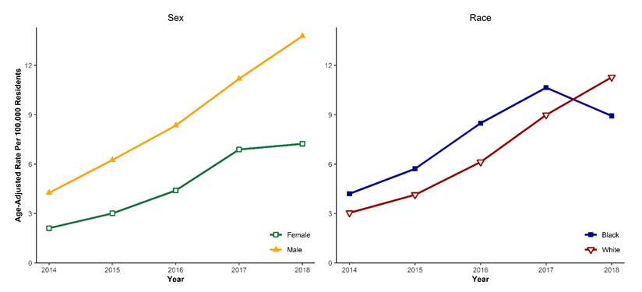
Stimulant-Related Overdose Deaths
Age-Adjusted Rates of Stimulant Deaths by Race and Sex in TN by Year for 2014-2018*
*Analysis conducted by the Office of Informatics and Analytics, TDH (last updated November 26, 2019). Limited to TN residents. Limited to Black and White TN residents for analyses by race. Data Source: TN Death Statistical File.

Slide 45
Stimulant-Related Overdose Deaths
Age-Adjusted Rates of Stimulant Deaths by Race and Sex in TN by Year for 2014-2018*
Age-adjusted rates for stimulant overdose deaths were higher in males compared to females between 2014-2018
Age-adjusted rates for stimulant overdose deaths for Blacks were higher than Whites from 2014 to 2017, with a decrease in 2018
*Analysis conducted by the Office of Informatics and Analytics, TDH (last updated November 26, 2019). Limited to TN residents. Limited to Black and White TN residents for analyses by race. Data Source: TN Death Statistical File.

Slide 46
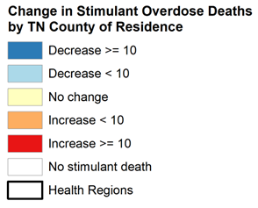
Stimulant-Related Overdose Deaths
Change in Number of Stimulant Overdose Deaths by TN County of Residence for 2017-2018*
*Data Source: Tennessee Department of Health, Death Statistical File. Analysis conducted by the Office of Informatics and Analytics. Updated on November 26, 2019.

Slide 47
Stimulant-Related Overdose Deaths
Change in Number of Stimulant Overdose Deaths by TN County of Residence for 2017-2018*
Forty-six counties had an increase in stimulant overdose deaths from 2017 to 2018
Thirty counties reported a decrease in stimulant overdose deaths from 2018-2018
Fourteen counties reported no change in stimulant overdose deaths from 2017 to 2018
*Data Source: Tennessee Department of Health, Death Statistical File. Analysis conducted by the Office of Informatics and Analytics. Updated on November 26, 2019.

Slide 48
Additional Information and Resources
A series of updated communication tools are available, including a website, a catalogue of slide sets, and a data dashboard. These tools were developed based on our tagline, “Numbers count. Every number is a story. Every story is a person.” and the philosophy that the role of this group is to reunite communities with their own data. Links to those tools can be found below:
Tennessee (TN) Together: Community Solutions to End the Opioid Epidemic
Tennessee Drug Overdose Dashboard
Prescription Drug Overdose Website
County Data Briefs
Resources on:
Laws and Policy
Coalitions
Naloxone Training
Drug Take Back Locations
Keeping Youth Off Drugs and Alcohol
Patients
Providers
Treatment and Recovery Services –TN REDLINE
These slides only provide selected data and measures for summary purposes. Additional data are available on the TN Drug Overdose Data Dashboard or by request (email: Prescription.Drugs@tn.gov) with most available measures listed in Appendix A of the 2020 Tennessee Annual Overdose Report.

Slide 49
These analyses were conducted by the Office of Informatics and Analytics, Tennessee Department of Health

