Slide 1
Thanks for joining us!
Please sign-in using the chat box:
Example: Luvetta Abdullah, OK
Notes:
Welcome, the meeting will begin shortly.

Slide 2
Today’s Agenda
Meeting Purpose Statement
Georgia’s POLST Collaborative
Questions
COVID-19
Future Topics
Save the Dates
Wrap-up
Materials are online at
CMP.health.ok.gov Navigate on the left panel to “National CMP Reinvestment Network”
Also available on tn.gov/health
Search for “Civil Monetary Penalty” and select Nursing Home Civil Monetary Penalty (CMP) Quality Improvement Program. Select “National CMP Reinvestment Network”
Notes:
Physician Orders for Life-Sustaining Treatment

Slide 3
Our Purpose
A national network to share experiences, challenges, and successes with the reinvestment of CMP funds to improve care in nursing homes.
Notes:
We are a national network created to share our experiences, challenges, and successes with managing CMP funds and improving care for residents within nursing and skilled nursing facilities. Tennessee and Oklahoma (with your participation and feedback) work as a team to schedule and plan these webinars. My name is Luvetta Abdullah. I am Oklahoma’s CMP Program Manager. My co-host today is Shaquallah Shanks. She is the Director of Tennessee’s CMP Program. Shaquallah, would you like to say a few words?

Slide 4
Lindsay P. Prizer, PhD, MSW, LCSW
Executive Director
Notes:
Our speaker today is Lindsay Prizer. She received her Bachelors in Social Work at Georgia State University and her Masters of Social Work at the University of North Carolina at Chapel Hill. She earned her PhD in Public Health, focusing on Health Promotion and Behavior at The University of Georgia. In addition to being a clinically licensed social worker, she is currently an Assistant Professor at Emory University and the Executive Director of the Georgia POLST Collaborative. Lindsay, we appreciate you for joining us today.

Slide 5
The Georgia POLST Collaborative
Financial Disclosure
This presenter has no financial interests or relationships to disclose.

Slide 6
Objectives
At the end of the course, participants should have an understanding of:
The background of the Georgia POLST Collaborative
How our program delivery through our funded projects
The difference between traditional advance directives and the POLST document

Slide 7
History of the Georgia POLST Collaborative
2010: Collaborative was established
2013: Partnered with Alliant QIO on a Special Innovation Project
2017: Became a 501(c)(3)
2018: Hired our first part time Executive Director
2019: Awarded a HRSA Sub-contract with Emory’s GWEP program
2019: Awarded a pilot research grant from Retirement Research Foundation

Slide 8
Georgia POLST Collaborative
• 40+ statewide organizations
• Part of a national movement to promote POLST
• Georgia POLST is endorsed by the National POLST Paradigm Taskforce
• Vision: All Georgians will have their health care preferences known and honored
Notes:
We invite you to join the Georgia POLST Collaborative and help promote the use of POLST across the state.

Slide 9
Georgia POLST Collaborative (cont’d)
• Mission: To improve health care at the end-of-life through
– Promoting the utilization of the Physician Orders for Life Sustaining Treatment form by health care professionals and institutions across the state
- Educate professionals throughout Georgia in monthly presentations (2019-2024)
– Educating Georgians about advance care planning and the role of POLST in having their wishes honored
- Assess the effectiveness of a group advance care planning guide compared to traditional support group exposure (2020)
HRSA Project
RRF Project
Notes:
We invite you to join the Georgia POLST Collaborative and help promote the use of POLST across the state.

Slide 10
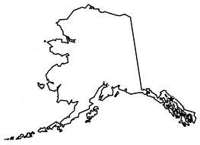
National POLST Paradigm Programs
www.polst.org
*As of January 2016
Mature Programs
Endorsed Programs
Regionally Endorsed Program
Developing Programs
Programs That Do Not Conform to POLST Requirements
No Program (Contacts)

Slide 11
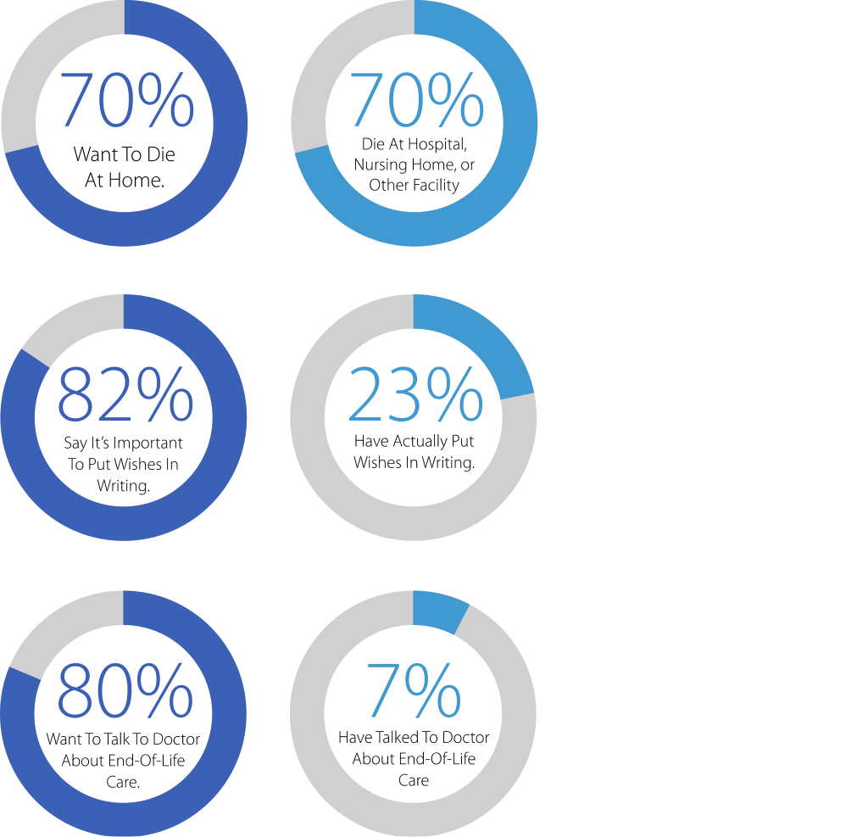
One Conversation Can Make All The Difference.
• 70% of people say they prefer to die at home yet
• 70% die in a hospital, nursing home, or long-term-care facility. (Centers for Disease Control, 2005)
• 82% of people say it’s important to put their wishes in writing ; 23% have actually done it. (Survey of Californians by the California HealthCare Foundation, 2012)
• 80% of people say that if seriously ill, they would want to talk to their doctor about end-of-life care; 7% report having had an end-of-life conversation with their doctor. (Survey of Californians by the California HealthCare Foundation, 2012)

Slide 12
Georgia Advance Directive for Health Care
In 2007, Georgia Law combined all three advance care planning tools into one document: • Power of Attorney: health care agent • Living Will: Stating treatment preferences
Also includes: • Authorizing organ donation, autopsy, burial
Legal with: • Patient signature & 2 witnesses
https://aging.georgia.gov/sites/aging.georgia.gov/files/related_files/service/GEORGIA_ADVANCE_DIRECTIVE_FOR_HEALTH_CARE-10.pdf
Notes:
July 1st 2007: The GA Advance Directive for Health Care Act replaced the GA Living Will as the new Chapter 32 of Title 31 of the official code of GA. Chapter 36 of Title 31 of the official code of GA creating the durable power of attorney for healthcare was repeled and that chapter reserved, meaning that for now, no law will be found in Chapter 36, but the space and number will be reserved for future use. The Living Will and Durable Power of Attorney for Health Care will no longer be available as options for advance directives in GA. Validly executed Living Wills created between March 28, 1986 and June 30th 2007 remain valid until revoked. Validly created DPOA created before June 30th 2007 remain valid until revoked.
Issues with living wills are that
They don’t normally transfer WITH the patient, so not all providers will have access to it
They require a ‘loud’ advocate to ensure that wishes are respected (ER depts will often go straight into life saving mode without asking for an advanced directive)
Many individuals don’t keep advance directives in accessible places (i.e. safety deposit box, etc)
They don’t legally mandate treatment, as they are not physician orders
POA – Must respect your actual wishes or they can make decisions with you that conflict with your personal goals of care

Slide 13
POLST: Physician Orders for Life Sustaining Treatment
• Medical order completed by a health care provider – Requires signatures by the patient or patient’s authorized representative AND a physician
• Activates a patient’s Advance directive
• Mechanism to communicate a patient’s wishes for their care at the end of their life
• Designed to travel from one care setting to another
• Must be honored by all health care professionals
Notes:
POLST can replace a DNR order, as it is more comprehensive and portable
If conflicting DNR and POLST orders, the most recently dated version will stand
If patient doesn’t have decision-making capacity and no authorized representative is available, two physician signatures are needed
Georgia POLST only effective in Georgia

Slide 14
Difference Between Advance Directives and POLST
Advance Directive | POLST
For anyone over 18 | For seriously ill/frail at any age
Completed by an individual | Completed by a physician and patient or authorized patient representative
General instructions for future treatment | Specific orders for current treatment
Signed by individual and two witnesses (neither an attorney nor notary is needed in GA) | Signed by physician and patient or authorized patient representative
Notes:
I use the explanation of what happens when 911 is called and EMS arrives. EMS cannot follow an advance directive. A POLST however, they can.

Slide 15
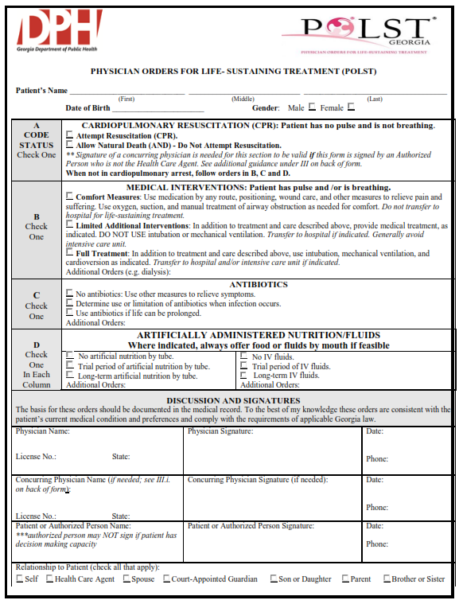
Georgia POLST Form
Five Sections
• Cardiopulmonary Resuscitation (CPR)
• Medical Interventions
• Antibiotics
• Artificially Administered Nutrition & Fluids
• Signatures

Slide 16
Why is this so important?
• When a patient and/or family has made a difficult decision and created a medical order to protect that wish, we must honor it!
• Wrongful life cases related to POLST are now appearing
-Paula Span. The Patients Were Saved. That’s Why the Families Are Suing. New York Times. APRIL 10, 2017. Accessed January 19, 2018: https://www.nytimes.com/2017/04/10/health/wrongful-life-lawsuit-dnr.html

Slide 17
Our Vision
STATE OF GEORGIA
HOSPITAL SYSTEMS
COMMUNITY SERVICE AREA
SNFs
LTC
Home Health
PHYSICIANS OFFICE
Assisted Living
Hospice
HOSPITAL SETTING
WITH ADVANCED
CARE PLAN

Slide 18
Additional Resources

Slide 19
Partner Organizations
• National POLST Organization
• Healthcare Ethics Consortium (Emory University)
• “Conversation Project”
• “Death Over Dinner”
• CAPC (Center to Advance Palliative Care)
Notes:
We invite you to join the Georgia POLST Collaborative and help promote the use of POLST across the state.

Slide 20
POLST Websites
http://www.gapolst.org
www.dph.ga.gov/POLST
http://polst.org
http://www.critical-conditions.org/
https://www.agingwithdignity.org/
http://capolst.org/
www.theconversationproject.org
www.deathoverdinner.org

Slide 21
References
CDC (2005). NCHS, National Vital Statistics System, Mortality. Accessed on Jan. 19, 2018 at: https://www.cdc.gov/nchs/data/dvs/Mortfinal2005_worktable_309.pdf
Survey of Californians by the California HealthCare Foundation. (2012). Final Chapter: Californians' Attitudes and Experiences with Death and Dying Accessed on Jan. 19, 2018 at: http://www.chcf.org/publications/2012/02/final-chapter-death-dying
Institute of Medicine. (2015). Dying in America: Improving Quality and Honoring Individual Preferences Near the
End of Life. Washington, DC: The National Academies Press. Accessed Jan. 19, 2018:
https://www.nap.edu/catalog/18748/dying-in-america-improving-quality-and-honoring-individualpreferences-near
Lisa Wade. (2013). How Do Physicians and Non-Physicians Want to Die? Accessed Jan. 19, 2018: http://thesocietypages.org/socimages/2013/12/31/how-do-physicians-and-non-physicians-want-to-die
Eric Fromme et al. Association Between Physician Orders for Life-Sustaining Treatment for Scope of Treatment and In-Hospital Death in Oregon. J Am Geriatr Soc 62:1246–1251, 2014
Louisiana Physician Orders for Scope of Treatment. n.d. Guide to Advance Care Planning. Accessed Jan. 19, 2018: http://www.polst.org/wp-content/uploads/2012/12/LaPOST-Guide-to-Advance-Care-Planning.pdf
GA Department of Human Resources. (2007). Georgia Advance Directive for Health Care. Accessed Jan. 19, 2018: https://aging.georgia.gov/sites/aging.georgia.gov/files/related_files/service/GEORGIA_ADVANCE_DIRECTIVE_FOR_HEALTH_CARE-10.pdf
West Virginia Center for End-of-Life Care. (2012). Using the POST Form: Guidance for Healthcare Professionals. Accessed Jan 19, 2018: http://www.polst.org/wp-content/uploads/2013/01/POST-Manual-2012-complete.pdf
Heerema, E. (2013). Antibiotic Use in Advanced Dementia. About.com Alzheimer’s/Dementia. Accessed Jan. 19, 2018: https://www.verywell.com/antibiotic-use-in-advanced-dementia-98209
Paula Span. The Patients Were Saved. That’s Why the Families Are Suing. New York Times. APRIL 10, 2017. Accessed January 19, 2018: https://www.nytimes.com/2017/04/10/health/wrongful-life-lawsuit-dnr.html
Coalition for Compassionate Care of California. (2011). Introducing the POLST. Access Jan. 19, 2018: https://www.youtube.com/watch?feature=player_embedded&v=FjUrI1NsM-M
American Geriatric Society Geriatric Review Syllabus Teaching Slide-set. Accessed Jan. 19, 2018: https://geriatricscareonline.org/ProductAbstract/grs-teaching-slides/S001/

Slide 22
Georgia Legal Foundations
• GA Advance Directive – Ga. AD Law - 2007 HB 24 – Ga. Dept. Of Human Resources (2007 HB 24 Rules And Regulations) – Ga. Code 31-39 DNR/AND & Cardiopulmonary Resuscitation Laws
• GA Physician Order For Life Sustaining Treatment (POLST)
– Ga. DPH, POLST Form, 2012 – SB 109 2015
Notes:
There are two basic documents that provide the legal basis for expressing and honoring end-of-life preferences. They are the Georgia Advance Directive for Health Care and the Physician Order for Life Sustaining Treatments or POLST.

Slide 23
SB109 (2015)
• Portable across care settings
• Review of form recommended at care transitions
• Immunity for all when followed in good faith
-Except if violates Code Section 16-5-5 (Assisted Suicide)
• Protections for treating pain
• Equates terms such as DNR=AND
• All conflicting laws are repealed
• Most recent document is valid one

Slide 24
POLST Implementation/Use in Hospital Setting
Medicare Conditions of Participation: Hospital orders may only be written by MD with staff privileges (this does not mean a POLST signed by a non-privileged physician should be ignored)
POLST Process when Patient Arrives at Hospital with POLST signed by non-privileged physician:
• Physician should review the document(s) and either
• Sign POLST form as the “Concurring Physician”
• Rewrite orders into hospital system
• Hospital policies should be written to govern this process
David W. Eddinger, RN, MPH
Captain US Public Health Service, Retired / Technical Director Hospital Survey and Certification
CMS/CCSQ/Survey & Certification Group/Division of Acute Care Services
Notes:
David Eddinger (officially on behalf of CMS) has stated that POLST should not be ignored. Although rules apply that an MD with staff privileges must be the final say on the order, this is easily done by either co-signing an appropriate POLST or using the POLST to guide hospital orders.
As per communication with Charlie Sabatino, Director, ABA Commision on Law and Aging, American Bar Association on Feb 9th 2015 with Dr. Richard Cohen of the GA POLST Collaborative: “CMS shows implicit acceptance of POLST in a variety of additional ways: The Hospice Item Set Manual, Guidance Manual for Completion of the Hospice Item Set (HIS) (July 24, 2014), recognizes POLST. CMS has funded research and demonstration projects such as Gundersen Lutheran Health System “Advanced Disease Coordination” project in which POLST is a prominent component. The resident Census and Conditions of Residents Form CMS-672 mentions POLST as one of the options to document under Advance Directives…even if one conceded that a non-credentialed signature on a POLST form was not binding on the hospital, the POLST form is essentially clear and convincing evidence of the patient’s wishes. Ignoring it without a substantial clinical justification would seem to put the hospital directly in the line of fire for battery and intentional failure to obtain informed consent. I don’t think the presumed consent doctrine for emergency care would apply at all in such a situation.”

Slide 25
Thank You
To learn more about how to become involved in POLST advocacy, please go to www.GAPOLST.org

Slide 26
Questions ?
The phones are unmuted for questions.
Notes:
Lindsay Prizer thank you very much for taking the time to speak today. You presentation was interesting, informative, and most of all, appreciated. Again, thank you!
The phones are unmuted for questions.
Deb and Alexandria, we will wrap up our meeting with a few announcements. Both of you are welcome to exit the meeting or stay with us.

Slide 27
COVID-19
How are CMP programs addressing COVID-19?
Are any programs utilizing their emergency funds in response?
If so, in what capacity and what CMS process had to be followed?
Have states received guidance on utilizing emergency fund from their regional CMS administrator?

Slide 28
Future Calls
What topic areas would you like to see discussed on future calls?

Slide 29
Save the Date
Future webinars:
Wednesday, June 17, 2020 – TBD
Wednesday, September 16, 2020 - TBD
Wednesday, December 16, 2020 - TBD
Time: 2:00 PM Central Standard Time (CST)
Notes:
Don’t forget to join us on these dates.

Slide 30
Wrap-Up
Materials will be available online at CMP.health.ok.gov within 48 hours. Send additional questions to:
CMP.health@tn.gov/health
CMP@health.ok.gov
Thanks for joining us and we appreciated your participation and feedback!
Notes:
If you think of any questions after we end this call, feel free to submit them to the e-mail addresses shown on your screen. Thank you everyone for your participation and feedback today.
Tennessee, please remain on the phone for a short meeting. Everyone else, until June 18th, farewell.

