Slide 1
E-Ticketing Requirements
Special Provision 109 ETAS
Construction Division and Materials & Tests Division

Slide 2
Requirements of SP109ETAS
Currently applied to interstate resurfacing projects
Provide an e-ticket in lieu of paper ticket
Must be automatically generated and integrated with the scales
Must contain all required information normally found on ticket
Including CPW Certification
Provide a shift summary for each continuous shift
Each ticket and shift summary must print to pdf for export on request.

Slide 3
Requirements of SP109ETAS
System must maintain data thru loss of signal
Data in the system must be secure
No possibility of tampering with data
Must be accessible to the Department at any time during the placement of the mixture
Inspector in the field shall have access while trucks are delivering thru smartphone app or website.
Automatically generate the time stamp when off loaded into the shuttle buggy

Slide 4
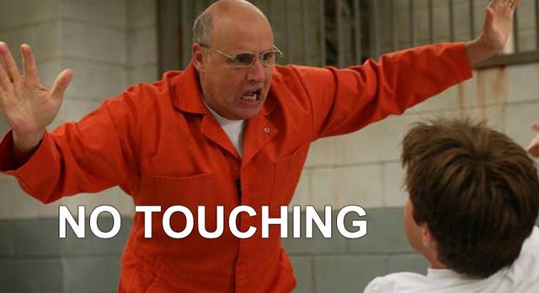
Automatically Generated?
Can the Driver push a button? No
Can the Paving Foreman push the button? No
Will the TDOT Inspector push a button? No

Slide 5
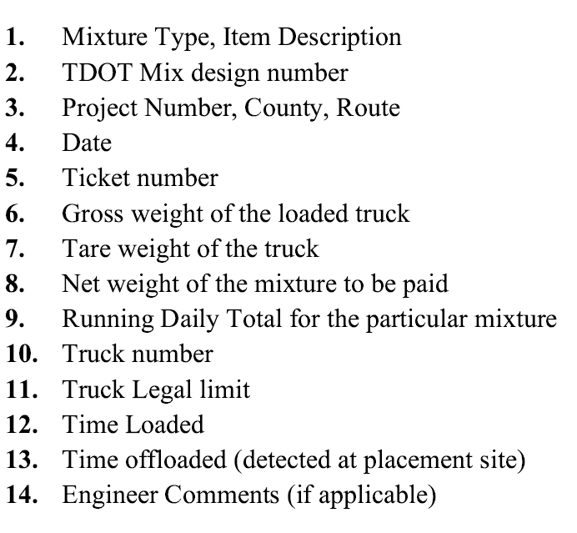
E-ticketing Software and 109ETAS Req’mts
Almost all e-ticketing programs can currently, or can be customized to provide:
Except…
?

Slide 6
FAQ about Automatic Delivery Stamps
So, who can automatically generate delivery time?
I hear only one company can do that, does TDOT want a monopoly?
TDOT E-ticketing Committee has been meeting with many e-ticketing software companies
We have developed a list of companies that have demonstrated the ability to meet all aspects of SP109ETAS, including the delivery stamp.

Slide 7
How to get on the list?
Any E-ticketing Company that is seeking to become Qualified for SP109ETAS should reach out to Jamie Waller or Matt Chandler to set up a demonstration meeting.
Jamie.Waller@tn.gov
Matthew.Chandler@tn.gov
The demonstration meeting will include reviewing the software’s capabilities and discussing how it will meet the automated delivery requirement.
Just because a contractor uses someone from the list does not mean it automatically meets the requirements.
Each E-ticketing Software entry on the list was qualified based on the ability of an options package to meet our requirements.
Contractors should ensure that all SP109ETAS requirements are being met with their software prior to starting work.

Slide 8
Qualified E-Ticketing Software
The Department has posted a list of these and will update as more demonstrate their capabilities.

Slide 9
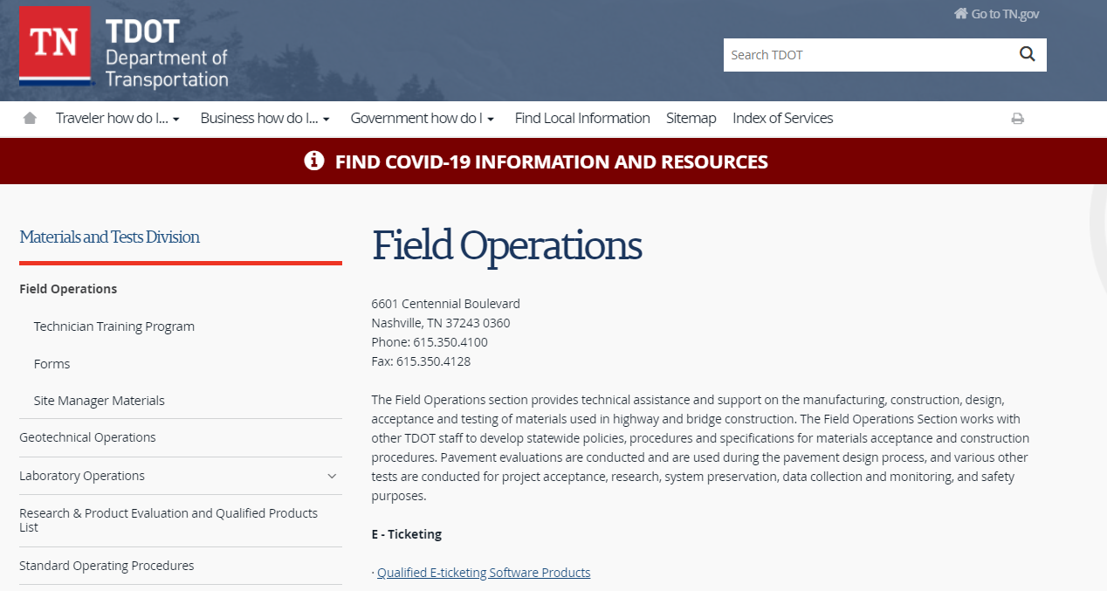
Posted on M&T Field Ops….

Slide 10
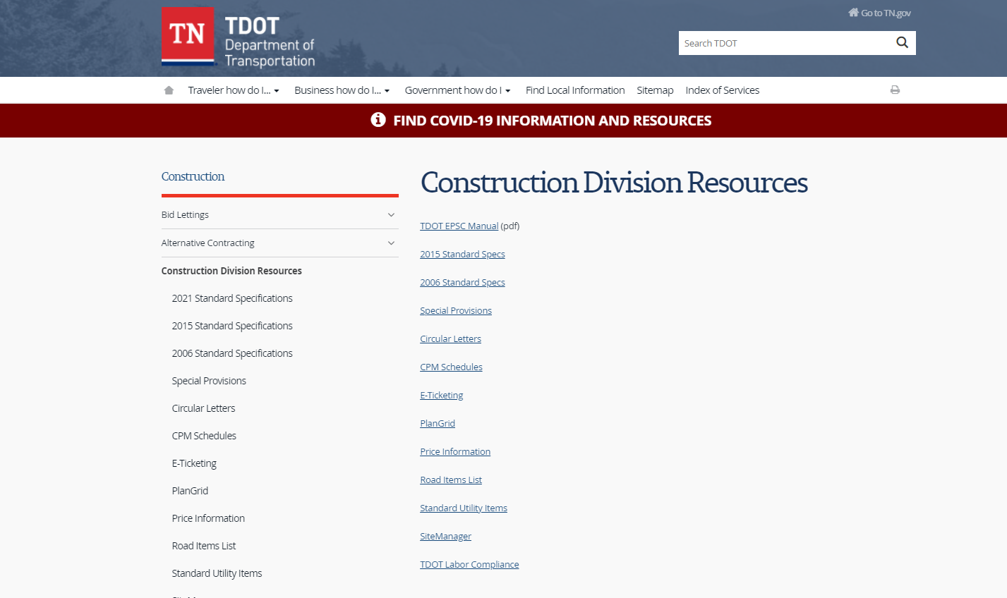
And Construction Division Resources

