Slide 1
THEC Space Seminar
THEC Space Allocation Guidelines
Developed in 2008/2009
Modified in 2013
Art Lidsky, Dober Lidsky Mathey
June 10th, 2020

Slide 2
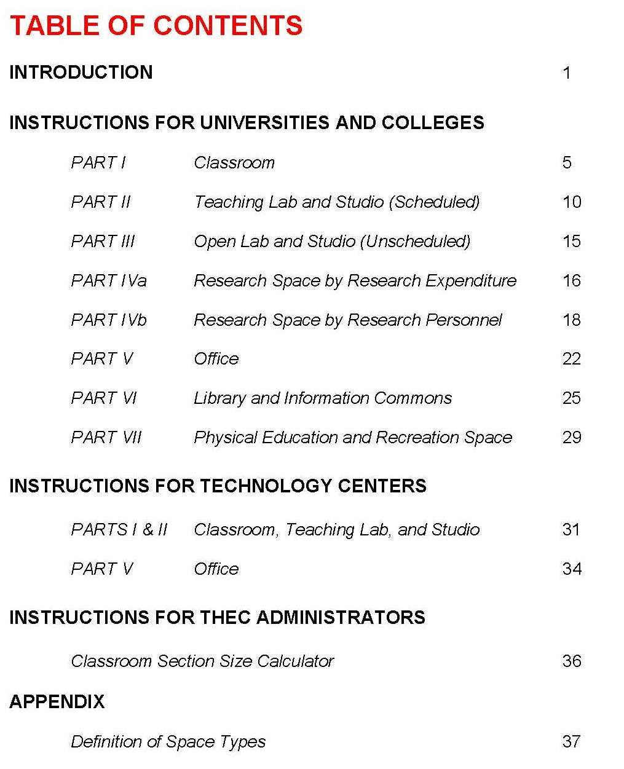
Table of Contents

Slide 3
The Guidelines consists of seven ‘parts’, each part
representing one of the seven space use categories.
Part | Space Use Category | FICM
I | Classrooms | 100/115
II | Teaching Laboratory and Studio (Scheduled) | 210/215
III | Open Laboratory and Studio (Unscheduled) | 220/225
IV | Research Laboratory | 250/255
V | Office and Support | 300
VI | Library, Study, Information Commons | 400
VII | Physical Education | 520/523/525

Slide 4
Facilities Inventory Classification Manual
000 Inactive
100 Classrooms
700 service
200 Laboratories
300 Office
400 Study
800 Healthcare
500 Special
900 Residential
02.100.xx Non Assignable
600 General

Slide 5
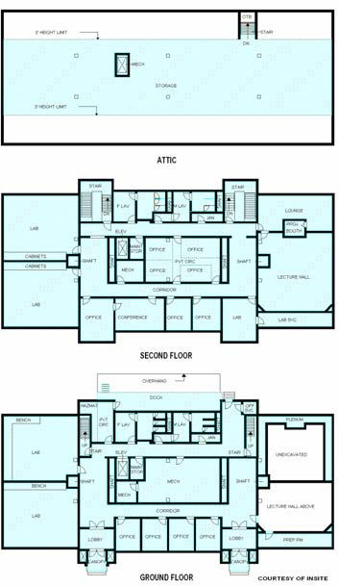
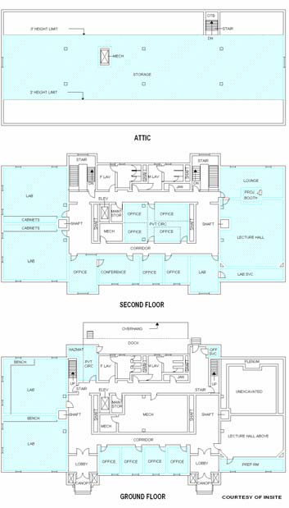
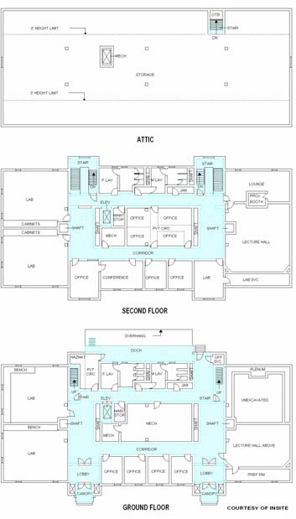
FICM Defines How to Define or Measure Space
Gross Sq. Ft.
Net Assignable Sq. Ft.
Circulation Sq. Ft.

Slide 6
Pink and Blue Cells
The Guidelines uses color-coded cells in a spreadsheet to indicate where data is to be entered. In all cases, the spreadsheet is arranged with pink cells indicating the THEC guidelines and blue cells indicating where institutional data is to be entered.
Blue
Institutional Data Inputs
Pink
THEC Guidelines / Planning Inputs
Only Change Blue Cells – they are for Institutional Data

Slide 7
Enrollment Data
This part of the spreadsheet collects enrollment data that is used in Parts III, VI, and VII. Enter on-ground FTE and headcount, online FTE, and, for those with a residential environment, the headcount of students living on campus.
Enrollment Data
Students | FTE | Headcount
On Ground | 12,500 | 15,600
On-Line | 2,300
Residential |  | 1,200
2020 is an Anomalous Year
Data to Use
Enrollment FTE and headcount should be consistent with Fall data reported to THEC.
The same enrollment figures are used in Parts III, VI and VII, but need to be entered here only.

Slide 8
Part I Classrooms
The following information is used to generate the data that is entered into the blue cells in Part I section. Essentially, the data required are the number of sections distributed by section size, and the number of weekly classroom hours by size. This data automatically generates the amount of space using THEC’s current guidelines:
A typical course file includes the following necessary fields for analysis
Data From the Registrar’s Course File
Building | Section Enrollment (after drop / add)
Room | Subject
Days (MTWRF) | Course
Start Time | Section
End Time | Faculty Name
Start Date | CIP Code (Labs only)
End Date

Slide 9
Part I Classrooms
For Part I, the data should include course sections that have scheduled meetings in classrooms, seminars, and lecture halls (FICM 100 spaces), as well as lecture-based courses that meet in spaces classified as auditoria (FICM 610), and conference rooms (FICM 350).
Do not double-count hours for cross-registered courses - multiple sections scheduled in the same classroom at the same time. However, when calculating enrollments, the sum enrollment of all sections meeting in the same space at the same time should be used.
Only credit bearing courses should be included
Classroom scheduling time window for day program is 7 AM to 5 PM

Slide 10
Part I Classrooms
There are three ways to measure how classrooms are used:
the number of hours per week that the room is scheduled
the proportion of seats that are filled when the room is scheduled
the amount of space allocated to each student station
30 Hours / Wk
60%
Varies
As pedagogy has changed, some of these multipliers should be modified – active learning, for instance

Slide 11
Part I Classrooms
Station Utilization 60%
Hours per week
30
Or 17 Hours
Section Size | Number of Sections | Total Weekly CR Hours
1 – 8
9 – 14
15 – 20
21 – 26
27 – 32
33 – 47
48 – 74
75 – 126
127+
Classroom Stations | NASF / Station | NASF per Classroom | Number of Classrooms | Total NASF
180
540
40
18
720
18
12,960

Slide 12
Part II Instructional Labs and Studios
There are three ways to measure how Instructional Labs and Studios are used:
the number of hours per week that the room is scheduled
the proportion of seats that are filled when the room is scheduled
the amount of space allocated to each student station
15 - 20 Hours / Wk
80%
Varies

Slide 13
Part II Instructional Labs and Studios
Teaching Lab and Studio Multipliers - Universities with CIP Codes
Category A | 150 NASF / Station | 14.02 Aeronautical, Aviation & Aerospace Automotive 46 Construction | 14.17,15.06 Industrial Machinery and Equipment 14.19 Mechanical Engineering 15.0611 Metal, Shop, & Welding | Power and Energy 14.31 Materials Science 51.24 Veterinary Medicine
Category B | 100 NASF / Station | 01 & 02 Agriculture 14.06 Ceramic 50.03 Dance 50.05 Dramatic Arts | 51.04 Dentistry 51.2306 Occupational Therapy 51.17 Optometry | 51.2308 Physical Therapy 14.08 Structural Engineering
Category C | 75 NASF / Station | 40.0502 Analytical Chemistry 26.04 Anatomy, Gross 04 Architecture 40.0202 Astrophysics 26.02 Biochemistry 26.02 Biophysics 26.04 Cell Biology 14.08 Civil Engineering 51.06 Dental Hygiene | 14.01 Engineering, General 15.13 CAD/CADD Technology 01.10 Food Science and Technology 26.08 Genetics (lab-based program) 40.06 Geophysics, and Seismology 26.04 Histology 21 Tech Ed / Industrial Arts 50.04 Interior Design 04.06 Landscape Architecture 26.05 Microbiology | 26.1302 Marine Biology 26.02 Molecular Biology 50.09 Music Performance 30.24 Neurosciences 51.16 Nursing - Practical and RN 40.0504 Organic Chemistry 51.2 Pharmacy 10.03 Printing and Lithography 42 Psychology (lab-based) 51.0911 Radiology
Category D | 60 NASF / Station | 45.02 Anthropology 40.0201 Astronomy 26.01 Biology, General 40.05 Chemistry, General 09.01 Communication 11.07 Computer Science | 50.07 Drawing, Painting 26.13 Ecology 16 Foreign Languages 26.08 Genetics (lecture-based program) 40.06 Geology 09.04 Journalism | 26.07 Pathology 40.08 Physics, General 51.22 Public Health
Category E | 40 NASF / Station | 52.03 Accounting 05.01 Afro-American Studies 50.07 Art History and Appreciation 52.08 Finance 45.06 Economics 13 Education | 13.06 Educational Statistics and Research 54 History 23&45 Humanities and Social Sciences 22 Law Learning Support 27 Mathematics | 50.09 Music History and Appreciation 45.10 Political Science and Government 42 Psychology (lecture-based program) 45.11 Sociology 45.12 Urban Studies

Slide 14
Part II Labs and Studios
Lower Division
Station Utilization
Hours
Per Wk
80%
20
Discipline | Number of Sections | Weekly Lab Hours | Total Enrollment
A
B
C
D
E
F
Section Size | Stations per Lab | NASF per Station | NASF per Lab | Number of Labs | Total Lab NASF | Support Allocation | Support NASF | Total NASF
48
101
1,040
22
28
75
2,100
5
10,500
30%
4,500
15,000

Slide 15
Part II Labs and Studios
Upper Division and Grads
Station Utilization
Hours
Per Wk
75%
15
Discipline | Number of Sections | Weekly Lab Hours | Total Enrollment
A
B
C
D
E
F
Section Size | Stations per Lab | NASF per Station | NASF per Lab | Number of Labs | Total Lab NASF | Support Allocation | Support NASF | Total NASF

Slide 16
Part III Open Labs and Studios
Included in this category are unscheduled:
Computer labs Writing labs Language labs Art studios | Practice studios Music practice rooms Informal student collaboration spaces.
These types of spaces are usually coded in facilities inventories as FICM 220/225 and 230/235. This space is allocated on a simple per-FTE basis. Currently there is no open lab allocation for online students.
Part III Open Labs & Studios
Student Enrollment on Ground FTE
12,500
5
62,500

Slide 17
Part IV A Research Labs by Research Expenditure
There are two approaches for determining the amount of research space. One is based on research expenditure while the other is based on the number of people (FTE) actually doing research. The method that results in the greater amount of space will be used.
Data to Use
Assemble research expenditures for the previous 3 years.
Break down expenditures into 3 categories: A) highly space-intensive, B) space-intensive, or C) moderately space-intensive.
Further break down data into on-campus and off-campus expenditure.
Find the 3-year average for each of these categories and enter data in spreadsheet

Slide 18
Part IV A Research Labs by Research Expenditure
Space-Use Intensity | Discipline - Space Use Category using CIP Code
A Highly Space-Intensive | 14.02 Aero Engineering 14.05 Bioengineering 14.07 Chemical Engineering 40.05 Chemistry | 14.08 Civil Engineering 14.10 Electrical 14.01 Engineering Industrial Engineering 14.18 Materials | 14.31 Materials Science 14.19 Mechanical, Medical 51.2 Veterinary Science
B Space-Intensive | 01 & 02 Agriculture 26.04 Anatomy 1.09 Animal Science 45.02 Anthropology (lab-based) 40.02 Astronomy 26 Biology 26.02 Biochemistry 26.0102 Biomedical | 40 Chemistry 14.09 Computer Engineering 1.03 Crop Science 51.04 Dentistry 15.03 Electrical Engineering 1.1 Food Science 40.06 Geology | 14.19 Mechanical Engineering 26.05 Microbiology 30.24 Neuroscience 40.08 Physics 26.03 Plant Pathology 42 Psychology (lab-based)
C Moderately Space-Intensive | 52.03 Accounting 4.02 Architecture, Art 50 Fine & Performing Arts 11.07 Computer Science Earth Science | 54 History 23 & 45 Humanities 22 Law 27 Math 50.09 Music | 51.16 Nursing 51.2 Pharmacy 45.10 Political Science 45 Social Science
D Office-based | 45.02 Anthropology (office-based) 52 Business 11 Computer Sci. (office-based) 13 Education 22 Law Foreign Languages | 27 Math 42 Psychology (office-based) 23 & 45 Social Sciences & Humanities 44.07 Social Work 27.05 Statistics

Slide 19
Part IV A Research Labs by Research Expenditure
There are two approaches for determining the amount of research space. One is based on research expenditure while the other is based on the number of people (FTE) actually doing research. The method that results in the greater amount of space will be used.
Inflation since 2012
Expenditure: 3-year Average
11%
100%
25%
Discipline | On-Campus | Off-Campus |  | NASF/$1M | Inflation Adjusted | On-Campus Factor | Off-Campus Factor
A |  |  |  | 6,350 | 5,650 | 0 | 0
B | $9,600,000 |  |  | 5,250 | 4,670 | 44,800 | 0 | 44,800
C | $1,200,000 |  |  | 3,450 | 3,100 | 3,700 | 0 | 3,700
 |  |  |  |  |  |  |  | 48,500
D | $800,000 |  |  | 2,600 | 2,310 | 1,850 | 0 | 1,850
 |  |  |  |  |  |  |  | 1,850

Slide 20
Part IV B Research Labs by Research Personnel
This part of the spreadsheet generates the amount of research space by allocating an amount of space per researcher, depending on the category of researcher and discipline.
Departments and disciplines with CIP codes are grouped into four categories. Each category has a specific set of space multipliers.
Data to Use
The number of FTE engaged in research (faculty, PhDs, Post-docs, non-faculty, graduate students, undergrads, visitors, adjuncts).
The FTE quantity is entered into the blue cells by personnel category and by discipline group.
FTE defined by load or by contract

Slide 21
Part IV B Research Labs by Research Personnel
Space-Use Intensity | Disciplines by CIP Code
A Highly Space-Intensive | 14.02 Aero Engineering 14.05 Bioengineering 14.07 Chemical Engineering 40.05 Chemistry | 14.08 Civil Engineering 14.10 Electrical 14.01 Engineering 14.18 Materials | 14.31 Materials Science 14.19 Mechanical, Medical 51.2 Veterinary Science
B Space-Intensive | 01 & 02 Agriculture 26.04 Anatomy 1.09 Animal Science 45.02 Anthropology (lab-based) 40.02 Astronomy 26 Biology 26.02 Biochemistry 26.0102 Biomedical | 40 Chemistry 14.09 Computer Engineering 1.03 Crop Science 51.04 Dentistry 15.03 Electrical Engineering 1.1 Food Science 40.06 Geology | 14.19 Mechanical Engineering 26.05 Microbiology 30.24 Neuroscience 40.08 Physics 26.03 Plant Pathology 42 Psychology (lab-based)
C Moderately Space-Intensive | 52.03 Accounting 45.02 Anthropology (office-based) 4.02 Architecture, Art 50 Fine & Performing Arts 11 Computer Sci. (office-based) 11.07 Computer Science | 54 History 23 & 45 Humanities 22 Law 27 Math 50.09 Music | 51.16 Nursing 51.2 Pharmacy 45.10 Political Science 42 Psychology (office-based) 45 Social Science
D Office-based | 52 Business 13 Education 22 Law 27 Math | 23 & 45 Social Sciences & Humanities 44.07 Social Work 27.05 Statistics

Slide 22
Part IV B Research Labs by Research Personnel
NASF Multipliers by Discipline Category
Personnel Category | A | B | C | D
Faculty | 600 | 450 | 300 | 50
PhD | 300 | 225 | 150 | 50
Non-Faculty | 300 | 225 | 150 | 50
GRA/GTA | 100 | 75 | 75 | 50
UGs | 50 | 50 | 50 | 50
Visitor/Adjunct | 300 | 225 | 150 | 50
% Support | 40% | 35% | 25% | 20%

Slide 23
Part IV B Research Labs by Research Personnel
Discipline Group - FTE
Research Lab NASF / FTE
Personnel Category | A | B | C | D |  | A | B | C | D | Research Lab NASF | Lab Support NASF | Total NASF
Faculty | 14.2 | 122.5 | 68.0 | 77.0 |  | 600 | 450 | 300 | 50 | 87,895 | 43,125 | 131,020
PhD, Post Doc |  |  |  |  |  | 300 | 225 | 150 | 50
Non-Faculty |  |  |  |  |  | 300 | 225 | 150 | 50
GRA / GTA |  |  |  |  |  | 100 | 75 | 75 | 50
Undergrad |  |  |  |  |  | 50 | 50 | 50 | 50
Visit/Adjunct |  |  |  |  |  | 300 | 225 | 150 | 50
 |  |  |  |  |  | 40% | 35% | 25% | 20%
Support Allocation
Total Research NASF
131,020

Slide 24
Part V Office
Data to Use
Count only staff requiring office space.
Most staffing categories use FTE, but three categories use headcount: GTA, GRA, and Other Students.
Use E&G and Restricted staffing numbers only. Do not count Auxiliary employees.
Employee data should correspond to the point in time used for other staffing data submissions to THEC.
For student employees, the number should represent the typical peak headcount number for this type of employee at any one time, not the cumulative total over the course of a year.

Slide 25
Part V Office
Personnel Category | Total FTE |  | NASF / FTE
President, Chancellor |  |  | 350
Provost, Vice President |  |  | 240
Dean |  |  | 180
Associate Dean, Dept Chair |  |  | 150
Professor, Associate, Assistant |  |  | 150
Other Faculty |  |  | 100
Professional Staff |  |  | 130
Clerical |  |  | 120
Staff, Technician |  |  | 100
GTA (Headcount) |  |  | 60
GRA (Headcount) |  |  | 40
Other Students (Headcount) |  |  | 10
Other, Auditor, etc. |  |  | 100
 |  |  | Subtotal NASF
 |  |  | 30%
Total Office NASF

Slide 26
Part VI Study, Library
Volumes
NASF/Vol
NASF
Total Volumes and Volume Equivalents
First 150,000 Volumes
0.10
Volumes in Compact Shelving
Next 150,000 Volumes
0.09
Cartographic Collection
Student Enrollment on-ground (FTE)
Next 300,000 Volumes
0.08
Student Enrollment on-line (FTE)
Next 600,000 Volumes
0.07
Student Living on Campus (FTE)
Next 1,200,000 Volumes
0.06
Total Student Enrollment on-ground (HC)
Next 2,400,000 Volumes
0.05
% of FTE Enrollment
# Tables, Carrels, Groups
Next 4,800,000 Volumes
0.04
Compact Shelving
0.03
Living on Campus
25%
Cartographic Collection
0.02
25%
On Ground, Off Campus
5%
Online
5%
A Number
Subtotal Volumes and Readers NASF
% Tables, Carrels, Etc
# Tables, Carrels, Groups
NASF per Station
Total
NASF
% Tech Services
12.5%
Total NASF
% Standard
45%
25
25%
% Enhanced, Group
25%
35
% Reserved, Assigned
20%
35
% Group Study
10%
35
Same Number

Slide 27
Part VII Physical Education
Student Enrollment on ground (FTE)
Per-institution Minimum NASF <4,000 FTE Students | 40,800
Per-institution Minimum NASF 4,000 + FTE Students | 68,000
Additional NASF per FTE | 11
Institution Minimum NASF
Per FTE Allocation
Total NASF

Slide 28
Questions? Comments? Issues?

