Slide 1
Welcome Memphis VA Medical Center
* Personalized * Proactive * Patient-Driven Care

Slide 2
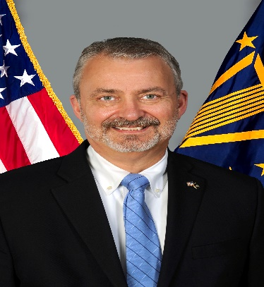
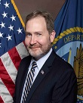
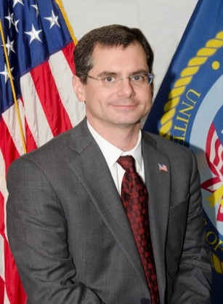
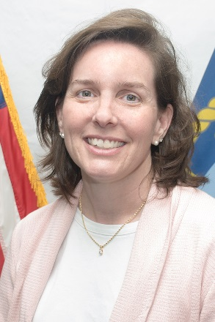
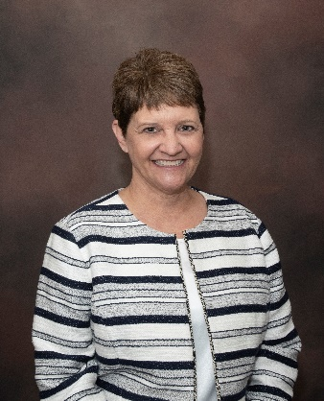
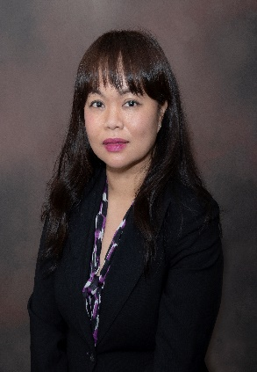
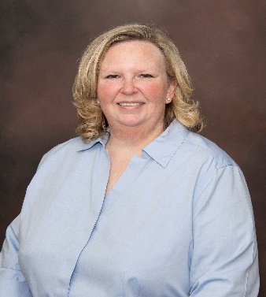
Executive Leadership Team
Mr. Joseph P. Vaughn
Medical Center Director
Thomas Ferguson, MD
Chief of Staff
Mr. Michael A. Nichols
Associate Director
Gail Berntson, MD, Deputy Chief of Staff
Mrs. Shawn Tyler
Associate Director for Patient Care Services/ Chief Nursing Officer
Ms. Hien Nguyen
Assistant Director
Mrs. Elizabeth “Beth” Wade
Deputy, Associate Director for Patient Care Services
Notes:
This is our leadership team.
when you come to work, you will likely see us out and about.
b. We foster a culture of transparency and open communication.

Slide 3
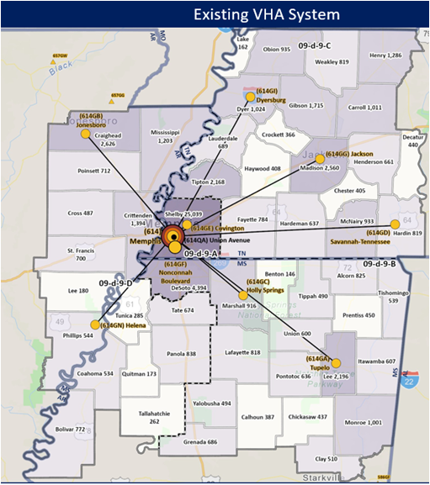
Memphis VA Medical Center
9 Community-based sites in
Memphis (2) * Jackson * Dyersburg * Helena * Holly Springs
Jonesboro * Savannah * Tupelo
Notes:
This slides shows where are 9 Community Based sites are in relationship to the city of Memphis and the states of Tenn, Arkansas & Mississippi

Slide 4
FY 21 Workload
Staff FY 21 YTD: 2,300+ FTE
Operating beds: 193
Veterans Served: 63,400+
Women Veterans: 7,300+
Inpatient Admissions: 6,800+
Outpatient Visits: 652,500+
Notes:
This slide provides you with a snapshot of our workload last year. As you can see, we stay very busy.

Slide 5
Construction
SCI Addition – Expand SCI Outpatient, renovate for SIM Lab, adding 8,000 sq ft and 10,000 sq feet renovation. Expected to be completed April 2023
Lab – Expected to be completed Oct 2022, new lab will be 24,000 sq feet and once old lab is out will renovate for primary care to move into 1st floor
Fisher House –
Our site has been approved by the Fisher House Foundation. We have ordered the surveys, which should take place within 30 days: historical, environmental (both required), and a sub-ground survey. Once the surveys are completed and everything is clear, we can begin site preparation.
Meanwhile on the fundraising side, a Chair has been named for the Friends of the Midsouth Fisher House Foundation. Other board members have been recruited.
Expected date of opening Spring 2024
Millington Clinic – North side of Millington near Walmart
Parking Garage is open!

Slide 6
Suicide Prevention
Just completed Suicide Prevention month and we held 30 events on/off campus.
Introduced the Community and Partnership Program to form coalitions and community partnerships particularly in rural areas to reduce barriers to care and connect Veterans to the resources they need.
Implementing new software for tracking
Continue to follow processes where Emergency Dept staff complete assessments/ safety plans who screen positive for high risk
New 988 number has been added to the Voice Mail greetings of all Mental Health staff workers.
Have followed up with 100% of Veterans who call the Crisis Line within one business day.

Slide 7
Accomplishments
Specialized Women’s Healthcare Coordination Team increased breast cancer screening metrics are at 87.2%, which is #1 in VISN 9
Ranked 2nd among 33 sites with selection of 13 out of 17 projects selected for a innovation program, projects focused on quality, surgery, prosthetics, SCI, mental health, ER
Implemented the Community Providers Orders (CPO) process where the nurses in the community care transcribe the Referral For Service (RFS) orders into the medical record for the community provider, this provides a seamless transition of care for the Veteran, Memphis was second in the nation to adopt the process and the first in VISN 9.
Implemented the 10-4 Initiative
Adding Whole Health Program
Appointed SAIL champions for the SAIL metrics that are at-risk
28 pharmaceutical trials or cooperative study projects (VA Clinical funded trials) and participating in research VA funded projects looking at different aspects of kidney disease from racial disparity to co-morbidities

Slide 8
Questions?

