Slide 1
Commodities, Services, & Technology
Local Government Purchasing Forum
October 27, 2022
Michael Gross, Category Specialist
State of Tennessee Central Procurement Office

Slide 2
Category Management & the Category Teams

Slide 3
Category Management – Team Differences
Commodities – Contracts to purchase tangible goods.
Services – Contracts with service components such as monthly services, inspections, maintenance and repair, rental, etc. These contracts have a human component to them.
Technology – Contracts with technology components, such as computers, cellular devices, multi-function devices, telecommunication equipment.
Notes:
Explain what a Statewide Contract (SWC) is.
Each category team is familiar with legal requirements and TCAs pertaining to their specific category.

Slide 4
Category Management – Commodities Team
Primarily responsible for the procurement and management of SWCs centered around commodities.
Notes:
Explain what a commodity is.
Examples include: Maintenance Repair Supplies, Herbicides, Office Supplies, Vehicles, Gas/Diesel, Copy Paper, Groceries, Office Furniture, etc.

Slide 5
Category Management – Commodities Team
Category Specialists:
Mike Neely
DeRenne Raley
Caroline Ballinger
Chad Butler
Adam Mamula
Laitin Beecham, Team Lead

Slide 6
Category Management – Services Team
Primarily responsible for the procurement and management of SWCs centered around personal, professional, and consulting services.
Notes:
Examples include: Vehicle Rental, Winter Road Maintenance And Equip., Electrical HVAC, Plumbing, Maintenance And Repair, Facility Fire and Security, etc.

Slide 7
Category Management – Services Team
Kayla Barnett, Team Lead
Category Specialists:
Erik Busby
Elle Lipinski
Sondra Park
Andrew Martin
Lauryen Harris

Slide 8
Category Management – Technology Team
Primarily responsible for the procurement and management of SWCs centered around technology related hardware and software.
Notes:
Examples include: Computer Server Storage, Commercial Off the Shelf (COTS) Software, Headsets and Headset Accessories, etc.

Slide 9
Category Management – Technology Team
Josh Gaddy, Team Lead
Category Specialists:
Richard Kotler
Michael Porter
Michael Gross
Zohreh Hurd
Melinda Lewis

Slide 10
Where to Locate Procurement Staff Contact Information
Central Procurement Office Directory
https://www.tn.gov/generalservices/procurement/central-procurement-office--cpo-/cpo-directory-.html
Edison Supplier Portal
https://hub.edison.tn.gov/psp/paprd/SUPPLIER/ERP/c/TN_PUBLIC_SUPPLIER.TN_ACTIVE_SWC_CMP.GBL?Page=TN_ACTIVE_SWC&Action=U&ExactKeys=Y&TargetFrameName=None

Slide 11
How to Determine if a Statewide Contract is Needed

Slide 12
Guiding Criteria for Establishing a New Statewide Contract (SWC)
Notes:
Projected Utilization- if there is a shared common need among State agencies, we will want to create a statewide contract
Significant volume- we leverage not only state agencies spend but also local spend on SWC when negotiating Contracts
Additional Discounts- the greater volume we have, the greater discounts we can see
Reoccurring need- If items are being purchased or rented on a regular basis, we would want to look into adding these items to a statewide contract.

Slide 13
Various Contract Structures

Slide 14
Contract Structures – Pricing Structures
Pricing Structures:
Fixed line items
Catalog items
Notes:
Contract Pricing Structures Include:
Fixed Line Items
Catalog Items

Slide 15
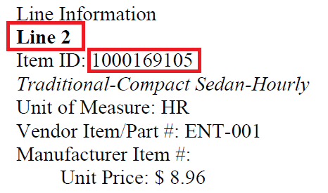
Pricing Structure – Fixed Line Items
Set items with fixed pricing
Will have contract line numbers and an item ID #
SWC 205 Vehicle Rental

Slide 16
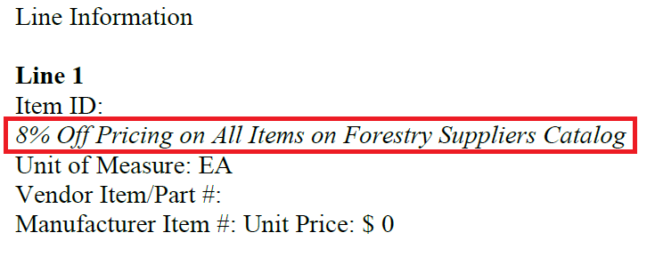
Pricing Structure – Catalog Items
Contracts that utilize a catalog for purchasing with a negotiated discount applied.
SWC 537 Forestry & Agricultural Supplies (Forestry Suppliers)
Notes:
Catalog contracts can be setup different depending on how the contract was awarded. You will find an explanation of how each catalog works in the terms and conditions and usage instructions
– Not all contracts have a discount for all of a company’s products, for example: SWC 201 Equipment Rental is awarded by category. Their catalog discounts only apply to the category(ies) they are awarded.
- There are also times where a contract can be a catalog/set line item hybrid, For example, there are catalogs on the office furniture contract, but there are also fixed line items for the consulting and installation portion of the contract.

Slide 17
Contract Structures – Award Structures
Award Structures:
Single supplier award
Multi-supplier award
Line-item award
Regional award
Tiered award
Constant-compete
Notes:
Various Award Structures include:
Single Supplier
Multi-supplier
Additionally:
Line-Item Award
Regional Award
Tiered Award
Constant-Compete

Slide 18
Single Award Contract Structure
Contracts that are awarded to only one supplier
SWC 303 Equipment Maintenance
SWC Nbr. | SWC Statewide Contract Name | Edison Contract Number | Contract Begin Date | Supplier Name
303 | Equipment Maintenance | 0000000000000000000066845 | 6/1/2020 | Specialty Underwriters LLC
Notes:
For example: SWC 303 Equipment Maintenance was awarded to only Specialty Underwriters. All services covered under this contract will be provided by Specialty Underwriters LLC.

Slide 19
Multi-Supplier Award Contract Structure
Contracts that are awarded to two or more suppliers
SWC 396 Legal Research Services
SWC Nbr. | SWC Statewide Contract Name | Edison Contract Number | Contract Begin Date | Supplier Name
396 | Legal Research Services | 0000000000000000000064777 | 10/29/2019 | RELX Group
396 | Legal Research Services | NV00000000000000000064776 | 10/29/2019 | LexisNexis Risk Solutions FL Inc.
396 | Legal Research Services | 0000000000000000000064780 | 10/29/2019 | West Publishing Corp.
Notes:
For example: Legal Research Services was awarded to three suppliers, RELX Group, LexisNexis Risk Solutions FL Inc., and West Publishing Corp.

Slide 20
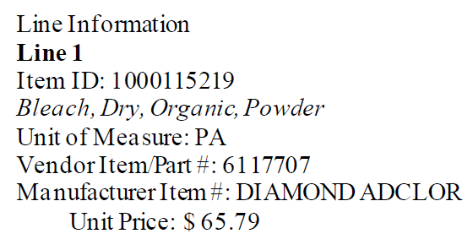
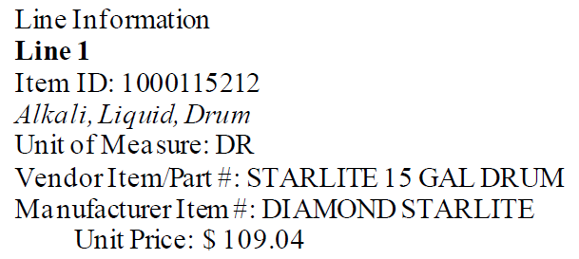
Line Award Contract Structure
Contracts that are awarded based on lowest cost per line item
SWC 521 Laundry Detergents & Compounds
Ecolab Inc – Contract 61234:
Diamond Chemical Company – Contract 61233:

Slide 21
Regional Award Contract Structure
Contracts awarded by TDOT Region

Slide 22
Regional Award Contract Structure
Contracts that are awarded based on region dependency
SWC 370 Uniforms, Linen, & Dust Control
Notes:
SWC 370 Uniforms, Linen, & Dust Control is awarded by Region. Suppliers are awarded specific regions or counties rather than covering the entire State.
Contract might be awarded this way to due to suppliers' ability to only provide coverage to specific counties/regions or to increase competitive pricing.

Slide 23
Tiered Award Contract Structure
Contracts that have a supplier hierarchy
SWC 700 HVAC, Electrical, Plumbing, Boiler, and Chiller Systems
Notes:
SWC 700 is awarded based on a tiered award system. For example, if there is an emergency HVAC job in Anderson County, the contract states they need to reach out to Vendor A, Air Quest, first for services. Only if Vendor A cannot perform the service or does not respond within a timely manner can the user reach out to Vendor B etc.

Slide 24
Constant-Compete Contract Structure
Multiple suppliers awarded on contract. User requests quotes to compete their job among awarded suppliers and awards job to lowest cost supplier.
RSWC 3999 NASPO COTS Software
Edison Contract ID | Supplier | Software
63087 | CDWG | Commercial off-the-shelf software
63066 | SHI
62925 | Insight
Notes:
So, on this type of contract you will want to send out a quote request, which provides job details as well as a response deadline. The quote request will be sent to all suppliers who were awarded your location for the services in need. Once you receive quotes back, you will award the job to the supplier with the lowest quote.

Slide 25
Statewide Contract Usage Instructions
Notes:
One way to find out how the contract you are reviewing is structured is by looking at the usage instructions. These detail the contract and how the end user can utilize it to meet their needs.
This is an example of what Statewide Contract Usage Instructions would look like.
Usage Instructions Include:
Contract Period
Summary/Background Information
State of TN CPO Contact Information

Slide 26
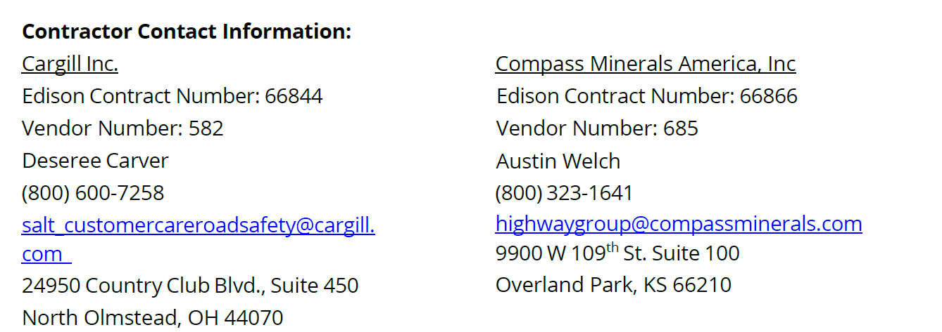
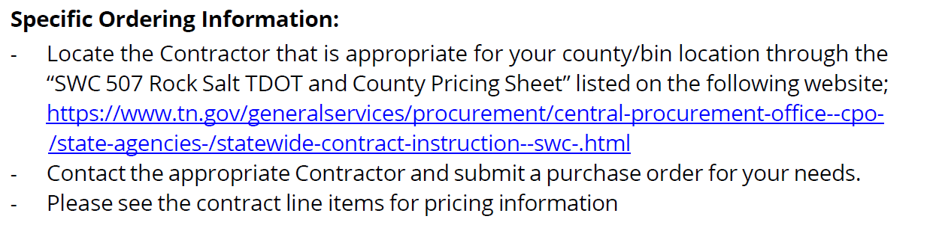
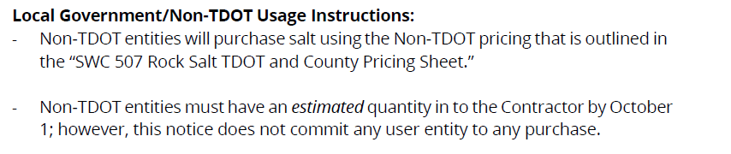
Statewide Contract Usage Instructions Cont.
Notes:
Supplier Contact Information
State Agency Ordering Instructions
Local Government Entity Instructions (if needed)
Other Contract-Specific Details
Some SWCs have the same instructions for all users. SWC 507 Rock Salt (shown) lists specific instructions for local government and non-TDOT users

Slide 27
Common SWCs Topics - Vehicles
SWC 205 – Vehicle Rental
SWC 209 – Vehicles
SWC 222 – Vehicle Leasing

Slide 28
Common SWCs Topics – Maintenance
SWC 161 – Trash Pick-up
SWC 172 – Facility Fire, Security, and Life Safety Systems and Products
SWC 182 – Elevator Maintenance
SWC 235 – Industrial Supplies
SWC 303 – Equipment Maintenance Management
SWC 700 – Electrical HVAC, Plumbing, Boiler & Chiller Systems Maintenance & Repair

Slide 29
Common SWCs Topics – Office and Paper
SWC 316 – Office Supplies
SWC 317 – Copy Paper
SWC 352 – Envelopes
SWC 365 – Paper & Plastic goods

Slide 30
Common SWCs Topics – Road Supplies & Equipment
SWC 110 – Pipe & Pipe Liner
SWC 126 – Highway Marking & Accessories
SWC 178 – Traffic Paint & Glass Beads
SWC 201 – Equipment Rental
SWC 204 – Vehicle & Equipment, Parts Lt & Heavy Duty
SWC 206 – Attenuators, Truck & Trailer
SWC 225 – Equipment, Highway and Heavy
SWC 226 – Winter Road Maintenance Equipment
SWC 503 – Summer Road Maintenance Materials
SWC 504 – Winter Road Maintenance Materials

Slide 31
Common SWCs Topics – Medical/Health Supplies, Equipment, & Services
SWC 439 – Dental Supplies
SWC 440 – Medical Supplies
SWC 529 – Pharmaceutical Return Processing & Reverse Distribution and Destruction Services
SWC 530 – Pharmaceutical Products
SWC 531 – Birth Control Devices
SWC 533 – Influenza Vaccine
SWC 563 – Laboratory Supplies

Slide 32
Common SWCs Topics – Technology
SWC 400 – Multifunction Devices, Scanners, & Software
SWC 3008 – ESRI/GIS Software
SWC 423 – Radio Equipment, Maintenance Repairs, Parts, Accessories, & Test Equipment
SWC 911 – First Responder Telecommunications Services & Equipment
SWC 811 – Cellular Device, Services, & Business solutions
SWC 338 – Apple Hardware, Software
SWC 3021 – Comprehensive Cloud Solutions
SWC 3999 – NASPO COTS Software

Slide 33
Conclusion

Slide 34
Your Questions Answered
Karen Conway, Parker Birt, Josh Gaddy, Jenny Young
State of Tennessee Central Procurement Office

Slide 35
Meet Your Speakers
Commodities Team: Karen Conway
Services Team: Parker Birt
Technology Team: Josh Gaddy
Legal Team: Jenny Young

Slide 36
Thank you for joining us!

