Slide 1

State of Tennessee Health Facilities Commission
CMS
PHASE 3 IMPLEMENTATION
Provider Training
October 2022

Slide 2
June 29th, the Centers for Medicare and Medicaid Services (CMS) released information announcing clarifications and enhancements of the Phase 2 Requirements of Participation (RoP) for nursing homes and interpretive guidance for implementation of the Phase 3 RoP.
These requirements will take effect on Oct. 24, 2022.
These regulations were originally adopted back in 2016, with implementation planned in 3 phases. Phase 1 was implemented in November 2016, Phase 2 took effect in November 2017, and Phase 3 took effect in 2019.
Due to the pandemic, there was a delay with the interpretive guidance and therefore the implementation of these regulations.

Slide 3
Overview of Regulation Reform
The regulation reform implements a number of pieces of
legislation from the Affordable Care Act (ACA) and the
Improving Medicare Post-Acute Care Transformation (IMPACT)
Act, including the following:
Quality Assurance and Performance Improvement (QAPI)
Reporting suspicion of a crime
Increased discharge planning requirements
Staff training section

Slide 4
Implementation Grid
Implementation Date | Type of Change | Details of Change
Phase 1: November 28, 2016 (Implemented) | Nursing Home Requirements for Participation | New Regulatory Language was uploaded to the Automated Survey Processing Environment (ASPEN) under current F Tags
Phase 2: November 28, 2017 | F Tag numbering Interpretive Guidance (IG) Implement new survey process | New F Tags Updated IG Began surveying with the new survey process throughout all states
Phase 3: November 28, 2019 | Infection Control & Antibiotic Stewardship; Water Management; Arbitration; PBJ; Psychosocial Outcome Severity Guide; Psychotropic Medications; Trauma Informed Care; Behavioral Health,; Abuse;/Neglect; Admission/Transfer/ Discharge; Resident Rights; Chaper 5 – Complaints & FRIs (Facility Reported Incidences) | OCTOBER 24, 2022 IMPLEMENTATION

Slide 5
Phase 2 of LTC Regulations (continued)
Phase 2 includes:
Behavioral Health Services – Assess staff competencies & skills to provide care for residents with behavioral needs
Quality Assurance and Performance Improvements
Infection Control and Antibiotic Stewardship
Physical Environment – smoking policies
Notes:
Phase 2 will include:
Behavioral Health Services
Quality Assurance and Performance Improvements (QAPI Plan Only)
Infection Control and Antibiotic Stewardship
Physical Environment – smoking policies

Slide 6
Phase 2 of LTC Regulations, continued
Phase 2 includes, but is not limited to:
Resident Rights and Facility Responsibilities – Required Contact Information
Freedom from Abuse, Neglect, and Exploitation
Admission, Transfer, and Discharge Rights – Transfer/Discharge Documentation
Notes:
Phase 2 will include, but is not limited to:
Resident Rights and Facility Responsibilities – Required Contact Information
Freedom from abuse, neglect, and exploitation – 1150B Requirements (reporting reasonable suspicion of a crime) See S&C 11-30 Memo -Reporting Reasonable Suspicion of a Crime
Admission, transfer, and discharge rights – Transfer/Discharge Documentation

Slide 7
Phase 2 of LTC Regulations, continued
Phase 2 includes, but is not limited to:
Comprehensive Person-Centered Care Planning – 48 Hr. Baseline Care Plan
Pharmacy Services – Drug regimen review and reporting – review of medical chart, definition of psychotropic medications
Dental Services – replacing lost dentures ( referral -3days)
Administration – Facility Assessment – tied to sufficient and competent staff requirements
Notes:
Phase 2 includes, but is not limited to:
Comprehensive Person-Centered Care Planning – Baseline Care Plan
Pharmacy Services – Drug regimen review and reporting – review of medical chart, definition of psychotropic medications
Dental Services – replacing lost dentures
Administration – Facility Assessment – tied to sufficient and competent staff requirements

Slide 8
Infection Control:
CMS Infection Control requirements released in October 2016.
These requirements are in response to the high cost of infections and the fact that long term care facilities are at the frontline in the battle against antibiotic resistant infections.
Noncompliance includes Failure to Have in Place an Infection Prevention & Control Program (IPCP).

Slide 9
The Phases of these requirements are as follows:

Slide 10
Phase 1:
Infection Control Requirements §483.80( effective November 28, 2016)
1) An Infection Prevention and Control Program (IPCP), with a system for preventing,
identifying, reporting, investigating and controlling infections & communicable
disease. This includes staff, visitors, and others performing contracted services to
the facility.
2) Written standards, policies and procedures and a system of surveillance designed
to identify possible communicable diseases.
3) Controlling infections before they can spread to other persons in the facility.
4) When and how isolation will be utilized for a resident.

Slide 11
Phase 2:
An Antibiotic Stewardship Program (effective Nov. 28, 2017)
1) Facilities must establish and official "Antibiotic Stewardship Program as Part of the
Infection Prevention and Control Program (IPCP).
2) The program must include antibiotic use protocols and a system for monitoring use of
Antibiotics.
3) A system of monitoring and surveillance of infections and outbreaks

Slide 12
Last Phase of Mandatory CMS Requirements:
Phase 3 - Infection Control Preventionist (Nov. 28, 2019)
Include elevating the current Infection Control Preventionist required in facilities to a well-trained infection control professional with extensive training in the field but focused on strong clinical backgrounds and not like current situations in which Infection Control Nurses are with facilities or other areas without much knowledge of infection.
Below is the link to CDC's handout:
What You Need to Know About Antibiotics in a Nursing Home (link below)
Core Elements for Antibiotic Stewardship in Nursing Homes: What You Need to Know About Antibiotics in a Nursing Home (cdc.gov)

Slide 13
Infection Prevention
&
Antibiotic stewardship

Slide 14
Facilities will have an Infection Prevention and Control Program that includes Antibiotic Stewardship.
Facilities must have at least a part time – 20 hour per week Certified Infection Preventionist (It is strongly recommended to have a back up for the Infection Preventionist).
Objectives will be accomplished by having a separate Infection Prevention and Control Committee (IPCC) that is to be incorporated into the Quality Assurance and Performance Improvement (QAPI) committee.

Slide 15
“Infection Preventionist (IP)”: Term used for the person(s) designated by the facility to be responsible for the infection prevention and control program.

Slide 16
Responsibility for the Infection Prevention and Control Program (including the Antibiotic
Stewardship Program)
The facility must designate one or more individuals as the infection preventionist (IP) who is responsible for assessing, developing, implementing, monitoring, and managing the IPCP.
While the IP is responsible for the IPCP, other staff play important roles in infection prevention and control as well as antibiotic stewardship. For example, staff must appropriately implement standard precautions such as hand hygiene and transmission-based precautions.

Slide 17
Furthermore, ASP development should include leadership support and accountability via the participation of the medical director, consulting pharmacist, nursing and administrative leadership and therefore, the IP should utilize and work collaboratively with these team members to also implement the ASP.
While an ASP is a team effort, the IP is responsible for ensuring the program meets the requirements for ASPs (at §483.80(a)(3), F881).
The IP should review and approve infection prevention and control training topics and content, as well as ensure facility staff are trained on the IPCP (for further information, see §483.95(e), F945, Infection Control Training).
However, the IP is not required to perform the IPCP training, since some facilities may have designated staff development personnel.

Slide 18
Primary Professional Training
The IP must be professionally-trained in nursing, medical technology, microbiology,
epidemiology, or other related field.
A professionally-trained nurse must have earned a certificate/diploma or degree in nursing.
A professionally-trained medical technologist (also known as clinical laboratory scientist)
must have earned at least an associate's degree in medical technology or clinical laboratory
science.
A professionally-trained microbiologist must have earned at least a bachelor's degree in
microbiology.
A professionally-trained epidemiologist must have earned at least a bachelor's degree in
epidemiology.
Examples of other related fields of training that are appropriate for the role of an IP include
physicians, pharmacists, and physician's assistants.

Slide 19
Qualifications
The IP must be qualified by education, training, experience or certification.
The IP must have the knowledge to perform the role.
The IP should remain current with infection prevention and control issues and be aware of national organizations' guidelines as well as those from national/state/local public health authorities (e.g., emerging pathogens).
The facility should ensure the individual selected as the IP has the background and ability to fully carry out the requirements of the IP based on the needs of the resident population, such as interpreting clinical and laboratory data.
Examples of experience in infection prevention and control may include, but are not limited to, identification of infectious disease processes, surveillance and epidemiologic investigation, and preventing and controlling the transmission of infectious agents.
An example of certification is the Certification in Infection Prevention and Control (CIC®) which is conducted by the Certification Board of Infection Control and Epidemiology, Inc. (CBIC®) and accredited by the National Commission for Certifying Agencies (NCCA).

Slide 20
IP Hours of Work
Designated IP hours per week can vary based on the facility and its resident population.
Therefore, the amount of time required to fulfill the role must be at least part-time and should
be determined by the facility assessment, conducted according to §483.70(e), to determine
the resources it needs for its IPCP, and ensure that those resources are provided for the
IPCP to be effective.
Based upon the assessment, facilities should determine if the individual functioning as the IP should be dedicated solely to the IPCP. A facility should consider resident census as well as resident characteristics, types of units such as respiratory care units, memory care, skilled nursing and the complexity of the healthcare services it offers as well as outbreaks and seasonality of infections such as influenza in determining the amount of IP hours needed.
The IP must have the time necessary to properly assess, develop, implement, monitor, and manage the IPCP for the facility, address training requirements, and participate in required committees such as QAA.
The IP must physically work onsite in the facility. He/she cannot be an off-site consultant or
perform the IP work at a separate location such as a corporate office or affiliated short term
acute care facility.

Slide 21
Specialized Training in Infection Prevention and Control
Infection prevention and control (IPC) training must be sufficient to perform the role of the
IP.
Specialized training in IPC may include care for residents with invasive medical devices,
resident care equipment (e.g., ventilators), and treatment such as dialysis as well as high acuity conditions.
If a facility's resident population changes, the IP should re-evaluate his/her knowledge and skills, and may need to obtain additional training for the change in the facility’s scope of care.
An IP must have obtained specialized IPC training beyond initial professional training or
education prior to assuming the role.
Training can occur through more than one course, but the IP must provide evidence of training through a certificate(s) of completion or equivalent documentation.

Slide 22
CMS recommends specialized training include the following topics:
• Infection prevention and control program overview,
• The infection preventionist’s role,
• Infection surveillance,
• Outbreaks,
• Principles of standard precautions (e.g., content on hand hygiene, personal protective equipment,
injection safety, respiratory hygiene and cough etiquette,
environmental cleaning and disinfection, and reprocessing reusable resident care equipment),
• Principles of transmission-based precautions,
• Resident care activities (e.g., use and care of indwelling urinary and central venous
catheters, wound management, and point-of-care blood testing),
• Water management,
• Linen management,
• Preventing respiratory infections (e.g., influenza, pneumonia),
• Tuberculosis prevention,
• Occupational health considerations (e.g., employee vaccinations, exposure control plan, and work
exclusions),
• Quality assurance and performance improvement,
• Antibiotic stewardship, and
• Care transitions.

Slide 23
A free online training is available and was developed by a collaboration between CMS and the Centers for Disease Control and Prevention (CDC).
The "Nursing Home Infection Preventionist Training Course" is located on CDC's TRAIN website (https://www.train.org/cdctrain/training_plan/3814). Other trainings may be available from entities such as associations, state public health, and universities.

Slide 24
Purpose:
The purpose of the Infection Prevention Program and the development of the Infection Control Committee is to oversee and coordinate efforts to prevent the spread of infection.

Slide 25
As per the CDC guidelines, the core elements for Antibiotic Stewardship Program include:
Leadership
Accountability
Drug Expertise
Action Implementation
Track measure of antibiotic use
Reporting on antibiotic use
Education of staff and residents about antibiotic stewardship

Slide 26
    Leadership is provided by the facility:
    Medical Director
    Consulting Pharmacist
    Administrative Leadership
    Regional Nurse
    Owners

Slide 27
    Accountability -of the program will be held by:
    Medical Director
    Administrator
    Director of Nursing
    Infection Preventionist
    Consultant Pharmacist
    Promote and oversee the antibiotic stewardship activity of the facility.

Slide 28
    Consultant Pharmacist:
    Designated as the Drug Expertise element of the Antibiotic Stewardship Program

Slide 29
    The Infection Control Committee

Slide 30
    Infection Control Committee:
    Will prioritize interventions based on facility needs
    Share outcomes from successful interventions with:
    Nurse staff
    Clinical providers

Slide 31
    Infection Control Committee:
    Track and monitor at least one process measure of antibiotic use & at least one outcome from antibiotic use in the facility to support antibiotic stewardship activities.
    Provide regular feedback on antibiotic use and resistance to:
    Prescribing clinicians
    Nursing staff and
    Other relevant staff

Slide 32
    The IP will collaborate with the contracted laboratory regarding reports and services to support antibiotic stewardship activities.

Slide 33

Toolkits From:

Slide 34
Nursing Home Stewardship Guide and toolkits
https://www.ahrq.gov/nhguide/toolkits/educate-and-engage/index.html
Talking With Residents provides talking points for nurses to educate residents about antibiotics and encourage them to ask questions or report symptoms :
https://www.ahrq.gov/sites/default/files/wysiwyg/nhguide/6_TK1_T4-Be_Smart_About_Antibiotics_Final.pdf
Talking With Residents’ Family Members provides similar talking points for nurses to use when talking to residents’ family members
https://www.ahrq.gov/sites/default/files/wysiwyg/nhguide/6_TK1_T2-Talking_with_Residents_Family_Members_checklist_version_Final.pdf

Slide 36
To Have Infection Prevention and Control Committee (IPCC)
(With guidance of the Medical Director)
Will:
  Develop and implement written policies and procedures for the prevention and control of infections
  among residents and employees and visitors
  Establish, assesses, evaluate, and oversee environmental infection prevention and control practices
  in accordance with CDC, federal and state guidelines and requirements
  Provide these guidelines and requirements to the facility employees to establish a safe
  and sanitary environment-All training should support current scope of standards of practice through
  curricula with detail learning objective, performance standard, evaluation criteria and addresses
  potential risks to residents, staff, and volunteers if procedures are not followed.
  A process should be place to track staff participation in and the understanding of the required training.

Slide 37
Such infection control training must, at a minimum, include the following areas (as
described in §483.80(a)(2)):
• The facility’s surveillance system designed to identify possible communicable diseases or infections
before they can spread to other persons in the facility;
• When and to whom possible incidents of communicable disease or infections in the facility should be
reported;
• How and when to use standard precautions, including proper hand hygiene practices and
environmental cleaning and disinfection practices;
• How and when to use transmission-based precautions for a resident, including but not limited to, the
type and its duration of use depending upon the infectious agent or organism involved;
• Occupational health policies, including the circumstances under which the facility must enforce work
restrictions and when to self-report illness or exposures to potentially infectious materials and
• Proper infection prevention and control practices when performing resident care activities as it pertains
to particular staff roles, responsibilities, and situations.
Please refer to F880 for a detailed description of these topics.

Slide 38
Develop isolation precaution protocols for when control of an infectious or communicable disease or disease risk is required in accordance with current CDC guidelines and recommendations

Slide 39
To Have Infection Prevention and Control Committee (IPCC)
(With guidance of the Medical Director)
  Develop an effective employee health program
  Identify situations that may result in employees' exposure to blood, body fluids, or other potentially infectious materials
  Develop infection prevention and control orientation and in-service training programs for all facility personnel
  Develop policies and procedures for the surveillance and monitoring of infection control practices
  Review and help monitor the medical waste management plan

Slide 40
Composition of the Committee

Slide 41
If the Infection Control Committee as a separate entity: may consist of the following disciplines:
  Administrator (or designee):
  Medical Director
  Director of Nursing Services
  Certified Infection Control Preventionist
  Dietitian/Food Services Director
  Environmental Services Director
  Maintenance Director
  Laundry Director/Supervisor
  Consultant Pharmacist- (if unable to attend, should have written recommendations regarding Antibiotic Stewardship for review)
  Others as appropriate

Slide 42
If the Infection Control Committee meets separately:
The IP will:
Report to the QAPI committee
Provide a summary of the committee findings/ concerns if any that would pose any infection risks to the residents, employees and visitors.

Slide 43
Unscheduled meetings of the Infection Control Committee
The Infection Control Committee should be gathered more frequently than scheduled in the following situations:
Emergency meeting during an outbreak situation
If directed by the local health department, State and Federal government, CDC.
If the IP or Medical Director deems there is an actual or potential infection control emergency
A change in local, state or federal regulation that requires immediate action on part of the Committee.

Slide 44
Delegation of Authority
The IP will oversee the Infection Prevention and Control program and report to the Infection Prevention and Control Committee.
The Administrator will be responsible for oversight of the Infection Prevention and Control Program.

Slide 45
Responsibilities of the Committee

Slide 46
The Medical Director will:
Provide assist and provide input and oversight with guiding the written
policies and procedures from the input of the Director of Nursing, Infection
Control Preventionist (IP), input of direct care employees, practitioners, for
the prevention and control of infectious or communicable diseases within the
facility for all facility employees, residents and visitors.

Slide 47
The Medical Director and Consultant Pharmacist :
Provide assist and provide input and oversight with guiding the written policies and procedures from the input of the Director of Nursing, Infection Control Preventionist (IP), input of direct care staff, practitioners for the Antibiotic Stewardship Program.
(Facility may have policy for further responsibilities)

Slide 48
Coordination and Oversight

Slide 49
The Infection Prevention and Control Program is coordinated and overseen by the Infection Control Preventionist (IP)
The IP is responsible for the facility’s IPCP
The IP must have primary professional training in nursing, medical technology, microbiology, epidemiology, or other related field; be qualified by education, training, experience or certification; have completed specialized training in infection prevention and control.

Slide 50
  The IP will remain current regarding CDC, state and federal guidelines of infection prevention and control.
  The IP will conduct unannounced infection prevention and control compliance rounds at least monthly and report any non-compliance.
  The IP will recognize and educate the staff member at the time of observation to assist in compliance with infection control prevention and control.
  The IP will report the observation of rounds to the Infection Control Committee and the QAPI team during the meetings.
  The IP will also educate the staff regarding the identification of issues of rounds with the appropriate infection control measures to be implemented.
  (Facility may have policy for further responsibilities)

Slide 51
Surveillance
• Surveillance is conducting with the use of tools that are
utilized in the recognition of occurrence of infections.
These tools are the documentation that will assist in the tracking and trending of infections.

Slide 52
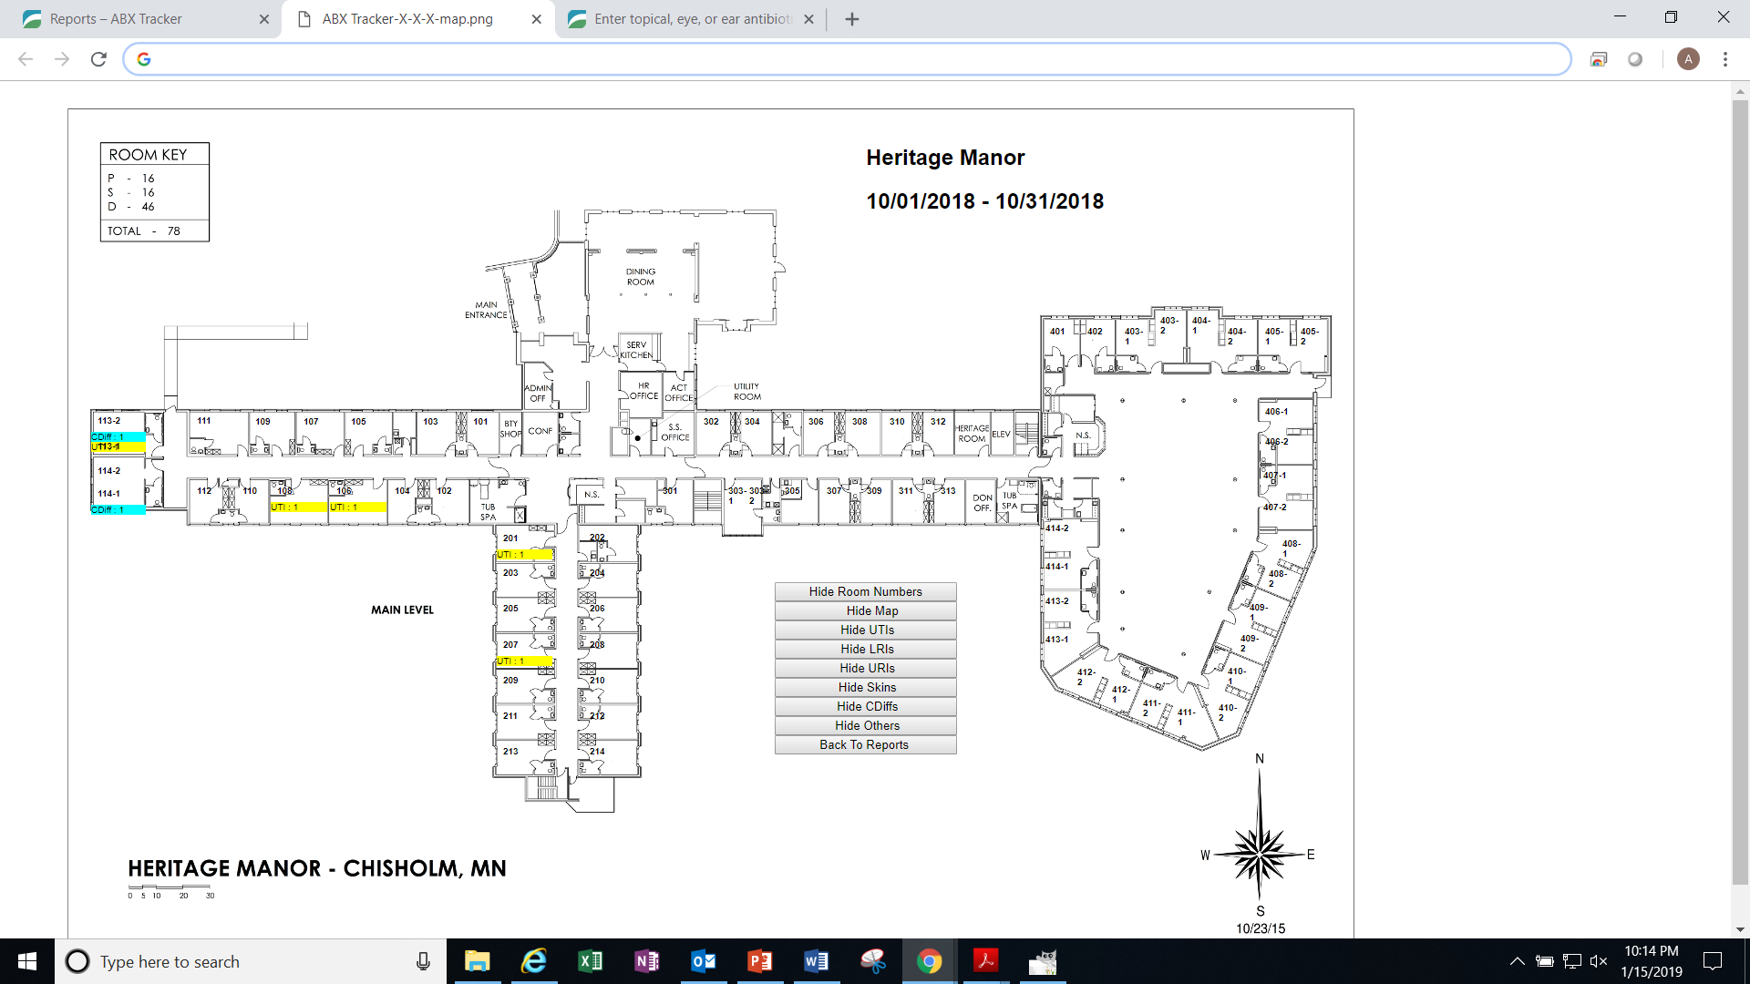

Slide 53
Antibiotic Stewardship
  Culture reports, sensitivity data, and antibiotic usage reviews are included in surveillance activities.
  Medical criteria and standardized definitions of infections are utilized in the recognition and management of actual and potential infections.
  Antibiotic usage is evaluated, and the NP/MD are provided feedback on the evaluations.

Slide 54
Data Analysis
  Data gathered during surveillance is used to tracking and recognize infection trends
  The IP will gather this data and provide analysis to the committee

Slide 55
Antibiogram
Generated after bacteria are isolated (as from a patient's tissues or body fluids)and subjected to laboratory testing.
Collection of data usually in the form of a table summarizing the percent of individual bacterial pathogens susceptible to different antimicrobial agents

Slide 56
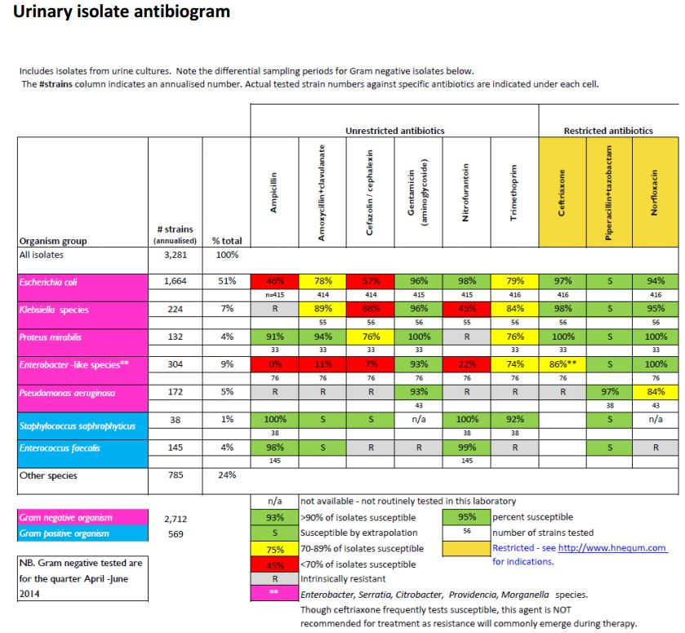

Slide 57
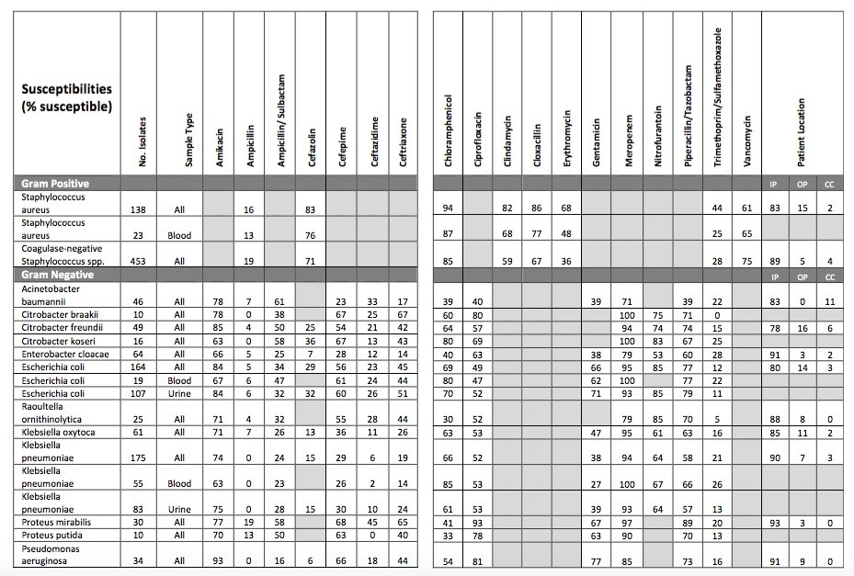

Slide 58
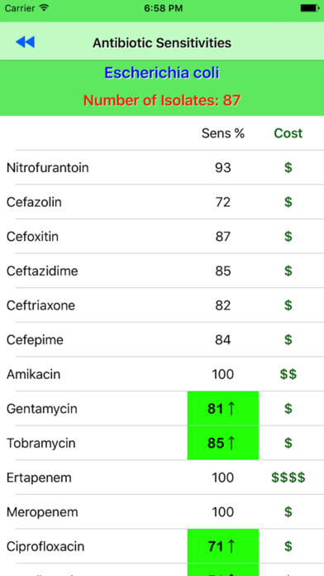

Slide 59
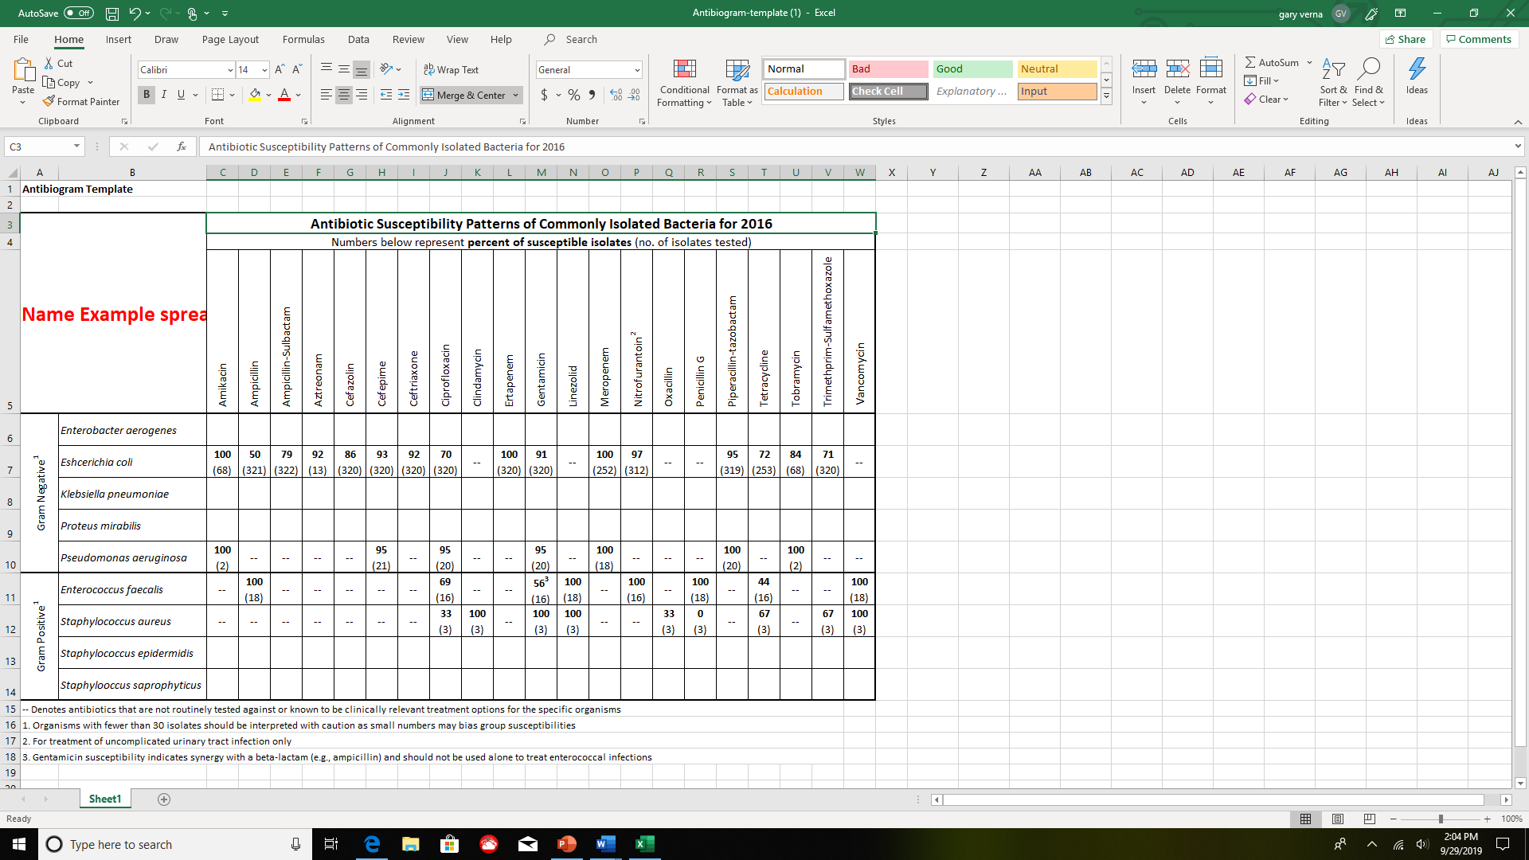

Slide 60
Immunization
Immunization is a form of primary prevention.
Influenza vaccine in the nursing facility is strongly encouraged.
Each resident will be offered an influenza immunization October 1 through March 31 annually, unless the immunization is medically contraindicated, or the resident has already been immunized during this time period;
The resident’s medical record includes documentation that indicates, at a minimum, the following:
That the resident or resident’s representative was provided education regarding the
benefits and potential side effects of influenza immunization; and
(b) That the resident either received the influenza immunization or did not receive the
influenza immunization due to medical contraindications or refusal.

Slide 61
Pneumococcal Immunization
  Each resident is offered a pneumococcal immunization, unless the immunization is medically contraindicated, or the resident has already been immunized
  Before offering the pneumococcal immunization, each resident or the resident’s representative receives education regarding the benefits and potential side effects of the immunization
  Before offering the pneumococcal immunization, each resident or the resident’s representative receives education regarding the benefits and potential side effects of the immunization;
  (ii) Each resident is offered a pneumococcal immunization, unless the immunization is medically contraindicated or the resident has already been immunized;
  (iii) The resident or the resident’s representative has the opportunity to refuse immunization; and
  (iv) The resident’s medical record includes documentation that indicates, at a minimum, the following:
  (A) That the resident or resident’s representative was provided education regarding the benefits and potential side effects of pneumococcal immunization; and
  (B) That the resident either received the pneumococcal immunization or did not receive the pneumococcal immunization due to medical contraindication or refusal.
  COVID-19 & Boosters- Adhere to CDC guidelines

Slide 62
Monitoring Employee Health and Safety
Pre-employment screening for infections required by law or regulation (such as TB) & COVID-19
Limitations (such as visiting restrictions) when there are infectious outbreaks in the facility; and during flu season
Employees with potential and direct exposure to blood and body fluids are trained upon hire and provided with personal protective equipment and appropriate training for needle exposure and as needed.

Slide 63
Education and Inservice Training
The Infection Control Preventionist (IP) & the Infection Control Committee will oversee the training programs for all employees who may have the potential for exposure to blood, or to body fluids containing visible blood, during their workday.
The IP will focus on identifying and using procedures related to the prevention of bloodborne illnesses.

Slide 64
Record keeping

Slide 65
The Infection Prevention and Control Committee will ensure that records are maintained to document the following:
In-service training records, with dates and content of training sessions and documentation of the signature of the employees conducting and receiving of said training.
Any issues or concerns observed or identified with infection control practices that include issues or concerns with protective clothing or equipment, exposure to body fluids and any actions taken in events of noncompliance
Any issues identified with surveillance of antibiotic usage and any patterns that would signify concerns or issues with Antibiotic Stewardship.

Slide 66
Documentation of Infection Control Meeting

Slide 67
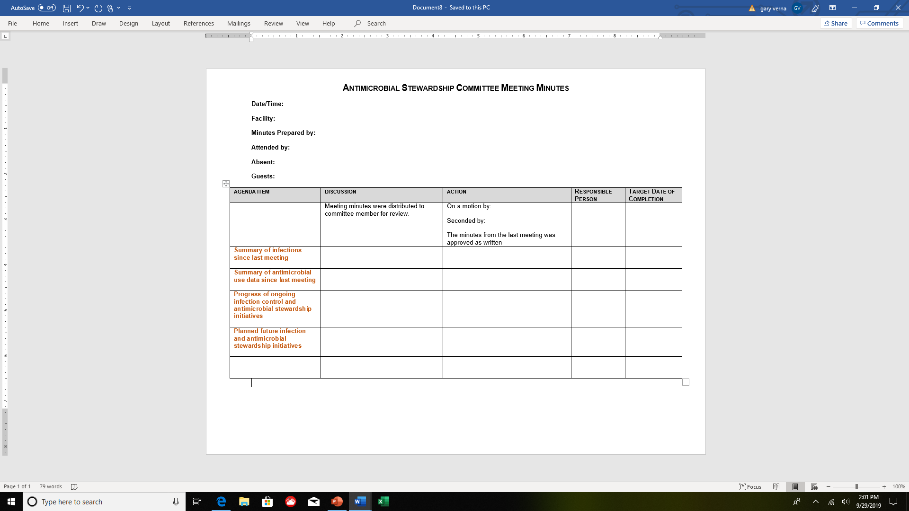

Slide 68
Infection Preventionist Participation on Quality Assessment and Assurance Committee.
The individual designated as the IP, or at least one of the individuals if there is more
than one IP, must be a member of the facility’s quality assessment and assurance
committee and report to the committee on the IPCP on a regular basis.

Slide 69
QAA Committee
The committee should be composed of staff who understand the characteristics and
complexities of the care and services delivered by each unit, and/or department.
The QAA Committee must be composed of, at a minimum:
• The director of nursing (DON),
• The Medical Director or his/her designee,
• The Infection Preventionist (IP), and
• At least three other staff, one of whom must be the facility’s administrator, owner,
board member, or other individual in a leadership role who has knowledge of
facility systems and the authority to change those systems.

Slide 70
Infection Preventionist Participation on Quality Assessment and Assurance (QAA) Committee:
The IP must be a participant on the facility’s QAA committee and report on the IPCP and
on incidents (e.g., healthcare-associated infections (HAIs)) identified under the program
on a regular basis.
Reporting may include, but is not limited to, facility process and outcome surveillance, outbreaks (ongoing and any since the last meeting) and control measures, occupational health communicable disease illnesses (e.g., TB, influenza) and the Antibiotic Stewardship Program (ASP) related to antibiotic use and resistance data.
In order to be considered an active participant, the IP should attend each QAA meeting.
If the IP cannot attend, another staff member should report on the IP’s behalf but this
does not change or absolve the IP’s responsibility to fulfill the role of QAA committee
member or reporting on the IPCP.

Slide 71
QAA Committee and the Governing Body
Functioning under the facility’s governing body, the QAA committee is responsible for reporting its’ activities, including the implementation of the QAPI program, to the governing body or designated person(s) functioning as the governing body.
Note: Small facilities might not have a Governing Body; there may only be an administrator who is already a required member of the QAA committee, and therefore, already apprised of QAPI activities.

Slide 72
Use of SBAR in Antibiotic Stewardship
Situation
Background
Assessment
Recommendation

Slide 73
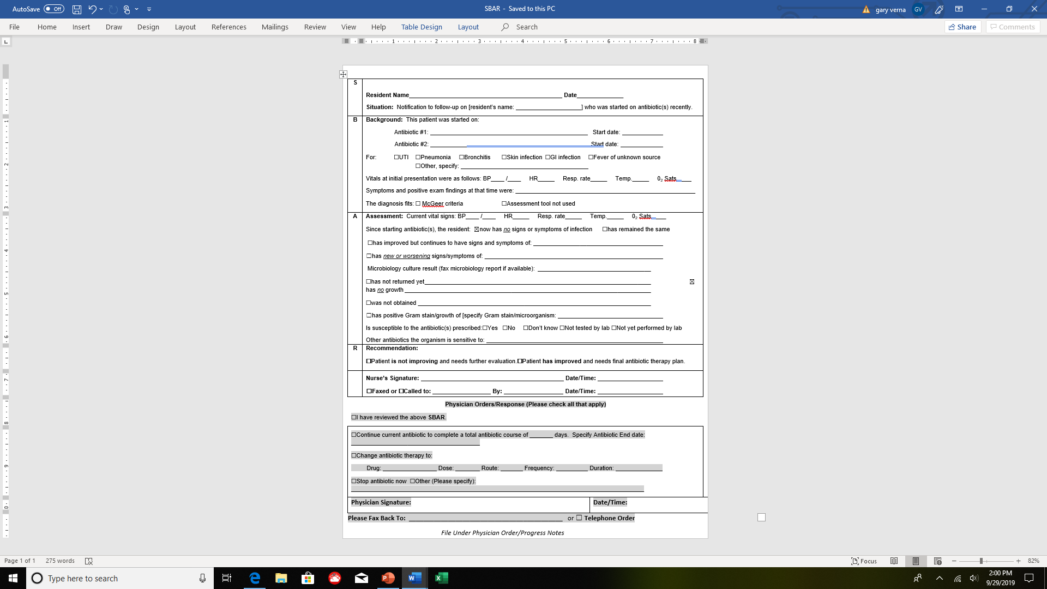

Slide 74
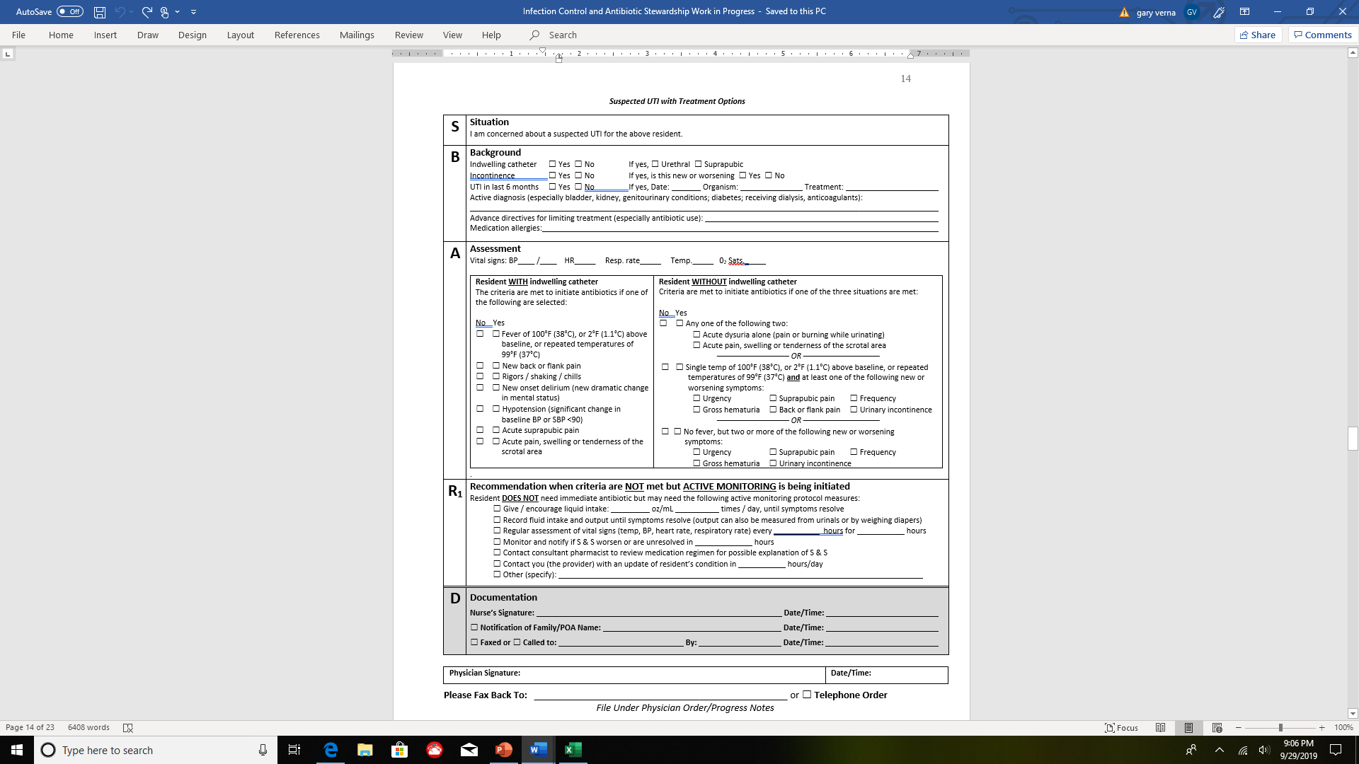

Slide 75
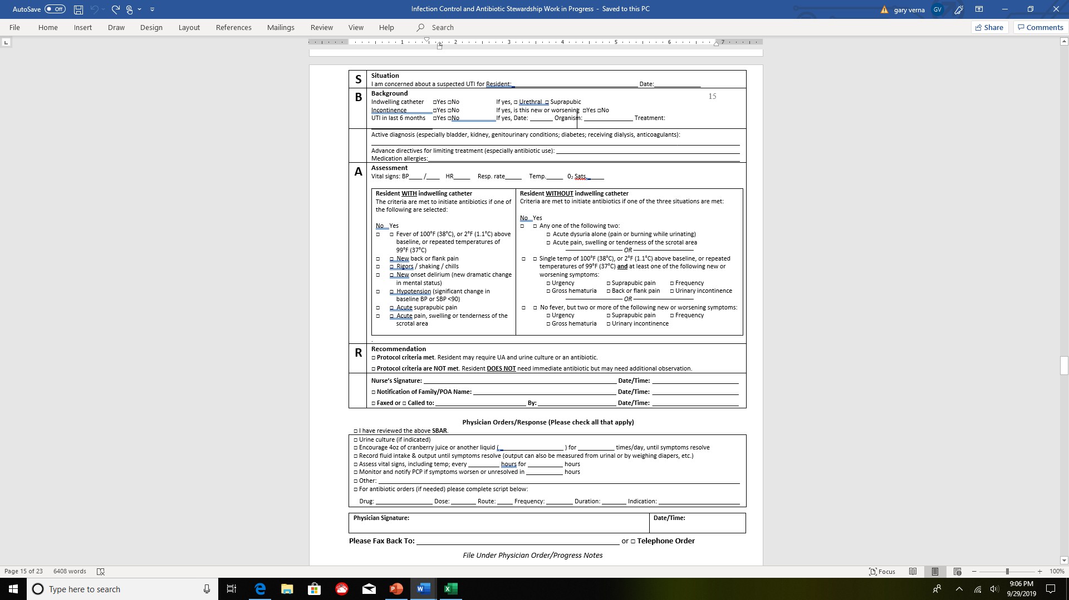

Slide 76
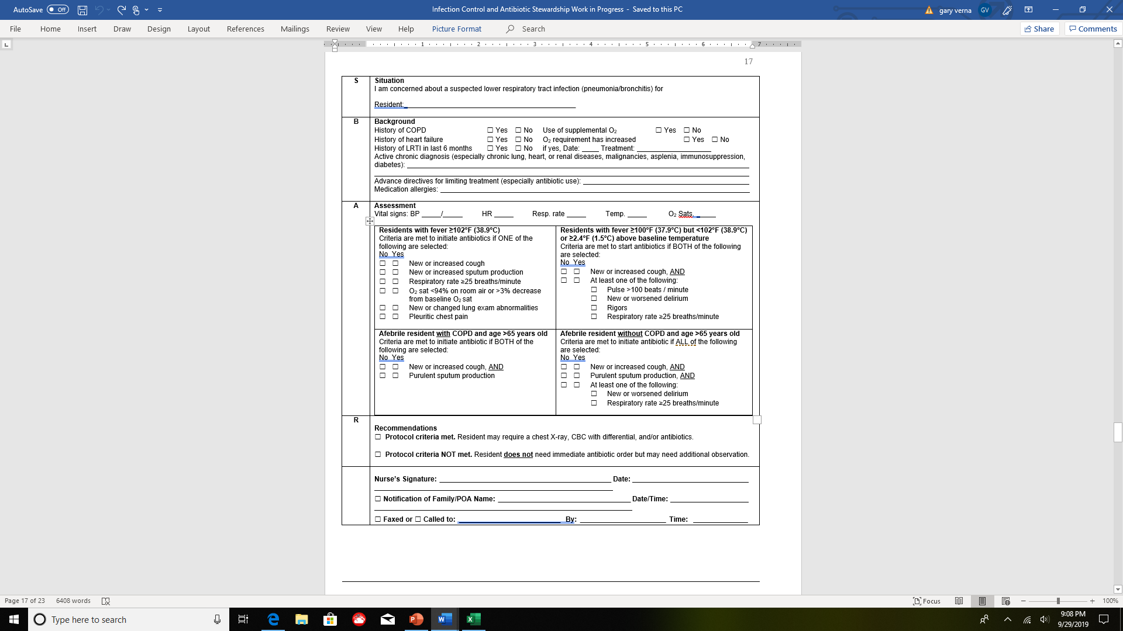

Slide 77
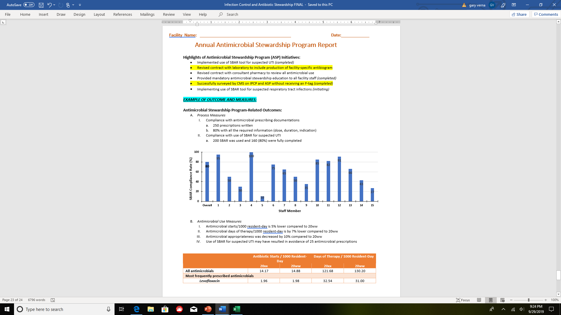

Slide 78
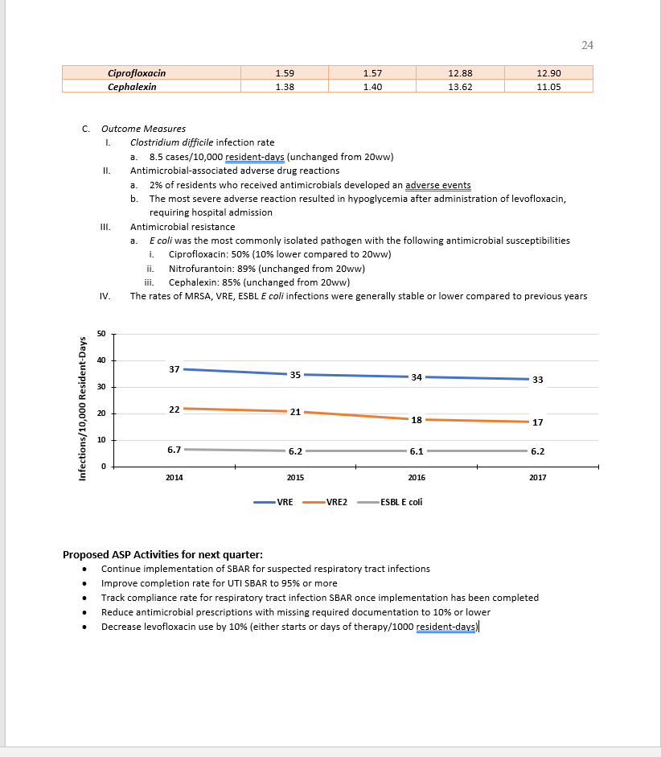

Slide 79
Revised McGeer Criteria for Infection Surveillance

Slide 80
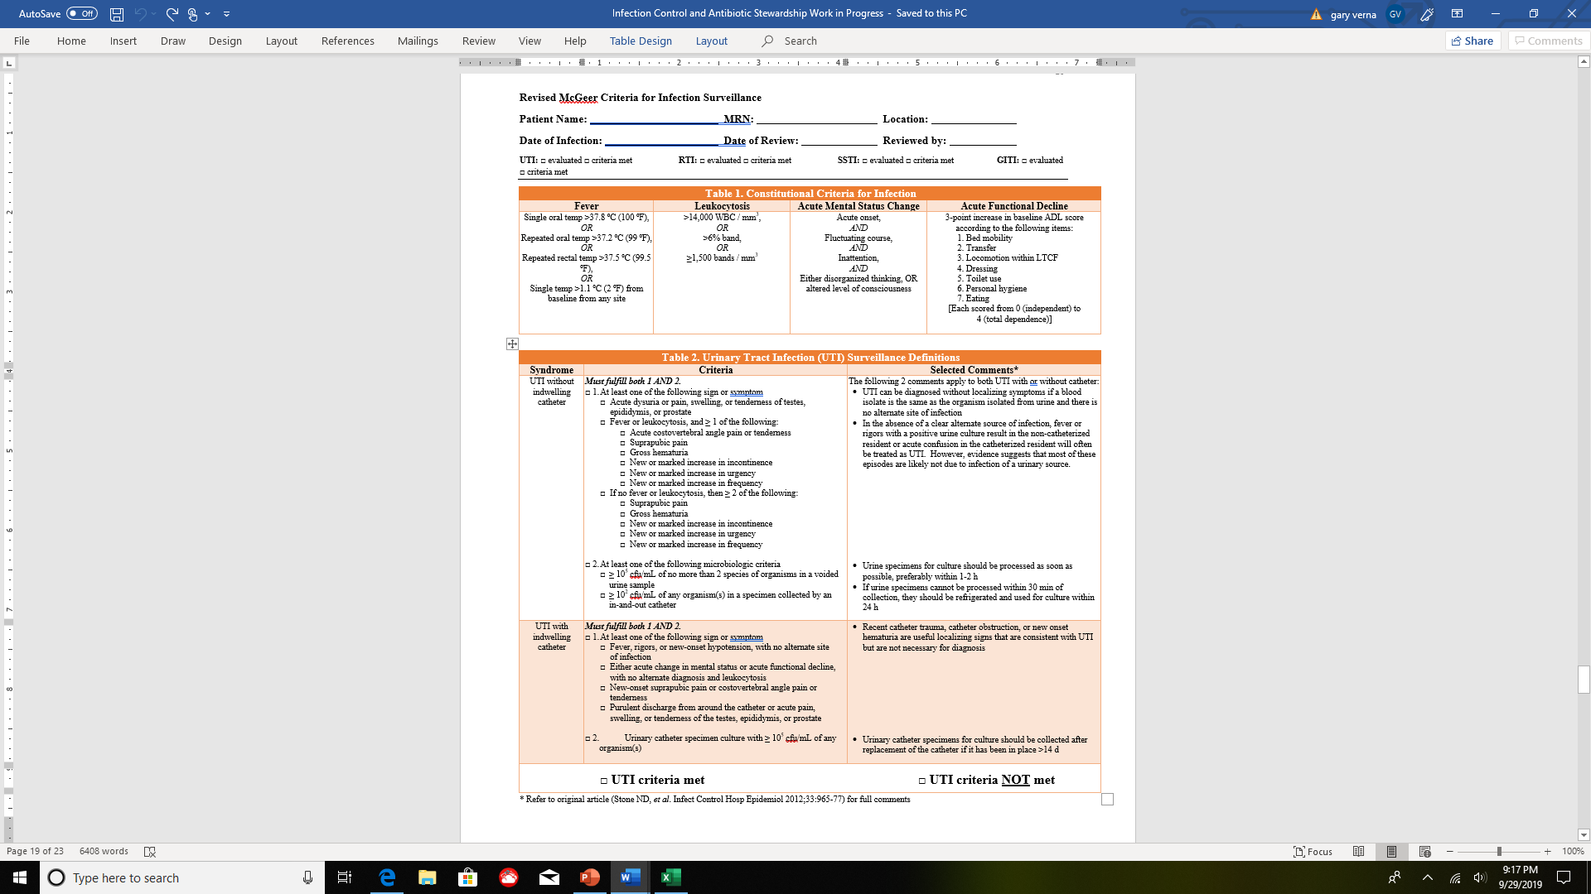

Slide 81
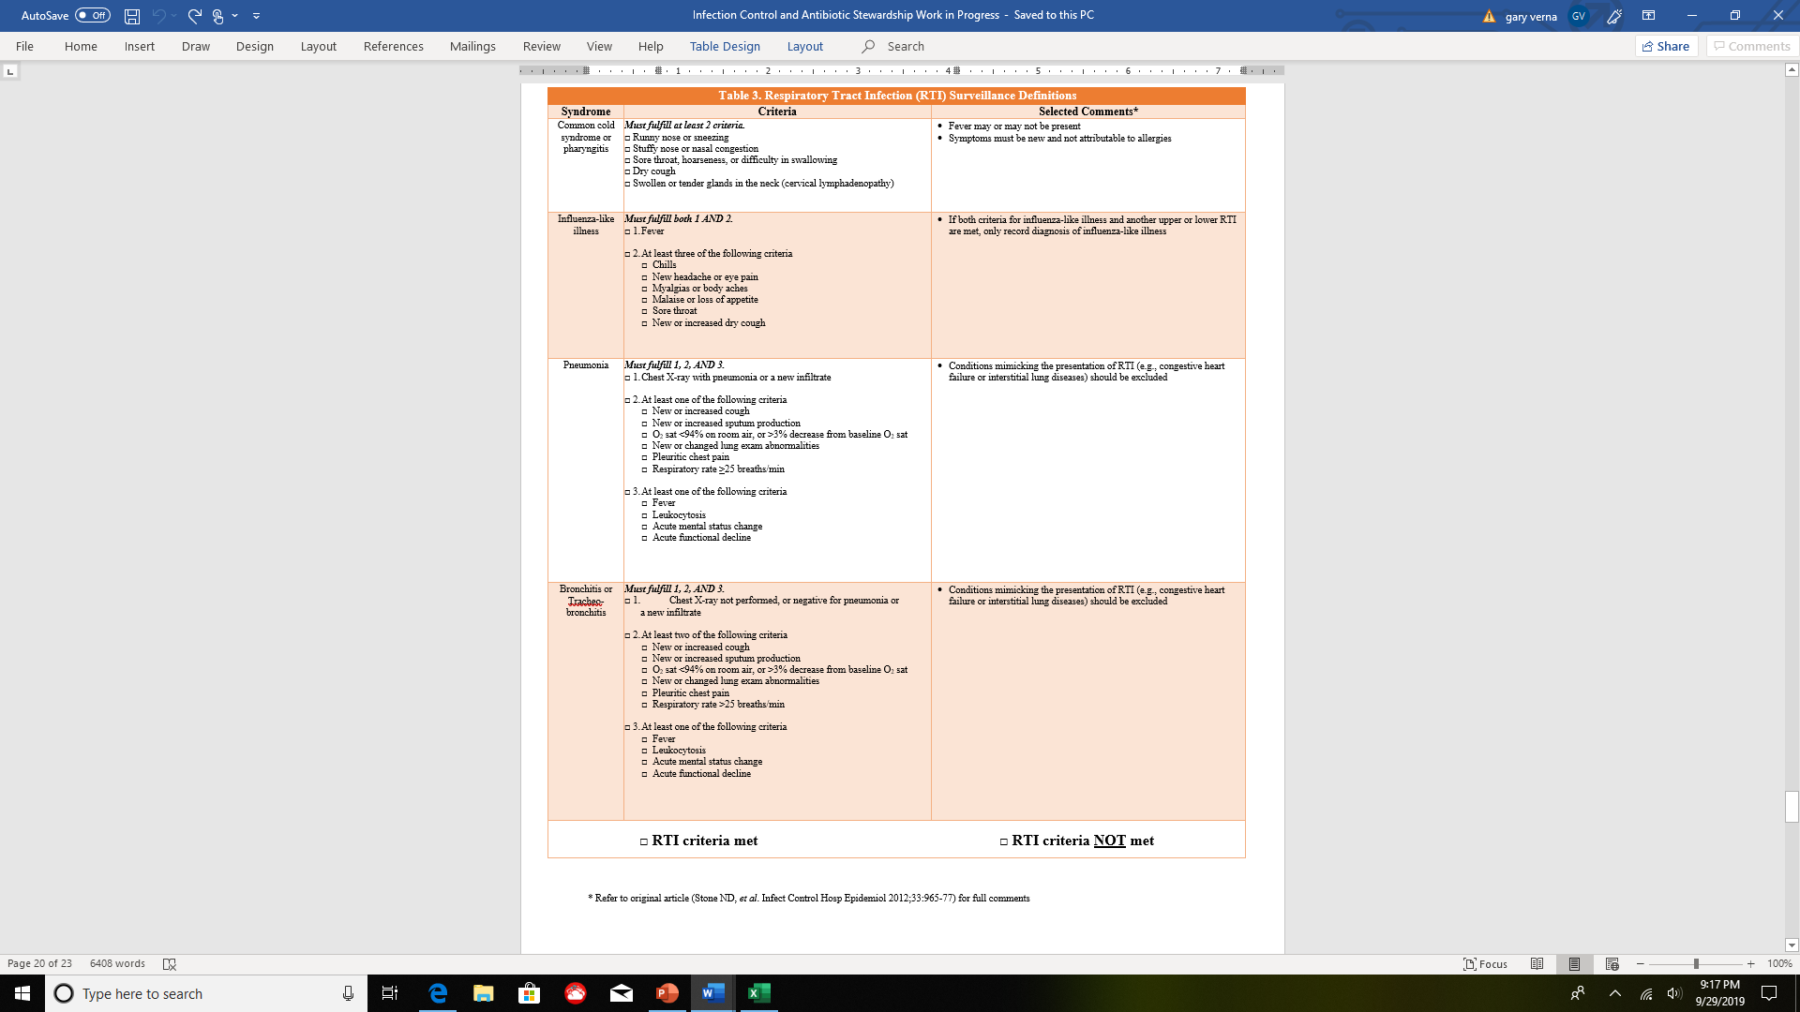

Slide 82
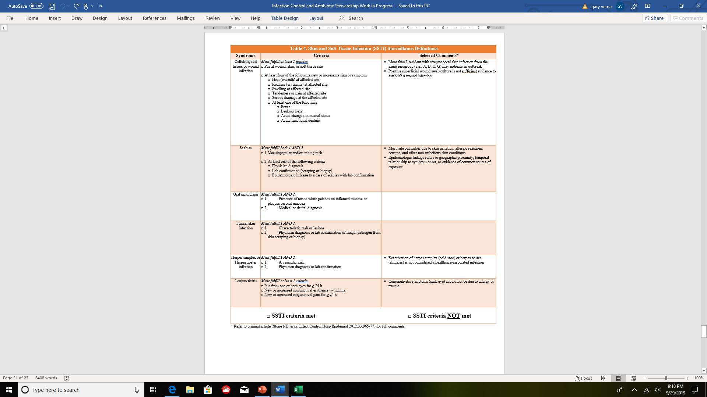

Slide 84
https://www.ahrq.gov/sites/default/files/wysiwyg/nhguide/6_TK1_T4-Be_Smart_About_Antibiotics_Final.pdf

Slide 85
F880
INFECTION CONTROL
The facility must establish and maintain an infection prevention and control program designed to provide a safe, sanitary, and comfortable environment and to help prevent the development and transmission of communicable diseases and infections.
WATER MANAGEMENT

Slide 86

Legionellosis
“Legionellosis” refers to two clinically and epidemiologically distinct illnesses: Legionnaires’ disease, which is typically characterized by fever, myalgia, cough, and clinical or radiographic pneumonia; and Pontiac fever, a milder illness without pneumonia (e.g., fever and muscle aches). Legionellosis is caused by Legionella bacteria

Slide 87

Water Management
The bacterium Legionella can cause a serious type of pneumonia called Legionnaires’ Disease in persons at risk, such as those who are at least 50 years old, smokers, or with underlying medical conditions such as chronic lung disease or immunosuppression.
Legionella can grow in parts of building water systems that are continually wet (e.g., pipes, faucets, water storage tanks, decorative fountains), and certain devices can spread contaminated water droplets via aerosolization.

Slide 88

Legionellosis Outbreaks
Generally are linked to locations where water is held or accumulates and pathogens can reproduce, including those found in long-term care facilities.
Transmission from these water systems to humans occurs when the water is aerosolized (i.e., converted into a spray/mist in the air).

Slide 89

Legionella is less commonly spread by aspiration of drinking water or ice.
Facilities must be able to demonstrate its measures to minimize the risk of Legionella and other opportunistic pathogens in building water systems such as by having a documented water management program.

Slide 90
Water management must be based on nationally accepted standards (e.g., ASHRAE (formerly the American Society of Heating, Refrigerating, and Air Conditioning Engineers), CDC, U.S. Environmental Protection Agency or EPA) and include:
• An assessment to identify where Legionella and other opportunistic waterborne pathogens (e.g., Pseudomonas, Acinetobacter) could grow and spread; and
• Measures to prevent the growth of opportunistic waterborne pathogens (also known as control measures), and how to monitor them.

Slide 91
CDC has a published toolkit that includes a worksheet for the Water Management Program
Legionella Toolkit-Version 1.1-June 24, 2021 (cdc.gov)

Slide 92

Legionella Toolkit-Version 1.1-June 24, 2021 (cdc.gov)

Slide 93
Examples of an assessment include a description of the building water systems using text and flow diagrams for identification.
Additionally, control measures may include visible inspections, use of disinfectant, and temperature (that may require mixing valves to prevent scalding).
Monitoring such controls include testing protocols for control measures, acceptable ranges, and documenting the results of testing. Water management should also include established ways to intervene when control limits are not met.

Slide 94
An industry standard calling for the development and implementation of water management programs in large or complex building water systems to reduce the risk of legionellosis was published by ASHRAE.

Slide 95

Resources are available to develop and implement a water management program, such as:
• “The ASHRAE Standard 188- Legionellosis: Risk Management for Building Water Systems” https://www.ashrae.org;
• The CDC toolkit to facilitate implementation of the ASHRAE Standard titled “Developing a Water Management Program to Reduce Legionella Growth & Spread in Buildings: A Practical Guide to Implementing Industry Standards” https://www.cdc.gov/legionella/wmp/toolkit/index.html; and
• The EPA's “Technologies for Legionella Control in Premise Plumbing Systems: Scientific Literature Review” is available at https://www.epa.gov/ground-waterand-drinking-water/technologies-legionella-control-premise-plumbing-systems.

Slide 96
The facility should contact the local/state public health authority if there is a case of healthcare-associated legionellosis or an outbreak of an opportunistic waterborne pathogen causing disease.
The facility must follow public health authority recommendations which may include, but is not limited to, remediating the pathogen reservoir and adjusting control measures as necessary.
Health Facilities Commission will work with local/state public health authorities, if possible, to determine if the water management program was inadequate to prevent the growth of Legionella or other opportunistic waterborne pathogens and whether the facility implemented adequate prevention and control measures once the issue was identified.

Slide 97


Slide 98

F847 Entering Into Binding Arbitration Agreements

Slide 99

§483.70(n) Binding Arbitration Agreements
If a facility chooses to ask a resident or his or her representative to enter into an agreement for binding arbitration, the facility must comply with all of the requirements
in this section.
§483.70(n)(1) The facility must not require any resident or his or her representative to sign an agreement for binding arbitration as a condition of admission to, or as a
requirement to continue to receive care at, the facility and must explicitly inform the resident or his or her representative of his or her right not to sign the agreement as a
condition of admission to, or as a requirement to continue to receive care at, the facility.
§483.70(n)(2) The facility must ensure that:
(i) The agreement is explained to the resident and his or her representative in a form and manner that he or she understands, including in a language the resident and his
or her representative understands;
(ii) The resident or his or her representative acknowledges that he or she understands the agreement…

Slide 100

§483.70(n)(3) The agreement must explicitly grant the resident or his or her representative the right to rescind the agreement within 30 calendar days of signing it.

Slide 101
§483.70(n)(4) The agreement must explicitly state that neither the resident nor his or her representative is required to sign an agreement for binding arbitration as a condition of admission to, or as a requirement to continue to receive care at, the facility.
§483.70(n)(5) The agreement may not contain any language that prohibits or discourages the resident or anyone else from communicating with federal, state, or local officials, including but not limited to, federal and state surveyors, other federal or state health department employees, and representative of the Office of the State Long-Term Care Ombudsman, in accordance with §483.10(k). . .

Slide 102
INTENT
To ensure that long-term care facilities inform residents or their representatives of the
nature and implications of any proposed binding arbitration agreement, to inform their
decision on whether or not to enter into such agreements.
The requirements at F847 emphasize the residents’ or their representatives’ right to
make informed decisions and choices about important aspects of residents’ health,
safety and welfare.
Facilities may present residents or their representatives the opportunity to utilize a
binding arbitration agreement to resolve disputes at any time during a resident’s stay as
long as the agreement complies with the regulations at §483.70(n)(1)-(5).

Slide 103

DEFINITIONS

Slide 104
1.) Arbitration: A private process where disputing parties agree that one or several other individuals can make a decision about the dispute
after receiving evidence and hearing arguments.
2.) Binding Arbitration Agreement (Arbitration Agreement or Agreement): a binding agreement by the parties to submit to arbitration all
or certain disputes which have arisen or may arise between them in respect of a defined legal relationship, whether contractual or not.
The decision is final, can be enforced by a court, and can only be appealed on very narrow grounds.
3.) Pre-dispute binding arbitration agreement (pre-dispute arbitration agreement or pre-dispute agreement): A binding agreement to
resolve a future unknown dispute with an arbitrator prior to any issue or dispute arising.
4. )Post-dispute binding arbitration agreement (post-dispute arbitration agreement, or post-dispute agreement): A binding agreement
signed after the circumstances of the dispute have occurred to resolve the dispute with an arbitrator.
5.) Dispute: A disagreement, controversy, or claim amongst parties where one party claims to have been harmed.
6.) Judicial Proceedings: any action by a judge (i.e., trials, hearings, petitions, or other matters) formally before the court.

Slide 105

GUIDANCE
Over the years, long-term care facilities and residents have used arbitration to resolve many disputes. Parties subject to arbitration give up their right to have some or all claims heard in court
The results of arbitration decisions are typically not disclosed to the public and arbitrators’ decisions are generally final and binding with little or no opportunity to initiate judicial proceedings that challenge unfavorable decisions.
Concerns have been raised about the fairness and transparency related to both the means by which these agreements are created and the fairness of the arbitration processes themselves in the specific context of long-term care facilities.
For example, an individual is often admitted to a long-term care facility directly from the hospital after a decline in their health. These individuals are often quite ill and are not in a position to engage in meaningful negotiations over the terms of an arbitration agreement or to coordinate care at another facility. As a result, this is quite often an extremely stressful situation with limited time to review documents before signing them.
During this time, long-term care facilities have often required individuals to sign pre-dispute arbitration agreements to obtain health care.
These factors, among others, impede individuals’ ability to obtain care and simultaneously make it extremely difficult for residents or their representatives to make an informed decision about arbitration. Therefore, asking individuals to commit to binding arbitration agreement in these situations may not represent the best option in terms of advancing the health care of residents.
This Photo by Unknown Author is licensed under CC BY-SA

Slide 106
USE OF A BINDING ARBITRATION AGREEMENT MUST BE:
Voluntary
Clearly communicated to the residents or their representatives
Optional
Not requirement as a condition of admission or to continue to receive care at the facility.
The agreement must be explained so that the resident or his or her representative understands the terms of the agreement.
This should include an explanation that the resident may be giving up his or her right to have a dispute decided in a court proceeding. And residents and their representatives must be provided 30 days after signing to fully review and potentially rescind any agreement that was not understood at the time of admission.
Pre- and Post-dispute Arbitration Agreements: Binding arbitration agreements may be offered either before (pre-dispute) or after (post-dispute) a dispute arises.
A pre-dispute binding arbitration agreement is an agreement to resolve an unspecified future dispute(s) through arbitration.
Facilities must not require residents or their representatives to enter into a binding pre-dispute arbitration

Slide 107
Surveyors should determine how the facility ensures residents or their representatives understood the terms of the binding arbitration agreement, and how this understanding is acknowledged.
Surveyors must verify through interview and record review, that the resident or their representative understood what they were signing.
In situations where the resident may have cognitive impairment, surveyors should refer to the medical record to identify the resident’s health care decision-making capacity at the time the agreement was offered, explained, and entered into.
Surveyors should thoroughly investigate the basis for transfer or discharge for any resident who has refused to enter into a binding arbitration agreement, and has been, or will be subsequently transferred or discharged.
For additional information, refer to the guidance at §483.15(c) - F622, Transfer and Discharge Requirements.

Slide 108

Arbitration Agreements Embedded within other Contracts or Agreements:
Binding arbitration agreements may not necessarily be a stand-alone document.
Facilities may choose to offer pre-dispute arbitration agreements at the time of admission.
Some facilities may embed the arbitration agreement within the admission agreement, contract, or other documents.
In these cases, all of the requirements related to arbitration agreements still apply.

Slide 109

F848 Arbitrator/Venue Selection and Retention of Agreements
§483.70(n) Binding Arbitration Agreements.
§483.70(n)(2) The facility must ensure that . . .
(iii) The agreement provides for the selection of a neutral arbitrator agreed upon by both parties; and
(iv)The agreement provides for the selection of a venue that is convenient to both parties. . .
§483.70(n)(6) When the facility and a resident resolve a dispute through arbitration, a copy of the signed agreement for binding arbitration and the arbitrator's final decision must be retained by the facility for 5 years after the resolution of that dispute on and be available for inspection upon request by CMS or its designee.

Slide 110
Neutral Arbitrator: An impartial, or unbiased third-party decision maker, contracted with, and agreed to by both parties to resolve their dispute.
GUIDANCE The requirement at §483.70(n)(2)(iii) states “the facility must ensure that the agreement provides for the selection of a neutral arbitrator agreed upon by both parties.”
Facilities wishing to utilize binding arbitration agreements should make reasonable efforts to ensure that any arbitration agreement entered into with a resident or his or her representative provides for the selection of an arbitrator who is impartial, unbiased, and without the appearance of a conflict of interest.
This ensures the integrity of the arbitration process, and also ensures that residents who choose this alternative dispute resolution are treated
Facilities may put forward suggestions for the use of specific arbitrators for residents (or their representatives) to select.
The resident or his or her representative is not obligated to use the arbitrator (either an arbitration services company or an individual arbitrator) suggested by the facility, and may suggest an alternative arbitrator of their choosing.
Facilities are expected to make a reasonable attempt to come to agreement with the resident or resident’s representative on the selection of a neutral arbitrator and provide a fair process for selecting an arbitrator or arbitration services company.

Slide 111

The requirement at §483.70(n)(2)(iv) states “the facility must ensure the agreement provides for the selection of a venue that is convenient to both parties.”
The venue is the geographical location of the arbitration proceeding that may be chosen, in part, on the basis of convenience. Convenience for the resident or resident’s representative may be determined by his or her needs in terms of ability to get to the venue.
The binding arbitration agreement must allow for the selection of a venue that is suitable in meeting the needs of both the resident or his or her representative, and the facility. The venue should be agreed upon by both parties.

Slide 112
KEY ELEMENTS OF NON-COMPLIANCE F848:
The surveyor’s investigation will generally show that the facility failed to do any one or more of the following:
• Ensure that the arbitration agreement specifically provides for the selection of a neutral arbitrator; or
• Ensure that the arbitration agreement specifically provides for the selection of a venue that is
convenient; or
For disputes resolved by arbitration, the facility failed to:
• Retain a copy of the signed agreement for binding arbitration and the arbitrator's final decision (for
disputes resolved by arbitration) after the facility and a resident or their representative resolve a
dispute through arbitration for five (5) years; or
• Refuse to make the signed agreement or final decision available for inspections upon request by CMS
or its designee.

Slide 113


Slide 114
F851
§483.70(q) Mandatory Submission of Staffing Information Based on Payroll Data in a Uniform Format.

Slide 115
Long-term care facilities must electronically submit to CMS complete and accurate direct care staffing information, including information for agency and contract staff, based on payroll and other verifiable and auditable data in a uniform format according to specifications established by CMS.

Slide 116
§483.70(q)(1) Direct Care Staff.
Direct Care Staff are those individuals who, through interpersonal contact with residents or resident care management, provide care and services to
allow residents to attain or maintain the highest practicable physical, mental, and psychosocial wellbeing.
Direct care staff does not include individuals whose primary duty is maintaining the physical environment of the long term care facility
(for example, housekeeping). §483.70(q)(2) Submission requirements.

Slide 117

The facility must electronically submit to CMS complete and accurate direct care staffing information, including the following:
The category of work for each person on direct care staff (including, but not limited to, whether the individual is a registered nurse, licensed practical nurse, licensed vocational nurse, certified nursing assistant, therapist, or other type of medical personnel as specified by CMS);
(ii) Resident census data; and
(iii) Information on direct care staff turnover and tenure, and on the hours of care provided by each category of staff per resident per day (including, but not limited to, start date, end date (as applicable), and hours worked for each individual).
§483.70(q)(3) Distinguishing employee from agency and contract staff.

Slide 118

When reporting information about direct care staff, the facility must specify whether the individual is an employee of the facility, or is engaged by the facility under contract or through an agency.
The facility must submit direct care staffing information on the schedule specified by CMS, but no less frequently than quarterly.

Slide 119
INTENT §483.70(q) To ensure that long-term care facilities are electronically submitting direct care staffing information (including agency and contract staff) per day, based on payroll and other verifiable and auditable data.
The staffing hours, when combined with census information, can then be used to not only report on the level of staff in each nursing home, but also to report on employee turnover and tenure.

Slide 120
GUIDANCE §483.70(q)
The facility must electronically submit to CMS complete and accurate direct care staffing information, including the following:
The category of work for each person on direct care staff (including, but not limited to, whether the individual is a registered nurse, licensed practical nurse, licensed vocational nurse, certified nursing assistant, therapist, or other type of medical personnel as specified by CMS);
(ii) Resident census data; and
(iii) Information on direct care staff turnover and tenure, and on the hours of care provided by each category of staff per resident per day (including, but not limited to, start date, end date (as applicable), and hours worked for each individual).

Slide 121
The facility is responsible for ensuring all staffing data entered in the Payroll-Based Journal (PBJ) system is auditable and able to be verified through either payroll, invoices, and/or tied back to a contract.
The surveyors can obtain PBJ data from the Certification And Survey Provider Enhanced Reports (CASPER) report to determine if the facility submitted the required staffing information based on payroll data in a uniform format.
The facility’s failure to submit PBJ data as required will be reflected on their CASPER report and result in a deficiency citation. If concerns were identified based on the CASPER report, or from any other source, refer to the critical element pathway “Sufficient and Competent Staffing.”

Slide 122
Refer to the CMS Electronic Staffing Data Submission Payroll-Based Journal Policy Manual for submission guidelines.
Please see the following link for more information:
https://www.cms.gov/Medicare/Quality-Initiatives-Patient-AssessmentInstruments/NursingHomeQualityInits/Staffing-Data-Submission-PBJ.html
For questions related to F851, surveyors, providers, or other stakeholders should email NHStaffing@cms.hhs.gov.

Slide 123

KEY ELEMENTS OF NONCOMPLIANCE
To cite deficient practice at F851, the surveyor’s investigation will generally show that the facility failed to do any one of the following:
Complete data for the entire reporting period, such as
hours paid for all required staff, each day; or
Provide accurate data; or
Provide data by the required deadline; or,
Submit the required staffing information based on payroll data in a uniform format.
Noncompliance at F851 focuses on the submission of
staffing data.

Slide 124
If the surveyor identifies concerns related to sufficient staffing, surveyors would investigate these concerns using the Sufficient and Competent Staff Critical Element Pathway, and guidance at §483.35 Nursing Services (F725 & F727).
F865
§483.75(a) Quality assurance and performance improvement (QAPI) program.

Slide 125


Slide 126
Psychosocial Outcome Severity Guide

Slide 127
DEFINITIONS/
CLARIFICATIONS

Slide 128

“Anger” refers to an emotion caused by the frustrated attempts to attain a goal, or in response to hostile or disturbing actions such as insults, injuries, or threats.
“Apathy” refers to a marked indifference to the environment; lack of a response to a situation; lack of interest in or concern for things that others find moving or exciting; absence or suppression of passion, emotion, or excitement.
“Anxiety” refers to the apprehensive anticipation of future danger or misfortune accompanied by a feeling of distress, sadness, or somatic symptoms of tension. Somatic symptoms of tension may include, but are not limited to, restlessness, irritability, hyper- vigilance, an exaggerated startle response, increased muscle tone, and teeth grinding. The focus of anticipated danger may be internal or external.
“Dehumanization” refers to the deprivation of human qualities or attributes such as individuality, compassion, or civility. Dehumanization is the outcome resulting from having been treated as an inanimate object or as having no emotions, feelings, or sensations.
“Depressed mood” (which does not necessarily constitute clinical depression) is indicated by negative statements; self-deprecation; sad facial expressions; crying and tearfulness; withdrawal from activities of interest; and/or reduced social interactions.

Slide 129
Some residents such as those with moderate or severe cognitive impairment may be more likely to demonstrate nonverbal symptoms of depression.
“Fear” is defined as an unpleasant often strong emotion caused by anticipation or
awareness of danger.
“Humiliation” refers to a feeling of shame due to being embarrassed, disgraced, or
depreciated. Some individuals lose so much self-esteem through humiliation that they
become depressed.
“Psychosocial” refers to the combined influence of psychological factors and the
surrounding social environment on physical, emotional, and/or mental wellness.

Slide 130

The purpose of the Psychosocial Outcome Severity Guide is to help surveyors determine the severity of psychosocial outcomes resulting from identified noncompliance at a specific Ftag, including how to determine the severity of the outcome when the impact on the resident may not be apparent or documented.
The Guide is used to determine the severity of a deficiency in any regulatory grouping (e.g., Quality of Life, Quality of Care) that resulted in, or may result in, a negative psychosocial outcome. This Guide is not intended to replace the current scope and severity grid, but rather it is intended to be used in conjunction with the scope and severity grid to determine the severity of outcomes to each resident involved in a deficiency that has resulted in a psychosocial outcome.

Slide 131
The team should select the level of severity for the deficiency based on the highest level of physical or psychosocial outcome.
For example, a resident who was slapped by a staff member may experience only a minor physical outcome from the slap but
suffer a greater psychosocial outcome, as demonstrated by fear, agitation, and/or withdrawal.
Another example is when a staff member physically assaults a resident with no resulting physical harm, but the resident only
demonstrates indifference to the incident at the time of the survey; however, it is likely that this caused a greater psychosocial
outcome.
In these cases, the severity level based on the psychosocial outcome would be used as the level of severity for the deficiency as
it would reflect the highest level of harm or potential for harm

Slide 132
Overview
Psychosocial outcomes (e.g., changes in mood and/or behavior) may result from a facility’s noncompliance with any regulatory requirement.
A resident may have experienced (or may have the potential or likelihood to experience) a negative physical outcome and/or a
negative psychosocial outcome resulting from facility noncompliance.
Psychosocial and physical outcomes are equally important in determining the severity of noncompliance, and both need to be
considered before assigning a severity level.
The severity level should reflect the highest level of harm/potential harm. The presence of a given affect (i.e., behavioral
manifestation of mood) does not necessarily indicate a psychosocial outcome that is the direct result of noncompliance.

Slide 133
A resident’s reactions and responses (or lack thereof) also may be affected by his/her preexisting psychosocial issues,
illnesses, medication side effects, and/or other factors.
Because many nursing home residents have sadness, anger, loss of self-esteem, etc. in reaction to normal life
experiences, the survey team must determine that the negative psychosocial outcome is a result of the noncompliance
and not a pre-existing condition for the resident.
Psychosocial outcomes may be the result of facility noncompliance with any regulation.
This also includes psychosocial outcomes resulting from a facility’s failure to assess and develop an adequate care plan
to address a resident’s pre-existing psychosocial issues, leading to continuation or worsening of the condition

Slide 134
Application of the Reasonable Person Concept
There are circumstances in which the survey team should apply the “reasonable person concept” to determine the outcome and the severity of the
deficiency, such as when a resident’s psychosocial outcome may not be readily determined through the investigative process.
The following are examples of circumstances in which a resident’s psychosocial outcome may not be readily determined through the investigative
process and the reasonable person concept should be used:
When a resident may not be able to express their feelings, there is no discernable response, or when circumstances may not permit the direct
evaluation of the resident’s psychosocial outcome. Such circumstances may include, but are not limited to, the resident’s death, cognitive
impairments, physical impairments, or insufficient documentation by the facility; or
When a resident’s reaction to a deficient practice is markedly incongruent (or different) with the level of reaction a reasonable person in the
resident’s position would have to the deficient practice. To apply the reasonable person concept, the survey team should determine the severity of
the psychosocial outcome or potential outcome the deficiency may have had on a reasonable person in the resident’s position (i.e., what degree of
actual or potential harm would one expect a reasonable person in a similar situation to suffer as a result of the noncompliance).

Slide 135
The survey team should consider the following regarding the resident’s position, which may include, but is not limited to:
The resident may consider the facility to be his/her “home,” where there is an expectation that he/she is safe,
has privacy, and will be treated with respect and dignity.
The resident trusts and relies on facility staff to meet his/her needs.
The resident may be frail and vulnerable. The surveyor should document the resident’s actual response and the
perspectives of someone familiar with the resident. In addition to the evidence gathered by the surveyor, the
use of the reasonable person concept should be applied and may reveal that the resident is likely to, or may
potentially, suffer a greater psychosocial outcome.
For example, in the case of a sexual assault, the resident did not exhibit a change in behavior as a result of the
incident. In addition, the resident’s relative presumed that the resident would be upset by the situation.
The evidence gathered by the surveyor should still be documented, but the determination of severity would be
based on how the reasonable person would experience serious psychosocial harm (immediate jeopardy) as a
result of a sexual assault. The survey team should document on the CMS-2567 when it applies the reasonable
person concept in determining the psychosocial outcome(s) for a deficiency

Slide 136

While the survey team may find negative psychosocial outcomes related to
any of the regulations, the following areas may be more susceptible to a
negative psychosocial outcome or contain a psychosocial element that may
be greater in severity than the physical outcome.

Slide 137
Areas where the survey team may more likely see psychosocial outcomes when citing a particular deficiency include, but are not limited to:
483.10 Resident Rights
F557, Respect, Dignity/Right to Have Personal Property;
F558, Reasonable Accommodation of Needs/Preferences;
483.12 Freedom from Abuse, Neglect, and Exploitation
F600 Free from Abuse and Neglect;
F602 Free from Misappropriation/Exploitation;
F603, Free from Involuntary Seclusion;
F604, Right to be Free from Physical Restraints;
F605, Right to be Free from Chemical Restraints;
F607, Develop/Implement Abuse/Neglect, etc. Policies;
F609, Reporting of Alleged Violations;
F610, Investigate/Prevent/Correct Alleged Violation;
483.21 Comprehensive Resident Centered Care Plans
F656, Develop/Implement Comprehensive Care Plan;
F657 Care Plan Timing and Revision;
F675, Quality of Life
F679, Activities Meet Interest/Needs of Each Resident;
483.25 Quality of Care
F699, Trauma Informed Care
483.40 Behavioral Health Services
F740, Behavioral Health Services;
F741 Sufficient/Competent Staff – Behavioral Health Needs;
F742, Treatment/Services for Mental/Psychosocial Concerns;
F743, No Pattern of Behavioral Difficulties Unless Unavoidable;
F745, Provision of Medically Related Social Services;
483.45 Pharmacy Services
F757, Drug Regimen is Free from Unnecessary Drugs; and
F758, Free from Unnecessary Psychotropic Medications/PRN Use

Slide 138


Slide 139
F758 Psychotropic Drugs
F641 Accuracy of Assessments.
F658 Services Provided Meet
Professional Standards

Slide 140
The assessment must accurately reflect the resident’s status.
INTENT §483.20(g) To assure that each resident receives an accurate assessment, reflective of the resident’s status at the time of the assessment, by staff qualified to assess relevant care areas and are knowledgeable about the resident’s status, needs, strengths, and areas of decline.
GUIDANCE §483.20(g) “Accuracy of Assessment” means that the appropriate, qualified health professionals correctly document the resident’s medical, functional, and psychosocial problems and identify resident strengths to maintain or improve medical status, functional abilities, and psychosocial status using the appropriate Resident Assessment Instrument (RAI) (i.e. comprehensive, quarterly, significant change in status).

Slide 141

Facilities are responsible for ensuring that all participants in the assessment process have the requisite knowledge to complete an accurate assessment.
The determination of appropriate participation of health professionals must be based on the physical, mental and psychosocial condition of each resident.
This includes an appropriate level of involvement of physicians, nurses, rehabilitation therapists, activities professionals, medical social workers, dietitians, and other professionals, such as developmental disabilities specialists, in assessing the resident, and in correcting resident assessments.
Involvement of other disciplines is dependent upon resident status and needs.

Slide 142
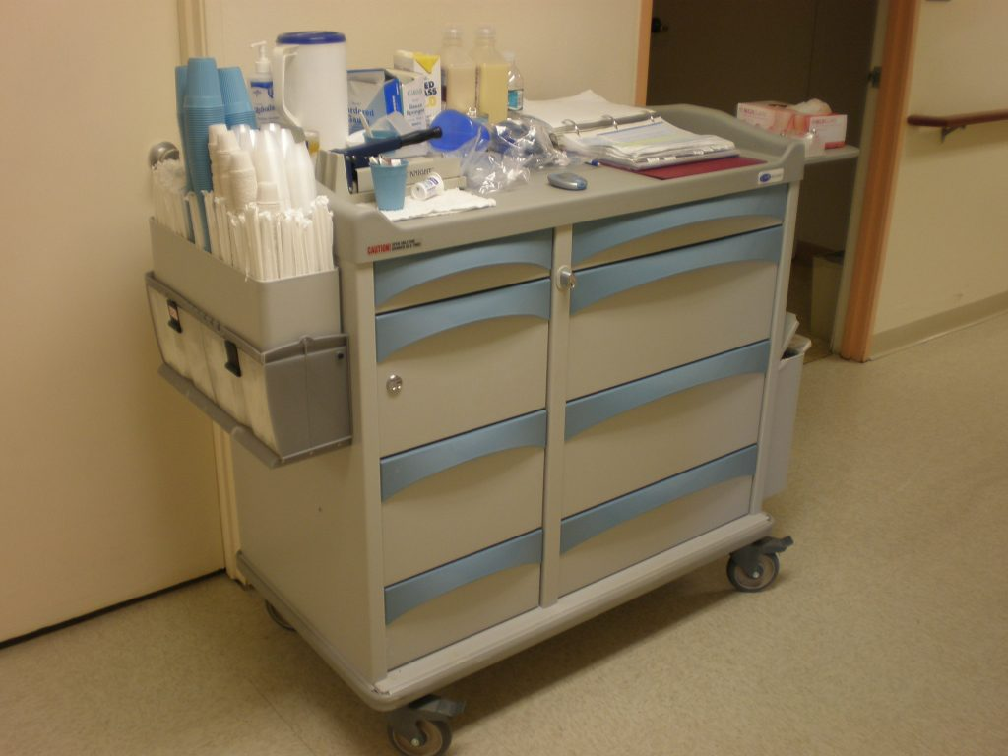
If the resident’s condition has not responded to treatment or has declined despite treatment, it is important to evaluate both the medication and the dose to determine whether the medication should be discontinued or the dosing should be altered, whether or not the facility has implemented GDR as required, or tapering.
Dose reductions should occur in modest increments over adequate periods of time to minimize withdrawal symptoms and to monitor symptom recurrence.
Additional information related to gradual dose reduction may be found The American Psychiatric Association Practice Guidelines on the use of Antipsychotics to Treat Agitation or Psychosis in Patients with Dementia, 2016 https://psychiatryonline.org/doi/full/10.1176/appi.books.9780890426807.ap02 and at https://www.ncbi.nlm.nih.gov/pmc/articles/PMC3119470/, Discontinuing Medications: A Novel Approach for Revising the Prescribing Stage of the Medication-Use Process (2008).
This Photo by Unknown Author is licensed under CC BY

Slide 143

CMS is aware of situations where practitioners have potentially misdiagnosed residents with a condition for which antipsychotics are an approved use (e.g., new diagnosis of schizophrenia) which would then exclude the resident from the long-stay antipsychotic quality measure.
For these situations, the Surveyor will determine if non-compliance exists for the facility’s completion of an accurate assessment.

Slide 144
F658 Meet professional standards of quality.

Slide 145
F758 §483.45(c)(3) A psychotropic drug is any drug that affects brain activities associated with mental processes and behavior.
These drugs include, but are not limited to, drugs in the following categories:
(i) Anti-psychotic;
(ii) Anti-depressant;
(iii) Anti-anxiety; and
(iv) Hypnotic.
§483.45(e) Psychotropic Drugs. Based on a comprehensive assessment of a resident, the facility must ensure that- Residents who have not used psychotropic drugs are not given these drugs unless the medication is necessary to treat a specific condition as diagnosed and documented in the clinical record;

Slide 146
For concerns related to a medication that involves an inadequate indication for use and evidence shows the medication is also being used for the purpose of discipline or staff convenience rather than to treat the resident's medical symptoms, surveyors should evaluate whether evidence shows the medication is being used to sedate the resident or restrict the resident’s movement or cognition and assess compliance with:
F605, Right to Be Free From Chemical Restraints

Slide 147
For these situations, determine if non-compliance exists related to the practitioner not adhering to professional standards of quality for assessing and diagnosing a resident. This practice may also require referrals by the facility and/or the survey team to State Medical Boards or Boards of Nursing.

Slide 148


Slide 149


Slide 150

TRAUMA INFORMED CARE

Slide 151
§483.25(m) The facility must ensure that residents who are trauma survivors receive culturally competent, trauma-informed care in accordance with professional standards of practice and accounting for residents’ experiences and preferences in order to eliminate or mitigate triggers that may cause re-traumatization of the resident.
INTENT
Ensure that facilities deliver care and services which, in addition to meeting professional standards, are delivered using approaches which are culturally-competent and account for experiences and preferences, and address the needs of trauma survivors by minimizing triggers and/or re-traumatization.

Slide 152
DEFINITIONS

Slide 153
Trauma Definition:
Results from an event, series of events, or set of circumstances that is experienced by an individual as physically or emotionally harmful or life threatening and that has lasting adverse effects on the individual’s functioning and mental, physical, social, emotional, or spiritual well-being.
(“Trauma.” SAMHSA-HRSA Center for Integrated Health Solutions. Substance Abuse and Mental Health Services Administration. 30 Nov 2016. Accessed at: http://www.integration.samhsa.gov/clinicalpractice/trauma)

Slide 154
What is Trauma- Informed Care?
An approach to delivering care that involves understanding, recognizing and responding to the effects of all types of trauma.
Recognizing the widespread impact in signs and symptoms of trauma in residents and avoiding re –traumatization.
Trauma-Informed Care understands and considers the pervasive nature of trauma.
Promotes environments of healing and recovery rather than practices and services that may inadvertently re traumatize.

Slide 155
“Culture” is the conceptual system that structures the way people view the world—it is the particular set of beliefs, norms, and values that influence ideas about the nature of relationships, the way people live their lives, and the way people organize their world.
Adopted from Substance Abuse and Mental Health Services Administration. Improving Cultural Competence. Treatment Improvement Protocol (TIP) Series No. 59. HHS Publication No. (SMA) 14- 4849. https://store.samhsa.gov/system/files/sma14-4849.pdf.

Slide 156


Slide 157
“Cultural competency” is a developmental process in which individuals or institutions achieve increasing levels of awareness, knowledge, and skills along a cultural competence continuum.
Cultural competence involves valuing diversity, conducting self assessments, avoiding stereotypes, managing the dynamics of difference, acquiring and institutionalizing cultural knowledge, and adapting to diversity and cultural contexts in communities.
US Department of Health and Human Services publication: A Blueprint for Advancing and Sustaining CLAS Policy and Practice at: https://www.thinkculturalhealth.hhs.gov/clas/blueprint

Slide 158


Slide 159

Background:
Increasingly diverse demographics among nursing home residents require nursing homes to provide culturally competent care.
Cultural competency, which includes language, and cultural preferences, and other cultural aspects such as thoughts, communications, actions, customs, beliefs, values, and institutions of racial, ethnic, religious, or social groups, is an important aspect of person-centered care.

Slide 160
These elements influence the beliefs surrounding health, healing, wellness and the delivery of health services and are critical to reducing health disparities.
Cultural competence has emerged as an important issue for three practical reasons.

Slide 161

First, as the United States becomes more diverse, practitioners will increasingly see people with a broad range of perspectives on health, often influenced by their social or cultural backgrounds.

Slide 162

Second, research has shown that provider-patient communication is linked to health outcomes.

Slide 163

And third, two landmark Institute of Medicine (IOM) reports—Crossing the Quality Chasm and Unequal Treatment—highlight the importance of patient-centered care and cultural competence in improving quality and eliminating health disparities.
According to the Substance Abuse and Mental Health Services Administration (SAMHSA), seventy percent (70%) of adults in the United States have experienced some type of traumatic event, at least once in their lives.
Studies have shown there is a direct correlation between trauma and physical health condition.

Slide 164
There is a direct correlation between trauma and physical health conditions such as:
Diabetes
Chronic Obstructive Pulmonary Disease (COPD)
Heart Disease
Cancer
High Blood Pressure.

Slide 165

While care and services must always be person-centered and honor residents’ choice and preferences, what is different about providing care and services to a trauma survivor is that these residents may have lost the ability to trust caregivers, and to feel safe in their environment.
As a result, the principles of trauma-informed care must be addressed and applied purposefully..

Slide 166
What is PTSD?
PTSD (Post Traumatic Stress Disorder) is a mental health problem that some people develop after experiencing or witnessing a life-threatening event such as:
Combat
Natural and human causes:
Disasters
History of imprisonment
History of homelessness
Survivors of abuse ( physical, sexual, and or mental)
Traumatic loss of loved one

Slide 167
What are the symptoms of PTSD?
Reliving the event
Avoiding things that remind you of the event
Having more negative thoughts and feelings
Feeling on edge

Slide 168
Trauma Informed Care
Trauma -Informed care calls for a change in organizational culture, and and emphasis is placed on the understanding, respecting, and appropriately responding to the effects of trauma at all levels
Ensures administrative commitment to integrating a trauma informed culture
Provides introductory training to all staff
Establish an internal trauma team
Includes providers and planning and evaluation of services
Addresses any potential for retraumatizing policies and procedures
It is important to conduct early and respectful trauma screening and assessment for all residents

Slide 169
The following principles pertaining to trauma-informed care have been adapted from:
SAMHSA’s Concept of Trauma and Guidance for a Trauma-Informed Approach, located at https://store.samhsa.gov/system/files/sma14-4884.pdf

Slide 170
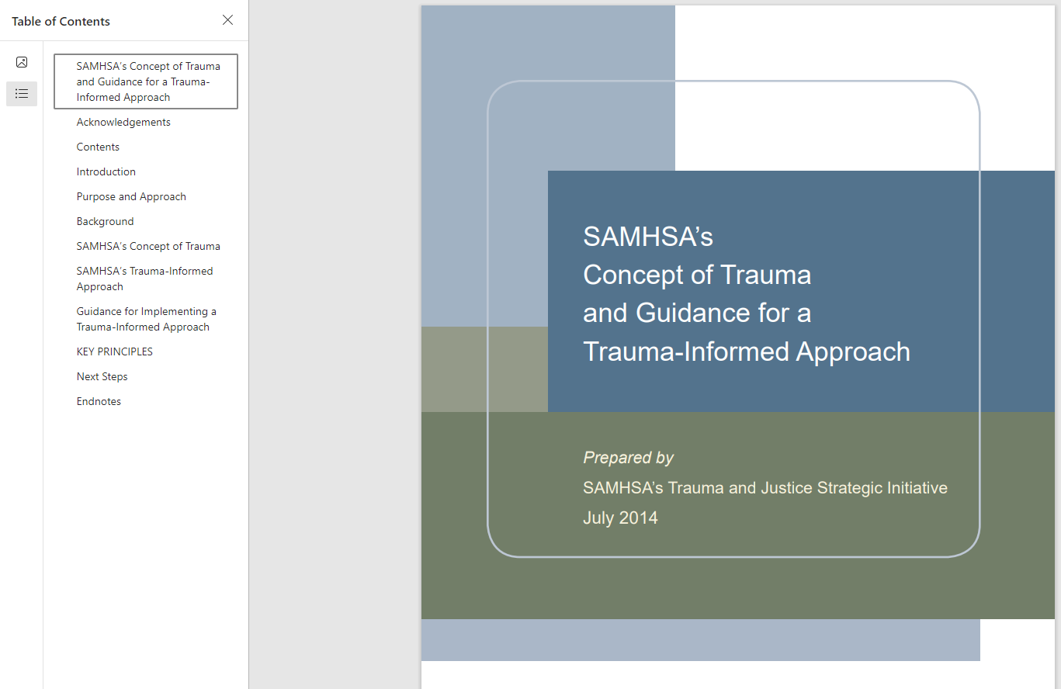

Slide 171
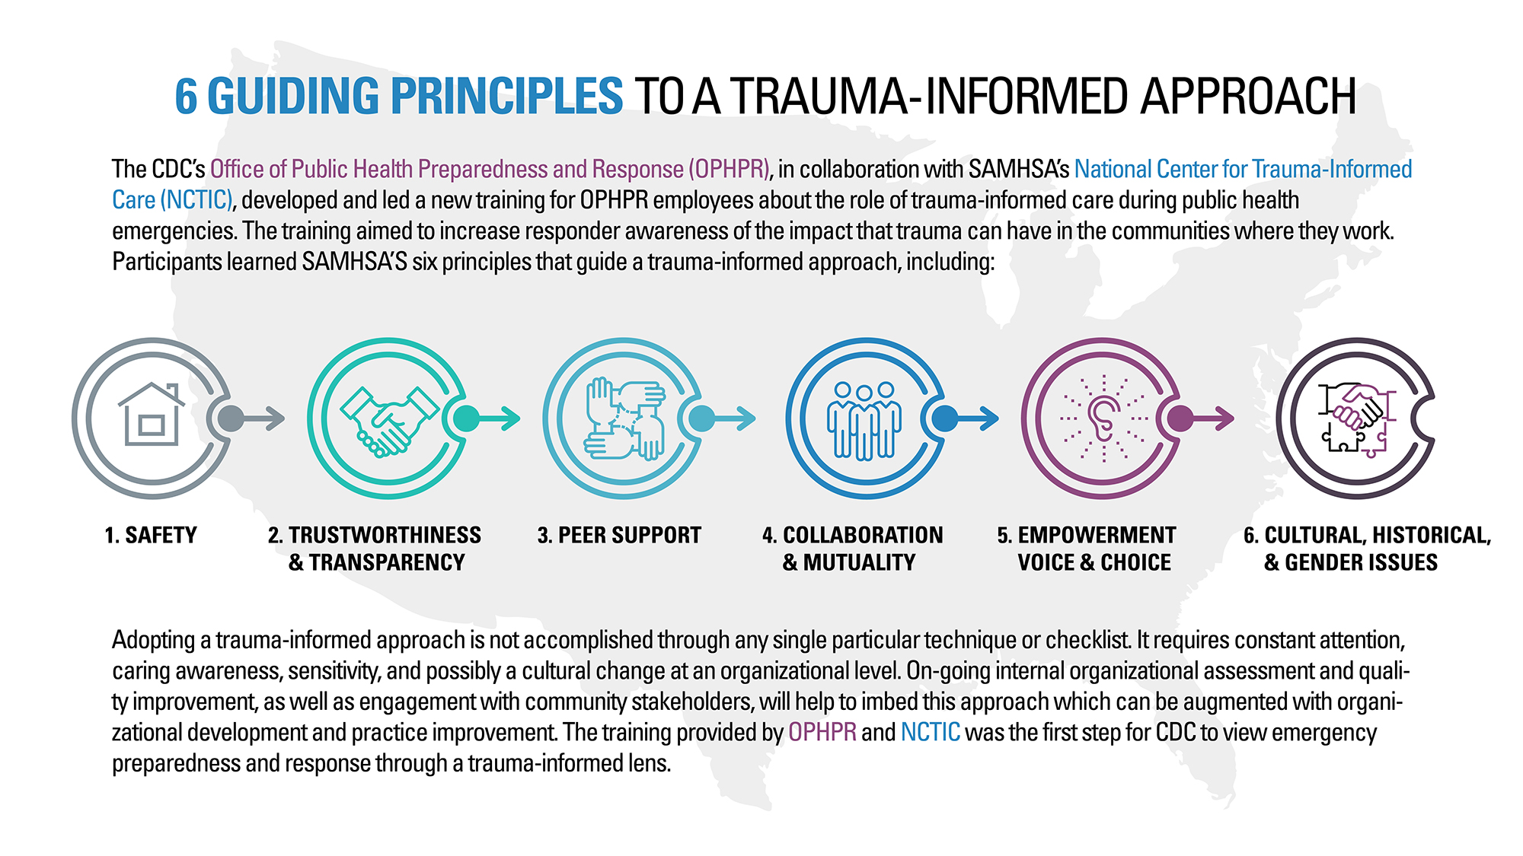

Slide 172

Safety – Ensuring residents have a sense of emotional and physical safety.

Slide 173

Trustworthiness and transparency –
Efforts to establish a relationship based on trust, and clear and open communication between the staff and the resident.
This Photo by Unknown Author is licensed under CC BY-NC-ND

Slide 174

Peer support and mutual self-help –
If practicable, it may be appropriate to assist the resident in locating and arranging to attend support groups which are organized by qualified professionals. It may be possible for the group to meet in the facility.

Slide 175

Collaboration – There is an emphasis on partnering between residents and/or his or her representative, and all staff and disciplines involved in the resident’s care in developing the plan of care. There is recognition that healing happens in relationships and in the meaningful
sharing of power and decision-making.

Slide 176

Empowerment, voice, and choice – Ensuring that resident’s choice and preferences are honored and that residents are empowered to be active Advanced Copy participants in their care and decision-making, including recognition of, and building on resident’s strengths

Slide 177

Cultural, Historical and Gender Issues

Slide 178

Benefits of Being Trauma- Informed
Can improve resident and staff experiences by:
Creating a proactive approach to safety
Creating safer physical can emotional environments for residents, families and staff
Creating and sustaining opportunities for choice, power and control through increased therapeutic interactions
Reducing the possibility of re-traumatization
Improving the social environment in a way that improves all relationships

Slide 179
Assessment:
Facilities should use a multi-pronged approach to identifying a resident’s history of trauma as well as his or her cultural preferences.
This would include asking the resident about triggers that may be stressors or may prompt recall of a previous traumatic event, as well as screening and assessment tools such as the Resident Assessment Instrument (RAI), Admission Assessment, the history and physical, the social history/assessment, and others.
There are many psychosocial screening and assessment tools available at the following SAMHSA website: https://www.integration.samhsa.gov/clinicalpractice/screening-tools#TRAUMA

Slide 180
Trauma Residents of long-term care facilities may include, but are not limited to, trauma survivors such as military veterans, survivors of large-scale natural and human-caused disasters, Holocaust survivors, survivors of physical, sexual, and/or mental abuse (past or current), or other violent crime, as well as residents with a history of imprisonment, homelessness, or who have suffered the traumatic loss of a loved one.
The history and physical assessment done by the attending physician can reveal many clues to a resident’s history of trauma. Scars and other signs of physical trauma should be explored to determine the cause if the resident is comfortable/agreeable with discussing them.
Numerical tattoos may be an indicator of World War II Holocaust survivors.
Residents with a history of trauma may have diagnoses such as anxiety, depression, or may have substance abuse issues such as alcoholism, and/or may abuse prescription medications or street drugs.

Slide 181

Evidence of physical and/or psychological trauma can be revealed during a comprehensive social history or assessment by the social worker

Slide 182
Triggers Facilities must identify triggers which may re-traumatize residents with a history of trauma.
A trigger is a psychological stimulus that prompts recall of a previous traumatic event, even if the stimulus itself is not traumatic or frightening.
For many trauma survivors, the transition to living in an institutional setting (and the associated loss of independence) can trigger profound re-traumatization.
While most triggers are highly individualized, some common triggers may include:
• Experiencing a lack of privacy or confinement in a crowded or small space;
• Exposure to loud noises, or bright/flashing lights;
• Certain sights, such as objects that are associated with those that used to abuse, and/or
• Sounds, smells, and even physical touch.

Slide 183
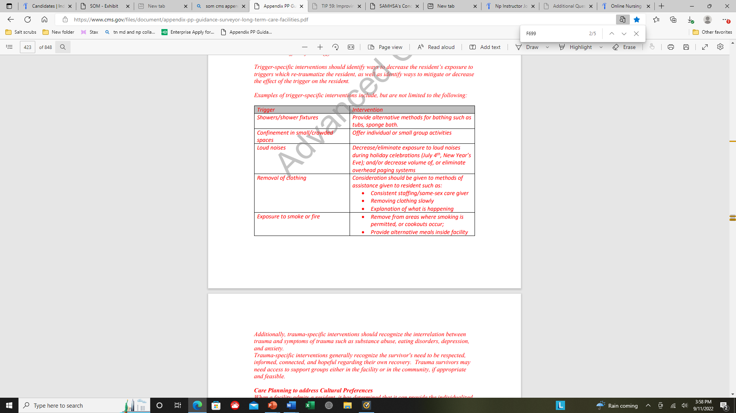

Slide 184
Culture - the increasingly changing demographics of nursing homes has led to the need to provide culturally competent care.
In addition to racial and ethnic diversity, this also includes religious preference, sexual orientation, and gender identity.
There are several tools that facilities may use in addition to the Resident Assessment Instrument (RAI) to assist them in identifying a resident’s cultural preferences.
Chapter 3 of the RAI gives guidance on completing Minimum Data Set (MDS) items in section A that addresses Race, Ethnicity, and Language with which the resident most closely identifies.
These MDS items may be indicators of a resident’s culture and may indicate further assessment is necessary to determine if there are any cultural preferences which should be honored while the resident is in the facility.
The categories in this classification are socio-political constructs and should not be interpreted as being scientific or anthropological in nature. They provide demographic race/ethnicity specific health trend information.

Slide 185
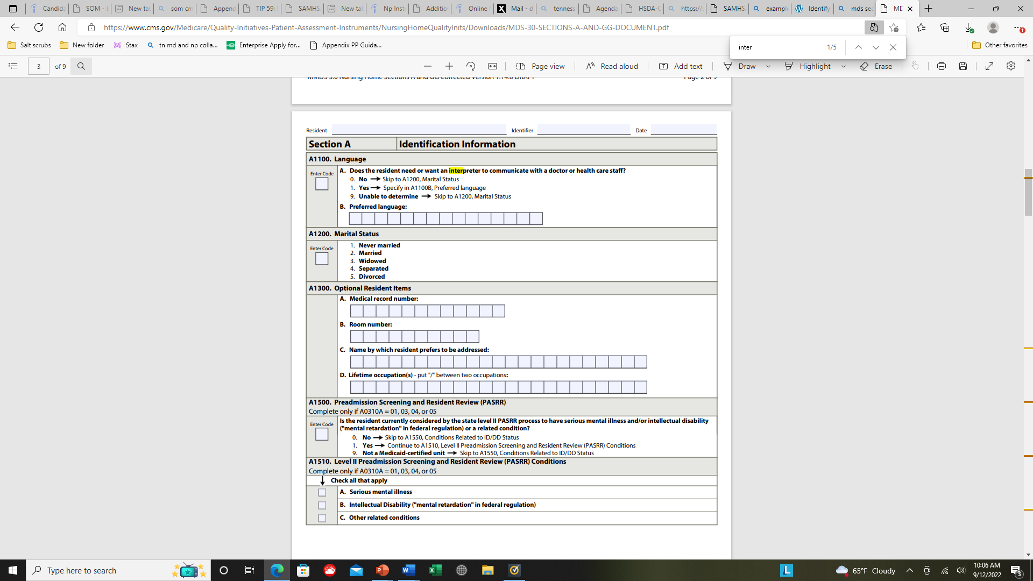
MDS Section A
-identifies whether the resident wants or needs an interpreter and the resident’s preferred language.
Inability to make needs known and to engage in social interaction because of a language barrier can result in isolation, depression, and unmet needs. Language barriers can interfere with accurate assessment.
For example, if the resident is non-English speaking, or has limited understanding of English, the facility should identify how communication will occur with the resident.
The care plan should identify the language spoken and what tools are available to communicate, whether it be with a communication board or other systems, or through translators. If communication systems are used, all staff interacting with the resident must know where those materials are kept, must understand how to use them, and consistently implement use of those methods.

Slide 186
Facilities must use their Facility Assessment (See F838 for additional guidance related to Facility Assessment) to identify resident populations having unique cultural characteristics, such as language (including American Sign Language), religious or cultural practices, values, and preferences.
This facilitates a facility-wide and department-wide understanding of cultural differences and how to approach the provision of care and services with dignity and respect for the individual. (Also see, F675, Quality of Life, for further discussion of the impact of cultural differences on residents and staff.)
NOTE: Facilities are required to communicate effectively, both verbally and in writing, with residents in a language and manner they can understand.
For additional information see:
F552, Right to be Informed/Make Treatment Decisions;
F572, Notice of Rights and Rules; and
F573, Right to Access/Purchase Copies of Records

Slide 187
Cultural competencies help staff communicate effectively with residents and their families and help provide care that is appropriate to the culture and the individual.
Cultural competence (also known as cultural responsiveness, cultural awareness, and cultural sensitivity) refers to a person’s ability to interact effectively with persons of cultures different from his/her own.
With regard to health care, cultural competence is a set of behaviors and attitudes held by clinicians that allows them to communicate effectively with individuals of various cultural backgrounds and to plan for and provide care that is appropriate to the culture and to the individual.
The following resources are intended for informational purposes only:
• The National Center for Cultural Competency https://nccc.georgetown.edu Advanced Copy
• The National Standards for Culturally and Linguistically appropriate Services in Health and Health Care (developed by the
Office of Minority Health in HHS)https://www.thinkculturalhealth.hhs.gov/clas/blueprint
• Office of Minority Health “Think Cultural Health” website https://www.thinkculturalhealth.hhs.gov
• Georgetown University publication: Cultural Competence in Health Care: Is it important for people with chronic
conditions https://hpi.georgetown.edu/agingsociety/pubhtml/cultural/cultural.html

Slide 188
The facility should collaborate with resident trauma survivors, and as appropriate, the resident’s family, friends, and any other health care professionals (such as psychologists, mental health professionals) to develop and implement individualized interventions.
In some cases if a facility has more than one trauma survivor, social services might consider establishing a support group that is run by a qualified professional, or allowing a support group to meet in the facility.
In situations where a trauma survivor is reluctant to share his or her history, facilities are still responsible to try to identify triggers which may re-traumatize the resident, and develop care plan interventions which minimize or eliminate the effect of the trigger on the resident.
Trigger-specific interventions should identify ways to decrease the resident’s exposure to triggers which re-traumatize the resident, as well as identify ways to mitigate or decrease the effect of the trigger on the resident

Slide 189

Care Planning to Address Past Trauma

Slide 190
Trauma-specific interventions should recognize the interrelation between trauma and symptoms of trauma such as substance abuse, eating disorders, depression, and anxiety.
Trauma-specific interventions generally recognize the survivor's need to be respected, informed, connected, and hopeful regarding their own recovery.
Trauma survivors may need access to support groups either in the facility or in the community, if appropriate and feasible. Care Planning to address Cultural Preferences
When a facility admits a resident, it has determined that it can provide the individualized care and services that resident requires.
Facilities must create and sustain an environment that humanizes and promotes each resident’s well-being and feeling of self-worth and self-esteem.

Slide 191

Nursing home leadership is to establish a culture that treats each resident with respect and dignity as an individual, and addresses, supports and/or enhances his/her feelings of self-worth including personal control over choices and cultural preferences.
In order to provide culturally competent care, staff must understand the cultural preferences of the individual and how it impacts the delivery of care.
A key component is identifying how to communicate with the resident, in order to be able to identify physical concerns and issues, and for developing a trusting relationship with staff.
This Photo by Unknown Author is licensed under CC BY

Slide 192

Staff must demonstrate proficiency in communicating with the resident to assure that critical information can be conveyed, such as a change in condition, the presence of pain, explanation of routine care, and the ability to refuse care and services.
The facility must provide sufficient guidance for staff, including temporary staff, on how to communicate and deliver care for the resident. §483.10(c)(1), Resident Rights and §483.21(b)(3)(iii) Comprehensive Person-Centered Care Planning.
There are many aspects of cultural preferences which may impact the delivery of care, such as: • Food preparation and choices;
• Clothing preferences such as covering hair or exposed skin;
• Physical contact or provision of care by a person of the opposite sex; or
• Cultural etiquette, such as avoiding eye contact or not raising the voice.

Slide 193


Additionally, facilities should consider:
• Offering activities that are culturally relevant to resident populations within the facility;
• Group activities with both sexes may not be permitted or appropriate in some cultures, or
the type of programming may be in conflict with his/her cultural preferences;
• Providing reading materials, movies, newspapers in the resident’s preferred language may
help orient a resident to date, times and events;
• Allowing the performance of religious rites at end of life to the extent possible; and
• Certain medications, procedures or treatments may be prohibited

Slide 194

Social services and facility administration may need to evaluate
how forms, including informed consent forms, are provided
in the language used by the resident.
Assisting the resident and his/her representative with
daily schedules, developed with input by the resident/representative,
ahead of time may alleviate fear and frustration.
Resident-specific approaches must be developed and
included in the resident’s care plan.
These interventions must be provided consistently,
and supervising staff should monitor the delivery of
care and staff interactions with the resident to assure
they are implemented as written.

Slide 195
Monitoring Delivery of Care and Services
As required with any care plan interventions, facilities must monitor the effects of their approaches to ensure they are implemented as intended, and are having the desired effect to achieve the measurable objectives and the resident’s goals for care.
For residents with a history of trauma in particular, facilities must evaluate whether the interventions have been able to mitigate (or reduce) the impact of identified triggers on the resident that may cause re-traumatization.
It is critical to involve the resident and/or his or her family or representative in this evaluation to ensure clear and open discussion and better understand if interventions must be modified.
It may be necessary to engage the services of an interpreter to monitor or evaluate the effect of cultural interventions for non-English speaking residents.
It is critical to involve the resident and/or his or her family in evaluating the effectiveness of cultural interventions in achieving measurable objectives and resident goals.

Slide 196
Potential Deficiencies Related to Trauma-Informed Care:
When Investigating Concerns Related to Culturally-Competent, Trauma Informed Care, the Surveyors will Refer to:
• F656: Comprehensive Care Plans: For concerns related to development or implementation of culturally competent
and/or trauma-informed care plan interventions;
•F740 Behavioral Health Services- For concerns with the history of trauma and/or post-traumatic stress disorder, receives
appropriate treatment and services.
• F726: Competent Nursing Staff- For concerns related to the knowledge, competencies, or skill sets of nursing staff to
provide care or services that are culturally competent and trauma-informed.
• F742: Treatment/Services for Mental/Psychosocial Concerns- For concerns related to treatment and services for resident
with history of trauma and/or history of post-traumatic stress disorder (PTSD

Slide 197


Slide 199
DEFINITIONS

Slide 203
The behavioral health care needs of those with a SUD or other serious mental disorder should be part of the facility assessment under §483.70(e) (F838) and the facility should determine if they have the capacity, services, and staff skills to meet the requirements as discussed in F741.
All residents are screened for possible serious mental disorders or intellectual disabilities and related conditions prior to admission to determine if specialized services under Preadmission Screening and Resident Review (PASARR) requirements are necessary. If a resident qualifies for specialized Level II services under PASARR, please refer to §483.20(k) (F645), as well as §483.20(e) (F644).
If the resident does not qualify for specialized services under PASARR, but requires more intensive behavioral health services (e.g., individual counseling), the facility must demonstrate reasonable attempts to provide for and/or arrange for such services. This would include ensuring that the type(s) of service(s) needed is clearly identified based on the individual assessment, care plan and strategies to arrange such services.

Slide 204
Behavioral health care and services could include:
• Ensuring that the necessary care and services are person-centered and reflect the resident’s goals for care, while
maximizing the resident’s dignity, autonomy, privacy, socialization, independence, choice, and safety;
• Ensuring that direct care staff interact and communicate in a manner that promotes mental and psychosocial well-being.
• Providing meaningful activities which promote engagement, and positive meaningful relationships between residents
and staff, families, other residents and the community. Meaningful activities are those that address the resident’s
customary routines, interests, preferences, etc. and enhance the resident’s well being. Residents living with mental
health and SUDs may require different activities than other nursing home residents. Facilities must ensure that activities
are provided to meet the needs of their residents.
NOTE: For concerns related to the facility’s activity program, or activities which do not address the needs of the resident, refer to §483.24(c), F679, Activities Meet Interest /Needs of Each Resident.

Slide 205
For residents with an assessed history of a mental disorder or SUD, the care plan must address the individualized needs the resident may have related to the mental disorder or the SUD.
Some facilities may use behavioral contracts as part of the individualized care plan to address behaviors which could endanger the resident, other residents and staff.
Behavioral contracts may be a method for encouraging residents to follow their plan of care. However, in some circumstances, using them to impose a system of rewards and/or punishments could be construed as meeting the definition of abuse which includes the willful infliction of punishment and/or the deprivation of goods and services.

Slide 206
Additionally, behavioral contracts are only intended to be used for residents who have the capacity to understand them. The contract cannot conflict with resident rights or other requirements of participation (i.e., requirements at §483.15 related to admission, transfer, and discharge), but may address issues such as:
• Residents with mental disorder and/or SUD may be at increased risk for leaving the facility without facility knowledge
(which could be considered an elopement) at various times throughout their treatment, or if going through active
withdrawal. The facility should explain the resident’s right to have a leave of absence and also explain the health and
safety risks of leaving without facility knowledge or leaving against medical advice (AMA). The facility cannot restrict
a resident’s right to leave the facility, but a contract can distinguish between leave of absence, elopement, and leaving
AMA. (For concerns related to inadequate supervision resulting in elopement, see F689 - Free of Accidents
Hazards/Supervision/Devices)

Slide 207
Facility efforts to help residents with mental disorder and/or SUD, such as individual counseling services, access to group counseling, or access to a Medication Assisted Treatment program, if applicable;
• Steps the facility may take if substance use is suspected, which may include:
o Increased monitoring and supervision in the facility to maintain the health and safety of the resident suspected
of substance use, as well as all residents;
o Restricted or supervised visitation, if the resident’s visitor(s) are deemed to be a danger to the resident, other
residents, and/or staff (See F563 - Right to receive/deny visitors);
o Voluntary drug testing if there are concerns that suspected drug use could adversely affect the resident’s
condition;
o Voluntary inspections, if there is reasonable suspicion of possession of illegal drugs, weapons or other
unauthorized items which could endanger the resident or others (See F557- Respect, Dignity/Right to have
Personal Property); and
• Referral to local law enforcement for suspicion of a crime in accordance with state laws, such as possession of
illegal substances, paraphernalia or weapons
(See F557- Respect, Dignity/Right to have Personal Property).

Slide 208
Refusal to accept or non-adherence to the terms of a behavioral contract cannot be the
sole basis for a denial of admission, a transfer or discharge.
A facility may only transfer or discharge a resident for one of the reasons listed in F622, §483.15(c)(1)(i)(A)-(F).
Rather, non-adherence to the contract should be treated like any care plan intervention that needs attention or needs to be altered to meet the needs of the resident. The IDT should work with the resident and resident representative to revise the care plan and contract.

Slide 209
The following discusses general information pertaining to conditions that are frequently seen in nursing home residents and may require facilities to provide specialized services and supports that vary, based upon residents’ individual needs.

Slide 210
Depression
Although people experience losses, it does not necessarily mean that they will become depressed. Depression (major depressive disorder or clinical depression) is a common and serious mood disorder. Symptoms may include fatigue, sleep and appetite disturbances, agitation, and expressions of guilt, difficulty concentrating, apathy, withdrawal, and suicidal ideation.
Depression is not a natural part of aging, however, older adults in the nursing home setting are more at risk than older adults in the community. Late life depression may be harder to identify due to a resident’s cognitive impairment, loss of functional ability, the complexity of multiple chronic medical problems that compound the problem, and the loss of significant relationships and roles in their life.
Depression presents differently in older adults and it is the responsibility of the facility to ensure that an accurate diagnosis is established.
Adapted from the American Psychiatric Association. “Diagnostic and Statistical Manual of Mental Disorders - Fifth edition.” 2013.

Slide 211
Anxiety and Anxiety Disorders
Anxiety is a common reaction to stress that involves occasional worry about circumstantial events. Anxiety disorders, however, could include symptoms such as excessive fear, intense anxiety, significant distress, and may cause debilitating symptoms.
The distinction between general anxiety and an anxiety disorder is subtle and can be difficult to identify. Accurate diagnosis by a qualified professional is essential.
Anxiety can be triggered by loss of function, changes in relationships, relocation, or medical illness. Importantly, anxiety may also be a symptom of other disorders, such as depression and dementia in older adults, and care must be taken to ensure that other disorders are not inadvertently misdiagnosed as an anxiety disorder
(or vice versa).
There are many types of anxiety disorders, each with different symptoms. The most common types of anxiety disorders include Generalized Anxiety Disorder, Social Anxiety Disorder, Panic Disorder, Phobias and Post-traumatic Stress Disorder.
Adapted from the American Psychiatric Association. “Diagnostic and Statistical Manual of Mental Disorders - Fifth edition.” 2013.

Slide 212
Schizophrenia
Schizophrenia is a serious mental disorder that may interfere with a person’s ability to think clearly, manage emotions, make decisions and relate to others.
It is uncommon for schizophrenia to be diagnosed in a person younger than 12 or older than 40. Schizophrenia must be diagnosed by a qualified practitioner, using evidence-based criteria and professional standards, such as the Diagnostic and Statistical Manual of Mental Disorders - Fifth edition (DSM-5), and documented in the resident’s medical record. Symptoms of Schizophrenia include delusions, hallucinations, disorganized speech (e.g., frequent derailment or incoherence), grossly disorganized or catatonic behavior, and diminished expression or initiative. Delusions refer to false beliefs that don’t change even when the person who holds them is presented with new ideas or facts. Hallucinations include a person hearing voices, seeing things, or smelling things others
can’t perceive.
Adapted from the:
• National Alliance on Mental Illness (NAMI). “Schizophrenia.” Accessed March 2, 2021. https://www.nami.org/Learn-More/MentalHealthConditions/Schizophrenia
• American Psychiatric Association. “Diagnostic and Statistical Manual of Mental Disorders - Fifth edition.” 2013.

Slide 213
Bipolar Disorder
Bipolar disorder is a mental disorder that causes dramatic shifts in a person’s mood or energy, and may affect the ability to think clearly.
People with bipolar experience high and low moods—known as mania and depression—which differ from the typical ups-and downs most people experience.
Symptoms and their severity can vary. A person with bipolar disorder may have distinct manic or depressed states but may also have extended periods—sometimes years—without symptoms. A person can also experience both extremes simultaneously or in rapid sequence.
Adapted from NAMI. “Bipolar Disorder.” Accessed March 2, 2021. https://www.nami.org/Learn-More/Mental-Health-Conditions/Bipolar-Disorder.

Slide 214
Abuse & Neglect

Slide 215


Slide 216
“Covered individual” is anyone who is an owner, operator, employee, manager, agent or
contractor of the facility (see section 1150B(a)(3) of the Act).
“Crime”: Section 1150B(b)(1) of the Act provides that a “crime” is defined by law of the
applicable political subdivision where the facility is located. A political subdivision would be a
city, county, township or village, or any local unit of government created by or pursuant to State
law.
“Law enforcement,” as defined in section 2011(13) of the Act, is the full range of potential
responders to elder abuse, neglect, and exploitation including: police, sheriffs, detectives, public
safety officers; corrections personnel; prosecutors; medical examiners; investigators; and
coroners.

Slide 217
“Serious bodily injury” means an injury involving extreme physical pain; involving substantial
risk of death; involving protracted loss or impairment of the function of a bodily member, organ,
or mental faculty; requiring medical intervention such as surgery, hospitalization, or physical
rehabilitation; or an injury resulting from criminal sexual abuse (see sections 2011(19)(A) and
(B) of the Act).
“Criminal sexual abuse”: In the case of “criminal sexual abuse” which is defined in section
2011(19)(B) of the Act, serious bodily injury/harm shall be considered to have occurred if the
conduct causing the injury is conduct described in section 2241 (relating to aggravated sexual
abuse) or section 2242 (relating to sexual abuse) of Title 18, United States Code, or any similar
offense under State law. In other words, serious bodily injury includes sexual intercourse with a
resident by force or incapacitation or through threats of harm to the resident or others or any
sexual act involving a child. Serious bodily injury also includes sexual intercourse with a
resident who is incapable of declining to participate in the sexual act or lacks the ability to
understand the nature of the sexual act.
“Willful” is defined at 483.5 in the definition of “abuse” and “means the individual must have acted deliberately, not that the individual must have intended to inflict injury or harm.”

Slide 218
If a facility has not developed and/or implemented policies and procedures related to
screening procedures prior to employment, a finding of noncompliance should be considered at
F606.
If it is determined that the facility employed or engaged an individual, either directly or under contract, who was found guilty by a court of law of abuse, neglect, misappropriation of property, exploitation or mistreatment, or had a finding entered into the State nurse aide registry or has a disciplinary action in effect against his/her professional license concerning abuse, neglect, mistreatment of residents or misappropriation of resident property, a finding of noncompliance must be cited at F606.

Slide 219
The facility must:
• Post a conspicuous notice of employee rights, including the right to file a complaint with the State
Survey Agency if they believe the facility has retaliated against an employee or
individual who reported a suspected crime and how to file such a complaint;
The sign may be posted in an area that is visible to employees, such as the same area where the facility posts other employee signs, such as labor management posters.
Size and type requirements for the sign should be no less than the minimum required for any other required employment-related signs.

Slide 220
Reporting/Response:
Added
To encourage reporting of reasonable suspicions of a crime, facilities should develop and
implement policies and procedures that promote a culture of safety and open communication in
the work environment. This may be accomplished through prohibiting retaliation against an
employee who reports a suspicion of a crime.

Slide 221
Actions that constitute retaliation against staff include:
• When a facility discharges, demotes, suspends, threatens, harasses, or denies a
promotion or other employment-related benefit to an employee, or in any other manner
discriminates against an employee in the terms and conditions of employment because of
lawful acts done by the employee.
• When a facility files a complaint or a report against a nurse or other employee with the
state professional licensing agency because of lawful acts done by the nurse or employee
for reporting a reasonable suspicion of a crime to law enforcement.

Slide 222
VIII. Coordination with QAPI:
The facility must develop written policies and procedures that define how staff will communicate and coordinate situations of abuse, neglect, misappropriation of resident property, and exploitation with the QAPI program under §483.75.
Cases of physical or sexual abuse, for example by facility staff or other residents, always require corrective action and tracking by the QAA Committee, at §483.75(g)(2).
This coordinated effort would allow the QAA Committee to determine:
• If a thorough investigation is conducted;
• Whether the resident is protected;
• Whether an analysis was conducted as to why the situation occurred;
• Risk factors that contributed to the abuse (e.g., history of aggressive behaviors, environmental factors); and
• Whether there is further need for systemic action such as:
o Insight on needed revisions to the policies and procedures that prohibit and prevent
abuse/neglect/misappropriation/exploitation,
o Increased training on specific components of identifying and reporting that staff may
not be aware of or are confused about,
o Efforts to educate residents and their families about how to report any alleged
violations without fear of repercussions,
o Measures to verify the implementation of corrective actions and timeframes, and
o Tracking patterns of similar occurrences.

Slide 223
F608 Reporting Reasonable Suspicion of Crime Deleted
and - Relocated to F607 & F609

Slide 224
F609
The facility must develop and implement written policies and procedures that:
Ensure reporting of crimes occurring in federally-funded long-term care facilities in accordance with section 1150B of the Act.
The policies and procedures must include but are not limited to the following elements.
(i) Annually notifying covered individuals, as defined at section 1150B(a)(3) of the Act, of
that individual’s obligation to comply with the following reporting requirements.
(A) Each covered individual shall report to the State Agency and one or more law enforcement entities for the political
subdivision in which the facility is located any reasonable suspicion of a crime against any individual who is a resident
of, or is receiving care from, the facility.
(B) Each covered individual shall report immediately, but not later than 2 hours after
forming the suspicion, if the events that cause the suspicion result in serious bodily injury, or not later than 24 hours if
the events that cause the suspicion do not result in serious bodily injury.
The facility should provide oversight and monitoring to ensure that implement the required policies and procedures.

Slide 225
Once an individual suspects that a crime has been committed, facility staff should
exercise caution when handling materials that may be used for evidence or for a criminal
investigation.
Facilities should reference applicable State and local laws regarding preserving
evidence. It has been reported that some investigations were impeded due to washing linens or clothing, destroying documentation, bathing or cleaning the resident before the resident has been examined, or failure to transfer a resident to the emergency room for examination including obtaining a rape kit, if appropriate

Slide 226
Facility should included in its policies and procedures examples of crimes that would be reported.
Examples of situations that would likely be considered crimes in all subdivisions would include but are not limited to:
• Murder;
• Manslaughter;
• Rape;
• Assault and battery;
• Sexual abuse;
• Theft/Robbery;
• Drug diversion for personal use or gain;
• Identity theft; and
• Fraud and forgery.

Slide 227
Facility policies and procedures addressing the following actions, which
should include, but are not limited to:
• Orienting new and temporary/agency/contractor staff to the reporting requirements;
• Assuring that covered individuals are annually notified of their responsibilities in a
language that they understand;
• Identifying barriers to reporting such as fear of retaliation or causing trouble for
someone, and implementing interventions to remove barriers and promote a culture of
transparency and reporting;
• Identifying which cases of abuse, neglect, and exploitation may rise to the level of a
reasonable suspicion of crime and recognizing the physical and psychosocial indicators
of abuse/neglect/exploitation;
• Working with law enforcement annually to determine which crimes are reported;
• Assuring that covered individuals can identify what is reportable as a reasonable
suspicion of a crime, with compentency testing or knowledge checks;
• Providing in-service training when covered individuals indicate that they do not
understand their reporting responsibilities; and
• Providing periodic drills across all levels of staff across all shifts to assure that covered
individuals understand the reporting requirements.

Slide 228
Annual Notification of Reporting Obligations to Covered Individuals
Policies and procedures should include, but are not limited to, the following:
• Identification of who are the covered individuals in the facility;
• How covered individuals are notified of the reporting requirements. Notification must
include the following:
o Each covered individual’s independent obligation to report the suspicion of a crime
against a resident or individual receiving care and services from the facility directly
to local law enforcement and the State Survey Agency;
o The timeframe requirements for reporting reasonable suspicion of crimes:
If the events that cause the reasonable suspicion result in serious bodily injury to
a resident, the covered individual must report the suspicion immediately, but not
later than 2 hours after forming the suspicion;
If the events that cause the reasonable suspicion do not result in serious bodily
injury to a resident, the covered individual shall report the suspicion not later
than 24 hours after forming the suspicion.
Penalties associated with failure to report

Slide 229
REPORTING ALLEGED VIOLATIONS
An alleged violation can be observed or reported by staff, resident, relative, visitor, another
health care provider, or others.
For example, a receiving hospital may report to the facility suspicious bruising of the resident near the inner thighs and groin area, which were identified during a medical exam in the emergency department.
The facility must submit reports that are accurate, to the best of its knowledge
at the time of submission of the report.
It is important that facilities not make reports that are misleading, such as reports that deliberately omit facts, or reports that are designed to make the incident appear less serious than it was, or reports that misrepresent the facility’s response.
Deliberate misrepresentations or omissions could result in a deficiency at F609 or may give rise
to other deficiencies.

Slide 230
Initial Report
For alleged violations of abuse or if there is resulting serious bodily injury, the facility must report the allegation immediately, but no later than 2 hours after the allegation is made.
For alleged violations of neglect, exploitation, misappropriation of resident property, or
mistreatment that do not result in serious bodily injury, the facility must report the allegation no
later than 24 hours.
The facility must provide in its report sufficient information to describe the
alleged violation and indicate how residents are being protected [see §483.12(c)(3)]. It is
important that the facility provide as much information as possible, to the best of its knowledge
at the time of submission of the report, so that State agencies can initiate action necessary to
oversee the protection of nursing home residents.

Slide 231
Follow-up Investigation Report
Within 5 working days of the incident, the facility must provide in its report sufficient information to describe the results of the investigation, and indicate any corrective actions taken, if the allegation was verified.
It is important that the facility provide as much information as possible, to the best of its knowledge at the time of submission of the report, so that State agencies can initiate action necessary to oversee the protection of nursing home residents [see §483.12(c)(4)]. The facility should include any updates to information provided in the initial report.

Slide 232
IDENTIFICATION OF ALLEGED VIOLATIONS

Slide 233
Staff to Resident Abuse
All allegations/occurrences of all types of staff-to-resident abuse must be reported to the
administrator and to other officials, including the State Survey Agency and adult protective
services, where state law provides for jurisdiction in nursing homes [see § 483.12(c)].
This includes, but is not limited to:
• All allegations/occurrences of physical, sexual, mental, and verbal abuse, including
deprivation of goods and services by staff, and involuntary seclusion perpetrated by staff
• Staff taking or distributing demeaning or humiliating photographs or recordings of
residents through social media or multimedia messaging; and
• All reports from residents of abuse perpetrated by staff; allegations must not be
dismissed on the basis of a resident’s cognitive impairment(s).

Slide 234
Resident to Resident Altercations
Resident-to-resident altercations that must be reported in accordance with the regulations include any willful action that results in physical injury, mental anguish, or pain, as defined at §483.5.
Having a mental disorder or cognitive impairment does not automatically preclude a
resident from engaging in deliberate or non-accidental actions.
** There may be some situations in which the psychosocial outcome to the resident may be difficult to determine or incongruent with what would be expected. In these situations it is appropriate to consider how a reasonable person in the resident’s circumstances would be impacted by the incident.

Slide 235
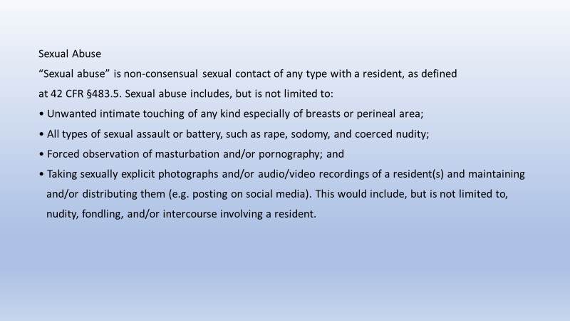

Slide 236
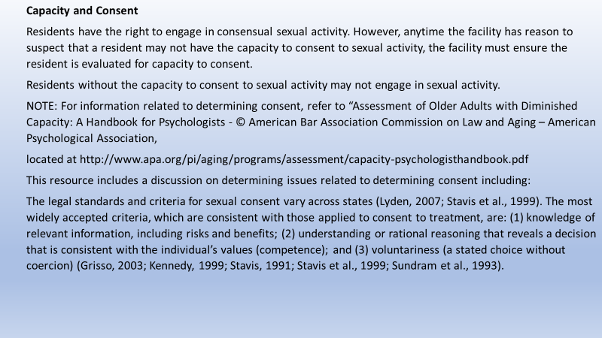

Slide 237
Reporting Suspicious Injuries of Unknown Source
“Injuries of unknown source” – An injury should be classified as an “injury of unknown
source” when ALL of the following criteria are met:
• The source of the injury was not observed by any person; and
• The source of the injury could not be explained by the resident; and
• The injury is suspicious because of:
a. The extent of the injury, or
b. The location of the injury (e.g., the injury is located in an area not generally
vulnerable to trauma), or
c. The number of injuries observed at one particular point in time, or
d. The incidence of injuries over time

Slide 238
Reportable Events Related to Potential Neglect
“Neglect,” means “the failure of the facility, its employees or service providers to provide goods and services to a resident that are necessary to avoid physical harm, pain, mental anguish or emotional distress.” (See §483.5) In other words, neglect occurs when the facility is aware, or should have been aware of, goods or services that a resident(s) requires but the facility fails to provide them to the resident(s), resulting in physical harm, pain, mental anguish or emotional distress.
Alleged violations of neglect include cases where the facility demonstrates indifference
or disregard for resident care, comfort or safety, resulting in physical harm, pain, mental
anguish or emotional distress. There may be some situations in which the psychosocial outcome to the resident may be difficult to determine or incongruent with what would be expected.
In these situations it is appropriate to consider how a reasonable person in the resident’s position would be impacted by the incident.

Slide 239
Examples of events to be reported include, but are not limited to, the following:
1. Failure to meet payroll or pay supplier bills resulting in residents not receiving goods or
services, such as
• Insufficient staff (including the night shift and weekends) resulting in the lack of provision for resident’s
care needs (e.g., residents who need continuous skilled nursing care or supervision, residents with
cognitive deficits requiring continuous supervision); or
• Lack of essential supplies or equipment such as incontinence supplies, wound care
supplies, or oxygen equipment or adaptive equipment according to the needs of the
resident(s); or
• Lack of sufficient amounts of food to meet the residents’ nutritional needs.
2. Staff repeatedly ignoring residents’ needs for assistance with activities of daily living, resulting in residents
remaining in bed when they want to be up and repeatedly missing activities; or residents being left in fecal
material or urine.
3. Failure to oversee the management of pain for a resident resulting in a resident not
receiving required medications or treatments, leading to prolonged excruciating pain.
4. Failure to implement and monitor care planned interventions, resulting in repeated failures
to provide necessary care and services to prevent the development a new avoidable pressure
ulcer that develops into a Stage 3 or 4 pressure ulcer.

Slide 240
Reportable Allegations of Misappropriation of Resident Property and Exploitation
The facility must exercise reasonable care for the protection of the resident's property from loss
or theft. The facility is expected to be responsive to a
resident’s concerns about lost items.
Examples of allegations of misappropriation of resident property and exploitation that must be
reported include, but are not limited to:
• Theft of personal property, including but not limited to jewelry, computer, phone, and other valuable
items such as eyeglasses and hearing aids;
• Unauthorized/coerced use by staff of resident’s personal property;
• Theft of money from bank accounts;
• Unauthorized or coerced purchases on a resident’s credit card;
• Unauthorized or coerced purchases from resident’s funds;
• Staff who accept money from a resident for any reason including when staff have made the resident
believe that staff was in a financial crisis or the resident believes that he/she is in a relationship with the
staff person;
• A resident who provides a gift to staff in order to receive ongoing care, based on staff’s persuasion; and
• Missing prescription medications or diversion of a resident’s medication(s), including,
but not limited to, controlled substances for staff use or personal gain.

Slide 241
Reportable Allegations of Mistreatment
“Mistreatment,” as defined at §483.5, is “inappropriate treatment or exploitation of a resident.”
Allegations of mistreatment should be reported only if they meet the criteria for reporting
alleged violations of abuse and/or exploitation.

Slide 242
F622 Transfer, and Discharge
F633 Notice Requirements Before Transfer or Discharge
F626 Permitting Residents To Return To Facility

Slide 243
F622 Transfer, and Discharge:
CMS clarified that when a facility initiates a discharge while the resident is in the hospital following an
emergency transfer (i.e., does not allow the resident to return to the nursing home), the facility must
have evidence that the resident’s status at the time the resident seeks to return to the facility (not at
the time the resident was transferred for acute care) meets one of the discharge criteria a
§483.15(c)(i). CMS also clarified guidance related to the requirement to provide notice of a transfer or
discharge to ensure that residents and their representatives receive complete and accurate
information in the notice of transfer and discharge.

Slide 244
If evidence reveals that a resident or resident representative was forced, pressured, or intimidated into leaving
AMA, the discharge would be considered a facility-initiated discharge, requiring further investigation to
determine compliance with the requirements.
If a surveyor has concerns about whether a resident-initiated transfer or discharge was actually a facility-
initiated transfer or discharge, the surveyor should investigate further through interviews and record review.
In certain cases, residents are admitted for short-term, skilled rehabilitation under Medicare, but, following
completion of the rehabilitation program, they communicate that they are not ready to leave the facility. In
these situations, if the facility proceeds with discharge, it is considered a facility-initiated discharge and the
requirements at §§483.15(c)(1) and (c)(2)(i)-(ii) apply to ensure the discharge is not involuntary. These
situations may require further investigation to ensure that discrimination based on payment source has not
occurred…

Slide 245
The facility must permit each resident to remain in the facility, and not transfer or discharge the resident from the facility unless—
The transfer or discharge is necessary for the resident’s welfare and the resident’s needs cannot be met in the facility;
The transfer or discharge is appropriate because the resident’s health has improved sufficiently so the resident no longer needs the services provided by the facility;
The safety of individuals in the facility is endangered due to the clinical or behavioral status of the resident;
The health of individuals in the facility would otherwise be endangered;
The resident has failed, after reasonable and appropriate notice, to pay for (or to have paid under Medicare or Medicaid)
a stay at the facility. Nonpayment applies if the resident does not submit the necessary paperwork for third party
payment or after the third party, including Medicare or Medicaid, denies the claim and the resident refuses to pay for his or her
stay. For a resident who becomes eligible for Medicaid after admission to a facility, the facility may charge a resident only
allowable charges under Medicaid; or
The facility ceases to operate.

Slide 246
The facility must document the danger that the failure to transfer or discharge would pose.
This must be documented in the resident’s medical record.
For facility-initiated transfer or discharge, the resident’s physician must document information about the basis for the transfer or discharge.
The transfer or discharge is necessary for the resident’s welfare and the resident’s needs cannot be met in the
facility;
(B) The transfer or discharge is appropriate because the resident’s health has improved sufficiently so the resident
no longer needs the services provided by the facility;

Slide 247
F633 Notice Requirements Before Transfer or Discharge
Notice of Transfer or Discharge & Ombudsman Notification

Slide 248
NOTICE BEFORE TRANSFER
Before a facility transfers or discharges a resident, the facility must—
Notify the resident and the resident’s representative(s) of the transfer or discharge and the reasons for the move in writing and
in a language and manner they understand.
The facility must send a copy of the notice to a representative of the Office of the State Long-Term Care Ombudsman.
Record the reasons for the transfer or discharge in the resident’s medical record in accordance with paragraph (c)(2) of this
section .
Copies of notices for emergency transfers must also still be sent to the Ombudsman, but they may be sent when practicable,
such as in a list of residents on a monthly basis, as long as the list meets all requirements for content of such notices at
§483.15(c)(5)

Slide 249
Contents of the Notice
The facility’s notice must include all of the following at the time notice is provided:
• The specific reason for the transfer or discharge, including the basis under §§483.15(c)(1)(i)(A)-(F);
• The effective date of the transfer or discharge;
• The specific location (such as the name of the new provider or description and/or address if the location is a
residence) to which the resident is to be transferred or discharged;
• An explanation of the right to appeal the transfer or discharge to the State;
• The name, address (mail and email), and telephone number of the State entity which receives such appeal hearing
requests;
• Information on how to obtain an appeal form;
• Information on obtaining assistance in completing and submitting the appeal hearing request; and
• The name, address (mailing and email), and phone number of the representative of the Office of the State
Long-Term Care Ombudsman.

Slide 250
For nursing facility residents with intellectual and developmental disabilities (or related disabilities) or with mental illness (or related disabilities), the notice must include the name, mailing and e-mail addresses and phone number of the state agency responsible for the protection and advocacy for these populations.

Slide 251
Timing of the Notice
Generally, this notice must be provided at least 30 days prior to the transfer or discharge of the resident. Exceptions to the 30-day requirement apply when the transfer or discharge is effected because:
• The health and/or safety of individuals in the facility would be endangered due to the clinical or
behavioral status of the resident;
• The resident’s health improves sufficiently to allow a more immediate transfer or discharge;
• An immediate transfer or discharge is required by the resident’s urgent medical needs; or
• A resident has not resided in the facility for 30 days. In these exceptional cases, the notice must be
provided to the resident, resident’s representative if appropriate, and LTC ombudsman as soon as
practicable before the transfer or discharge.

Slide 252
Changes to the Notice
If information in the notice changes the facility must update the recipients of the notice as soon as practicable with the
new information to ensure that residents and their representatives are aware of and can respond appropriately.
For significant changes, such as a change in the transfer or discharge destination, a new notice must be given that clearly
describes the change(s) and resets the transfer or discharge date in order to provide 30- day advance notification and
permit adequate time for discharge planning.
Example:
A facility determines it cannot meet a resident’s needs and arranges for discharge to another nursing home
which can meet the resident’s needs. Before the discharge occurs, the receiving facility declines to take the resident and
the discharging facility changes the destination to a setting that does not appear to meet the resident’s ongoing medical
needs.

Slide 253
F626 Permitting Residents To Return To Facility

Slide 254
GUIDANCE
Facilities must develop and implement policies for bed-hold and permitting residents to return
following hospitalization or therapeutic leave. These policies apply to all residents, regardless of their payment source.
The facility policies must provide that residents who seek to return to the facility within the bed-hold period defined in the State plan are allowed to return to their previous room, if available.
Additionally, residents who seek to return to
the facility after the expiration of the bed-hold period or when state law does not provide for bed-holds are allowed to
return to their previous room if available or immediately to the first available bed in a semi-private room provided that the resident:
• Still requires the services provided by the facility; and
• Is eligible for Medicare skilled nursing facility or Medicaid nursing facility services.
The policies must also provide that if the facility determines that a resident cannot return, the
facility must comply with the requirements of paragraph at 42 CFR 483.15(c) as they apply to
facility-initiated discharges.

Slide 255


Slide 256
F895 Compliance And Ethics Program

Slide 257
INTENT
To ensure that facilities have in operation an effective compliance and ethics program that uses internal controls to more efficiently monitor adherence to applicable statutes, regulations and program requirements to deter criminal, civil and administrative violations under the Act and promote quality of care for nursing home residents.

Slide 258
GUIDANCE
Background
On March 16, 2000, the Department of Health and Human Services Office of the Inspector General (OIG) issued their Compliance Program Guidance for Nursing Facilities to promote “a higher level of ethical and lawful conduct throughout the entire health care industry” (65 FR 14289).
The OIG previously issued guidance for other segments of the health care industry based on the belief that “a health care provider can use internal controls to more efficiently monitor adherence to applicable statutes,
regulations, and program requirements.”
This guidance also provided the basis for Section 6102(b)(1) of the Patient Protection and Affordable Care Act of 2010 which amended the Act to add section 1128I(b) of the Social Security Act (the Act) requiring Medicare skilled nursing facilities and Medicaid nursing facilities to have a compliance and ethics program.

Slide 259
The OIG guidance from 2000 recommended seven elements which should be included in an effective, comprehensive compliance and ethics program that are:
1. Implementing written policies, procedures and standards of conduct
2. Designation of a compliance officer and compliance committee
3. Conducting effective training and education
4. Developing effective lines of communication
5. Enforcing standards through well-publicized disciplinary guidelines
6. Conducting internal monitoring and auditing
7. Responding promptly to detected violations and corrective action

Slide 260
Common risk areas are mostly associated with the delivery of health care to nursing facility residents, including sufficient staffing, comprehensive care plans, medication management, infection prevention, appropriate use of psychotropic medications and resident abuse, neglect and safety.
Additional risk areas include, but are not limited to, resident rights, fraud prevention, billing and cost reporting, employee screening, resident assessment accuracy, creation and retention of records, falsification and modification of documentation, conflicts of interest, kickbacks, inducements and self-referrals.

Slide 261
REQUIREMENTS FOR ALL FACILITIES
Compliance and Ethics Program
The operating organization of each facility must have a compliance and ethics program that has been reasonably designed, implemented, maintained and enforced, so that it is likely to be effective in preventing and detecting criminal, civil, and administrative violations under the Act and in promoting quality of care.
It is important for the facility to consider their facility assessment developed according to §483.70(e) in identifying risk areas, developing and maintaining their compliance and ethics program, and determining resources needed for the program.

Slide 262
Written standards, policies and procedures
The operating organization must have written standards, policies and procedures for its compliance and ethics program,
which include at a minimum:
• Designation of an appropriate compliance and ethics program contact to whom an individual can report suspected
violations;
• An alternate method of reporting suspected violations anonymously without fear of retribution;
• Disciplinary standards that describe the consequences for committing violations for the entire staff.

Slide 263
High-level Personnel Oversight
The operating organization must assign specific individuals within the high-level personnel of the organization with the overall responsibility of overseeing adherence to the compliance and ethics program’s standards, policies, and procedures.
High-level personnel means individuals who have substantial control over the operating organization or who have a substantial role in the making of policy within the operating organization.
The individuals considered ‘‘high-level personnel’’ will differ according to each operating organization’s structure.
Some examples include, but are not limited to, a director; executive officers including the chief executive officer (CEO); members of the board of directors; an individual in charge of a major business or functional unit of the operating organization; or an individual with a substantial ownership interest in the
operating organization, as defined in section 1124(a)(3) of the Act.

Slide 264
Sufficient Resources and Authority
The program must include provisions ensuring that the specific individual(s) designated with oversight responsibility have sufficient resources and authority to assure compliance with program standards, policies, and procedures.
The resources devoted should include both human and financial resources.

Slide 265
Delegation of Substantial Discretionary Authority
Organizations must exercise the care that a reasonable person would use under the same circumstances (due care) when delegating substantial discretionary authority to individuals, to ensure that the delegation is not made to an individual who the operating organization knew, or should have known, through the exercise of due diligence, had engaged in or had the predisposition to engage in unethical acts, or potential criminal,
civil and/or administrative violations of the Act.

Slide 266
Effectively Communicating Program Standards, Policies and Procedures
The facility is required to effectively communicate to the entire staff, the standards, policies and procedures of the compliance and ethics program. Requirements include, but are not limited to, mandatory participation in training, as set forth in §483.95(f), orientation programs, and/or dissemination of information that explains what is required
under the program, in a practical manner.

Slide 267
Reasonable Steps to Achieve Program Compliance
The facility must take reasonable steps to achieve compliance with the program’s
standards, policies and procedures. These steps include, but are not limited to:
Utilizing monitoring and auditing systems to detect criminal, civil, and administrative violations under the Act, by any of the facility’s entire staff.
2. Publicizing a reporting system whereby any of the organization’s entire staff could report violations
anonymously within the operating organization without fear of retaliation.
3. Having a process for ensuring the integrity of any reported data.

Slide 268
Consistent Enforcement through Disciplinary Mechanisms
The compliance and ethics program must establish appropriate disciplinary mechanisms and effectively communicate those mechanisms, so that the operating organization’s entire staff is clearly aware of the consequences of program violations.
The operating organization is required to consistently enforce its standards, policies, and procedures through appropriate disciplinary mechanisms, including, as appropriate, discipline of individuals responsible for failing to detect and report a violation to the appropriate party identified in the organization’s compliance and ethics program.

Slide 269
Response to Detected Violations
After an operating organization detects a violation, it must ensure that all reasonable steps identified in its program are taken to respond appropriately to the violation and to prevent further similar violations. This includes any necessary modification to the organization’s program to prevent and detect criminal, civil, and administrative
violations under the Act.
The reasonable steps that should be taken when a violation is detected should be clearly identified in the operating organization’s program. Such steps may include a corrective action plan, the return of overpayments, a report to the government and/or or a referral to criminal and/or civil law enforcement authorities.
The steps will differ depending upon the size of the operating organization, the position of the individual reporting the violation, and the type of violation. For example, an operating organization’s program may state that a staff member should immediately notify their immediate superior when he or she detects a violation. However, if it is the immediate superior or the operating organization’s management whom the staff member believes is committing the violation, the staff member should have an alternative process to report the violation, such as, an executive officer of the organization, the Office of the State Long-Term Care Ombudsman or other appropriate agency or law enforcement authority.
Facilities should integrate the information and data they collect or which arises out of their compliance and ethics programs into their Quality Assurance and Performance Improvement (QAPI) program, see §483.75(g)(2)(iii), F868. The QAPI committee should work with the compliance officer to determine if there are trends or patterns of systemic problems.

Slide 270
Annual review
As an operating organization becomes aware of changes in laws and/or requirements, it should modify its program to ensure it is current with requirements.
The operating organization's performance in prior years should also be used to improve its program.
As an operating organization revises its program, it should ensure that those changes are communicated to its entire staff.

Slide 271
ADDITIONAL REQUIREMENTS FOR OPERATING ORGANIZATIONS WITH FIVE OR MORE FACILITIES
Mandatory Annual Training
For operating organizations with five or more facilities, the organization must have a mandatory annual training program.
The annual training should be delivered in a practical manner based on its resources, the complexity of the operating organization and its facilities and in accordance with compliance and ethics training requirements in
§483.95(f), (F946).

Slide 272
Designated Compliance Officer
Operating organizations that operate five or more facilities must designate a compliance officer for whom the compliance and ethics program is a major responsibility.
The operating organization should ensure that the assigned compliance officer has sufficient time and other resources to fulfill all of his or her responsibilities under the operating organization's compliance and ethics program.
The compliance officer should be able to communicate with the governing body without being subject to any coercion or intimidation.
This is to ensure that the compliance officer is not unduly influenced by other managers or executive officers, such as the general counsel, chief financial officer or chief operating officer

Slide 273
Designated Compliance Liaison
A designated compliance liaison must be located at each of the operating organization’s facilities.
At a minimum, the facility-based liaison should be responsible for assisting the compliance officer with his or her duties under the operating organization’s program at their individual facilities.

Slide 274


Slide 275
RESIDENT RIGHTS

Slide 276
F557 Respect and Dignity

Slide 277
Facility must obtain permission from the resident or the resident’s representative to search a resident’s body or personal possessions.
Facility staff should have knowledge of signs, symptoms, and triggers of possible illegal substance use; such as changes in resident behavior, increased unexplained drowsiness, lack of coordination, slurred speech, mood changes, and/or loss of consciousness, etc.
This may include asking residents, who appear to have used an illegal substance (e.g., cocaine, hallucinogens, heroin), whether or not they possess or have used an illegal substance.
If the facility determines through observation that a resident may have access to illegal substances that they have brought into the facility or secured from an outside source, the facility should not act as an arm of law enforcement.
Rather, in accordance with state laws, these cases may warrant a referral to local law enforcement. To protect the health and safety of residents, facilities may need to provide additional monitoring and supervision.
If facility staff identify items or substances that pose risks to residents’ health and safety and are in plain view, they may confiscate them. But, facility staff should not conduct searches of a resident or their personal belongings, unless the resident, or resident representative agrees to a voluntary search and understands the reason for the search.

Slide 278
SURVEYORS WILL REFER TO:
F689, §483.25(d) – Accidents for any concerns at it relates to the
identification of risk and supervision to prevent accidental overdoses.
F740, §483.40 – Behavioral Health Services.

Slide 279
F561 Self-determination

Slide 280
If a facility changes its policy to prohibit smoking (including electronic cigarettes), it should
allow current residents who smoke to continue smoking in an area that maintains the quality of
life for these residents and takes into account non-smoking residents.
The smoking area may be an outside area provided that residents remain safe. Residents admitted after the facility changes its policy must be informed of this policy at admission.
For further explanation of safety concerns, refer to F689.
For information on smoking policies, refer to F926.

Slide 281
F563 Right to Receive/Deny Visitors

Slide 282
GUIDANCE §483.10(f)(4)(ii)-(v)
“Reasonable clinical and safety restrictions” include a facility’s policies, procedures or
practices that protect the health and security of all residents and staff.
These may include, but are not be limited to:

Slide 283
Restrictions placed to prevent community-associated infection or communicable disease
transmission to one or more residents. A resident’s risk factors for infection (e.g., immunocompromised condition) or current health state (e.g., end-of-life care) should be considered when restricting visitors.
• In general, visitors with signs and symptoms of a transmissible infection (e.g., a visitor is febrile and exhibiting signs and symptoms of an influenza-like illness) should defer visitation until he or she is no longer potentially infectious (e.g., 24 hours after resolution of fever without antipyretic medication), or according to CDC guidelines, and/or local
health department recommendations.
• Keeping the facility locked or secured at night with a system in place for allowing visitors approved by the resident;
• Denying access or providing limited and supervised access to an individual if that individual is suspected of abusing,
exploiting, or coercing a resident until an investigation into the allegation has been completed or has been found to be
abusing, exploiting, or coercing a resident;
• Denying access to individuals who have been found to have been committing criminal acts such as theft;
• Denying access to individuals who are inebriated or disruptive; or
• Denying access or providing supervised visitation to individuals who have a history of bringing illegal substances into
the facility which places residents’ health and safety at risk.

Slide 284
Visitation Considerations During a Communicable Disease Outbreak
Facilities may need to modify their visitation practices when there are infectious outbreaks or
pandemics to align with current CMS guidance and CDC guidelines that enables maximum
visitation, such as by:
• Offering options for outdoor or virtual visitation, or indoor designated visitation areas
• Providing adequate signage with instructions for infection prevention, i.e. hand hygiene, cough etiquette, etc.
• Ensuring access to hand hygiene supplies
• Taking other actions that would allow visitation to continue to occur safely in spite of the presence of a contagious infection
• Contacting their local health authorities for guidance or direction on how to structure their visitation to reduce the risk
of communicable disease transmission during an outbreak
During an infectious disease outbreak, while not recommended, residents who are on transmission-based precautions (TBP) can still receive visitors. In these cases, before visiting residents who are on TBP, visitors should be made aware of the potential risk of visiting and precautions necessary in order to visit the resident. Visitors should adhere to principles of infection prevention.

Slide 285
Resident’s family members are not subject to visiting hour limitations or other restrictions not imposed by the resident, with the exception of reasonable clinical and safety restrictions, consistent with §483.10(f)(4)(v), placed by the facility based on recommendations of CMS, CDC, or the local health department.
With the consent of the resident, facilities must provide 24-hour access to other non-relative visitors, subject to reasonable clinical and safety restrictions. Visitation should be person-centered, consider the residents’ physical, mental, and psychosocial well-being, and support their quality of life.

Slide 286
Visitation and Illegal Substance Use
It is important for facility staff to have knowledge of signs, symptoms, and triggers of possible illegal substance use such as changes in resident behavior, particularly after interaction with visitors or leaves of absence, increased unexplained drowsiness, lack of coordination, slurred speech, mood changes, and/or loss of consciousness, etc. Following such occurrences, this may include asking residents, who appear to have used an illegal substance (e.g., cocaine, hallucinogens, heroin), whether or not they possess or have used an illegal substance.
If the facility determines illegal substances have been brought into the facility by a visitor, the facility should not act as an arm of law enforcement. Rather, in accordance with state laws, these cases may warrant a referral to local law enforcement. To protect the health and safety of residents, facilities may need to provide additional monitoring and supervision. Additionally,
facility staff should not conduct searches of a resident or their personal belongings, unless the resident or resident representative agrees to a voluntary search and understands the reason for the search.
For concerns related to them identification of risk and the provision of supervision to prevent accidental overdose, investigate potential non-compliance at F689 Accidents.
For concerns related to the behavioral health services that are provided, investigate potential
non-compliance at F740– Behavioral Health Services.

Slide 287
F604 Respect and Dignity.
The resident has a right to be treated with respect and dignity, including: The right to be free from any physical or chemical restraints imposed for purposes of discipline or convenience, and not required to treat the resident's medical symptoms.
GUIDANCE
As described under Definitions, a physical restraint is any manual method, physical or mechanical device/equipment or material that limits a resident’s freedom of movement and cannot be removed by the resident in the same manner as it was applied by staff.
The resident’s physical condition and his/her cognitive status may be contributing factors in determining whether the resident has the ability to remove it.
For example, a bed rail is considered to be a restraint if the bed rail keeps a resident from voluntarily getting out of bed
in a safe manner due to his/her physical or cognitive inability to lower the bed rail independently.

Slide 288
F582 Medicaid/Medicare Coverage/Liability Notice
Skilled Nursing Facility Advanced Beneficiary Notice of Non-Coverage ( SNF/ ABN)

Slide 289
Beneficiary Notices
Notice of Medicare Non-Coverage (NOMNC)
The NOMNC, Form CMS-10123, is given by the facility to all Medicare beneficiaries at least two days before the end of a Medicare covered Part A stay or when all of Part B therapies are ending.
The NOMNC informs the beneficiaries of the right to an expedited review by a Quality Improvement Organization. See also 42 CFR 405.1200 and 422.624.
The NOMNC is not given if:
• The beneficiary exhausts the SNF benefits coverage (100 days), thus exhausting their Medicare Part A SNF benefit.
• The beneficiary initiates the discharge from the SNF.
• The beneficiary elects the hospice benefit or decides to revoke the hospice benefit and return to standard Medicare
coverage.

Slide 290
2. Skilled Nursing Facility Advanced Beneficiary Notice of Non-coverage (SNF ABN)
It is important to note that the SNF ABN, CMS-10055, is only issued if the beneficiary intends to continue services and the SNF believes the services may not be covered under Medicare.
It is the facility’s responsibility to inform the beneficiary about
potential non coverage and the option to continue services with the beneficiary accepting financial liability for those services.
Per Ch. 30, section 70.2 of the Medicare Claims Processing Manual (IOM Pub. 100-04), a SNF ABN must be given to a beneficiary
for the following triggering events:
• Initiation - In the situation in which a SNF believes Medicare will not pay for extended care items or services that a physician
has ordered, the SNF must provide a SNFABN to the beneficiary before it furnishes those non-covered extended care items or
services to the beneficiary.
• Reduction - In the situation in which a SNF proposes to reduce a beneficiary’s extended care items or services because it
expects that Medicare will not pay for a subset of extended care items or services, or for any items or services at the current
level and/or frequency of care that a physician has ordered, the SNF must provide a SNFABN to the beneficiary before it
reduces items or services to the beneficiary.
• Termination - In the situation in which a SNF proposes to stop furnishing all extended care items or services to a beneficiary
because it expects that Medicare will not continue to pay for the items or services that a physician has ordered and the
beneficiary would like to continue receiving the care, the SNF must provide a SNF ABN to the beneficiary
before it terminates such extended care items or services.

Slide 291
The SNF ABN provides information to beneficiaries so that they can decide if they wish to continue receiving the skilled services that may not be paid for by Medicare and assume financial responsibility. If the SNF provides the beneficiary with the SNF ABN, the facility has met its obligation to inform the beneficiary of his or her potential
financial liability and related standard claim appeal rights.
The SNF:
• Files a claim when requested by the beneficiary (this claim is called a “demand bill”); and
• May not charge the beneficiary for Medicare covered Part A services during demand bill
process.
For detailed information refer to the Medicare Claims Processing Manual (IOM Pub. 100-04) at
https://www.cms.gov/Regulations-and-Guidance/Guidance/Manuals/downloads/clm104c30.pdf.
SNFABN is addressed in Ch. 30, section 70 of the manual and NOMNC is addressed in section
260.
NOTE: A facility’s requirement to notify and explain via the SNFABN that the individual is no longer receiving Medicare Part A services based on the SNF’s belief that Medicare Part A will not pay for the resident’s stay, is separate and unrelated to the admission and discharge requirements under 42 CFR §483.15, which outlines the notification and requirements underwhich an individual may be discharged from the facility or when the transfer or discharge is not initiated by the resident.

Slide 292
References
CMS Nursing Homes Medicare and Medicaid Programs; Reform of Requirements for Long- Term Care Facilities Downloads. Retrieved from https://www.cms.gov/Medicare/Provider-Enrollment-and-Certification/GuidanceforLawsAndRegulations/Nursing-Homes
CMS Appendix PP State Operations Manual. Retrieved from https://www.cms.gov/files/document/appendix-pp-guidance-surveyor-long-term-care-facilities.pdf

Slide 293



Slide 294
CHAPTER 5
10/24/22
COMPLAINT PROCEDURES
Long Term Care

Slide 295
PURPOSE: The Complaint Intake Unit’s goal is to provide a system that will assist in promoting and protecting the health, safety, and welfare of residents, patients, and clients receiving health care services.

Slide 296
Complaint
DEFINITION: A complaint is an allegation of noncompliance with Federal and/or State requirements.

Slide 297
Process:
Complaints and Incidents may be reported to the State Agency (SA) by any of the following:
written (email)
phone (Hot Line)
or the state’s Facility Incident Reporting system (FRIs).
Other public entities such as office of the coroner’s office, Adult Protective Services (APS), Ombudsman’s office, and/or law enforcement may provide information regarding complaints and/or incidents.

Slide 298
Privacy to the complainant
The SA (State Agency) and RO (Regional Office) ensure the privacy and anonymity of every complainant.
The SA discloses the complainant’s identity only to those individuals with a need to know who are acting in an official capacity to investigate the complaint.

Slide 299
Information
Collected
The SA will collect comprehensive information to allow for proper prioritization.
The information will include: information about the complainant (name, address, telephone, etc.);(unless the person wishes to remain anonymous)
Individuals involved and affected;
Specifics of the concerns including any dates and times of the allegation;
The complainant’s views about the frequency of the allegations (has this previously occurred or is it still ongoing);
Location of the occurrence (unit, room, floor, etc.);
How/why the complainant believes the alleged event occurred;
Whether the complainant has initiated any other action such as notifying other agencies (APS, Ombudsman, Law Enforcement),
Has the complainant discussed this with the facility (Administrator, Social Services),
Has the complainant received a response/resolution from the facility; and the complainant’s expectation for resolution.

Slide 300
Once a complaint has been filed then:
The SA will provide to the complainant the following:
1
Policies and procedures for handling intakes.
The course of action that the SA or RO (Regional Office) will take and anticipated time frames.
Information about other appropriate agencies that could provide assistance.
A State Agency contact name and number for follow-up.
2

Slide 301
NOTIFICATION TO COMPLAINANT
The SA provides the complainant a written report of the investigative findings as a summary record of the investigation.
The following principles guide preparation of the report to the complainant:
Acknowledge the complainant’s concern(s);
Identify the SA’s regulatory authority to investigate the complaint/incident and any statutory or regulatory limits that may bear on the authority to conduct an investigation;
Provide a summary of investigation methods (e.g., on-site visit, written correspondence, telephone inquiries, etc.);
Provide date(s) of investigation;
Provide an explanation of your SA’s decision-making process (NOTE: CMS and the SA should avoid using terms such as “substantiated” and “unsubstantiated”);
Provide the complainant with information regarding whether or not noncompliance was identified during the complaint investigation. (NOTE: To the extent possible, the summary should not compromise the anonymity of individuals, or include specific situations that may be used to identify individuals, when anonymity has been requested or is appropriate in the judgment of the SA);
Identify where the complainant may find the Statement of Deficiencies and Plan of Correction (e.g., posted at the nursing home, Nursing Home Care Compare, request the CMS-2567 from the SA);
Describe how the complainant may request a copy of the investigation report, subject to Federal and State disclosure requirements (e.g., see 42 CFR §488.325 and FOIA requirements at 45 CFR Part 5); and
Identify appropriate referral information (i.e., other agencies that may be involved).

Slide 302

RO notifications
The SA immediately forwards allegations to the RO if:
It involved a deemed provider/supplier
Hospital and psychiatric residential treatment facilities restraint/seclusion deaths.
EMTALS complaints
Fires resulting in serious injury or death in a Medicare/Medicaid facility
Federal facilities
Religious Non-Medical Health Care Institutions
CLIA – certified and exempt laboratory.
Blood transfusion-related fatalities
Over-utilization or inappropriate utilization of services within the QIO’s jurisdiction
Civil rights violation
Medicare or Medicaid fraud.

Slide 303
ASPEN
Reported Accidents and/or incidents are entered into ACTS:
ASPEN COMPLAINTS/INCIDENTS TRACKING SYSTEM (ACTS):
ACTS is a Federal System and data entry system which collects information against health care providers/suppliers related to complaints and facility-reported incidents and uses the system to track and monitor the receipt and disposition of the complaint and/or incident intakes.
All complaints gathered as part of Federal survey and certification responsibilities, regardless if an onsite survey is conducted; for all nursing home all self-reported incidents that are reported under Federal law and the requirements for participation AND for all non-long term providers/supplies all self-reported incidents are entered into ACTS.

Slide 304
REPORTING GUIDELINES
Nursing homes send the following types of incidents to the State Survey Agency:
• All alleged violations involving abuse, neglect, exploitation or mistreatment, including injuries of unknown source and misappropriation of resident property;
• The results of all facility investigations involving alleged violations of abuse, neglect, exploitation or mistreatment, including injuries of unknown source and misappropriation of resident property; and
• Reasonable suspicions of crimes against nursing home residents.
NOTE: If the SA receives information that a suspected crime may have occurred in a facility and there is indication that it has not been reported or the SA cannot verify that a report was made to law enforcement, then the SA forwards the information from the initial report immediately to law enforcement.

Slide 305
FRI’s
Facility Reported Incidents (FRIs) – Initial Report The facility must provide in its report sufficient information to describe the alleged violation and indicate how residents are being protected [See §483.12(c)(3)].
It is important that the facility provide as much information as possible, to the best of its knowledge at the time of submission of the report, so that state agencies can initiate action necessary to oversee the protection of nursing home residents.

Slide 306
IJ DETERMINATION
If the State Agency (SA) determines the allegation(s) of noncompliance falls within the authority of the SA, the SA determines the severity and urgency of the allegations, so that appropriate and timely action can be pursued to protect the health and safety of all residents, patients, and clients.
IJ Determination:
Nursing Homes, when it is determined that Immediate Jeopardy (IJ) may be present and ongoing, the SA must start the on-site investigation within three (3) business days of receipt of the initial complaint or incident report. If the complaint is received after normal business hours then it is considered as received the next business day.
For facility-reported incidents (FRIs) an IJ priority level is assigned if immediate jeopardy may have occurred, regardless of whether an immediate risk may continue to exist.

Slide 307
IJ
5310.2A-Immediate Jeopardy Priority (Rev.) In cases where the initial report indicates the following, the SA must initiate an onsite survey within three business days of receipt of the initial report: 1) The alleged noncompliance may have caused, or may likely cause, serious injury, harm, impairment, or death to a resident,
2) The facility has not implemented adequate protection for all residents or the SA has not received sufficient evidence to conclude that residents are adequately protected. For these cases, the SA will enter into ACTS: Intake Type=Incident; Priority = IJ; and Investigate Within X Days = 3 Working Days. In cases where the initial report indicates the following, the SA must initiate an onsite survey within seven business days of receipt of the initial report: 1) The alleged noncompliance may have caused, or may likely cause, serious injury, harm, impairment, or death to a resident, and 2) The facility has potentially implemented adequate protection for all residents.

Slide 308
NON-IJ HIGH PRIORITY
In nursing homes for situations where a determination is made that noncompliance has caused or is likely to cause harm that negatively impacts the individual’s mental, physical, or psychosocial status, and there continues to be risk of consequences that a rapid response by the SA is indicated then
The SA must initiate the onsite survey within an average of 15 business days or receipt of the initial report, not to exceed 18 business days.

Slide 309
MEDIUM PRIORITY
In nursing homes for situations (facility reported incidents) which did not cause any actual physical or psychosocial harm but there is the potential for more than minimal harm to the residents AND the facility did not provide an adequate response an onsite survey will be initiated within 45 calendar days of receipt of the initial report.
For FRIs if the facility has provided adequate response to the allegation the SA will review for possible trends/common themes to investigate during the next on-site survey (complaint or standard). A complaint may be initiated.

Slide 310
REFERRALS-IMMEDIATE
Intakes are assigned this priority if the nature and seriousness of a complaint/incident requires the referral or reporting of this information for investigation by another agency without delay.
When the SA refers the complaint/intake to another agency or entity such as law enforcement, Ombudsman, or licensure agency for action, the SA MUST request a written report on the results of the investigation.

Slide 311
NO ACTION NECESSARY PRIORITY
If the SA/RO determines with certainty that no further investigation, analysis or action is necessary.
For facility reported incidents these are incidents that are not reportable under Federal law/regulations; injuries where the resident was able to explain or abuse or neglect, lost items that are found and no theft is expected

Slide 312
NO FURTHER ACTION EXAMPLES
Nursing Homes: The following are examples of reports that require no further action or investigation by the SA/RO:
Facility-reported incidents that are not reportable events under Federal law or regulations;
Facility-reported incidents involving injuries where the resident was able to explain or describe how he/she received the injury as long as there is no other indication of abuse or neglect;
Facility-reported incidents involving lost items, which are found and no theft is suspected; and
The alleged event occurred before the last standard survey and there is sufficient evidence that the facility does not have continuing noncompliance since the last standard survey.

Slide 313
ASSESSMENT OF COMPLAINT
An assessment of each complaint or incident intake must be made by an individual who is professionally qualified to evaluate the nature of the problem based upon his/her knowledge of Federal requirements and his/her knowledge of current clinical standards of practice.
From a complainant’s allegation(s) or an allegation from a facility-reported incident, the SA/CMS Location identifies potential concerns where the provider/supplier may not be in compliance with Federal requirements.
The SA/CMS Location must review the allegation(s) for all requirements that apply and should be investigated. These requirements will be specific to each health care entity.
The surveyor then investigates each of those areas of concern and health care entity type. The role of the surveyor is not to validate whether the events contained in the allegation had occurred, but it is to determine whether the facility is in compliance with the Federal requirements for Medicare/Medicaid-certified providers/suppliers.
If CMS or the SA believes that the complaint or facility-reported incident should also be investigated under the jurisdiction of another entity, referrals should be made as appropriate (e.g, law enforcement for criminal activity, State licensing boards for health care practitioners, the Medicare Administrative Contractor (MAC) for billing issues).
In the case of nursing homes, in situations where a determination is made that immediate jeopardy may be present and ongoing, the SA must start the on-site investigation within three business days of receipt of the initial complaint or incident report.
Receipt of the initial complaint or incident report means when the report is received by the SA, whether it is received by the SA directly, or another State agency under arrangement or contractor that is receiving the report on behalf of the SA from the complainant or facility. Also, if a complaint or facility-reported incident is received after business hours, then it is considered to be received on the next business day, for purposes of calculating the investigation timeframe. For example, if a complaint is received on Saturday and the SA office is closed during the weekend, then the following Monday will be used to calculate the investigation timeframe

Slide 314
EX: Resident Protected
Monitoring of the alleged victim and other identified residents who are at risk, such as conducting unannounced management visits at different times and shifts;
Evaluation of whether the alleged victim feels safe and if he/she does not feel safe, taking immediate steps to alleviate the fear, such as a room relocation, increased supervision, etc.;
Providing social services (e.g., emotional support and counseling) to the resident, as needed;
Immediate assessment of the alleged victim and provision of medical treatment as necessary;
Provision of goods and/or services that are necessary to avoid serious injury, harm, impairment, or death to a resident;
Immediate notification of the alleged victim’s physician and the resident representative, when there is injury or a change in condition or status;
If the alleged perpetrator is staff- removal of access by the alleged perpetrator to the alleged victim and other residents and assurance that ongoing safety and protection is provided for the alleged victim and other residents
If the alleged perpetrator is a resident or visitor- removal of access by the alleged perpetrator to the alleged victim and, as appropriate, other residents and assurance that ongoing safety and protection is provided for the alleged victim and other residents
Notification of the alleged violation to other agencies or law enforcement authorities, within timeframes as specified under Federal or State law or regulations; and
Whether administrative staff, including the administrator, were informed and involved as necessary in the investigation.

Slide 315
EX: Resident Not Protected
BELOW ARE EXAMPLES THAT INDICATE THAT A RESIDENT(s) MAY NOT BE PROTECTED IN THE FACILITY:
The alleged perpetrator continues to have access to the alleged victim and/or
Retaliation occurs against a resident who reports an alleged violation;
A resident who repeatedly fondles other residents is moved to another unit, where he/she continues to exhibit the same behaviors to other residents; and • A resident with a history of striking a resident is left unsupervised with a resident who has been targeted in the past.

Slide 316
TIME FRAMES ASSIGNED FOR INVESTIGATIONS

Slide 317
TIME FRAMES:
Nursing Homes – Long Term Care:
IJ (P-1): 3 business days
Non IJ High (P-2) : 18 business days
Medium (P-3): 45 calendar days

Slide 318
Non-Long Term Care
(Hospitals, ESRD, HHA, Hospice, EMTALA, FQHC)
IJ (P-1): 2 business days
Non IJ High (P-2): 45 calendar days
Medium (P-3): schedule no later than the next survey

Slide 319
5 DAY INVESTIGATION
5-Day Final Report of Suspected Allegation Within 5 working days of the incident, the facility must provide in its report sufficient information to describe the results of the investigation, and indicate any corrective actions taken, if the allegation was verified.
It is important that the facility provide as much information as possible, to the best of its knowledge at the time of submission of the report, so that State agencies can initiate action necessary to oversee the protection of nursing home residents [see §483.12(c)(4)].

Slide 320
SURVEY OF COMPLAINTS
Section 42 CFR 488.332 provides the Federal regulatory basis for the investigation of The survey agency must review all complaint allegations and conduct a standard or an abbreviated standard survey to investigate complaints of violations of requirements if its review of the allegation concludes that:
• A deficiency in one or more of the requirements
may have occurred; and
• Only a survey can determine whether a
deficiency or deficiencies exist.
The survey agency does not conduct a survey if the complaint raises issues that are outside the purview of Federal participation requirements.

Slide 321
REVIEW
Review of new FRI reporting format and 5 day investigation form:
Attachments of form included.

Slide 322
SURVEY
The order and manner in which information is gathered depends on the type of complaint that is being investigated. Conduct comprehensive, focused, and/or closed record reviews as appropriate for the type of complaint.
Generally, it is not necessary to review records and information from more than one year ago. However, the SA is not precluded from doing so if concerns identified during the investigation indicate it is necessary in order to determine current compliance.
It is very important to remember that the determination of whether the complaint happened is not enough.
The surveyor needs to determine noncompliant facility practices related to the complaint situation and which, if any, requirements are not met by the facility.

Slide 323
REPORTING TO LAW ENFORCEMENT OR OTHER AGENCIES
5330 - Reporting Abuse to Law Enforcement and the Medicaid Fraud Control Unit for Nursing Homes (Rev.) If the SA receives information that a suspected crime may have occurred in a facility and there is indication that it has not been reported or the SA cannot verify that a report was made to law enforcement, the SA must report the suspected crime to law enforcement.
Verifying that a complainant, facility, and/or covered individual(s) has made a report to law enforcement would include review and confirmation of the following information:
1. Who submitted the report to law enforcement, including name and
contact information;
2. Who did the reporter contact, including law enforcement
entity, name, and contact information;
3. Date/Time that the report was filed;
4. Any copies of the report made to law enforcement, if available; • What
information was conveyed to law enforcement; and
5. The police report number provided by law enforcement.

