Slide 1
Tennessee Child Care Task Force Consultant
Task Force Meeting: February 17, 2022
Public Consulting Group LLC
This project is funded through a contract with the Tennessee Department of Human Services and Public Consulting Group LLC

Slide 2
Agenda
Welcome & Intros 3
About PCG 4
Project Goals, Schedule 11
Research Next Steps 22

Slide 3
Introductions
Zane Wyrick, PMP
Project Manager
Heather Gann
Engagement Manager
Paul Lefkowitz
Senior Consultant
Shelbi Neely
Business Analyst
Allison Gress
Business Analyst

Slide 4
Introduction to PCG

Slide 5
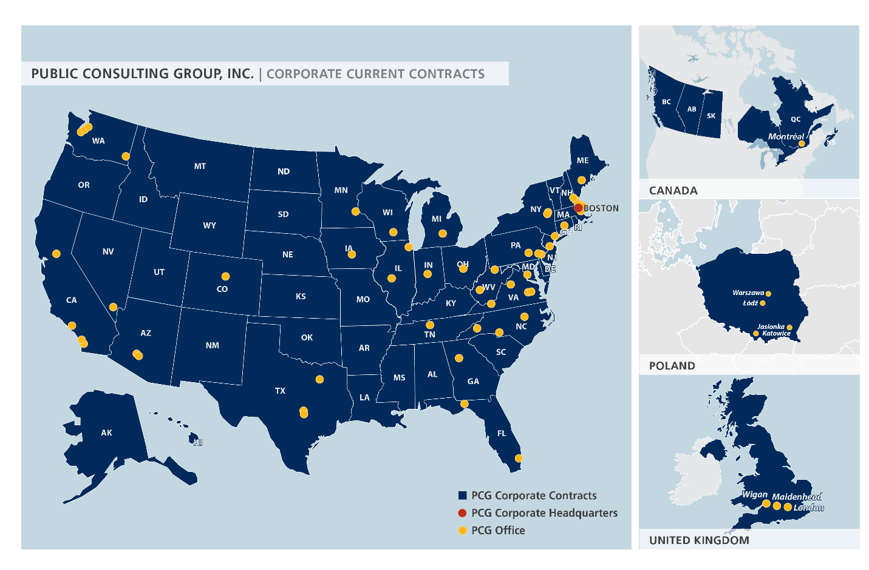
Introduction to Public Consulting Group (PCG)
Founded in 1986, PCG is headquartered in Boston, MA and employs more than 2,700 professionals in 42 offices
Management consulting to assist public sector agencies to better serve their targeted populations
Large presence throughout Tennessee, and has been working with the state since the 1990s
Five Practice Areas:
Human Services
Health
Education
Technology Consulting
Public Partnerships, LLC (PPL)

Slide 6
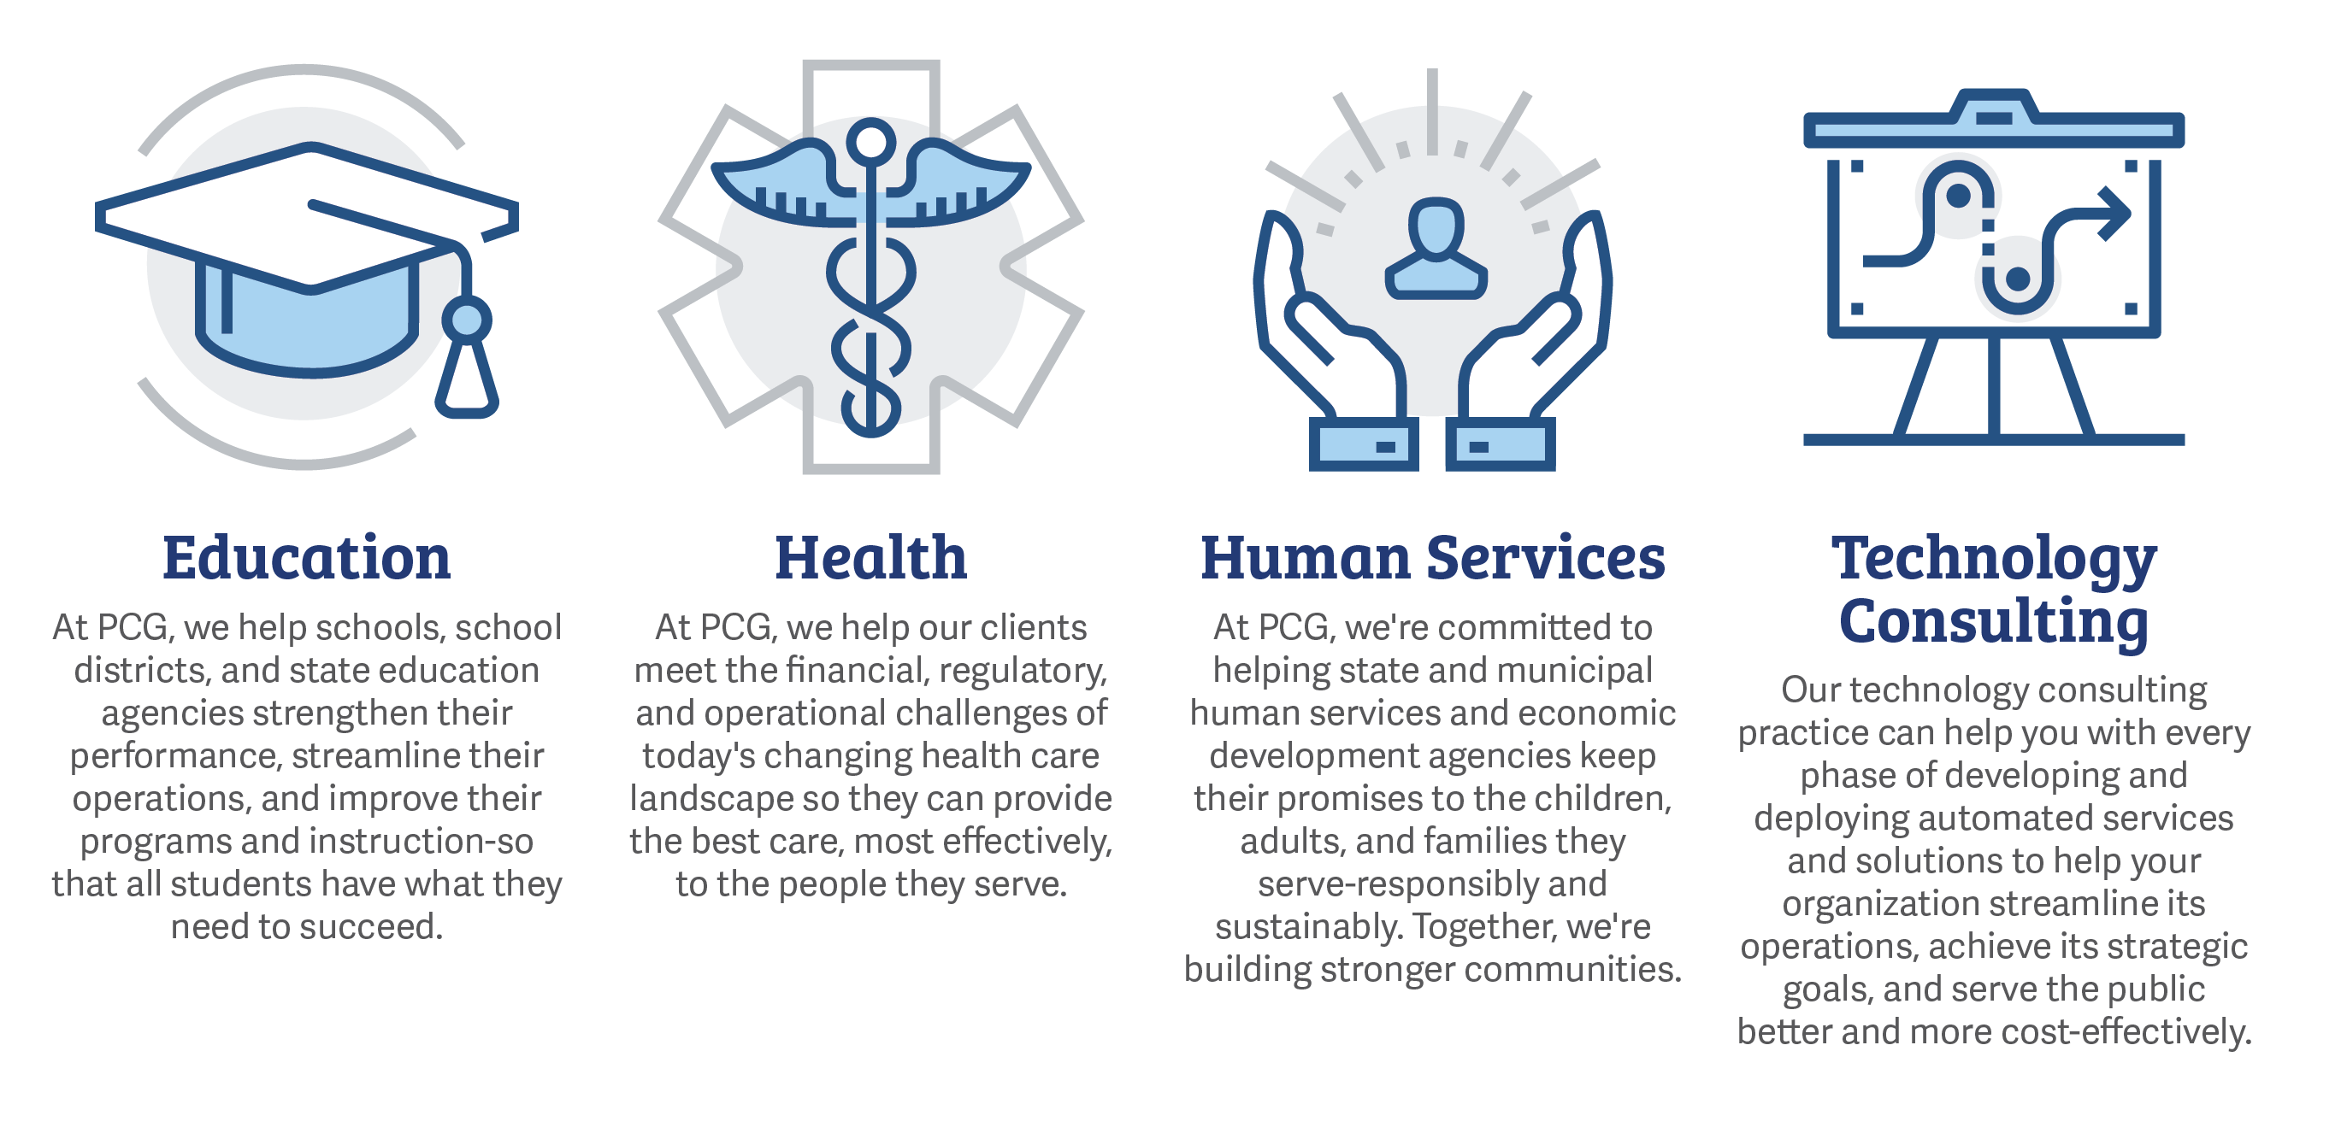
About PCG
Public Consulting Group, Inc. is a management consulting firm that primarily serves public sector clients
Founded in 1986 by Bill Mosakowski, who remains the Company’s President and Chief Executive Officer
Employs over 2,700 professionals in 40+ offices located across the United States, Canada, United Kingdom, and Poland

Slide 7
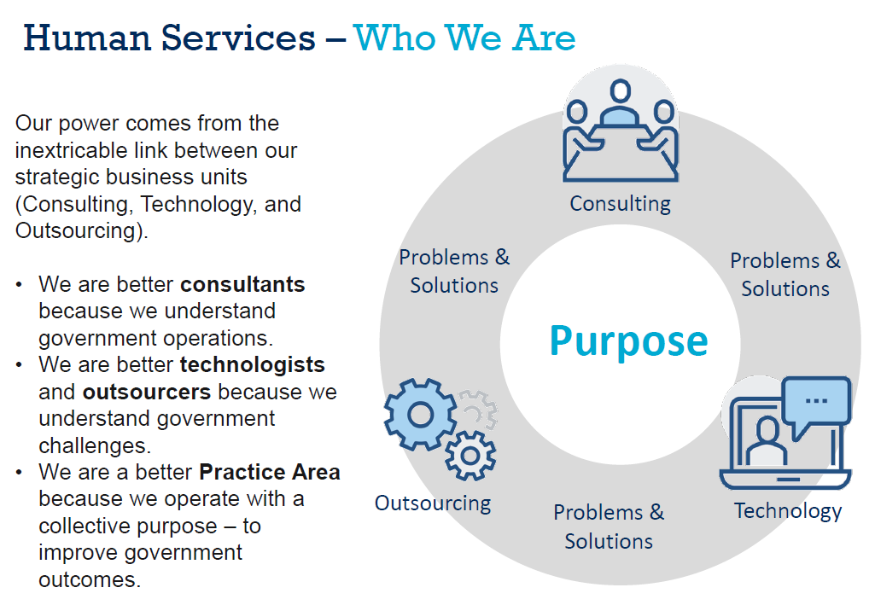

Slide 8
PCG Human Services – Current Clients

Slide 9
PCG Human Services – Our Work

Slide 10
Examples of Things We Do:
Performance-Based Contracting or Value-Based Purchasing
Behavioral Economics
Child Welfare Information Systems
Financial Management
Employment Services
Business Process Redesign
Entrepreneurship Training
Coaching
Workforce Development
Supplemental Nutrition Assistance Programs (SNAP)
Housing Supports
Integrate Eligibility Planning
Evaluation
Implement Evidence-Based Practices
Veterans Programs
Temporary Assistance for Needy Families (TANF)
Maintenance of Effort Identification and Claiming
Cost Allocation Planning
Person-Centered Programming
Training
Sustainable Change
Reduce Institutionalization
Provider Billing
Stakeholder Engagement
Social Security Disability Benefit Advocacy
10

Slide 11
Project Goals and Schedule

Slide 12
Project Goals
To create a strategic action plan in collaboration with the Task Force to:
Address the challenges of quality, affordability, and accessibility of child care in Tennessee;
More effectively using public resources to address the above challenges;
Building partnerships between government and the business sector, through which businesses are motivated to create and participate in strategies that address the child care needs of their employees; and,
Streamlining coordination between the Department of Human Services, Department of Labor and Workforce Development, Department of Economic and Community Development, Department of Health, and Department of Education in developing solutions to the state's child care challenges.

Slide 13
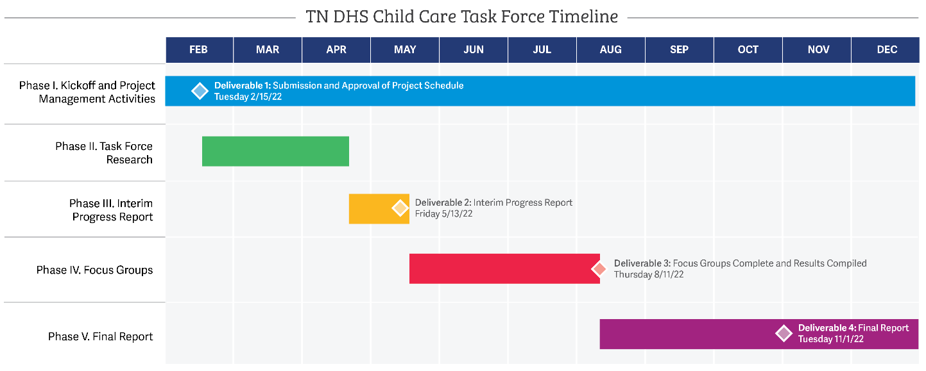
Project Schedule

Slide 14
Project Schedule: Phase I
1 | Phase I. Kickoff and Project Management Activities | Start Date | End Date
1.1 | Contract Signature | Tue 2/15/22 | Tue 2/15/22
1.2 | Hold Project Kickoff Meeting | Thu 2/17/22 | Thu 2/17/22
1.2.1 | Establish Status Meeting Schedule | Thu 2/17/22 | Thu 2/17/22
1.2.2 | Review Project Workplan and Schedule [inc. project goals, objectives, and expected results] | Thu 2/17/22 | Thu 2/17/22
1.2.3 | Identify Project Stakeholders and Reporting Structure and Process | Thu 2/17/22 | Thu 2/17/22
1.3 | Deliverable: Finalize and Submit Project Schedule for State Review and Approval [inc. tasks, deliverables, dependencies, and resources] | Thu 2/17/22 | Fri 2/25/22
1.4 | Project Reporting | Wed 2/16/22 | Fri 12/30/22
1.4.1 | Submit Monthly Reports to State on Project Status [inc. progress against project schedule; services completed in prior month; services to complete in the coming month; other issues and risks meriting State attention] | Thu 2/17/22 | Fri 12/30/22
1.4.2 | Provide Ad-Hoc Reports to State as Requested | Thu 2/17/22 | Fri 12/30/22
1.5 | Child Care Task Force Meetings | Wed 2/16/22 | Mon 12/5/22
1.5.1 | Attend and Participate in All Regular and Special Meetings of Child Care Task Force | Thu 2/17/22 | Mon 12/5/22
1.6 | Milestone: Phase I. Complete | Fri 12/30/22 | Fri 12/30/22
Deliverable 1

Slide 15
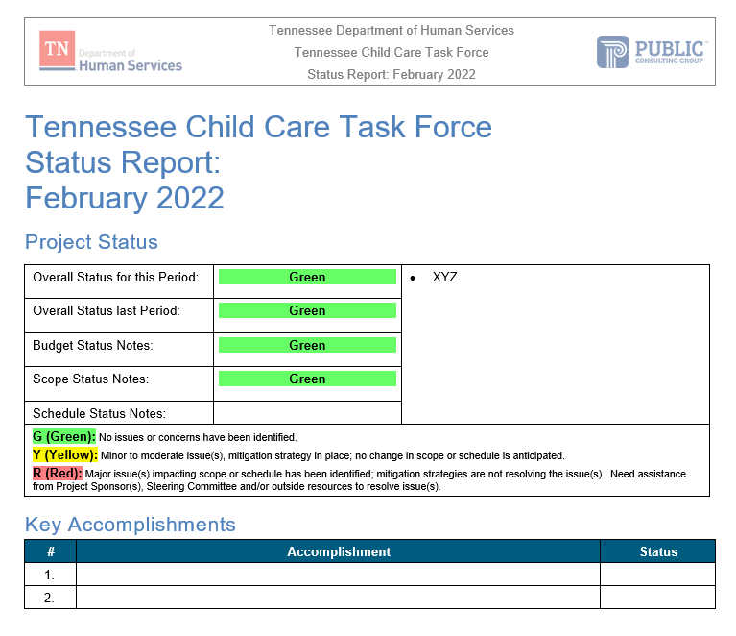
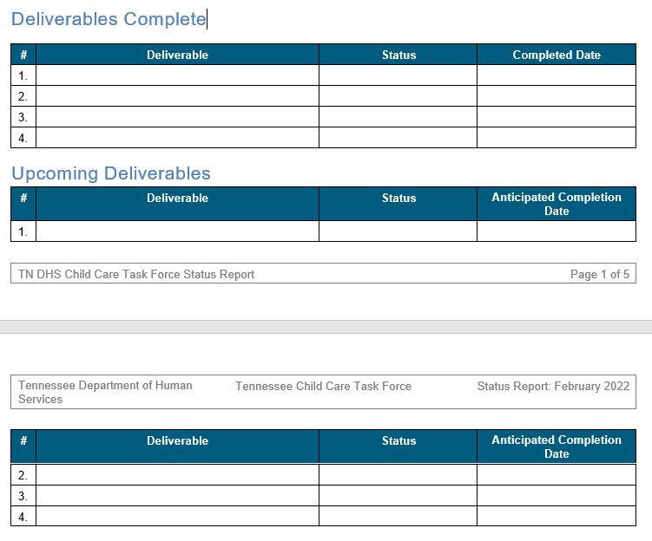
Status Reporting

Slide 16
Project Schedule: Phase II
2 | Phase II. Task Force Research | Start Date | End Date
2.1 | Research Impacts of COVID-19 on Demand and Availability of Child Care in Tennessee | Thu 2/17/22 | Wed 4/13/22
2.2 | Research Strategies to Increase Supply of High Quality, Affordable, and Accessible Child Care | Thu 2/17/22 | Wed 4/13/22
2.2.1 | Identify Peer States and States of Interest | Thu 2/17/22 | Wed 4/13/22
2.2.2 | Conduct Literature Review of Federal, State, and Private Publications | Thu 2/17/22 | Wed 4/13/22
2.2.3 | Assess Landscape of Other State Models of Identified Peer and Intrest States | Thu 2/17/22 | Wed 4/13/22
2.2.4 | Engage with Child Care Leadership in Identified States | Thu 2/17/22 | Wed 4/13/22
2.2.5 | Determine Facets of Identified States' Activities [inc. how long strategies have been in place; measurable outcomes of strategies; costs and funding streams associated with each strategy] | Thu 2/17/22 | Wed 4/13/22
2.3 | Synthesize Research for Input into Interim and Final Reports | Thu 4/14/22 | Thu 4/21/22
2.4 | Milestone: Phase II. Complete | Thu 4/21/22 | Thu 4/21/22

Slide 17
Phase II. Task Force Research
Literature review of Federal, State, and Private publications
Administration for Children & Families’ Data & Research
Office of Planning, Research, and Evaluation
EBSCO.com
States of Interest Identification
4-6 States of interest
States ID’d by Task Force and states suggested by PCG
Preparation of interview questions and focus of research:
How long strategies to support child care providers or increase supply have been in place;
The measurable outcomes of these strategies;
Cost and funding streams associated with each strategy; and,
Lessons learned from the process.

Slide 18
Project Schedule: Phase III
3 | Phase III. Interim Progress Report | Start | Finish
3.1 | Draft Interim Progress Report | Fri 4/22/22 | Mon 5/9/22
3.1.1 | Report on Literature and Statistics Reviewed | Fri 4/22/22 | Mon 5/9/22
3.1.2 | Report on Names and Titles of Child Care Leadership Staff Consulted in Other Staff | Fri 4/22/22 | Mon 5/9/22
3.1.3 | Report on Other Actions taken to Support Development of Findings and Recommendations | Fri 4/22/22 | Mon 5/9/22
3.2 | Submit Draft Interim Progress Report | Mon 5/9/22 | Mon 5/9/22
3.3 | State Reviews Draft Interim Progress Report and Provides Feedback and Changes | Tue 5/10/22 | Thu 5/12/22
3.4 | PCG Makes Revisions to Interim Progress Report | Fri 5/13/22 | Fri 5/13/22
3.5 | Deliverable: Submit Interim Progress Report | Thu 5/19/22 | Thu 5/19/22
3.6 | Present Interim Progress Report Results to the Child Care Task Force at Request of the State | Thu 5/19/22 | Thu 5/19/22
3.7 | Milestone: Phase III. Complete | Thu 5/19/22 | Thu 5/19/22
Deliverable 2

Slide 19
Project Schedule: Phase IV
4 | Phase IV. Focus Groups | Start Date | End Date
4.1 | Develop Focus Group Protocol | Tue 5/17/22 | Tue 5/31/22
4.1.1 | Create Standard Agenda for Focus Groups [inc. meeting purposes; introductions and information overview; discussion topics; and key research questions] | Tue 5/17/22 | Tue 5/31/22
4.1.2 | Identify Main Stakeholders and Other Stakeholders to Invite to Focus Groups | Tue 5/17/22 | Tue 5/31/22
4.1.3 | Outline Objectives, Goals, and Measures for Focus Groups | Tue 5/17/22 | Tue 5/31/22
4.1.4 | Determine Locations for Focus Groups | Tue 5/17/22 | Tue 5/31/22
4.1.5 | Develop Accompanying Focus Group Materials | Tue 5/17/22 | Tue 5/31/22
4.2 | East Tennessee Focus Group | June 2022
4.3 | Middle Tennessee Focus Group | July 2022
4.4 | West Tennessee Focus Group | August 2022
4.4.4 | Synthesize Notes and Results of Focus Group for Input into Final Report | Thu 6/30/22 | Wed 8/10/22
4.4.5 | Submit Summary Results for Focus Group [inc. summary of meeting, attendees, time and location, and summary of discussion and results] | Thu 8/11/22 | Thu 8/11/22
4.5 | Deliverable: Compiled Focus Group Results | Thu 8/11/22 | Thu 8/11/22
4.6 | Milestone: Phase IV. Complete | Thu 8/11/22 | Thu 8/11/22
Deliverable 3

Slide 20
Project Schedule: Phase V
5 | Phase V. Final Report | Start Date | End Date
5.1 | Draft Final Report | Fri 8/12/22 | Fri 10/7/22
5.1.1 | Develop Executive Summary of Findings and Recommendations | Fri 8/12/22 | Fri 10/7/22
5.1.2 | Include Information and Data that Support Findings and Recommendations | Fri 8/12/22 | Fri 10/7/22
5.1.3 | Provide Findings and Conclusions about Child Care Needs in Tennessee [inc. short, medium, and long-term impacts of COVID-19 on Demand and Availability of Child Care in Tennessee] | Fri 8/12/22 | Fri 10/7/22
5.1.4 | Develop Strategic Action Plan with Specific Recommendations and Proposed Action Steps | Fri 8/12/22 | Fri 10/7/22
5.2 | Submit Draft Final Report | Fri 10/7/22 | Fri 10/7/22
5.3 | State Reviews Draft Final Report and Provides Feedback and Changes | Mon 10/10/22 | Fri 10/21/22
5.4 | PCG Makes Revisions to Final Report | Mon 10/24/22 | Mon 10/31/22
5.5 | Deliverable: Submit Final Report | Mon 10/31/22 | Mon 10/31/22
5.6 | Present Final Report Results to the Child Care Task Force at Request of the State | Thu 11/17/22 | Thu 11/17/22
5.7 | Milestone: Phase V. Complete | Thu 11/17/22 | Thu 11/17/22
Deliverable 4

Slide 21
Phase V: Final Report
The final report should include:
An executive summary of findings and recommendations
Information and data to support PCG findings and recommendations
Findings and conclusions about the child care needs in Tennessee, including the short, medium, and long-term impacts of COVID-19 on the demand for and availability of child care in the State
A strategic action plan with specific recommendations: to support the existing network of child care providers; to increase the supply of high quality, affordable, and accessible child care; to address the challenges of quality, affordability, and accessibility of child care; to more effectively use public resources to address those challenges; to build partnerships between governments and businesses to create motivation and participation for business to address employee child care needs; to streamline coordination between Tennessee state departments and offices to develop solutions to child care; and legislative actions necessary to implement this plan.

Slide 22
Research Team Next Steps

Slide 23
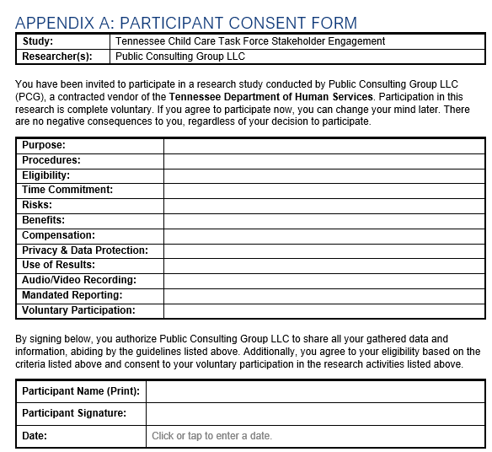
Research Protocol
Purpose
To ensure ethical research practices for all participants
To inform all interview participants that their responses may be used in publicly consumed documents
To provide transparency and integrity to the process of data collection
Who
Any participant in an interview, focus group, and/or any research activities conducted by PCG associated with this project (including, but not limited to any state official(s), stakeholder(s), or other persons of interest)

Slide 24
Research Next Steps: Brainstorming Reminder
Current State/Gaps of Current System (SWOT)
A Day in the Life
What are the barriers?
Well Defined Deliverables
Outcomes Desired
What things do we need?
More providers
Affordable care
Quality care
Better dispersion/availability of care
Taskforce challenges
Inventory barriers
Access
Affordability
Quality
Accurate Data Landscape
Basic understanding of regulation landscape
Resources/funding stream analysis
Current allocations
Process to Guide Taskforce to Solutions
Standard Definitions
Define “Childcare”
Definition of access, affordability, and quality
Access
Because if CC services don’t exist, affordability and quality don’t matter
Quality
QRIS System
Quality monitoring accountability
The cost of quality
Importance of ECE for children
Childcare Business Model and Industry
Affordability
Business partnerships
Childcare supply & demand/current state
How to elevate childcare workers to a profession
Support(s) for childcare industry
ECE workforce pipeline
Focus Group Diversity
Economic and geographical location
Best practices
Possibilities for collaboration to serve all children

Slide 25
Research Next Steps: Future State Reminder
Access
Every Tennessean have access to quality childcare within X miles of their home or workplace, or study.
Consumer user friendly enrollment process
Childcare deserts (providers and square footage)
Access to multiple types of childcare services (drop-off, higher Ed, 3rd shift).
Special needs
PR/Marketing
Expand hours
More centers that accept newborn and infants
Affordability
Right size the government support, regulations, and resources to ensure business sustainability of all childcare programs (DOE, DHS, etc.).
No one pays more than 10% of their HH income (robust sliding scale payment assistance) (need data on current state)
Family discount for families with multiple children
Fully functional, skilled, and appropriately compensated pipeline of professionals in ECE.
Staffing and credentials – every staff member has credentials, making this a profession
Understand their value and worth, and widely valued
PR/Marketing

Slide 26
Exercise: Peer State/Agency Identification
State / Agency | Theme to Investigate
? | ?

Slide 27
Exercise: Non-Task Force Stakeholder Analysis
R – Responsible for completing the work
A – Accountable for ensuring task completion/sign off
C – Consulted before any decisions are made
I – Informed of when an action/decision has been made
Stakeholder Group | Specific Named Stakeholders | RACI
TN DHS Staff
Providers
Parents and Child Care Customers
CCDF Quality Partners
Business Community
Local Gov / Economic Dev Agencies
Other Groups

Slide 28
Sample Interview Questions
What barriers have been encountered in service delivery and how has the state addressed these barriers? What additional support is needed?
What business practices or supports have been implemented within your state to assure business sustainability/ continued operations for child care businesses?
How have these changes improved the service model?
What administrative hurdles were experienced in implementation?
What effects were reported or found related to the workforce, with respect to recruitment, retention, and professional development needs?
Were changes required to funding new service models? Where there funding considerations or barriers that had to be worked through? What solutions were found/ implemented?
How was equity considered when structuring the revised service model?
What measures were put in place to measure the maintenance of quality under the new service model?
Are there opportunities to more effectively coordinate and align early childhood resources that lead to improved outcomes for children and families as a result of the new service model?

